Slide 1
FPGA implementation of a rad-hard adaptive baseband processor for ground-to-satellite links
TWIN-RELECT training school, 19.05 – 21.05.2025
IHP, Frankfurt (Oder), Germany
Nicola Miglioranza, Marko Andjelkovic, Nebojsa Maletic, Milos Krstic

Slide 2

Introduction
Integrating terrestrial (TNs) and non-terrestrial networks (NTNs) into a unified 3D network improves reliability and coverage, overcoming terrestrial limitations and requiring robust technologies for harsh environments typical of the future 6G networks.
The digital baseband processor, the backhaul hardware responsible for data processing in the physical layer, represents a key component in the next wireless communication infrastructure.
Implementing the baseband in NTNs vehicles, such as satellites and drones, requires a rad-hardening analysis to prevent the occurrence of soft errors (SEUs and SETs) coming from space radiation.
Figure 1: General architecture of a 3D network.

Slide 3
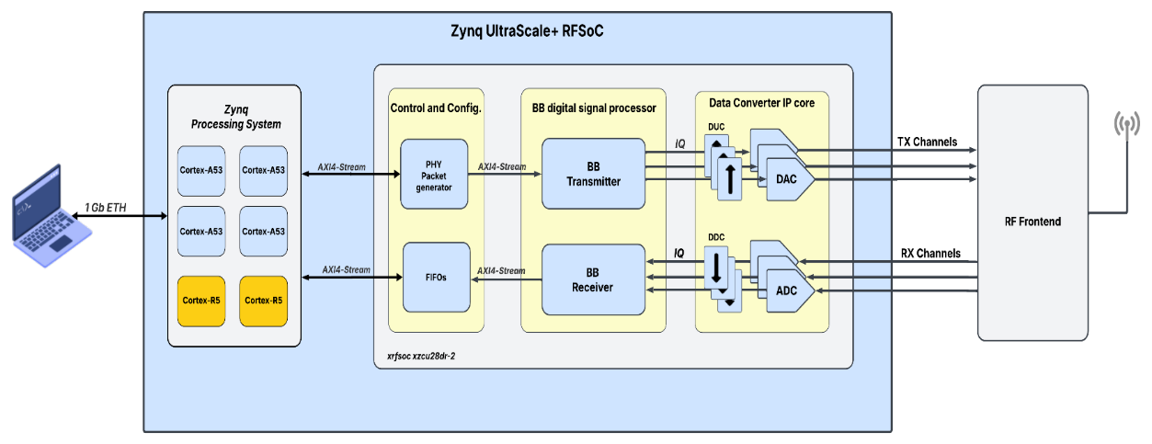
Baseband design concept
The baseband design was initially developed in MATLAB. For functional verification and validation, its RTL model was then implemented on a commercial Xilinx Ultrascale+ RFSoC FPGA.
The baseband design implements a single-carrier architecture, with an adaptive modulation, depending on channel conditions and application requirements.
Type of modulation | Modulation schemes | Bits per symbol
Phase Shift Keying (PSK) | BPSK | 1
 | QPSK | 2
Amplitude and Phase Shift Keying (APSK) | 16-APSK | 4
 | 32-APSK | 5
 | 64-APSK | 6
Quadrature Amplitude Modulation (QAM) | 16-QAM | 4
 | 32-QAM | 5
 | 64-QAM | 6
Figure 2: Overall demonstrator concept.
Table 1: Selected Modulation schemes.

Slide 4
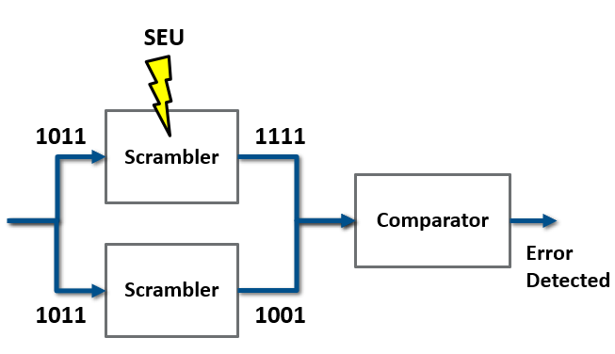
Fault injection analysis
The fault-tolerance analysis of the baseband design against soft errors will be assessed at the RTL level using the Cadence Incisive Functional Safety Simulator (IFSS).
Fault analysis will identify the functional blocks most susceptible to soft errors, enabling the injection of both SEUs and SETs to determine the most appropriate fault mitigation strategy for each block.
The selected mitigation strategies are Dual Modular Redundancy (DMR) with comparison and Triple Modular Redundancy (TMR) for the worst-case scenarios.
Figure 3: Implementation of DMR with comparison.

Slide 5
325
miglioranza@ihp-microelectronics.com

