Slide 1
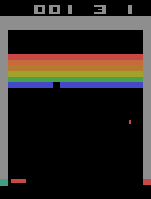
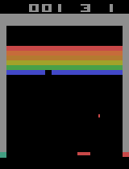
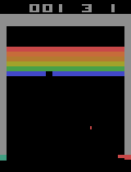


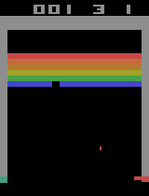
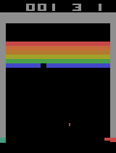
Failure Case: Perception Error
Action: right
Action: right
Action: right; Current State:
…
…
Thought: The ball is currently to the right of the paddle and moving downwards and to the right. I need to move the paddle to the right to intercept the ball and prevent losing another life. The previous clips show that I lost a life when the paddle was too far left and the ball went down on the right. I will choose a shorter plan this time since the ball is relatively low and moving fast.
Move: [right, right, right, right, right]
Action: right
Action: right; Current State:
…
Notes:
/home/hal-mingjiahuo/AtariBench/runs/breakout/gemini-2.5-flash/0413_182841_cfg_001_run_007

