Slide 1
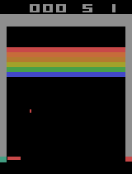
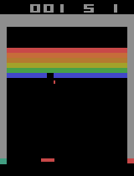
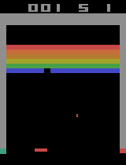
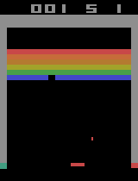
Game: Breakout
You are an intelligent AI player playing a game. Your goal is to make progress and maximize total reward within the fixed time budget.
BREAKOUT Quick Guide:
Goal: Rewards are earned by hitting bricks with a ball controlled by a paddle, while preventing the ball from falling.
Available actions:
noop: Do nothing. The paddle remains stationary.
start: At the beginning of the game, generate a ball.
left: Move the paddle to the left.
right: Move the paddle to the right.
Your Task: Based on the current state of the game (which will be provided to you), decide on your next actions. Your move can contain 1 to 10 actions. Each action is executed for 0.1 second. As a result, your move is for the next 0.1 to 1 seconds. You are encouraged to plan for less actions if the ball is low and close, as shorter plans (fewer actions) will get feedback sooner. An example of response is:
thought: [your thought here]
move: [right, right, right]
Time Budget: You are optimizing total reward over a fixed budget of 30 seconds. Losing a life does not directly reduce your score, but it does consume time because the game pauses and restarts the player state.
To make your decision, you will be provided with both historical context from your current game session and the current, up-to-the-moment game state. [Instruction of formats of historical context and current game state.]
Non-zero reward history: Recent history:
Now please predict the next actions.
Action: right
Action: noop
Action: right
Action: right; Current state:
…
…
Feedback: positive reward

