Slide 1


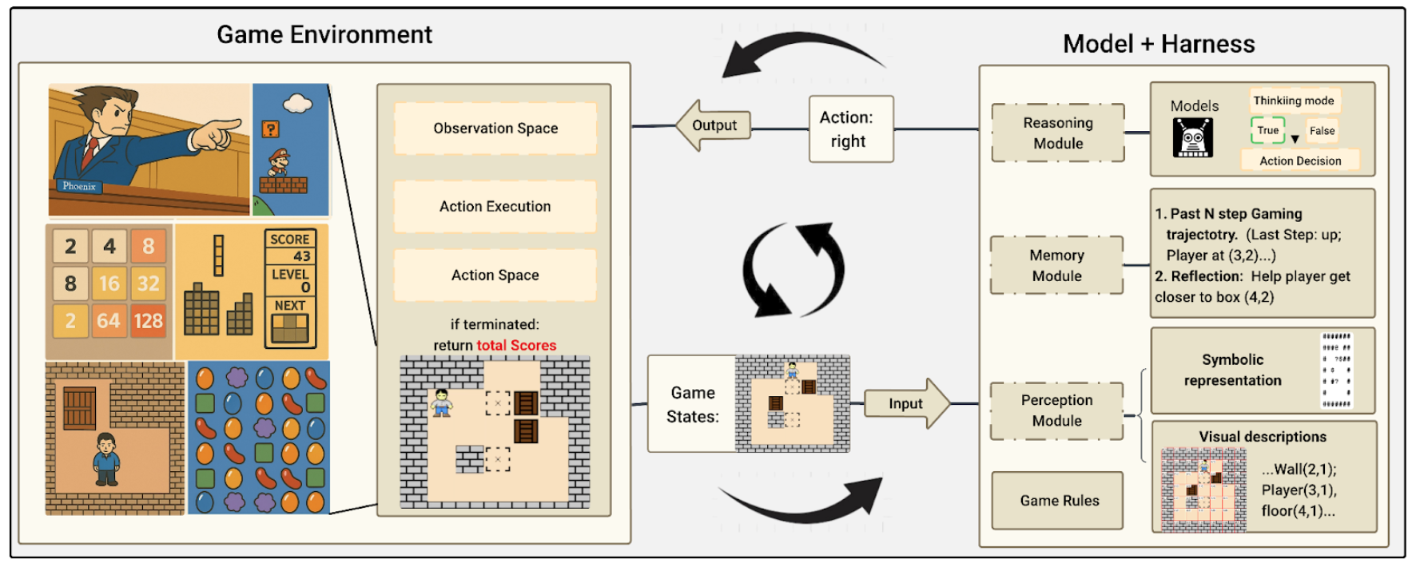
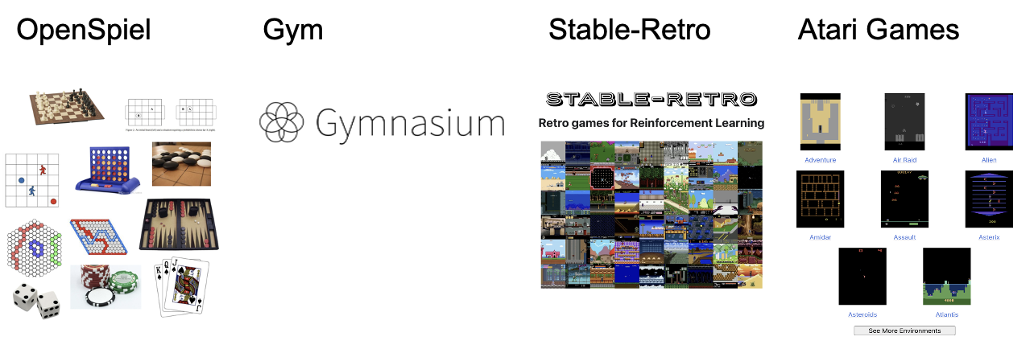
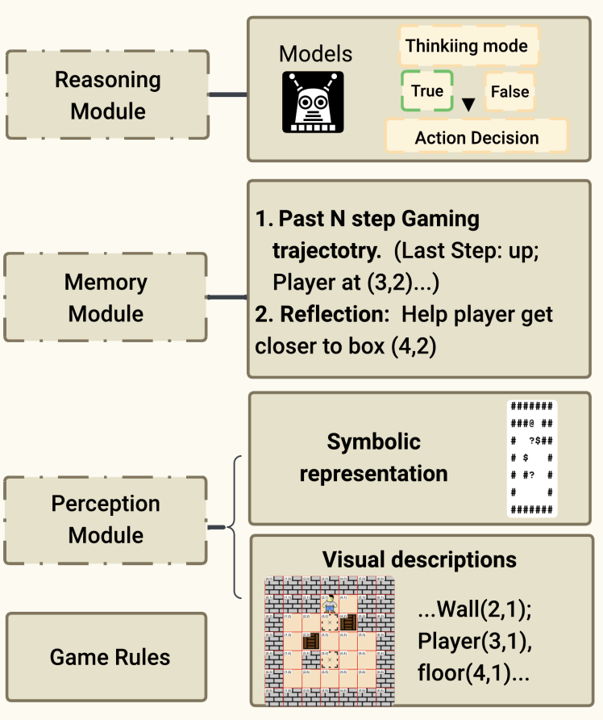
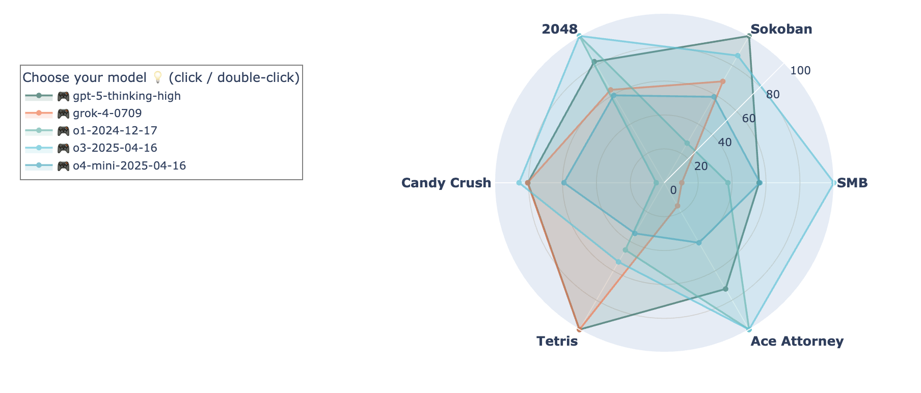
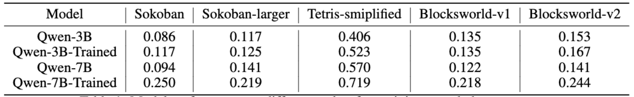
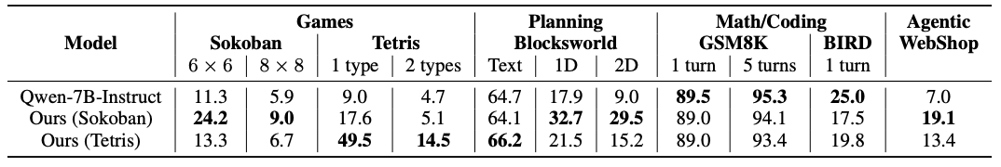
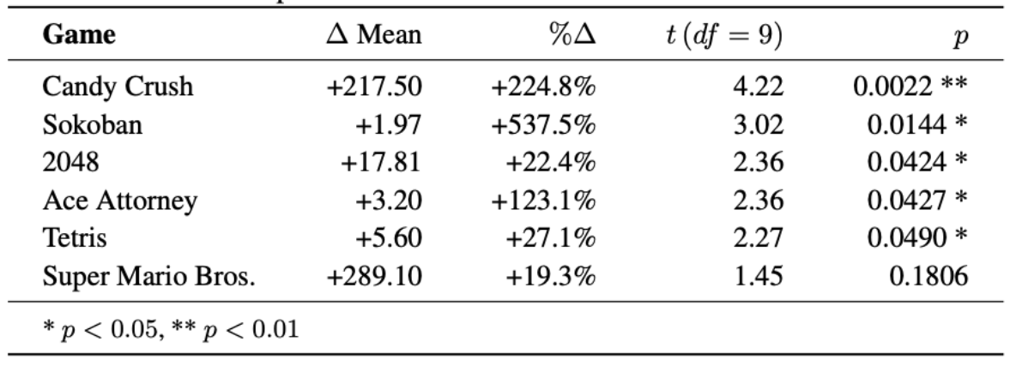
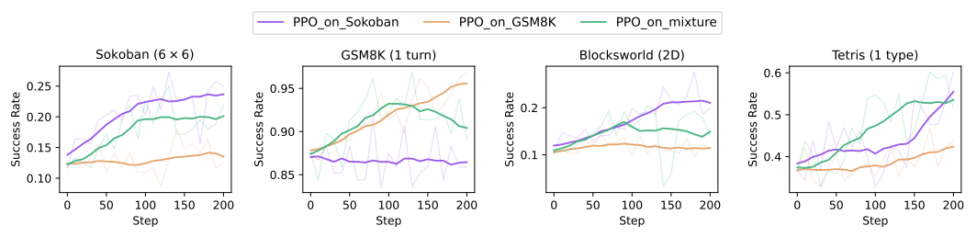







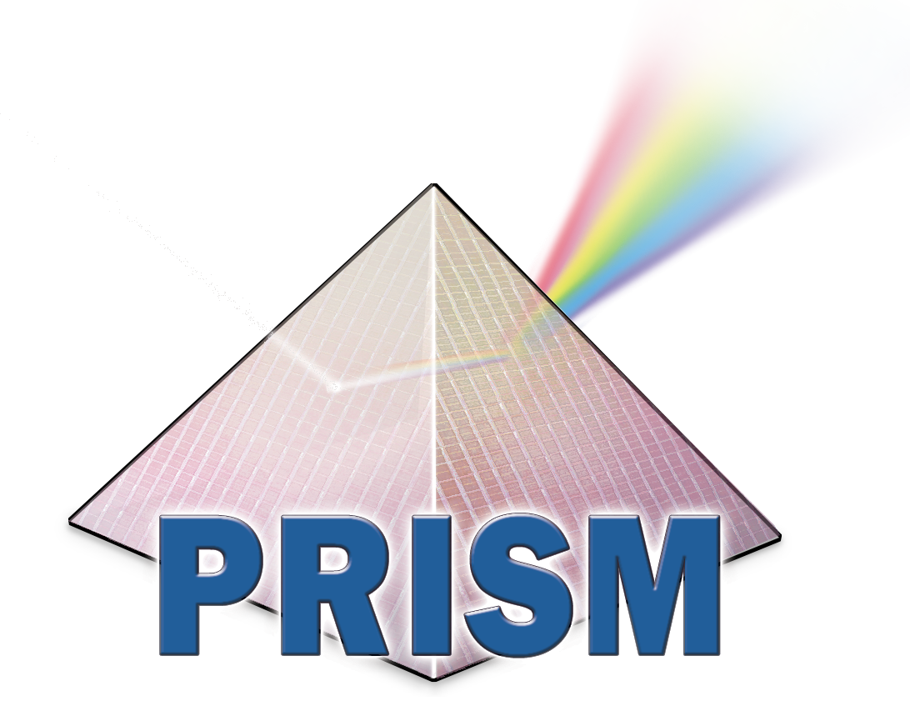






Theme 1 - 3135.003 Lmgame-Bench:
Benchmarking and Training LLMs and VLMs
through Gaming Simulation Environments
Mingjia Huo (PhD), Lanxiang Hu (PhD),
Yuxuan Zhang (BS), Haoyang Yu (BS), Hao Zhang (PI@UCSD), Haojian Jin (PI@UCSD), Tajana Rosing (PI@UCSD)
Objectives
Technical Approach
Technical Approach
Goal: We create a benchmark (lmgame-Bench) to test how well Large Language Models (LLMs) and Vision Language Models (VLMs) can perceive, remember, and plan while performing agentic tasks in gaming environments.
Problem today: Existing agentic benchmarks for LLMs are brittle—models often fail due to poor visual understanding, prompt sensitivity, and data contamination—making results unreliable.
Our Solution:
  Combining perception, memory, and long-horizon reasoning into a benchmark.
  Scalability: it’s very expensive craft agentic benchmark. We can repurpose gaming environments into agentic benchmarks.
Impact: It advances state-of-the-art general-purpose AI systems that can act and adapt in dynamic environments.
Games as Evaluation Benchmarks
Sokoban: Grid puzzles with irreversible moves (planning)
Tetris: Fast-paced spatial game (geometric reasoning)
2048: Tile-merging game (value tracking)
Candy Crush: Match-3 with cascades (pattern reasoning)
Ace Attorney: visual novel (vision language reasoning)
Super Mario Bros: platformer game (spatial reasoning)
We leveraged a unified Gym-style API to interact with gaming environments, with the following standard inputs and outputs:
environment outputs
  state observation, reward, termination
environment inputs
  LLM-generated action(s)
(Vision) Perception module:
  Load ground truth symbolic game state (e.g. as a text table) from backend
  Extract symbolic game state from vision input to facilitate spatial reasoning
Memory module:
  Short term memory: state, action, reward for past N turns
  Long term memory: state, action, reward for all past turns
  Reflection module: synthesize lessons learned (to avoid critical mistakes — actions that lead to failures)
Reasoning module: Recent reasoning models explore reasoning paths and synthesize final answers, achieving strong results in math, coding, and planning. LMGame-Bench supports evaluating such models with or without long chain-of-thought reasoning..
Text Body 24 pt Lucida Sans.
Figure 2. Overview of lmgame-Bench, where models interact with diverse game environments through perception, memory, and reasoning modules to interpret states and decide actions in a closed evaluation loop.
Figure 1. There are various gaming environments that have long been used to study decision making and reinforcement learning algorithms, and we repurpose gaming environments to evaluate perception, memory, long-horizon reasoning of LLMs and VLMs.
Figure 3. lmgame-Bench uses modular harnesses—such as perception, memory, and reasoning modules—to systematically extend a model’s game-playing capabilities, allowing the model to engage with a simulated game environment through iterative interaction loops.
Results and Comparison
to the State-of-the-Art
z
Experimental Setup
Key Accomplishments,
Showstoppers & Next Steps
Setup:
  13 state-of-the-art models from OpenAI, Claude, etc., covering both open and closed source models.
  Turn on/off memory/perception/reasoning harness modules.
Leaderboard:
  We put the models into the gaming environment, to test how the most advanced models of today perform on gaming tasks that require environment interaction skills.
Agentic design significantly improves model performances.
In lmgame bench, we also build a testbed for RL agent training.
Setup:
  Multi-turn RL on Text-only LLMs (7B parameters)
  Trained on Sokoban or Tetris, and evaluated on planning, math, coding and agentic tasks.
Training results show not only improvement on the game itself, but also on other reasoning and decision making tasks (e.g. if we train on Sokoban, results on Tetris and BLocksworld improve).
In-domain generalization (other games or the same game under different settings):
Out-of-domain generalization (math, coding, and agentic tasks):
Mixed data training, where we trained LLMs with a half-half mixture of math and game.
Key accomplishments:
  lmgame-Bench is a unified benchmark that evaluates and trains language models through interactive reasoning and decision-making across diverse games.
Grand Challenge Applications: Deep insights
  Contribute to grand challenges in agentic AI and generalizable model training, focusing on perception, planning, and decision-making in uncertain environments.
  Datasets: Six curated games (Super Mario Bros., Tetris, Sokoban, Candy Crush, 2048, Ace Attorney) with structured state/action/reward annotations, plus contamination-mitigated variants.
  Infrastructure: open-source RL frameworks (RAGEN, veRL), and standardized Gym-style APIs for reproducibility.
Lessons learned:
  Current VLMs are far from human-level perception, underscoring the need for our perception module.
  Spatial and temporal reasoning remain key bottlenecks, limiting real-time decision-making.
  Long-context understanding is weak, as models fail to extract useful information from full game trajectories.
  Computational cost of inference remains a barrier, as multi-turn gameplay often requires long reasoning traces that drive up latency and resource usage, reducing scalability for larger models.
Showstoppers:
  Data contamination was observed in narrative-heavy game Ace Attorney, where model outputs initially showed strong correlation with publicly available transcripts.
Next steps
  Apply algorithm optimization and build a automatic prompt optimization pipeline for agentic applications.
  Adapt hardware-software codesign to improve agent efficiency.
Table 2. In-domain RL generalization after training on Sokoban and evaluated on other board games.
Figure 4. Leaderboard of state-of-the-art LLMs.
Table 3. Out-of-domain RL generalization after training on Sokoban and evaluated on Planning, Math, Coding and Agentic Tasks. After training on Sokoban or Tetris, we observed a better performance on planning and agentic tasks, due to similar input format and multi-turn capabilities.
Table 1. The performance gains with agentic harness modules.
Figure 5. Success rates during training across different evaluation tasks, with models trained on Sokoban, GSM8K, or a half-half mixture of both.
This work was supported in part by the Semiconductor Research Corporation (SRC) and DARPA.
Publications: Hu, L., Huo, M., Zhang, Y., Yu, H., Xing, E.P., Stoica, I., Rosing, T., Jin, H. and Zhang, H., “lmgame-Bench: How Good are LLMs at Playing Games?” ICLR In Submission.
PRISM Annual Review | November 12-13, 2025

