Slide 1
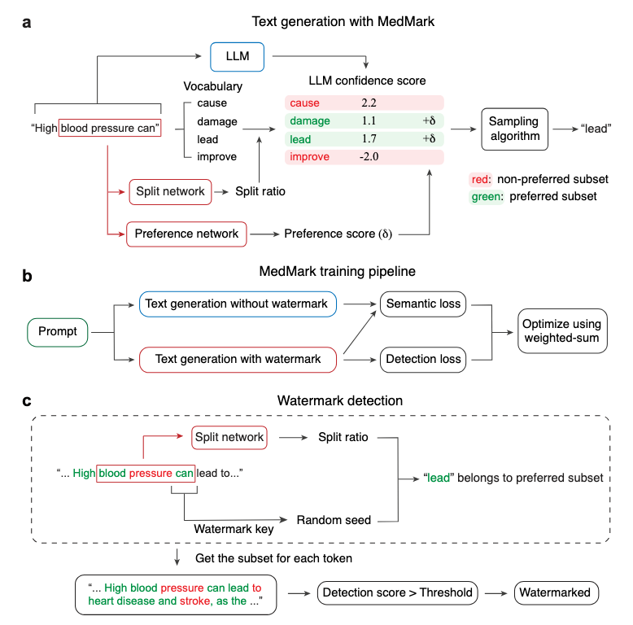
Learnable Watermarking Enables Traceable Medical Text Generation with Large Language Models
Presenter: Mingjia Huo (PhD, UCSD), Ruiyi Zhang (PhD, UCSD), Avi Patel (MD, UCSD), Akshat Kumar (MD, UCSD), Joseph Ahn (MD, Mayo Clinic), Atul Malhotra (MD, UCSD), Robert N. Weinreb (MD, UCSD), Davey Smith (MD, UCSD)
Tajana Rosing (PI, UCSD), Pengtao Xie (PI, UCSD)
Project #: T1 - 3135.004
Problem & State of the Art
  The integration of Large Language Models (LLMs) in healthcare creates risks of misuse, unauthorized distribution, and leakage of sensitive medical information.
Technical Approach:
  MedMark is a learnable, context-aware framework to distinguish machine-generated text from human-written ones, advancing secure and trustworthy systems software.
  We use a multi-task learning objective (optimizing detection loss and semantic coherence loss) to train neural networks that guide token generations.
Results & metrics:
  MedMark consistently outperforms SOTA methods [ICML’2023, Nature’24], achieving high detection rates (TPR@FPR=1%) alongside superior semantic similarity before and after watermarking, greater diversity, and robustness against text manipulation.
  Clinical expert evaluations verified that MedMark maintains high clinical utility.
Showstopper:
  Watermark detection remains unreliable in very short texts (<50 tokens) due to insufficient statistical evidence.
Grand challenge application:
  Precision medicine.
Publications: Learnable Watermarking Enables Traceable Medical Text Generation with Large Language Models. Mingjia Huo, Ruiyi Zhang, Avi Patel, Akshat Kumar, Joseph Ahn, Tajana Rosing, Atul Malhotra, Robert N. Weinreb, Davey Smith, and Pengtao Xie, 2025, to be submitted.

