Slide 1
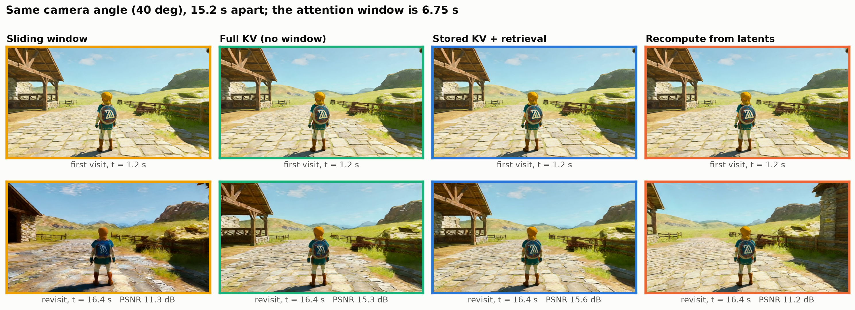
Why store KV: memory needs the KV, not the latents
WorldKV keeps the full KV bank and retrieves by camera pose: PSNR 15.7, close to full KV 15.9 and far above a sliding window 12.2, at window speed
OmniMem keeps full-resolution KV in host memory and fetches per-head blocks over PCIe; it names "union explosion": sparse compute, large KV footprint
Our test (LingBot-World-Fast 14B, camera turns 0 -> 90 -> 0 deg three times): consistency with the first visit, stored KV 16.1 dB vs latents + recompute 12.5, like a sliding window 11.8
Why: deep-layer KV carries the context it was generated with; recomputed V matches at layer 0 (cos 1.0) but only ~0.7 by layer 30

Slide 2
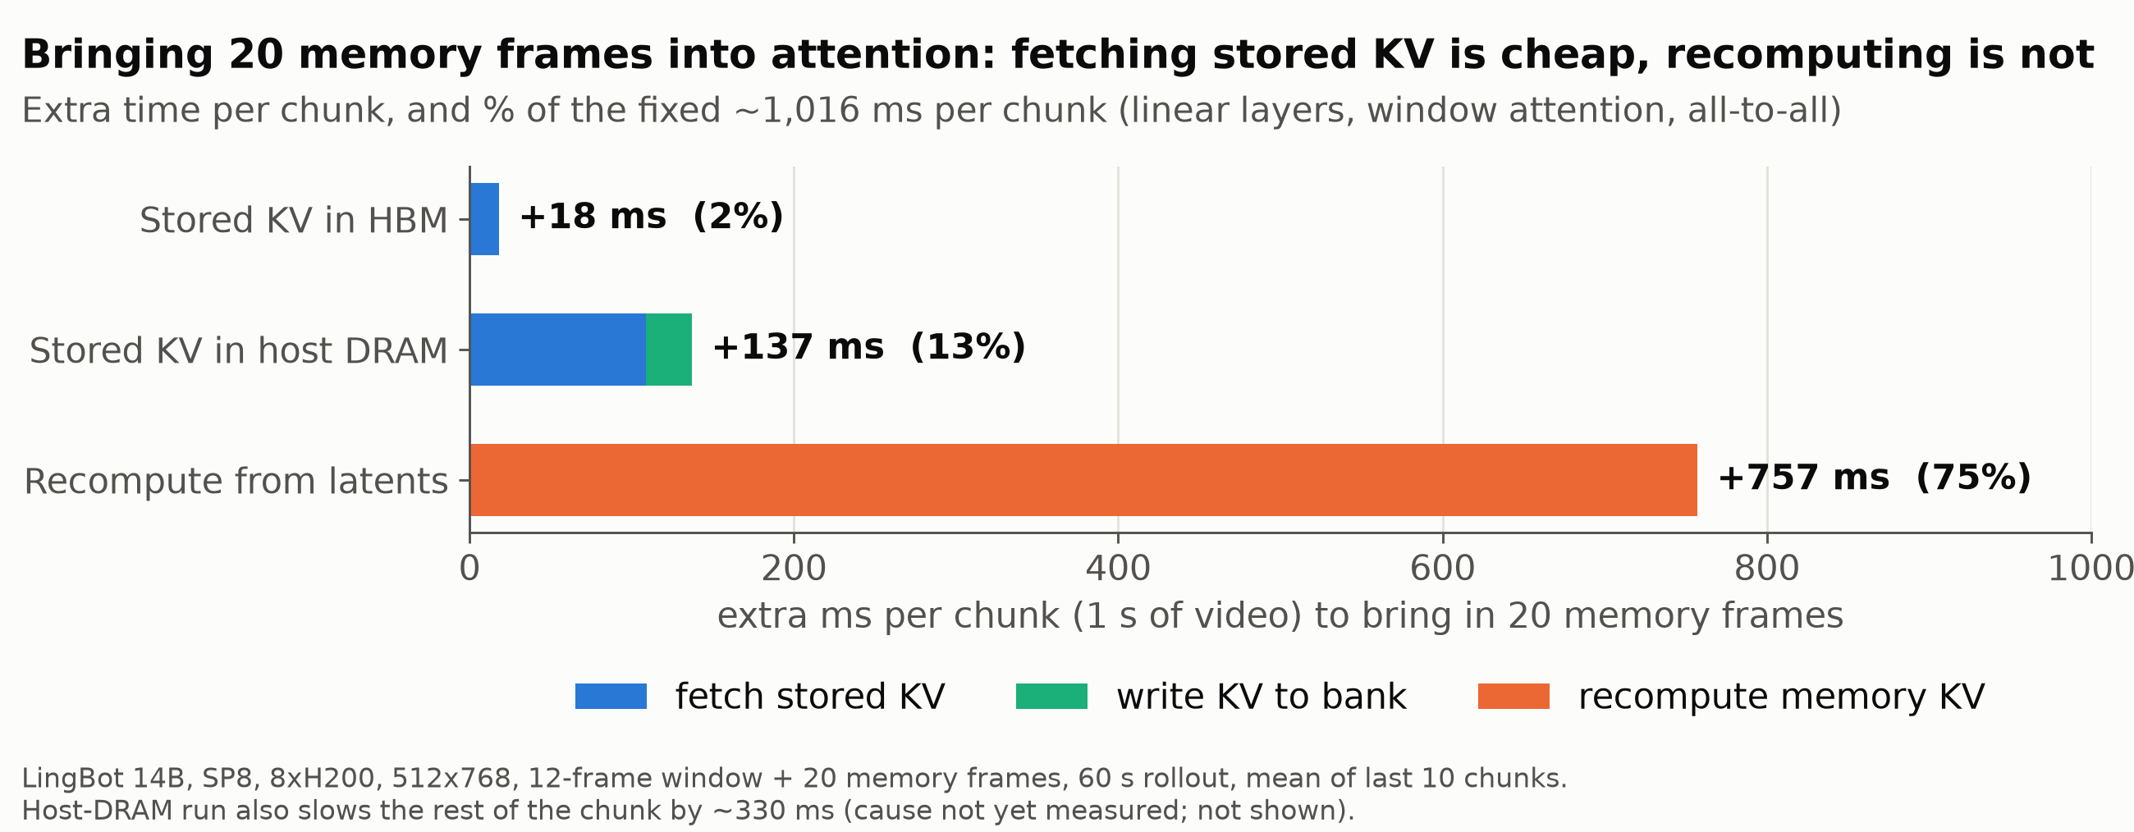
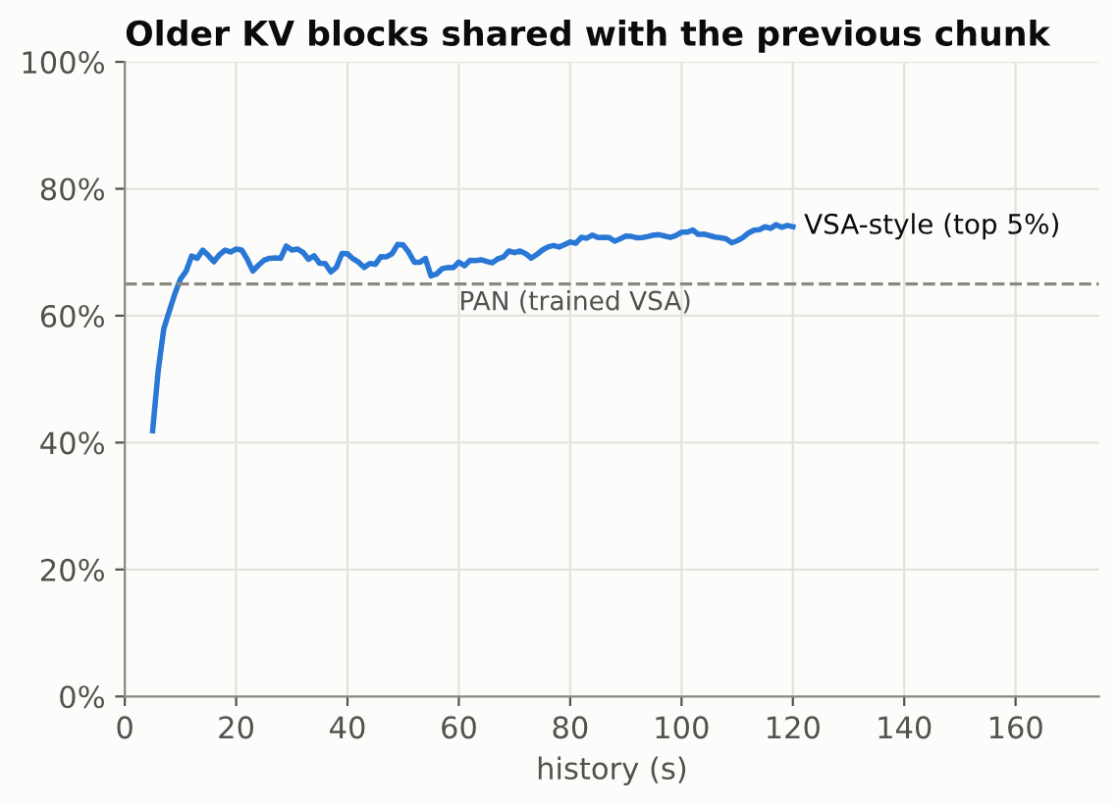
What storing KV costs: fetch time and access pattern
LingBot-World v2 14B, 512x768, 1 s chunks (4 steps + commit), SP8 on 8x H200, FA4 block-sparse, full KV to 120 s (~3 TB per stream at 10 min)
Bringing 20 memory frames (fixed work ~1,016 ms per chunk): stored KV +18 ms in HBM, +137 ms from host DRAM; recompute +757 ms
VSA-style top-5% selection shares ~70% of older blocks with the previous chunk (PAN 65%); each fetched block serves ~6 query blocks
Demand at 10 min: ~170 GB/s per GPU (fetch once per chunk) vs PCIe 28 GB/s, 4.8 GB/s for per-head pieces

