Slide 1
Long-term memory for real-time world models
Store the KV, not the latents, and what reading it costs
Part 1 (algorithm): two recent papers keep the full KV; our test shows latents + recompute do not give memory
Part 2 (systems): profiling LingBot-World 14B with a full-history KV: time, access pattern, fetch bandwidth
Mingjia, 2026-10-15

Slide 2
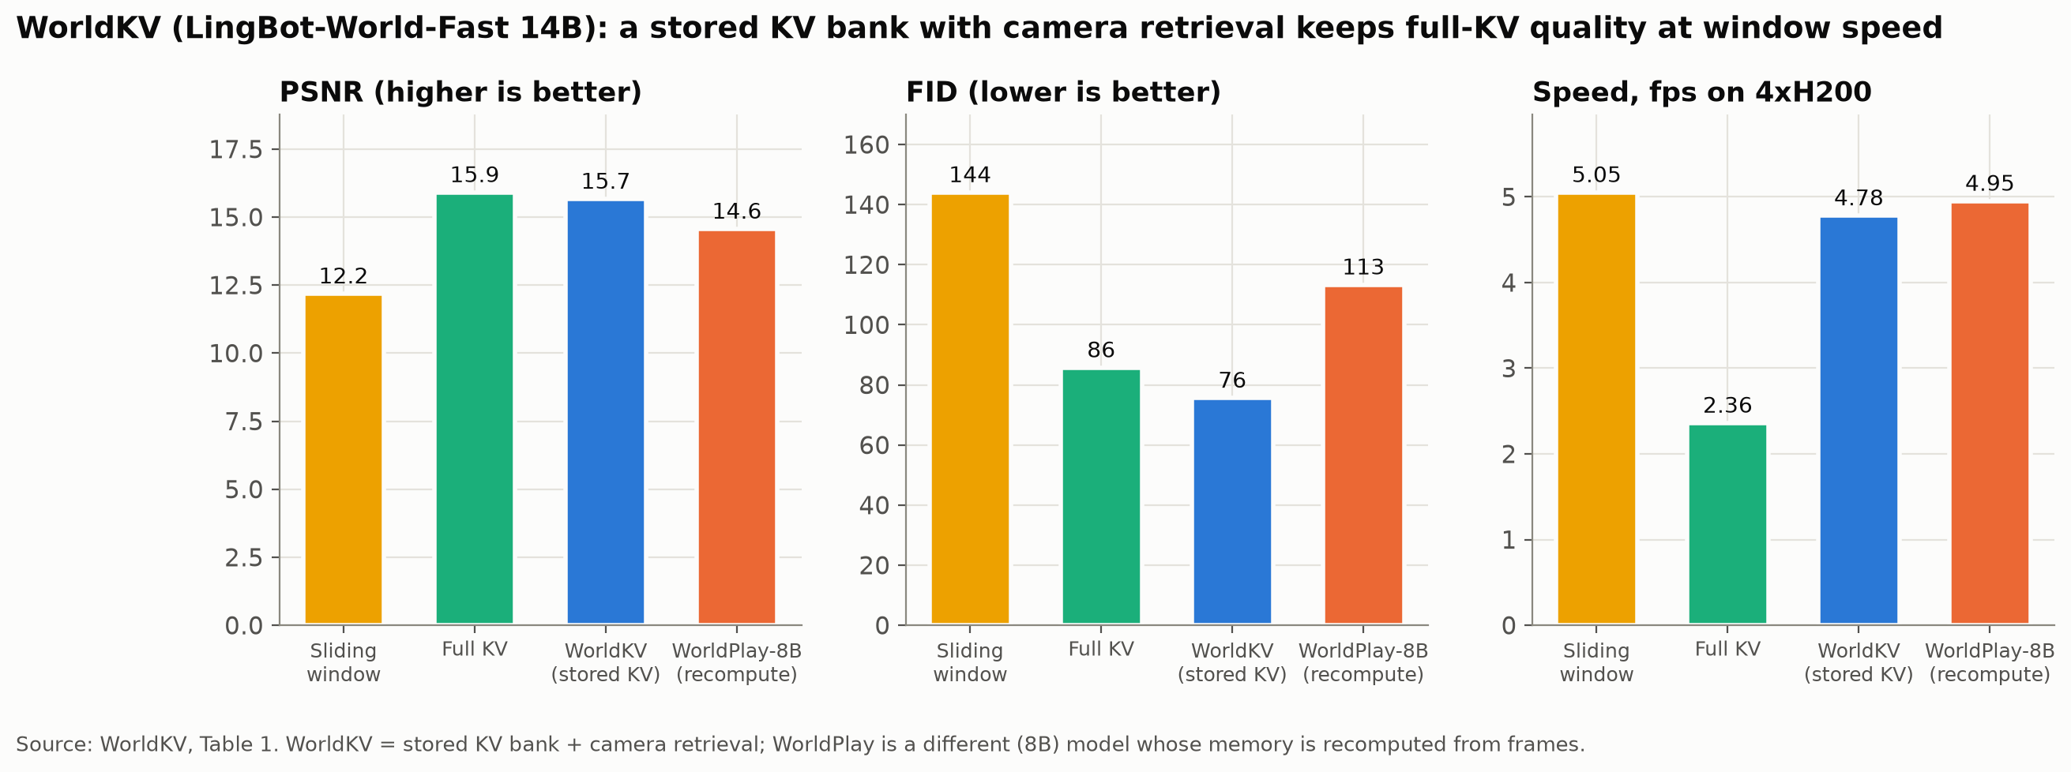
Motivation 1. WorldKV: a stored KV bank keeps memory
LingBot-World-Fast 14B, training-free: keep every chunk's KV, retrieve 18 frames by camera pose
PSNR 15.7 / FID 76, vs full KV 15.9 / 86 and sliding window 12.2 / 144
4.78 fps, close to the window (5.05); full KV drops to 2.36

Slide 3
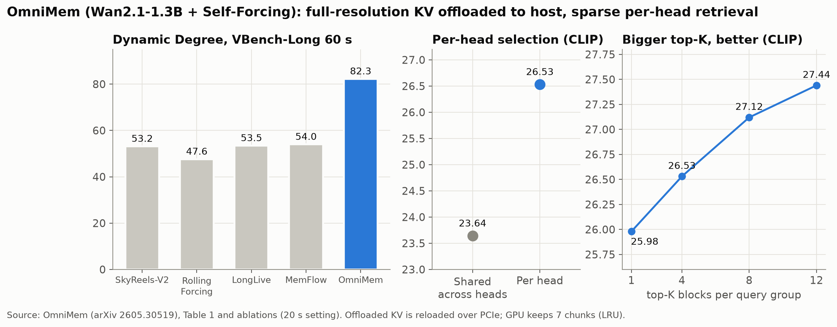
Motivation 2. OmniMem: full KV in host memory, per-head retrieval
Wan2.1-1.3B + Self-Forcing. Keeps the full-resolution KV per head and chunk; offloaded blocks are reloaded over PCIe, the GPU keeps 7 chunks
Dynamic Degree 82 vs ~54 for the best baseline; selection must be per head (CLIP 26.5 vs 23.6 shared); a larger top-K is better
The authors name the systems problem: "union explosion", sparse in compute but a large KV footprint

Slide 4
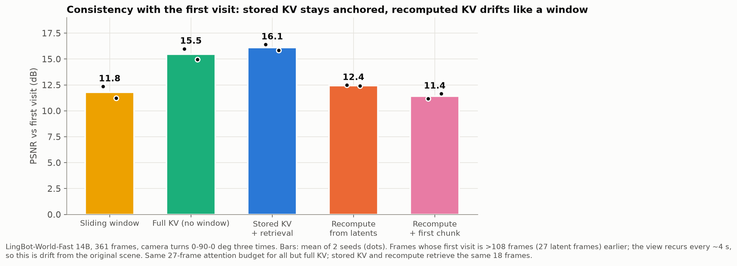
Our test: stored KV vs latents + recompute
WorldKV code, LingBot-World-Fast 14B, 361 frames (22.5 s); the camera turns 0 -> 90 -> 0 deg three times in place
Same 27-latent-frame attention budget; stored KV and recompute retrieve the same 18 frames
Metric: PSNR vs the first visit at the same angle (the view recurs every ~4 s, so this measures drift)
Stored KV 16.1 dB, close to full KV 15.5; recompute 12.5 / 11.4, like the sliding window 11.8: recomputed memory acts like no memory

Slide 5
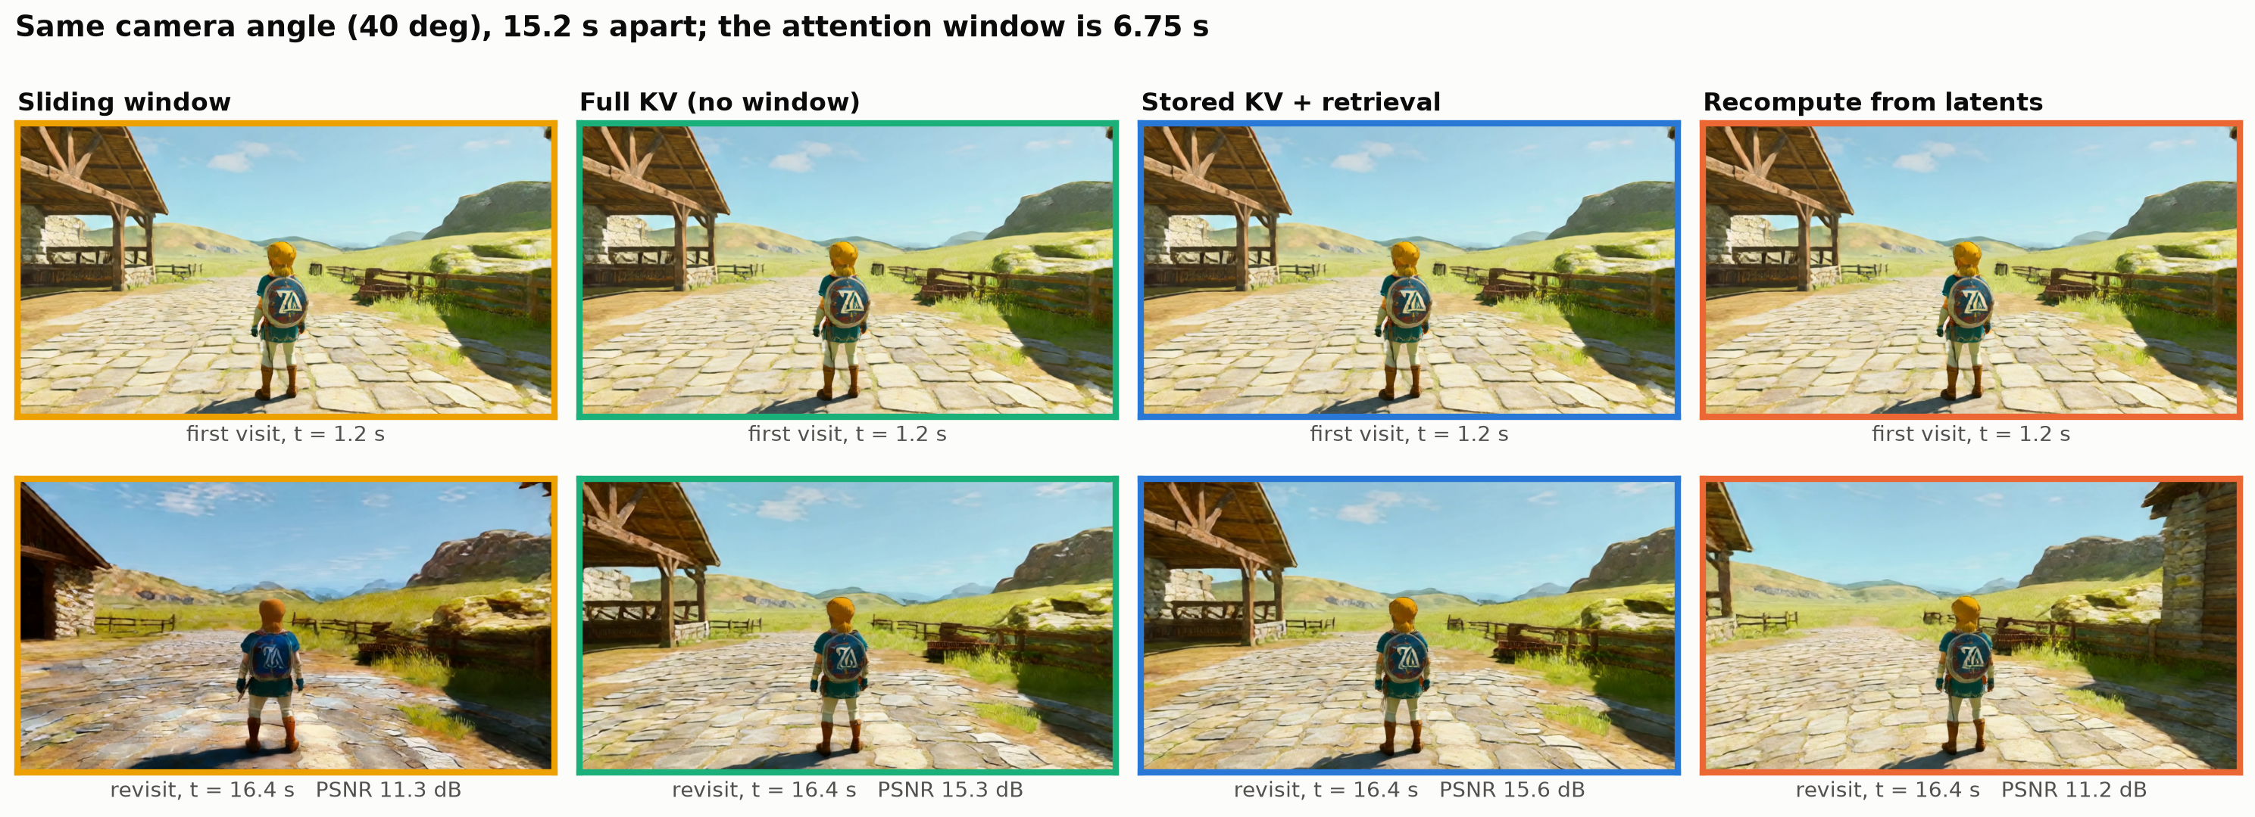
What it looks like: same 40 deg view, 15 s apart
Stored KV and full KV redraw the barn on the left; the window and recompute invent a different scene (stone buildings)
Each frame looks fine on its own; the failure is consistency with what was there before

Slide 6
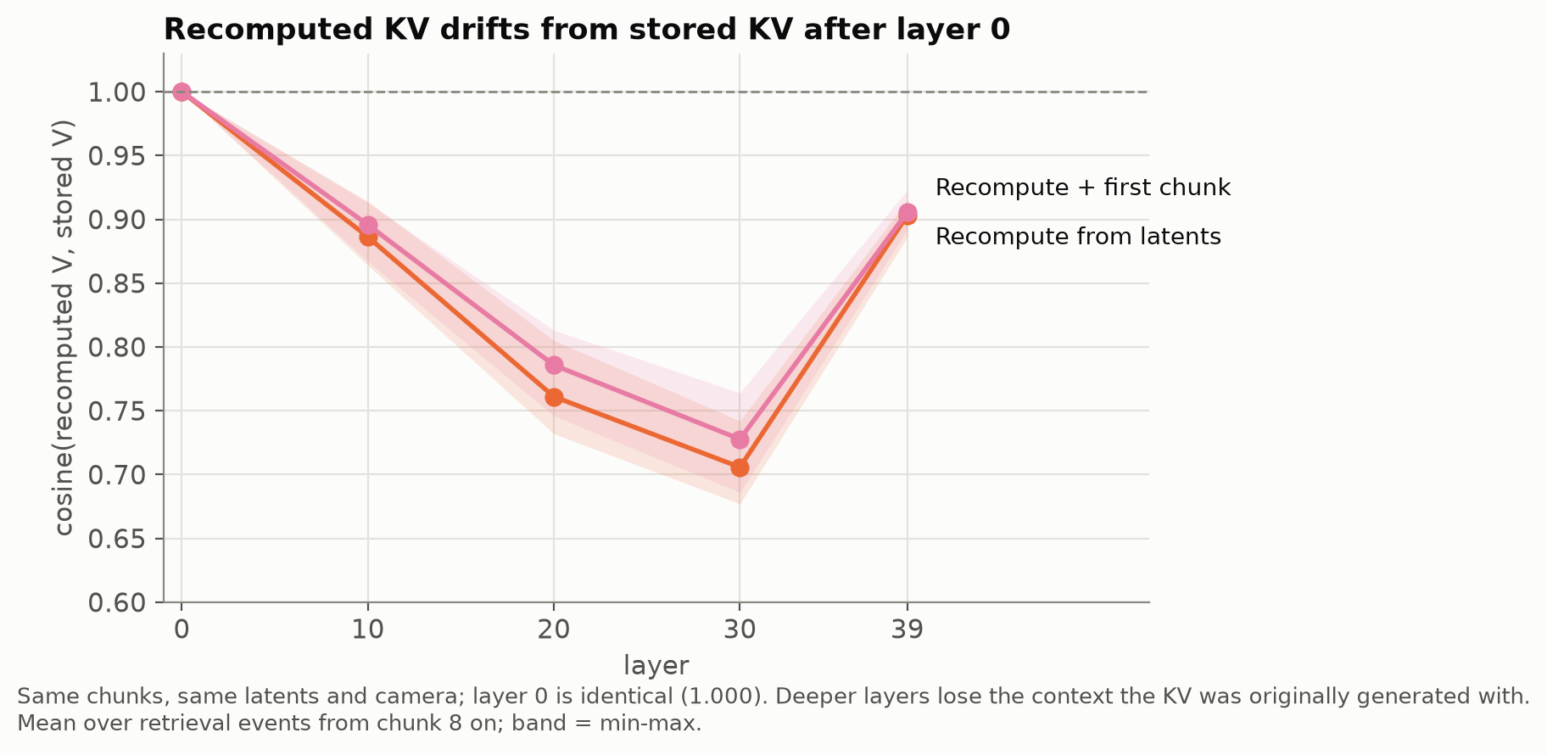
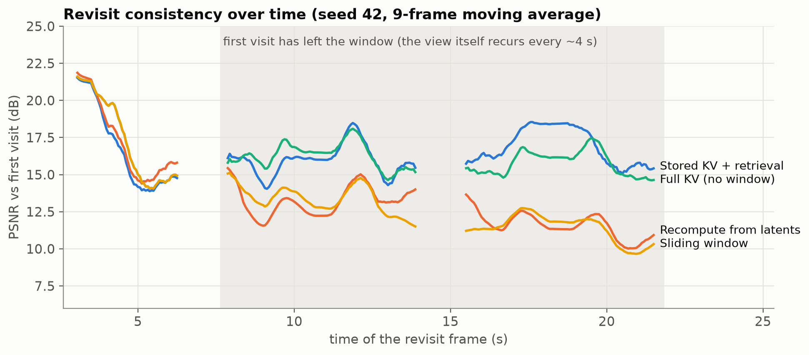
Why recompute fails: deep KV carries its generation context
Layer-l KV = the frame's latent plus what it attended to when generated (first frame, its window, its memories)
Recompute sees only the retrieved frames: V cosine 1.000 at layer 0 (same inputs), 0.76 / 0.71 at layers 20 / 30
Off-distribution KV is not used, so the model falls back on the recent window; the gap opens once the first visit leaves the window
Caveat: training-free; a model trained with recomputed memory (WorldPlay) may learn to use it

Slide 7
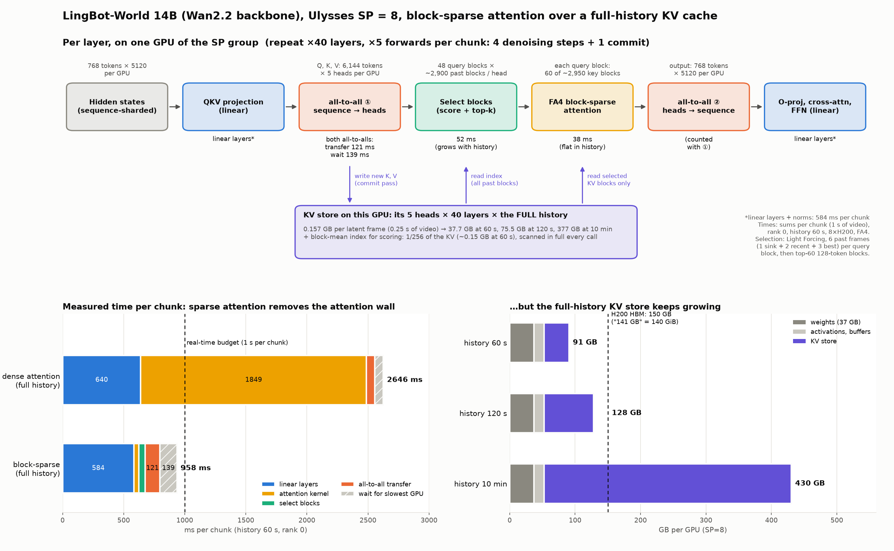
Profiling setup
LingBot-World v2 14B causal-fast (Wan2.2-14B): 40 layers x 40 heads, head_dim 128, bf16
512x768, 16 fps; 1 chunk = 4 latent frames = 1 s = real-time budget; 4 denoising steps + 1 commit
Ulysses SP8 on 8x H200 (5 heads per GPU); FlashAttention 4, dense and block-sparse
Full-history KV up to 120 s: 0.157 GB per latent frame per GPU, 75 GB per GPU at 120 s, ~3 TB per stream at 10 min
Block-sparse attention, 128x128 blocks, chosen per layer, head and query block:
VSA-style: last 12 latent frames dense + top 5% of older blocks
Light Forcing-style: pick frames first, then blocks
Quality runs: LingBot-World-Fast v1 14B, SP4, 361 frames, 2 seeds

Slide 8
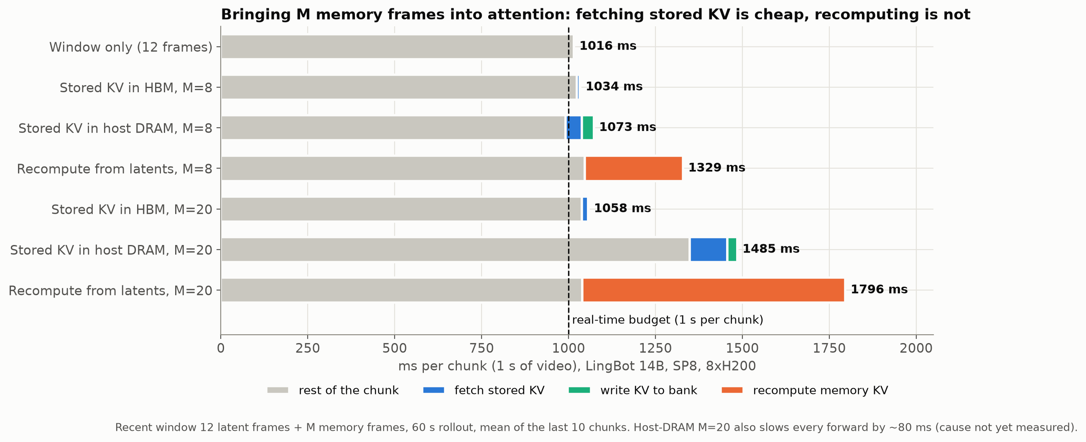
Time per chunk: fetching KV is cheap, recomputing is not
Dense full history is compute-bound: 2646 ms per chunk at 60 s; block-sparse 958 ms (attention kernel 38 ms, flat in history)
M memory frames: stored KV in HBM +18 ms (M=8); host DRAM +57 ms (fetch 46 ms); recompute +313 ms (M=8), +780 ms (M=20)
Open item: host DRAM at M=20 costs ~330 ms more than fetch + write-back (not yet explained)

Slide 9
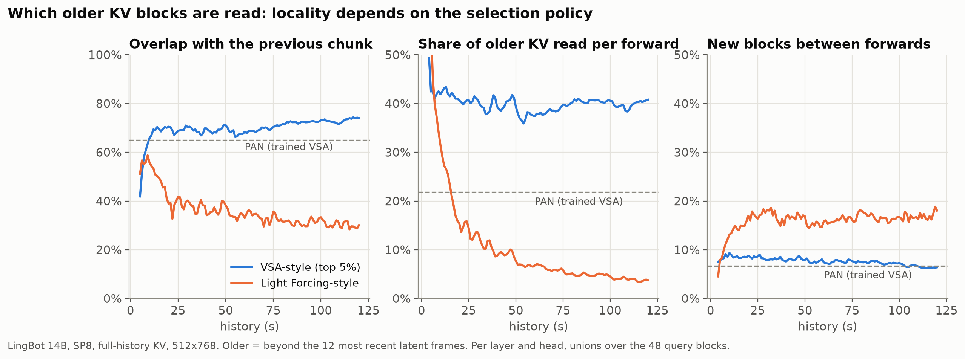
Access pattern: locality depends on the selection policy
Older KV shared with the previous chunk: VSA-style ~70% (PAN, trained with VSA: 65%); Light Forcing-style ~30%
Share of older KV read per forward: VSA ~40%; LF falls to 4%
Reuse (Tianqi): each fetched block serves ~6 query blocks; AI 128 FLOP/B unmerged, ~770 merged per forward, ~3300 cached across the 5 forwards

Slide 10
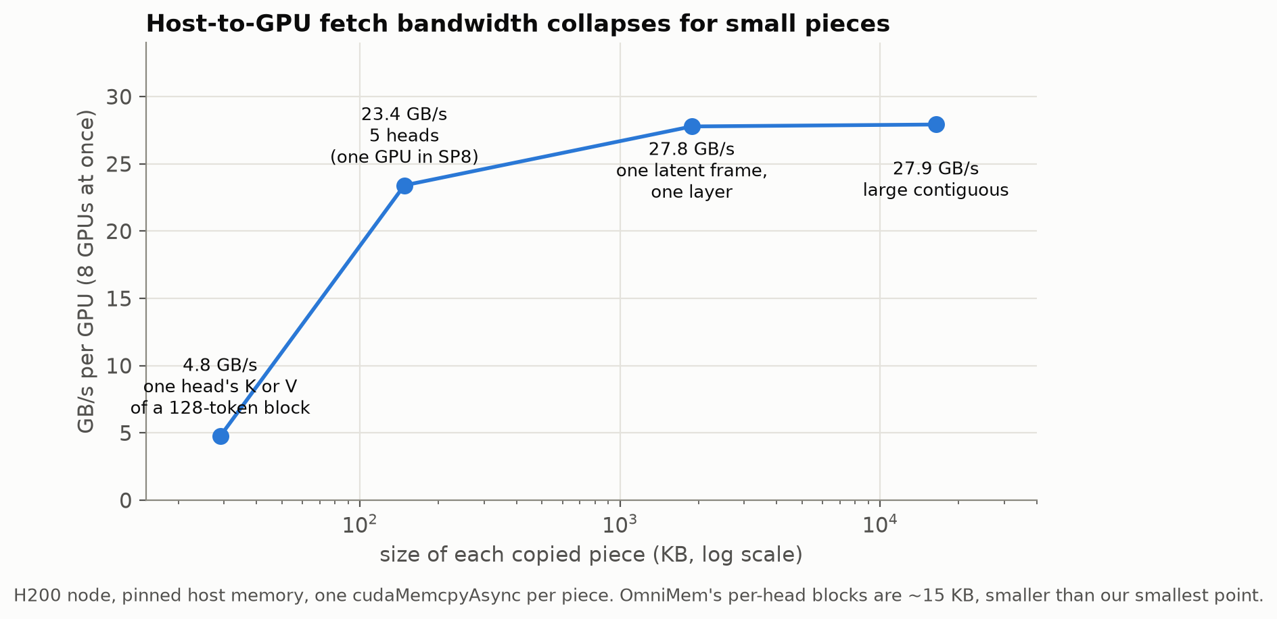
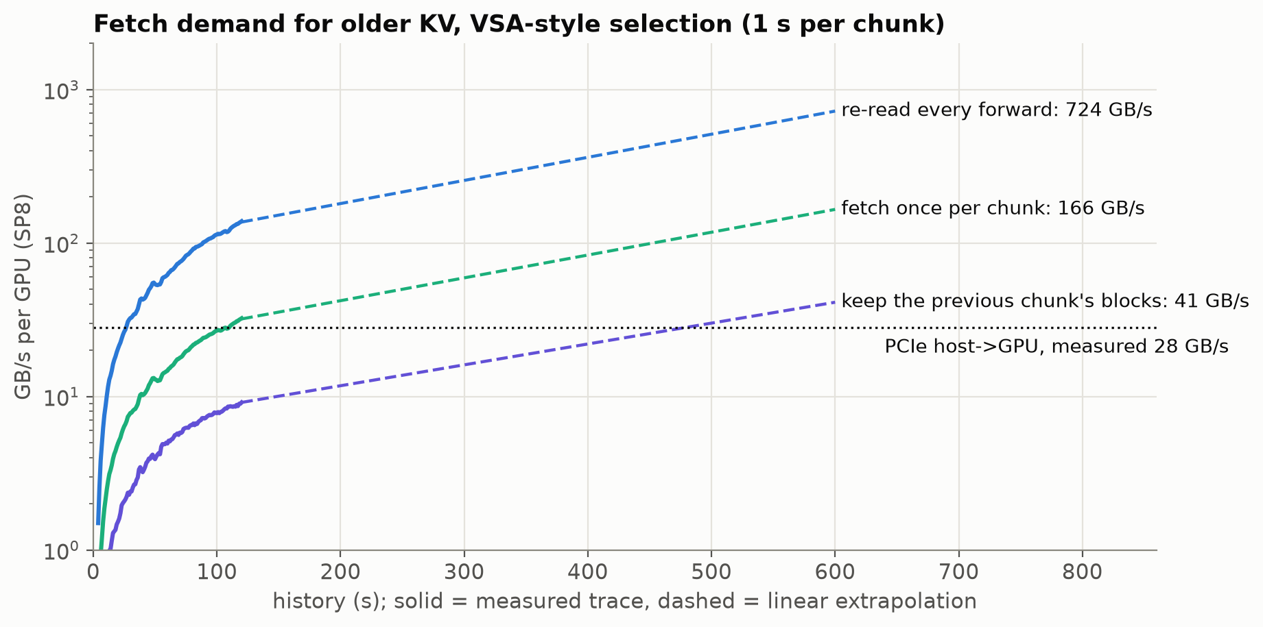
Fetch cost: PCIe cannot keep up
Host -> GPU: 28 GB/s per GPU for large copies, 4.8 GB/s for one head's 128-token K or V
VSA-style demand per GPU, 117 s -> 10 min: re-read every forward 139 -> ~720 GB/s; once per chunk 32 -> ~170; keeping the previous chunk's blocks 9 -> ~41
TB-scale capacity, 0.04-0.7 TB/s per GPU, fine-grained, decided at run time: the Glass regime

Slide 11
Caveats and next steps
Caveats
Quality: one scene, one 22.5 s trajectory, 2 seeds; PSNR is pixel-level
The view recurs every ~4 s, so the test measures drift, not recall after a long absence
Our recompute is training-free; a model trained for it may do better
LingBot was not trained with sparse attention; its access pattern matches PAN's, quality is unverified
VSA-style selects a fixed ratio, so compute grows with history; a fixed top-k would cap it
Next (needs GPUs)
Turn-away trajectory (leave a view for longer than the window), more scenes and seeds
Attention weight on memory tokens: stored vs recomputed KV
Explain the host-DRAM M=20 overhead; clean VSA timing; fixed-k trace
End-to-end sparse fetch from a capacity tier

Slide 12
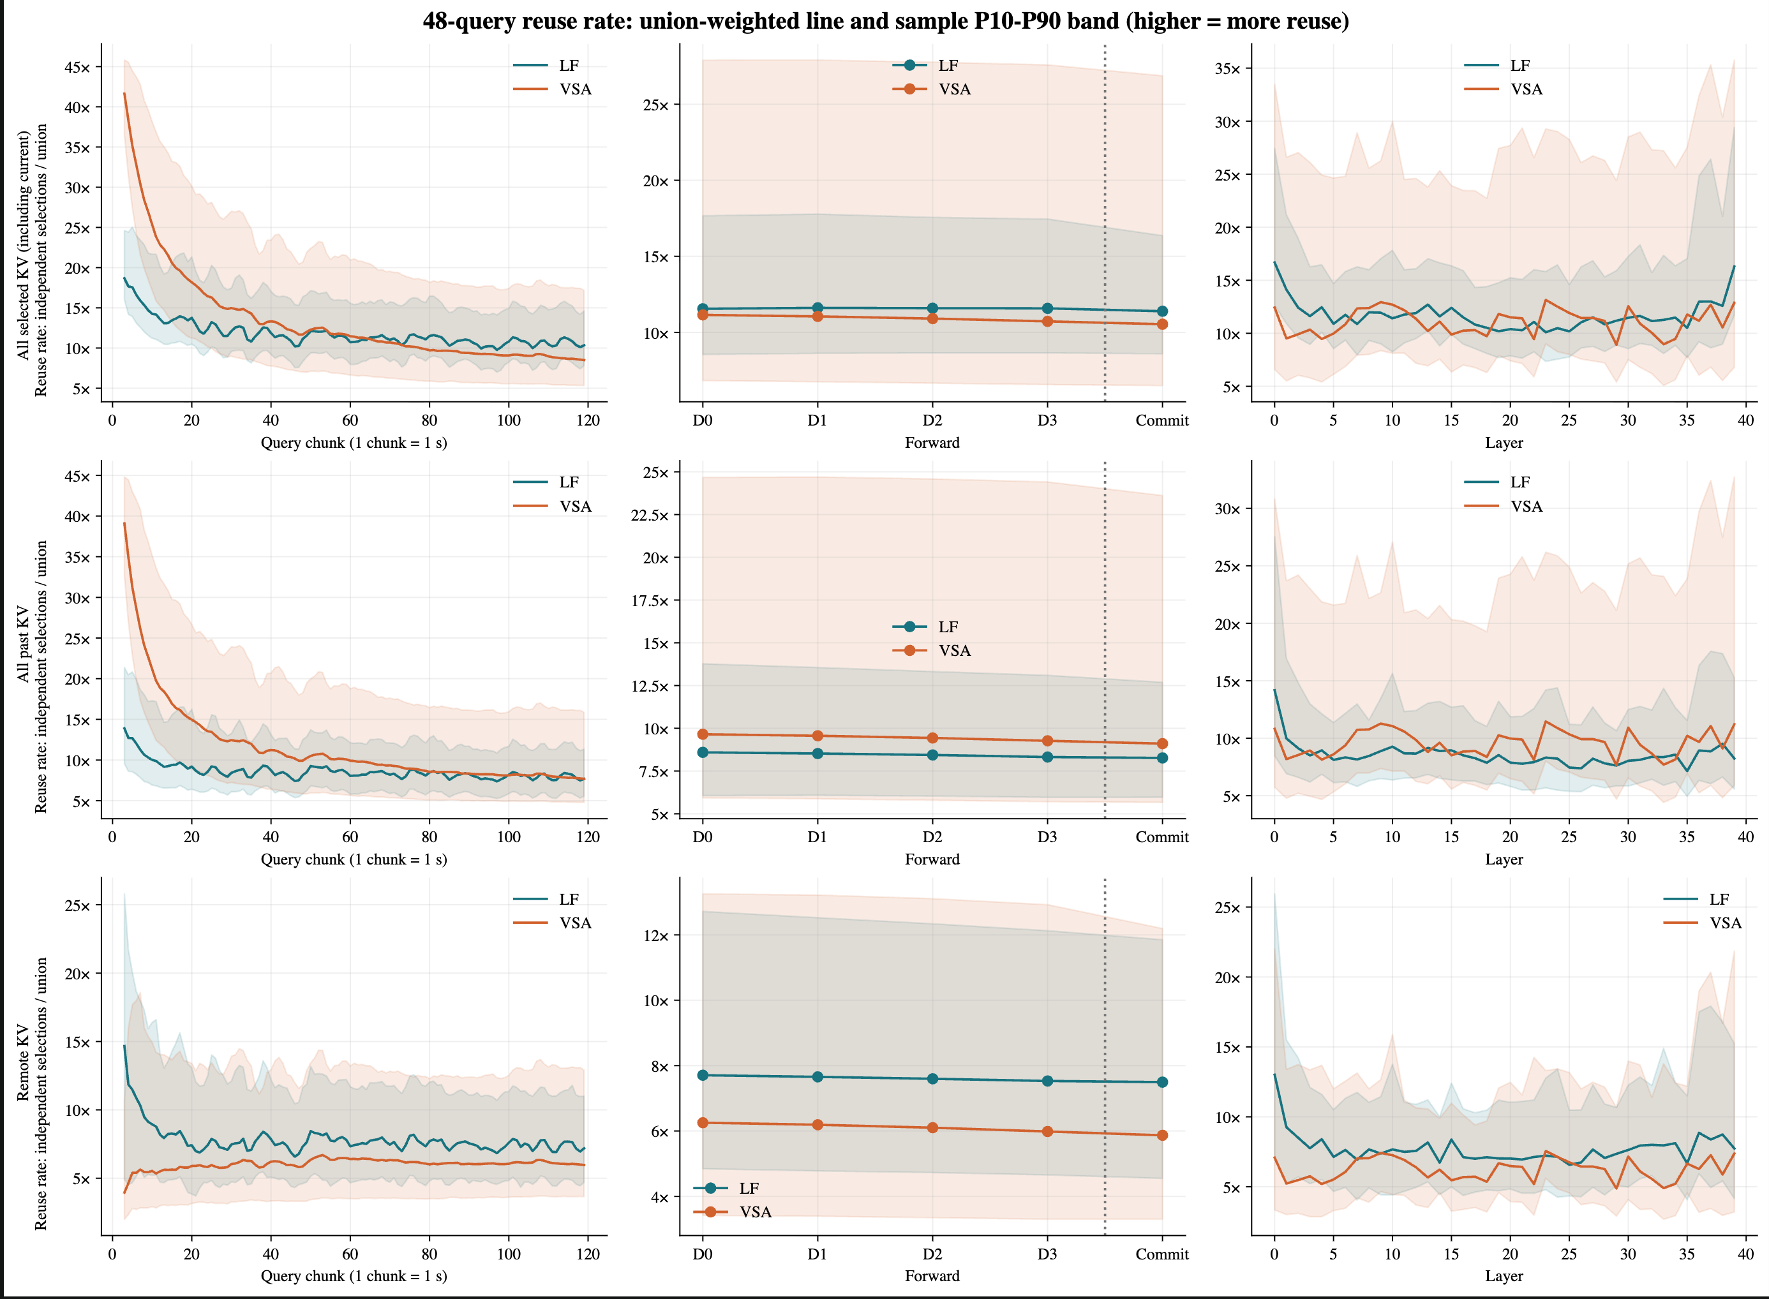
Backup: reuse of fetched blocks (Tianqi)
Reuse rate = independent selections / union, per forward; stable over time and steps

Slide 13
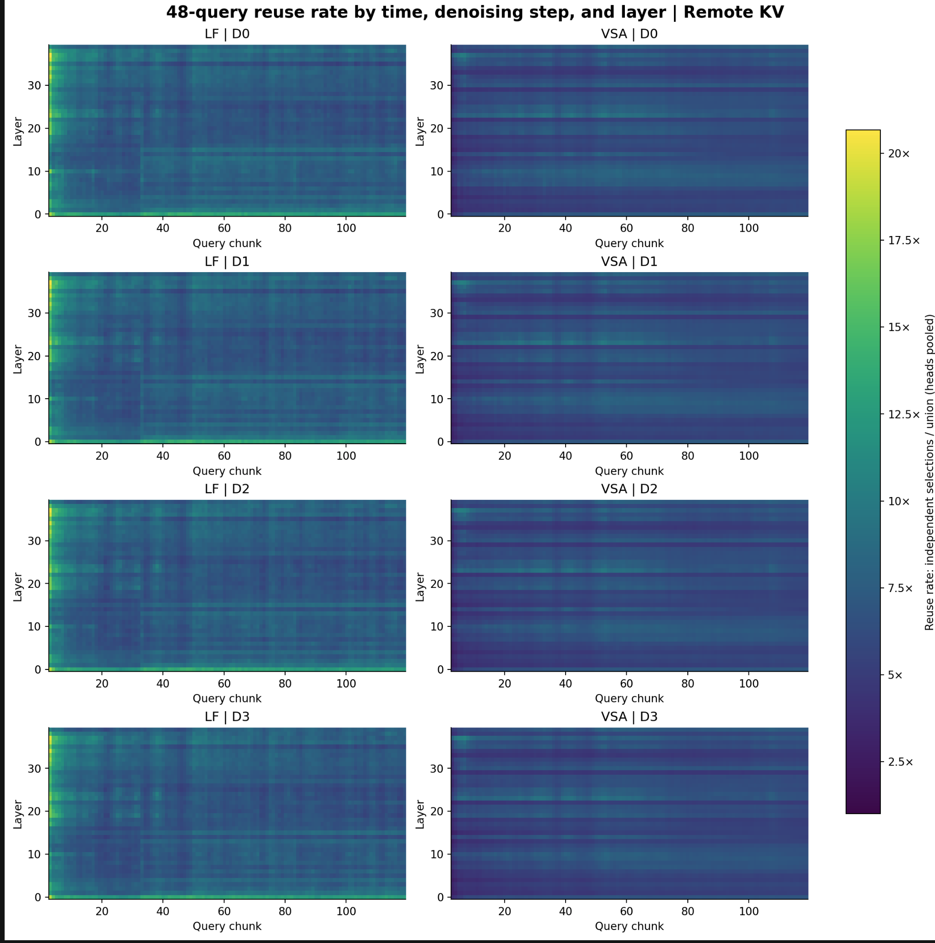
Backup: remote-KV reuse by layer and chunk (Tianqi)
Per-layer bands stay constant over 120 s: placement or bandwidth can be set per layer

