Slide 1
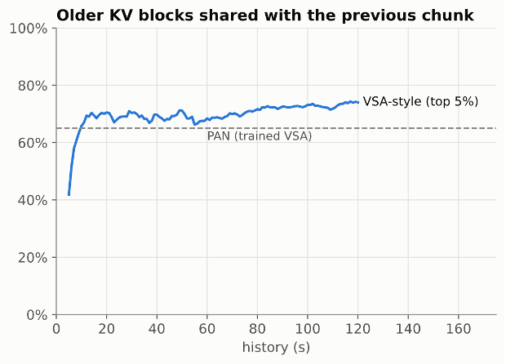
Mingjia Huo
Glass ML + causal video gen inference
  Model Setting: LingBot-World v2 14B causal-fast: 512p, 16 fps; 1 chunk = 1 s; 4 denoising steps
  Sequence Parallel: Ulysses Sequence Parallel on 8x H200 (5 heads per GPU)
  Memory Capacity: Full-history KV up to 120 s: 0.157 GB per latent frame per GPU, 75 GB per GPU at 120 s, ~3 TB per stream at 10 min
  Sparse Attention:
    last 12 latent frames dense + top 5% of older blocks
Next Week: Measure Communication Overhead of Ring Attention
  Ring attention is a commonly used method to parallel long video generation and reduce memory across nodes
  Communication overhead higher than Sequence Parallel.
How to deal with KV cache? | Added Latency | Overhead
Stored KV in HBM | +18 ms | 2%
Stored KV in host DRAM | +137 ms | 13%
Recompute from latents | +757ms | 75%

