Slide 1
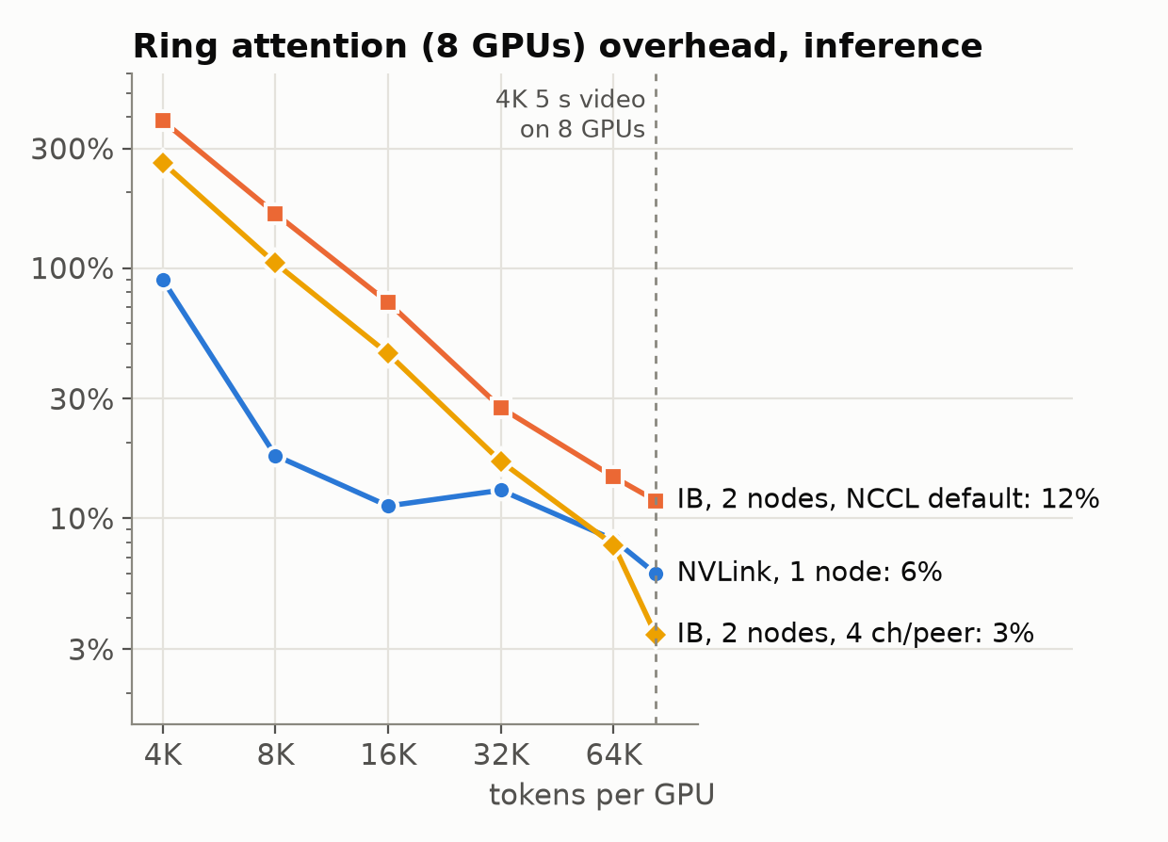
Mingjia Huo
Ring attention: bidirectional video is not comm-bound, even with sparse attention
  Why: per ring step compute grows as s², KV traffic as s (s = tokens/GPU); 4K video: s ≥ 80K
  Dense: Ulysses in node x ring across nodes hides comm on IB (1% measured); glass adds nothing
  + Sparse (13.5% compute, same KV bytes): still 5% at 16 GPUs; shows only at 64 GPUs/sample
  Need a causal workload: chunk-by-chunk generation, full-history KV cache, sparse selection
Training overhead (bold: measured, blue: projected) | GPUs | IB 31 GB/s | NVL72 | Glass
Dense 5 s, Ulysses 4×ring 2 | 8 | 1% | – | –
Dense 10 s, Ulysses 8×ring 2 | 16 | 1% | 0% | 0%
Sparse 10 s, Ulysses 8×ring 2 | 16 | 5% | 1% | 0%
Dense 5 s, Ulysses 8×ring 8 | 64 | 18% | 12% | 12%
Sparse 5 s, Ulysses 8×ring 8 | 64 | 56% | 14% | 13%
Sparse + causal 5 s, Ulysses 8×ring 8 | 64 | 137% | 16% | 13%
Next Week: chunked causal decode with a sharded full-history KV cache + sparse selection (LingBot / PAN shapes)
Notes:
Source: docs/ring_attn_overhead.md and model_ring.py. Overhead = distributed attention time / single-kernel flash-attention time - 1, training step (fwd+bwd), Wan2.1-14B shapes (40 heads x 128), H200 compute. 5 s = 680K tokens, 10 s = 1.33M tokens. Measured row: 2 nodes x 4 H200, NCCL_NCHANNELS_PER_NET_PEER=4 (NCCL default gets 20 GB/s and roughly doubles cross-node ring overhead). Projections: model fitted to all measurements (median error < 4%); NVL72 0.9 TB/s, glass 4 TB/s per GPU. Sparse = compute x 0.135 (PAN trace), KV traffic unchanged. All rows are full-sequence passes (diffusion / training step), not KV-cache decode. Ulysses degree must divide 40 heads, so at most 8 inside a node; more GPUs need Ulysses x ring.

