Slide 1
CSOPSEY MO2
Multi-tasking OS
Andreo Canilao, Bryle Magura, Migs Guiao, Ralph Garcia

Slide 2
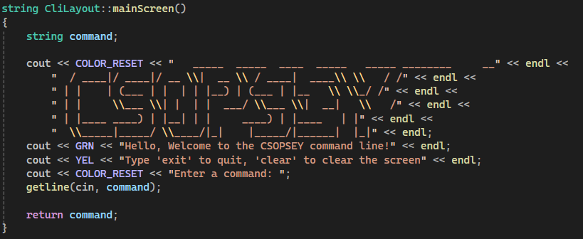
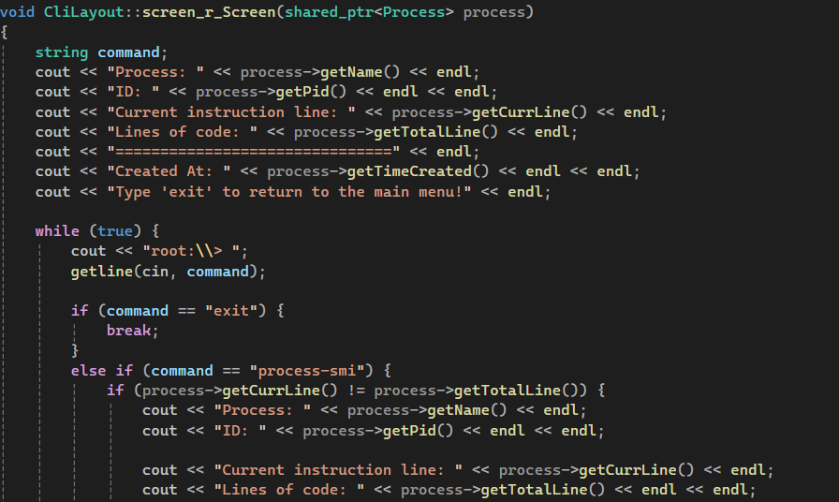
Command Recognition
The CliLayout class handles in getting command inputs from the user through the getline function of the std namespace.
The mainScreen method displays the ascii-text header and acts as the main menu of the program where it will ask the user for a command input.
The screen_r_Screen method displays the UI for “screen –r” command and prompts the user for a command to display the current status of the process.
In the case of incorrect commands, the menu displays the appropriate message such as “Process po1 does not exist. Use 'screen -s <name> to create it.“ for the awareness of the user.
After this, the menu will then ask again for user input, which makes it capable of handling errors.

Slide 3
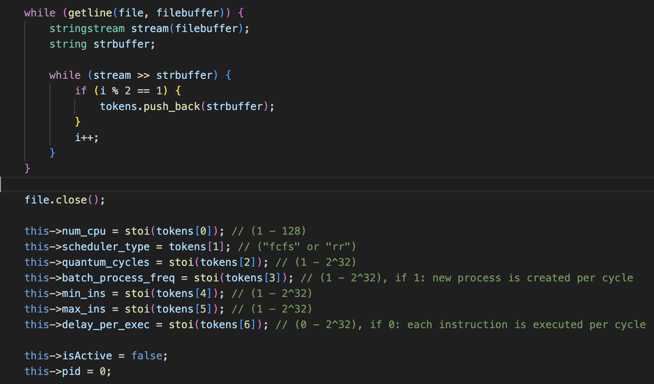
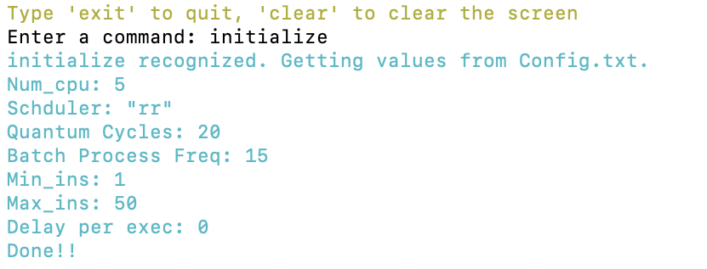
Command Recognition
For example, the initialize command reads the “config.txt” file to take in the following information:
  Number of CPUs
  Scheduler type (FCFS or Round robin)
  Quantum cycles
  Batch process frequency
  Minimum instructions per process
  Maximum instructions per process
  Delay before executing the next instruction in CPU cycles
Once ”initialize” command is activated, these will be printed in the command line.
These information are to be used later on in the scheduler-test.

Slide 4
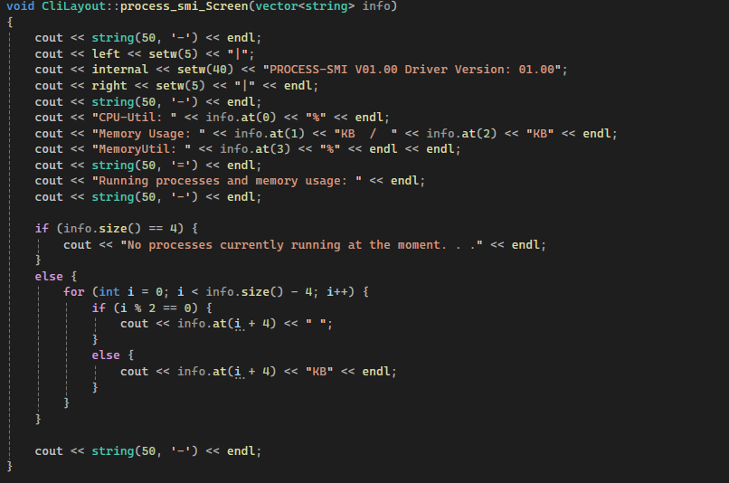
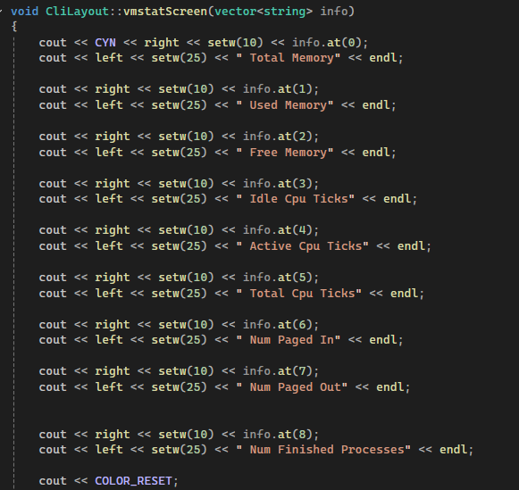
Command Recognition
For the "vmstat" command, the vmstatScreen() method of the CliLayout class is called with string vector as its parameter which contains the information needed to be displayed. It also contains the format for the command.
For "process-smi" command, similarly to the "vmstat" command, it is implemented as a method of the CliLayout class with a string vector as its parameter. The vector contains information such as cpu utilization, used memory, total memory, memory utilization, and process information that are currently running in the memory.

Slide 5
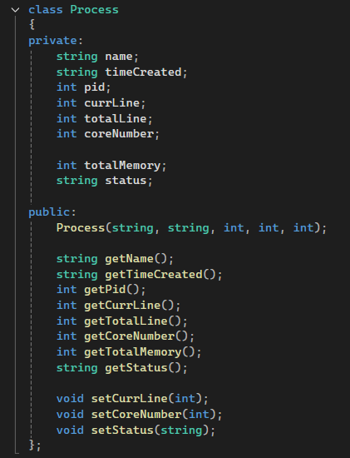
Process Representation
Each individual process is represented as a class with the following fields:
Name = Corresponds to the name of the process.
timeCreated = Which was when the process was created in (MM:DD:YY HH:MM:SS AM) format.
currLine = Corresponds to the current line of instruction to be executed.
totalLine = Which is the total lines of instruction to be executed.
coreNumber = Corresponds to the cpu assigned to run the process. By default, its value is -1, meaning no cpu was assigned to it yet.
status = Represents the status of the process. Can be "RUNNING", "WAITING", or "COMPLETED"
TotalMemory = Represents the total used memory needed or consumed by the process.

Slide 6
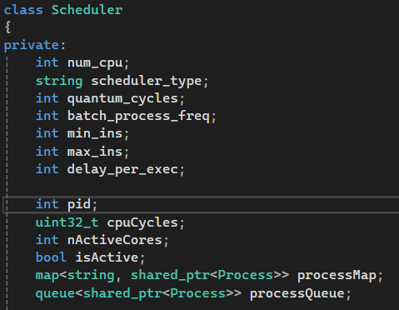
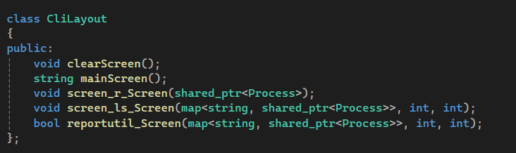
Process Representation
The list of processes created in the program is represented in the following ways:
Map = Stores the list of processes for displaying in the “screen –ls” and “report –util” command.
Queue = Represents the list of processes ready queue and is used in the scheduling methods.
When a process is created, it is stored to the map and queue as a reference so that when the process information gets modified in the queue, the changes also reflects on the map.

Slide 7
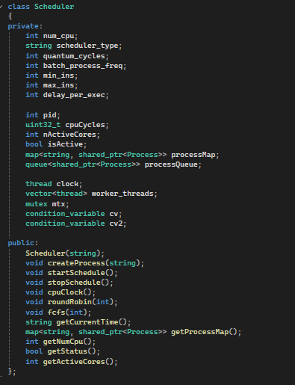
Scheduler Implementation
The scheduler class handles the program configurations and various methods relating to the scheduling such as:
createProcess = Creates a new process with a unique name and pid. It also calls the getCurrentTime function to know when the process was created.
cpuClock = Represents the cpu clock of the program.
startSchedule = Creates the threads necessary and calls the roundRobin and fcfs functions.
stopScheduler = Stops the scheduler and joins all the threads together.

Slide 8
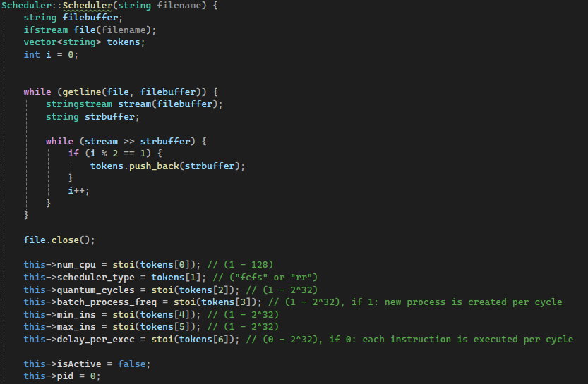
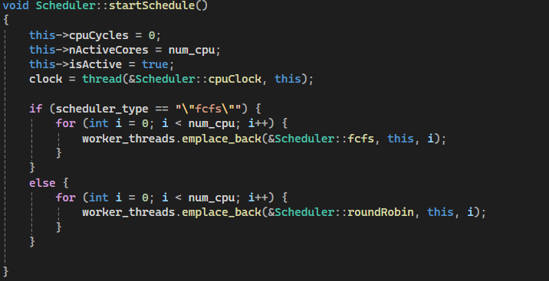
Scheduler Implementation
The scheduler is initialized by the CliManager class upon entering the “initialize” command. It then calls the scheduler constructor which reads the configuration file which will be used in setting the fields of the scheduler class.
Once the user inputs the command “scheduler-start”, the CliManager class will call the startScheduler method which will initialize the threads and other necessary fields for the scheduler.
The threads that were created will then call the fcfs or roundRobin method depending on the settings of the configuration file.

Slide 9
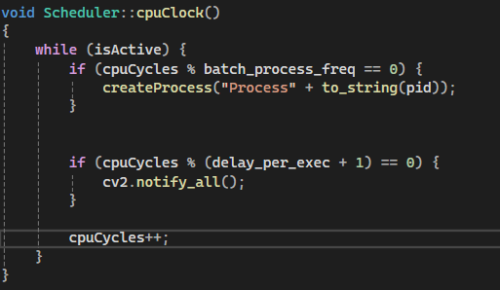
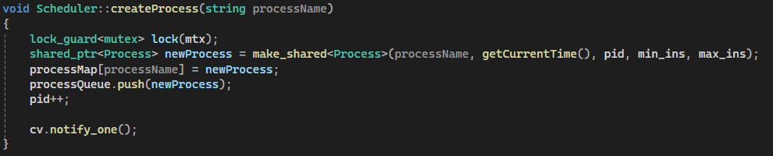
Scheduler Implementation
The cpuClock method is implemented as a separate thread from the fcfs and roundRobin method as it will run independently to determine when a new process will be created and when an instruction will be executed by the schedulers.
The condition variable cv2 is used to notify the schedulers that an instruction should be executed in that cpu cycle.
The createProcess method is called by the cpuClock and CliManager class when a new process will be created.
To resolve the consumer-producer problem, the condition variable cv is used to notify the schedulers that a process has been created.

Slide 10
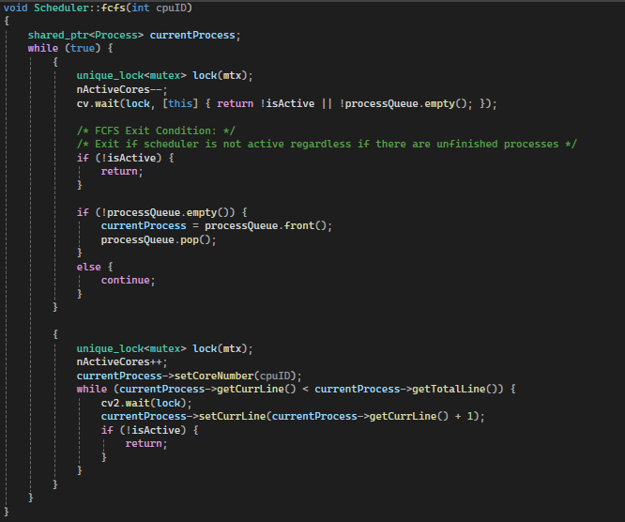
Scheduler Implementation
The fcfs method implements the first come first serve scheduling algorithm. It contains a parameter cpuID which corresponds to the cpu core running the scheduling algorithm.
It uses a unique_lock and condition variable to synchronize with the cpuClock and createProcess methods.
This method will first see if the ready queue is empty or not. If empty, it will wait indefinitely until the createProcess notifies one of the threads that a new process is created and stored in the ready queue.
It then removes the front element from the queue and stores it in a shared pointer called “currentProcess” which will be the process that will be executed by the scheduling algorithm.

Slide 11
Scheduler Implementation
The nActiveCores field is decremented in the first unique lock as the cpu core isn’t executing a process during that time. It is then incremented in the second unique lock as it when the cpu is actively running the process.
When running the process, the fcfs method must wait for the cpuClock to notify all fcfs method threads before they increment the current line of instruction of the process.
The fcfs method will then stop if the isActive variable is set to false, regardless if there are still unfinished processes in the ready queue.

Slide 12
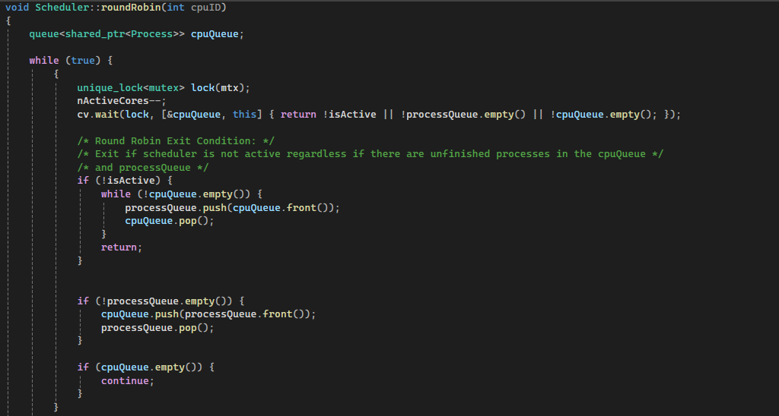
Scheduler Implementation
The roundRobin method implements the round robin scheduling algorithm with the cpuID as its parameter which represents cpu core running the scheduling algorithm.
Similarly to the fcfs method, the roundRobin method also uses unique locks and condition variables to synchronize with the cpuClock and createProcess methods.
Unlike the fcfs method, each thread in this method contains its own queue called cpuQueue wherein processes from the ready queue will be then stored here to ensure that only one cpu core is running a process and that it is not being passed around in other cpu cores.

Slide 13
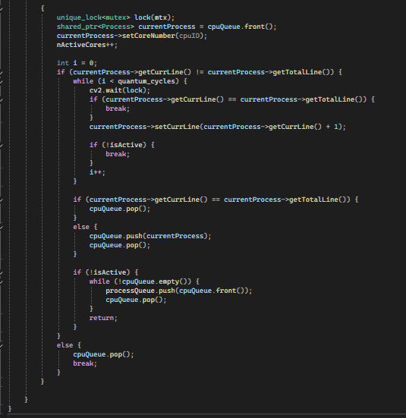
Scheduler Implementation
The execution of process in the roundRobin method is similar to the fcfs method except for some few minor changes.
This method will only increment the current line of instruction on a certain time slice.
If a process is finished executing before the time slice ends, it will then be removed from the cpuQueue. Otherwise, it will then be pushed back in the back of the cpuQueue.
The roundRobin method will stop once isActive is set to false and will push back all elements of the cpuQueue back to the ready queue.

Slide 14
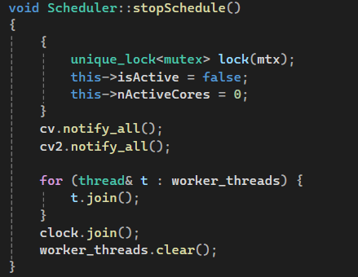
Scheduler Implementation
When the user inputs the “scheduler-stop” command, the CliManager class will then call the stopSchedule method. It will set the isActive variable to false and the nActiveCores to 0. It will then notify all the threads that are waiting to be assigned a process, and that are currently running a process.
Once all the threads are notified, it will then join all threads of the scheduler, including the thread for the cpuClock method.
Lastly, it will clear the vector of threads so that the program won’t have any issues when the startSchedule method is called again.

Slide 15
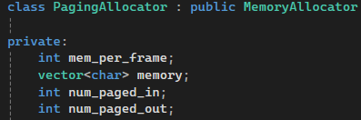
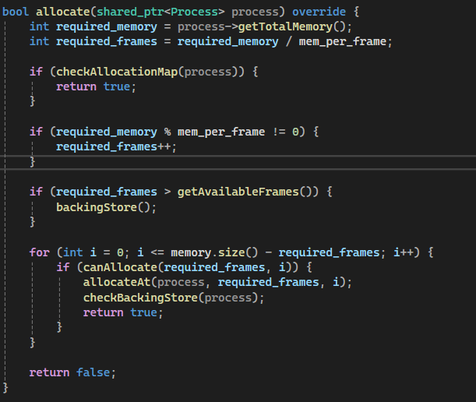
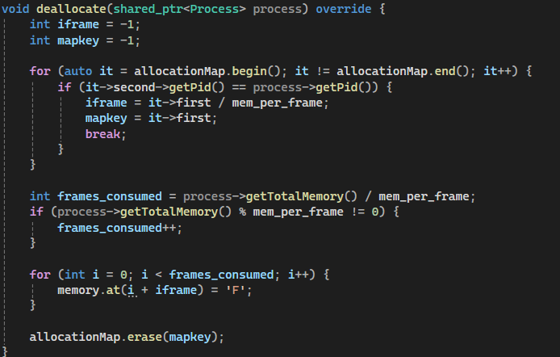
Memory management – paging
In the paging memory management , the main memory is segmented into frames which is represented by mem_per_frame.
The character of vectors named "memory" contains the values "F" if memory frame is free and "O" if memory frame is occupied.
num_paged_in and num_paged_out counts the number of paged in and paged out.
Allocate() method allocates the process in the memory through the use of helper methods such as canAllocate(), allocateAt(), getAvailableFrames(), etc.
Deallocate() method deallocates the process in the memory. The process is removed from the memory allocationMap and the memory frames are set to "F" signifying that the frame is free.

Slide 16
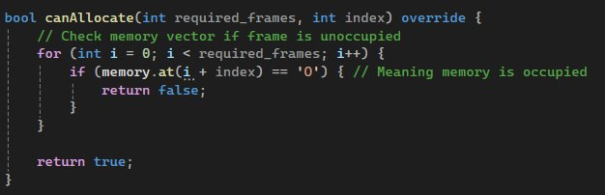
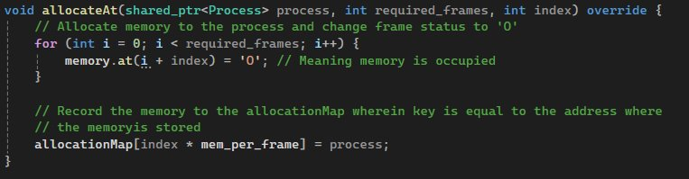
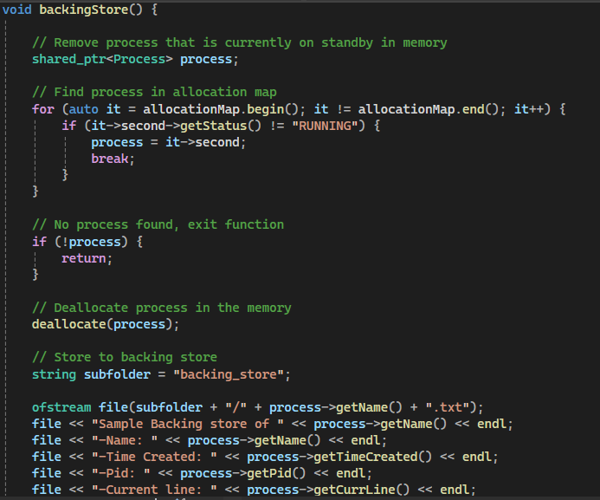
Memory management – paging
canAllocate() method checks if a frame in a memory is unoccupied or not
allocateAt() method that allocates a memory to a process.
The backingStore() method finds a process in the memory that is not "RUNNING", deallocates it and stores it in the backing_store folder with the name <process.name>.txt.
If no process is found in the memory that can be stored in the backing store, the function exits.
The checkBackingStore() method is for checking if the process has been stored in the backing store. If there is a record, it deletes it from the backing store. This method is called by the allocate() method.

Slide 17
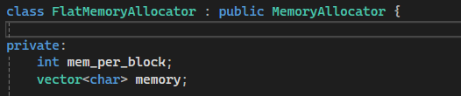
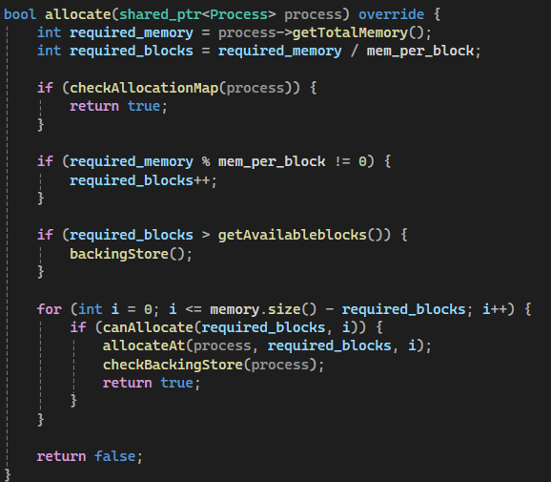
Memory management – flat memory
In the flat memory management , the main memory is segmented into "blocks" wherein mem_per_block is equal to 1 by default.
All of the methods in the flat memory are almost the same as the implementation with the paging allocator. The only difference is that the memory per block is 1 to signify that the the memory is one single contiguous block.

Slide 18
End of slides

