Slide 1
MCO 1
S-12 Group 25
Canilao
Garcia
Guiao
Magura

Slide 2
Command recognition
Info here

Slide 3
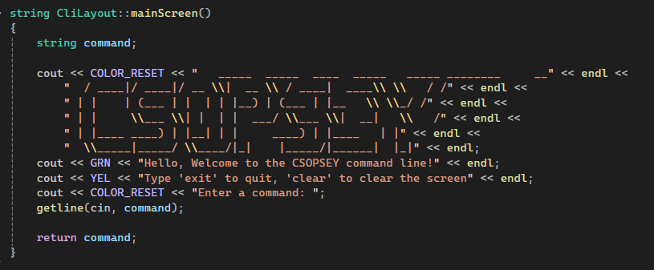
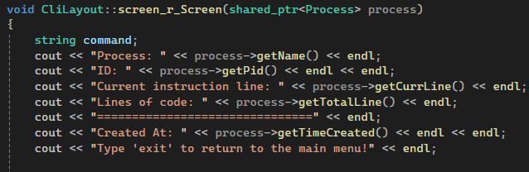
Console UI Implementation
The UI in the main screen, process smi, process list and scheduler was implemented by simply using print statements and appending the required display values.
To Implement the colors, we used a header file from github that contains ANSI color codes which was used to apply colors in the UI (https://gist.github.com/RabaDabaDoba/145049536f815903c79944599c6f952a)
Main Screen
Process smi

Slide 4
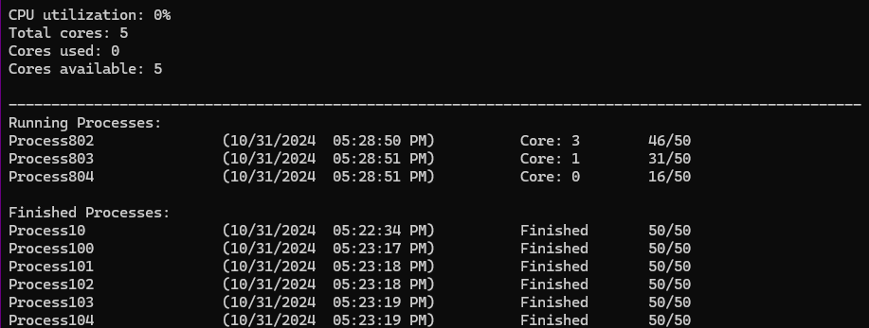
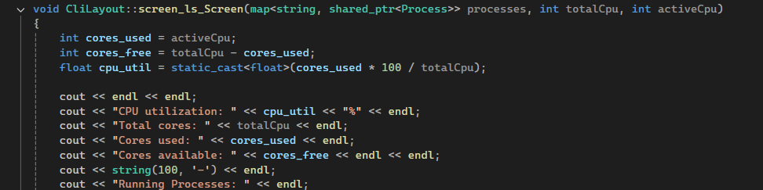
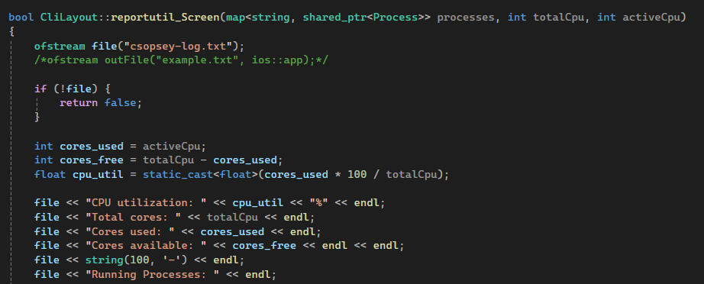
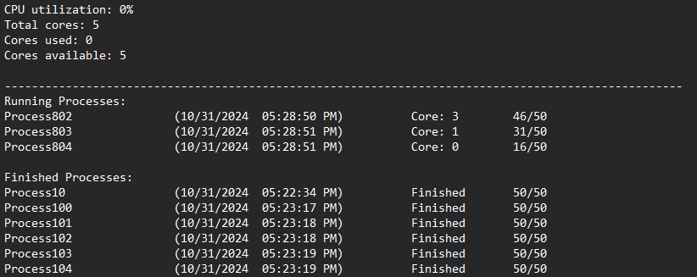
Console UI Implementation
Process List
Report-util
Both commands have similar display but Report util is in .txt file like what was mentioned in the specs.

Slide 5
Command interpreter implementation

Slide 6
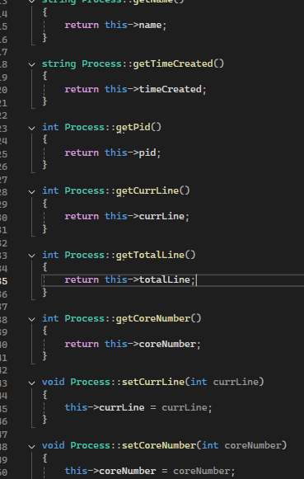
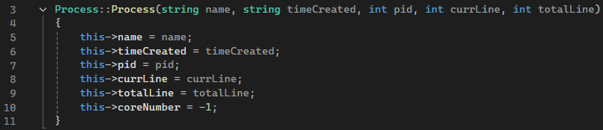
Process Representation
The process was represented by creating a class to maintain object-oriented programming paradigm. The class contains the needed variables for a process such as the name, the time when it was created, process ID, the total number of lines to be executed, the current line that has been executed and the core number. Similar to the typical OOP, we also defined the constructor, and the getters and setters for the class.

Slide 7
Process Representation
Upon creating a process, we store the created process into a map in which we used the name of the process as the key for easy lookup name which will accessed in other functions.

Slide 8
Scheduler Implementation
Info here

Slide 9
End of slides

