Slide 1

React

Slide 2
Contents

Slide 3
Contents
Workspace setup
Creating a component
Rendering
State
Props
Property Types
Lifecycle

Slide 4
Contents
Actions & Event Handling

Slide 5
Workplace Setup

Slide 6
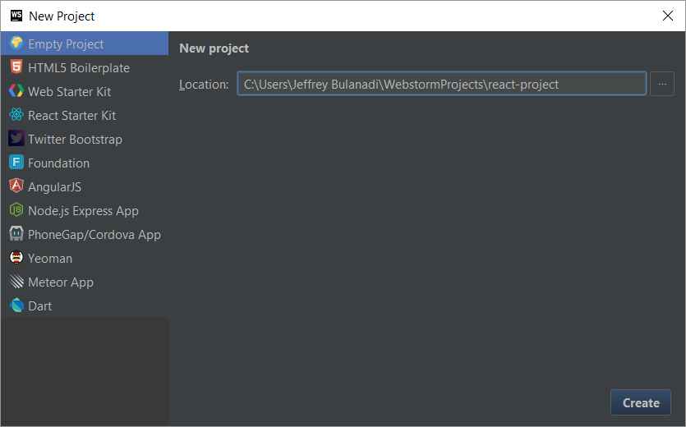
Workplace Setup

Slide 7
Workplace Setup
Git Bash
$cd ~/WebstormProjects/react-project/
$npm init
Press enter for all prompts (default values)

Slide 8
Workplace Setup
{
"name": "react-training-sample",
"version": "1.0.0",
"description": "",
"main": "index.js",
"scripts": {
"dev": "webpack-dev-server --colors --progress --hot
--inline --watch"
},
"author": "",
"license": "ISC",

Slide 9
Workplace Setup
"devDependencies": {
"babel-core": "^6.10.4",
"babel-loader": "^6.2.4",
"babel-preset-es2015": "^6.3.13",
"babel-preset-react": "^6.3.13",
"babel-preset-stage-0": "^6.3.13",
"webpack": "^1.13.1",
"webpack-dev-server": "^1.14.1"
},

Slide 10
Workplace Setup
"dependencies": {
"axios": "^0.14.0",
"babel-preset-react": "^6.11.1",
"css-loader": "^0.23.1",
"react": "latest",
"react-dom": "^15.2.0",
"react-redux": "latest",
"redux": "^3.5.2",
"redux-form": "^5.2.5",
"redux-thunk": "^0.1.0",
"render": "^0.1.4",
"style-loader": "^0.13.1"
}
}

Slide 11
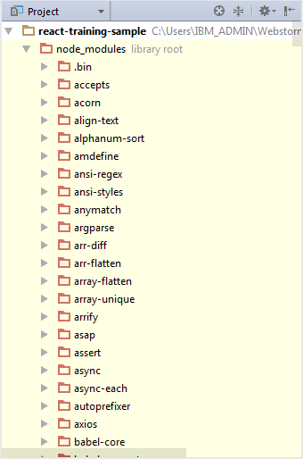
Workplace Setup
Go to Git Bash/Command Prompt
$ npm install

Slide 12
Workplace Setup
Create the following files
  <project-name>
    src/
      components/
        hello-world.jsx
    index.html
    index.jsx
    webpack.config.js
Notes:
Show the contents of the following files:
Index.html
Index.jsx
Webpack.config.js <- explain
Personal-info-panel.jsx

Slide 13
Workplace Setup
$ npm install
Notes:
Show the contents of the following files:
Index.html
Index.jsx
Webpack.config.js <- explain
Personal-info-panel.jsx

Slide 14
Your First ReactJS Application
A simple Hello World ☺

Slide 15
Hello World!
import React from 'react';
let HelloWorld1 = React.createClass({
propTypes: {
appState: React.PropTypes.object
},
render() {
return (
<div>
Hello World 1
</div>
);
}
});
export {HelloWorld1};
Notes:
There are 2 ways on how we can create a component
By using the React.createClass method
By extending React.Component
Both will yield the same result but how you code the component will be different

Slide 16
Hello World!
import React from 'react';
class HelloWorld2 extends React.Component {
constructor(props) {
super(props);
}
render() {
return (
<div>
Hello World 2
</div>
);
}
}
export default HelloWorld2;

Slide 17
Hello World!
$ npm run dev
Access this url in your browser
  http://localhost:8080/
**Note that the dev in the command is the “scripts” which we have entered in the configuration in package.json
"scripts": {
"dev": "webpack-dev-server --colors --progress --hot --inline --watch"
},
Notes:
After creating a HelloWorld component you can now run your code via npm run dev and access the app via http://localhost:8080/
This will start the webpack-dev-server which will run our application

Slide 18
States

Slide 19
States
Affects how a property behaves, renders.
Considered as private data.
Updating a state will trigger an update for the component.

Slide 20
States

Slide 21
States – Initialization
Initial States need to be created first before it can be used.
Done inside getInitialState()
getInitialState() {
return {
var1: 'Hello World!',
var2: ''
}
},

Slide 22
States – Usage
render() {
return (
<div>
{this.state.var1}
</div>
);
}

Slide 23
States – Update
updateState() {
var newState = {
var1: 'You have updated the state'
};
this.setState(newState);
},

Slide 24
States
Notes:
What if we have to update the state in personal-information-panel.jsx and we have to do it from self-info-component.jsx?
In this case, we can use callbacks to update states.

Slide 25
States – Callbacks
render() {
return (
<div>
<button onClick={
(event) => {
this.props.updateParentStateCallback('Jeffrey')
}
}>Update State</button>
</div>
);
}

Slide 26
States – Callbacks
updateState(firstName) {
console.log(`Hi my name is ${firstName}`)
},
render() {
return (
<div>
<CallBackSample
updateParentStateCallback={this.updateState}/>
</div>
);
}

Slide 27
Properties(props)

Slide 28
Properties
Considered as the ‘initialization’ part of a component.
Optional declaration -- Although it is preferred that the properties of a component is declared.
Can’t be modified.

Slide 29
Properties – Declaration & Usage
let HelloWorld1 = React.createClass({
propTypes: {
helloText: React.PropTypes.string.isRequired
},
render() {
return (
<div>
{this.props.helloText}
</div>
);
}
});

Slide 30
Properties – Declaration & Usage
let App = React.createClass({
render() {
return (
<div>
<HelloWorld1 helloText="Hello World! from Props!"/>
</div>
);
}
});

Slide 31
Property Types(propType)

Slide 32
Property Types
You can declare that a prop is a specific JS primitive. By default, these are optional.
array
bool
func
number
object
string
symbol
Notes:
Demo sample usage

Slide 33
Property Types
node
element
instanceOf
oneOf
oneOfType
arrayOf
objectOf
shape
func
any

Slide 34
Component Lifecycle

Slide 35
Component Lifecycle
componentWillMount()
componentDidMount()
componentWillReceiveProps()
shouldComponentUpdate()
componentWillUpdate()
componentDidUpdate()
componentWillUnmount()

Slide 36
Actions & Event Handling

Slide 37
Actions & Event Handling
buttonOnClickHandler() {
alert("You clicked the button!");
},
fieldOnChangeHandler(event) {
console.log(event.target.value)
},

Slide 38
Actions & Event Handling
render() {
return (
<div>
<input type="text"
onChange={
(event) => {
this.fieldOnChangeHandler(event)
}
}
/>
<button onClick={
(event) => {
this.buttonOnClickHandler(event)
}
}>Click Me!</button>
</div>
);
}

