Slide 1


Slide 2
Introduction

Slide 3
Redux?
Redux is a predictable state container for JavaScript apps.
It helps you write applications that behave consistently, run in different environments (client, server, and native), and are easy to test.
You can use Redux together with React, or with any other view library.

Slide 4
Installing Redux

Slide 5
Installing Redux
Install redux using npm
Install react-redux
npm install --save redux
npm install --save react-redux

Slide 6
Using Redux

Slide 7
Actions

Slide 8
Actions
Payloads of information that send data from your application to your store
They are the only source of information for the store
Sent to the store using dispatch()

Slide 9
Actions (things to remember!)
Actions are plain JavaScript objects
Actions must have a type property that indicates the type of action being performed
Types should typically be defined as string constants
Notes:
Other than type, the structure of an action object is really up to you

Slide 10
Actions
export const CREATE_USER = "CREATE_USER"; export function completeCreateUser() { return { type: CREATE_USER }; }

Slide 11
Reducers

Slide 12
Reducers
Actions describe the fact that something happened, but don't specify how the application's state changes in response. This is the job of a reducer.

Slide 13
Reducers
return { state, createUserPanel: { isCompleted: true, data: action.data } }

Slide 14
Actions + Reducers

Slide 15
Actions + Reducers
The reducer is a pure function that takes the previous state and an action, and returns the next state.
(previousState, action) => newState

Slide 16
Important!!
Do not mutate its arguments;
Do not perform side effects like API calls and routing transitions;
Do not call non-pure functions, e.g. Date.now() or Math.random().

Slide 17
Reducers
Again …

Slide 18
Reducers
export function appReducers(state = initialState, action) { if(!action) { return state; } switch (action.type) { case actionsConstants.CREATE_USER: { return { state, createUserPanel: { isCompleted: true, data: action.data } } } default: return state; } }

Slide 19
Store

Slide 20
Store
Holds application state
Allows access to state via getState()
Allows state to be updated via dispatch(action)
Registers listeners via subscribe(listener)
Handles unregistering of listeners via the function returned by subscribe(listener).

Slide 21
Store
It's important to note that you'll only have a single store in a Redux application
When you want to split your data handling logic, you'll use reducer composition instead of many stores
Notes:
2nd bullet will not be discussed

Slide 22
Store
import {appReducers} from './reducers'; import {createStore} from 'redux'; export default function configureStore(initialState) { return createStore( appReducers, initialState ) }

Slide 23
Dispatching Actions

Slide 24
Dispatching Actions

Slide 25
Redux Workflow

Slide 26
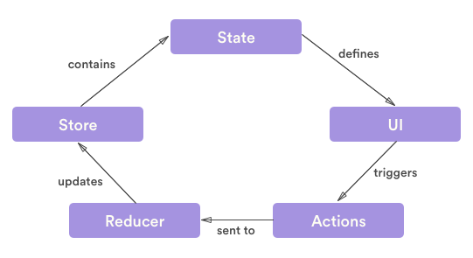
Redux Workflow

Slide 27
End

