Slide 1
Settl.ai
AI agents buy the APIs they need.
Their company controls the spend.
Miggy Rivera · _ra1ve
Velo x Noir hackathon / Stellar testnet MVP
Notes:
15 seconds. Settl.ai lets AI agents buy the APIs they need, within a budget their company controls. Built by Miggy Rivera (_ra1ve). Stellar testnet MVP.

Slide 2
The purchase between agent and API
An agent needs a paid tool
to finish its task.
The buyer needs a spending limit.
The provider needs a payment receipt.
02
Notes:
25 seconds. Imagine a bookkeeping agent that needs a paid receipt parser. Its company needs control over spend. The API seller needs a price and a verifiable payment record. These are the product problems this prototype addresses, not a claim of validated customer demand. Sources: README.md Problem; docs/superpowers/specs/2026-11-04-settl-api-mcp-design.md.

Slide 3
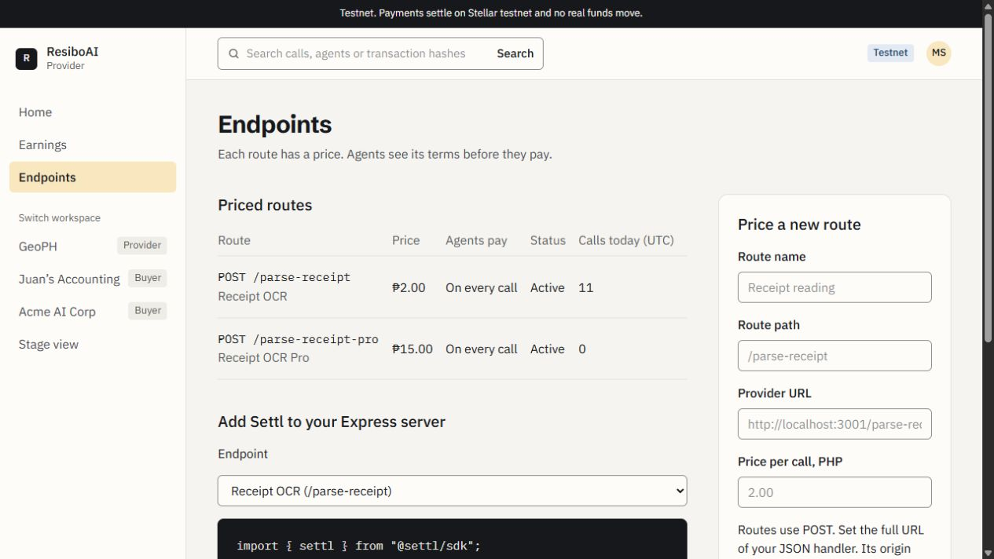
Settl connects the purchase
Providers price an API.
Buyers set the limits.
Agents request purchases.
Deployed testnet provider workspace
Notes:
25 seconds. Providers price a JSON endpoint and add @settl/sdk. The buyer sets an agent budget. The existing agent connects to hosted MCP or REST. The shared broker applies policy, authorizes payment and returns output with a receipt. Screenshots are actual deployed testnet demo data. Source: apps/web/lib/server/broker.ts; apps/web/lib/server/mcp-tools.ts; apps/resibo/src/server.ts.

Slide 4
A budget the agent must respect
PHP 2
Receipt OCR
Allowed within the example policy
PHP 15
Receipt OCR Pro
Declined against the PHP 10 maximum
PHP 8
GeoPH lookup
Needs approval above the PHP 5 threshold
04
Notes:
30 seconds. The example policy uses a PHP10 maximum and PHP5 automatic approval threshold. Receipt OCR is PHP2 per call. Pro at PHP15 is declined by Settl before payment. GeoPH at PHP8 needs a buyer approval, then the same approval ID resumes the request. The price refusal is off-chain, not evidence of an on-chain cap rejection. Noir separately enforces asset, per-payment cap and expiry. Sources: apps/web/lib/server/policy.ts; apps/web/prisma/seed.ts; apps/web/prisma/demo-usage-billing.ts.

Slide 5
Live demo: the agent requests payment
A tool request becomes
a controlled purchase.
Budget check, service discovery, then a PHP 2 request
Receipt and transaction hash, then a PHP 15 refusal
05
Notes:
90 seconds. Switch to the external Codex CLI connected to Settl MCP. Read budget and list services. Ask for one clean resibo_parse call with maxPricePhp 10.00. Show the actual returned status and transaction link. Ask for resibo_pro with maxPricePhp 10.00 and show declined / over_max_price. If rehearsed within time, show the PHP8 GeoPH approval and resume the exact approval ID once. Use real receipts only. Do not rerun pending or unknown requests. OCR fixtures are mock data, and the current product charges PHP2 per invocation regardless of fixture quality. Existing historical transactions or a backup recording must be identified as recorded. /stage is scripted, not live payment proof. Source: docs/CODEX_MCP_LIVE_DEMO.md.

Slide 6
Noir limits spend. Velo handles operations
Noir
Velo
Device identity
Agent cap, asset and expiry
Escrow authorization and claims
Checkout sessions and status
Signed payment callbacks
Gas sponsorship requests
Settl connects the two in application code.
06
Notes:
40 seconds. Noir SDK0.3.0 encodes the deployed testnet device, policy and escrow contract calls. The adapter signs and prepares with Stellar SDK17. Velo alpha.4 creates top-up checkouts, retrieves payment status, verifies raw-body signed callbacks and requests eligible gas sponsorship. Checkout confirmation and Noir escrow funding are separate operations connected by Settl treasury funding. Explicit sponsorship refusals can use a relayer and are labelled as fallback. The original hosted paid checkout still needs reconciliation, so do not claim fully verified hosted checkout-to-funding. Sources: packages/stellar/src/rpc.ts; packages/stellar/src/noir.ts; packages/stellar/src/gas.ts; apps/web/lib/server/velo.ts; HANDOFF.md.

Slide 7
First users and business model
API providers
and teams running agents
Entry point: one priced API, used by an existing MCP client
Model to validate: transaction fee or hosted gateway plan
07
Notes:
35 seconds. The first target users are API providers selling JSON tools and teams operating agents that need spending controls. Start with a provider integration and an existing MCP client, then measure repeated paid tool use. Possible revenue is a fee per settled purchase or a hosted gateway plan. These are hypotheses, not an implemented Settl fee, customers, revenue, traction, validated market size or commitments. Source: product model in README.md and docs/superpowers/specs/2026-11-04-settl-api-mcp-design.md.

Slide 8
The next purchase can use Settl
A paid tool.
A controlled budget.
A receipt both sides can inspect.
Seeking API builders and agent teams for a testnet pilot
settl-ai-pi.vercel.app
github.com/migsrvr/settl.ai
08
Notes:
40 seconds. Close by returning to the product: agent-initiated tool purchases with company-controlled budgets and a shared payment record. Ask API builders and agent operators to try a testnet pilot. State the next engineering milestones: finish hosted checkout reconciliation, replace fixture APIs, harden auth and custody, and operationalize recovery. No real funds. Built by Miggy Rivera, Discord _ra1ve. Live website https://settl-ai-pi.vercel.app; public repo https://github.com/migsrvr/settl.ai. No demo video yet.

Slide 9
Appendix: implementation and boundaries
Agent client uses MCP / REST to reach the shared broker
Next.js dashboards and API
Express fixture provider and SDK
Noir adapter, verifier and shared protocol
Prisma / PostgreSQL operation records
Testnet only. Custodial keys. Fixture API. Recovery needs an operator.
09
Notes:
Q&A only. Not part of the five-minute pitch. Three apps and four shared packages form the npm monorepo. MCP/REST share a broker backed by Prisma/PostgreSQL. The Express provider uses @settl/sdk. Off-chain reservations support optional result billing. Pending submission identities and source/agent locks avoid blind replacement payment. Offline tests use mocked integrations. Earlier Linux verification recorded 752 passing tests. Fresh Windows checks currently encounter missing native dependencies and workspace links, so do not claim current local green. Hosted demo login is not production auth. Sources: HANDOFF.md; docs/REPOSITORY_REVIEW.md; package.json; apps/web/prisma/schema.prisma.

Slide 10
Appendix: inspect the evidence
Agent authorization
fcb5d00a…86c3105 / PHP 2, earlier outcome demo
Approved purchase
44f3c9cd…e5e6d95 / PHP 8 GeoPH
Full explorer links are in the notes and the judging README.
10
Notes:
Q&A only. Historical Bookkeeper authorization: https://stellar.expert/explorer/testnet/tx/fcb5d00a5dc4af8d17c3e34f9294257de169ee9db9ed84eeaa8e6364e86c3105 . Human-approved GeoPH: https://stellar.expert/explorer/testnet/tx/44f3c9cdaf4ace58092146b09d05022e6b42e1849f445f2661ac8fb06e5e6d95 . Fresh deployed dashboard observation: Codex Purchasing Agent, PHP2 paid call, November6 18:05:23 UTC, transaction https://stellar.expert/explorer/testnet/tx/56a799be36aba98be4c8c33cf120fa542010cda0898b4ee9f0d9eec538711faa . This preparation initiated no payment and did not independently reverify those chain records. Handoff historical evidence uses earlier outcome mode. No production customer or revenue claims.

