Slide 1
The Term Vocabulary and Postings Lists
Lectured by Shangsong Liang
Sun Yat-sen University

Slide 2
Overview
Recap
Documents
Terms
General + Non-English
English
Skip pointers
Phrase queries

Slide 3
Outline
Recap
Documents
Terms
General + Non-English
English
Skip pointers
Phrase queries

Slide 4
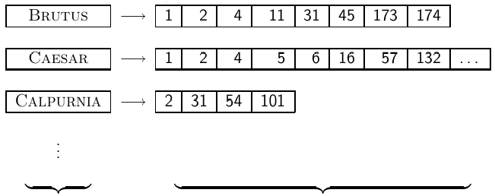
Inverted Index
For each term t, we store a list of all documents that contain t.
dictionary postings
4

Slide 5
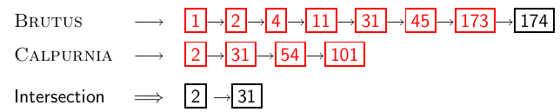
Intersecting two posting lists
5

Slide 6
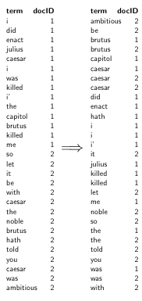
Constructing the inverted index: Sort postings
6

Slide 7
Westlaw: Example queries
Information need: Information on the legal theories involved in
preventing the disclosure of trade secrets by employees formerly
employed by a competing company Query: “trade secret” /s
disclos! /s prevent /s employe! Information need: Requirements
for disabled people to be able to access a workplace Query: disab! /p access! /s work-site work-place (employment /3 place)
Information need: Cases about a host’s responsibility for drunk
guests Query: host! /p (responsib! liab!) /p (intoxicat! drunk!)
/p guest
7

Slide 8
Does Google use the Boolean model?
On Google, the default interpretation of a query [w₁ w₂ . . .w_{n}] is w₁ AND w₂ AND . . .AND w_{n}
Cases where you get hits that do not contain one of the wi :
anchor text
page contains variant of w_{i} (morphology, spelling correction, synonym)
long queries (n large)
boolean expression generates very few hits
Simple Boolean vs. Ranking of result set
Simple Boolean retrieval returns matching documents in no particular order.
Google (and most well designed Boolean engines) rank the result set – they rank good hits (according to some estimator of relevance) higher than bad hits.
8

Slide 9
Take-away
Understanding of the basic unit of classical information retrieval systems: words and documents: What is a document, what is a term?
Tokenization: how to get from raw text to words (or tokens)
More complex indexes: skip pointers and phrases
9

Slide 10
Outline
Recap
Documents
Terms
General + Non-English
English
Skip pointers
Phrase queries

Slide 11
Documents
Last lecture: Simple Boolean retrieval system
Our assumptions were:
We know what a document is.
We can “machine-read” each document.
This can be complex in reality.
11

Slide 12
Parsing a document
We need to deal with format and language of each document.
What format is it in? pdf, word, excel, html etc.
What language is it in?
What character set is in use?
Each of these is a classification problem, which we will study later in this course (IIR 13).
Alternative: use heuristics
12

Slide 13
Format/Language: Complications
A single index usually contains terms of several languages.
Sometimes a document or its components contain multiple languages/formats.
French email with Spanish pdf attachment
What is the document unit for indexing?
A file?
An email?
An email with 5 attachments?
A group of files (ppt or latex in HTML)?
Upshot: Answering the question “what is a document?” is not trivial and requires some design decisions.
Also: XML
13

Slide 14
Outline
Recap
Documents
Terms
General + Non-English
English
Skip pointers
Phrase queries

Slide 15
Outline
Recap
Documents
Terms
General + Non-English
English
Skip pointers
Phrase queries

Slide 16
Definitions
Word – A delimited string of characters as it appears in the text.
Term – A “normalized” word (case, morphology, spelling etc); an equivalence class of words.
Token – An instance of a word or term occurring in a document.
Type – The same as a term in most cases: an equivalence class of tokens.
16

Slide 17
Normalization
Need to “normalize” terms in indexed text as well as query terms into the same form.
Example: We want to match U.S.A. and USA
We most commonly implicitly define equivalence classes of terms.
Alternatively: do asymmetric expansion
window → window, windows
windows → Windows, windows
Windows (no expansion)
More powerful, but less efficient
Why don’t you want to put window, Window, windows, and Windows in the same equivalence class?
17

Slide 18
Normalization: Other languages
Normalization and language detection interact.
PETER WILL NICHT MIT. → MIT = mit
He got his PhD from MIT. → MIT ≠ mit
18

Slide 19

Recall: Inverted index construction
Input:
Output:
Each token is a candidate for a postings entry.
What are valid tokens to emit?
19

Slide 20
Exercises
In June, the dog likes to chase the cat in the barn. – How many
word tokens? How many word types? Why tokenization is difficult
– even in English. Tokenize: Mr. O’Neill thinks that the boys’
stories about Chile’s capital aren’t amusing.
20

Slide 21
Tokenization problems: One word or two? (or several)
Hewlett-Packard
State-of-the-art
co-education
the hold-him-back-and-drag-him-away maneuver
data base
San Francisco
Los Angeles-based company
cheap San Francisco-Los Angeles fares
York University vs. New York University
21

Slide 22
Numbers
3/20/91
20/3/91
Mar 20, 1991
B-52
100.2.86.144
(800) 234-2333
800.234.2333
Older IR systems may not index numbers . . .
. . . but generally it’s a useful feature.
22

Slide 23
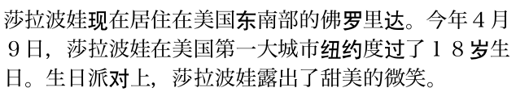
Chinese: No whitespace
23

Slide 24

Ambiguous segmentation in Chinese
The two characters can be treated as one word meaning ‘monk’ or as a sequence of two words meaning ‘and’ and ‘still’.
24

Slide 25
Other cases of “no whitespace”
Compounds in Dutch, German, Swedish
Computerlinguistik → Computer + Linguistik
Lebensversicherungsgesellschaftsangestellter
→ leben + versicherung + gesellschaft + angestellter
Inuit: tusaatsiarunnanngittualuujunga (I can’t hear very well.)
Many other languages with segmentation difficulties: Finnish, Urdu, . . .
25

Slide 26
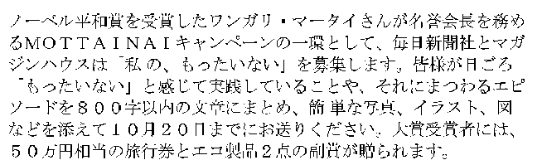
Japanese
4 different “alphabets”: Chinese characters, hiragana syllabary for inflectional endings and functional words, katakana syllabary for transcription of foreign words and other uses, and latin. No spaces (as in Chinese). End user can express query entirely in hiragana!
26

Slide 27
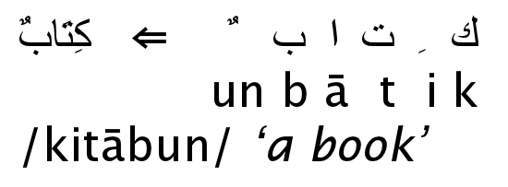
Arabic script
27

Slide 28
Arabic script: Bidirectionality
← → ← → ← START
‘Algeria achieved its independence in 1962 after 132 years of French occupation.’
Bidirectionality is not a problem if text is coded in Unicode.
28

Slide 29
Accents and diacritics
Accents: résumé vs. resume (simple omission of accent)
Umlauts: Universität vs. Universitaet (substitution with special letter sequence “ae”)
Most important criterion: How are users likely to write their queries for these words?
Even in languages that standardly have accents, users often do not type them. (Polish?)
29

Slide 30
Outline
Recap
Documents
Terms
General + Non-English
English
Skip pointers
Phrase queries

Slide 31
Case folding
Reduce all letters to lower case
Possible exceptions: capitalized words in mid-sentence
MIT vs. mit
Fed vs. fed
It’s often best to lowercase everything since users will use lowercase regardless of correct capitalization.
31

Slide 32
Stop words
stop words = extremely common words which would appear to be of little value in helping select documents matching a user need
Examples: a, an, and, are, as, at, be, by, for, from, has, he, in, is, it, its, of, on, that, the, to, was, were, will, with
Stop word elimination used to be standard in older IR systems.
But you need stop words for phrase queries, e.g. “King of Denmark”
Most web search engines index stop words.
32

Slide 33
More equivalence classing
Soundex: IIR 3 (phonetic equivalence, Muller = Mueller)
Thesauri: IIR 9 (semantic equivalence, car = automobile)
33

Slide 34
Lemmatization (词形归并)
Reduce inflectional/variant forms to base form
Example: am, are, is → be
Example: car, cars, car’s, cars’ → car
Example: the boy’s cars are different colors → the boy car be different color
Lemmatization implies doing “proper” reduction to dictionary headword form (the lemma).
Inflectional morphology (cutting → cut) vs. derivational morphology (destruction → destroy)
34

Slide 35
Stemming
Definition of stemming: Crude heuristic process that chops off the ends of words in the hope of achieving what “principled” lemmatization attempts to do with a lot of linguistic knowledge.
Language dependent
Often inflectional and derivational
Example for derivational: automate, automatic, automation all reduce to automat
35

Slide 36
Porter algorithm
Most common algorithm for stemming English
Results suggest that it is at least as good as other stemming options
Conventions + 5 phases of reductions
Phases are applied sequentially
Each phase consists of a set of commands.
Sample command: Delete final ement if what remains is longer than 1 character
replacement → replac
cement → cement
Sample convention: Of the rules in a compound command, select the one that applies to the longest suffix.
36

Slide 37
Porter stemmer: A few rules
Rule
SSES → SS
IES → I
SS → SS
S →
Example
caresses → caress
ponies → poni
caress → caress
cats → cat
37

Slide 38
Three stemmers: A comparison
Sample text: Such an analysis can reveal features that are not easil visible from the variations in the individual genes and
can lead to a picture of expression that is more
biologically transparent and accessible to interpretation
Porter stemmer: such an analysi can reveal featur that ar not easili visibl from the variat in the individu gene and can lead to
pictur of express that is more biolog transpar and
access to interpret
Lovins stemmer: such an analys can reve featur that ar not eas vis from th vari in th individu gen and can lead to a pictur of
expres that is mor biolog transpar and acces to
interpres
Paice stemmer: such an analys can rev feat that are not easy vis from
the vary in the individ gen and can lead to a pict of
express that is mor biolog transp and access to interpret
38

Slide 39
Does stemming improve effectiveness?
In general, stemming increases effectiveness for some queries, and decreases effectiveness for others.
Queries where stemming is likely to help: [tartan sweaters], [sightseeing tour san francisco] (equivalence classes: {sweater,sweaters}, {tour,tours})
Porter Stemmer equivalence class oper contains all of operate operating operates operation operative operatives operational.
Queries where stemming hurts: [operational AND research], [operating AND system], [operative AND dentistry]
39

Slide 40
Exercise: What does Google do?
Stop words
Normalization
Tokenization
Lowercasing
Stemming
Non-latin alphabets
Umlauts
Compounds
Numbers
40

Slide 41
Outline
Recap
Documents
Terms
General + Non-English
English
Skip pointers
Phrase queries

Slide 42
Recall basic intersection algorithm
Linear in the length of the postings lists.
Can we do better?
42

Slide 43
Skip pointers
Skip pointers allow us to skip postings that will not figure in the search results.
This makes intersecting postings lists more efficient.
Some postings lists contain several million entries – so efficiency can be an issue even if basic intersection is linear.
Where do we put skip pointers?
How do we make sure intersection results are correct?
43

Slide 44
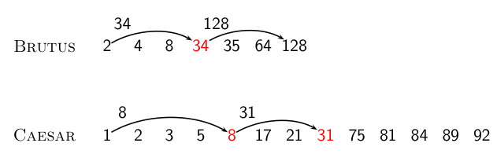
Basic idea
44

Slide 45
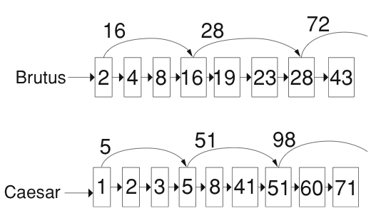
Skip lists: Larger example
45

Slide 46
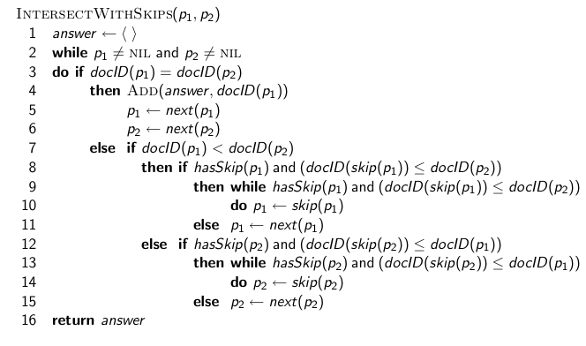
Intersection with skip pointers
46

Slide 47
Where do we place skips?
Tradeoff: number of items skipped vs. frequency skip can be taken
More skips: Each skip pointer skips only a few items, but we can frequently use it.
Fewer skips: Each skip pointer skips many items, but we can not use it very often.
47

Slide 48

Where do we place skips? (cont)
Simple heuristic: for postings list of length P, use evenly-spaced skip pointers.
This ignores the distribution of query terms.
Easy if the index is static; harder in a dynamic environment because of updates.
How much do skip pointers help?
They used to help a lot.
With today’s fast CPUs, they don’t help that much anymore.
48

Slide 49
Outline
Recap
Documents
Terms
General + Non-English
English
Skip pointers
Phrase queries

Slide 50
Phrase queries
We want to answer a query such as [stanford university] – as a phrase.
Thus The inventor Stanford Ovshinsky never went to university should not be a match.
The concept of phrase query has proven easily understood by users.
About 10% of web queries are phrase queries.
Consequence for inverted index: it no longer suffices to store docIDs in postings lists.
Two ways of extending the inverted index:
biword index
positional index
50

Slide 51
Biword indexes
Index every consecutive pair of terms in the text as a phrase.
For example, Friends, Romans, Countrymen would generate two biwords: “friends romans” and “romans countrymen”
Each of these biwords is now a vocabulary term.
Two-word phrases can now easily be answered.
51

Slide 52
Longer phrase queries
A long phrase like “stanford university palo alto” can be represented as the Boolean query “STANFORD UNIVERSITY” AND “UNIVERSITY PALO” AND “PALO ALTO”
We need to do post-filtering of hits to identify subset that actually contains the 4-word phrase.
52

Slide 53
Extended biwords
Parse each document and perform part-of-speech tagging
Bucket the terms into (say) nouns (N) and articles/prepositions (X)
Now deem any string of terms of the form NX*N to be an extended biword
Examples: catcher in the rye
N X X N
king of Denmark
N X N
Include extended biwords in the term vocabulary
Queries are processed accordingly
53

Slide 54
Issues with biword indexes
Why are biword indexes rarely used?
False positives, as noted above
Index blowup due to very large term vocabulary
54

Slide 55
Positional indexes
Positional indexes are a more efficient alternative to biword indexes.
Postings lists in a nonpositional index: each posting is just a docID
Postings lists in a positional index: each posting is a docID and a list of positions
55

Slide 56
Positional indexes: Example
Query: “to₁ be₂ or₃ not₄ to₅ be₆” TO, 993427:
‹ 1: ‹7, 18, 33, 72, 86, 231›;
2: ‹1, 17, 74, 222, 255›;
4: ‹8, 16, 190, 429, 433›;
5: ‹363, 367›;
7: ‹13, 23, 191›; . . . ›
BE, 178239:
‹ 1: ‹17, 25›;
4: ‹17, 191, 291, 430, 434›;
5: ‹14, 19, 101›; . . . › Document 4 is a match!
56

Slide 57
Proximity search
We just saw how to use a positional index for phrase searches.
We can also use it for proximity search.
For example: employment /4 place
Find all documents that contain EMPLOYMENT and PLACE within 4 words of each other.
Employment agencies that place healthcare workers are seeing growth is a hit.
Employment agencies that have learned to adapt now place healthcare workers is not a hit.
57

Slide 58
Proximity search
Use the positional index
Simplest algorithm: look at cross-product of positions of (i) EMPLOYMENT in document and (ii) PLACE in document
Very inefficient for frequent words, especially stop words
Note that we want to return the actual matching positions, not just a list of documents.
This is important for dynamic summaries etc.
58

Slide 59
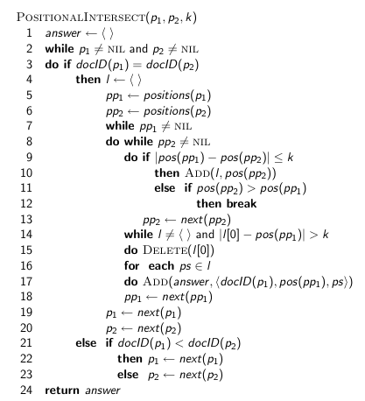
“Proximity” intersection
59

Slide 60
Combination scheme
Biword indexes and positional indexes can be profitably combined.
Many biwords are extremely frequent: Michael Jackson, Britney Spears etc
For these biwords, increased speed compared to positional postings intersection is substantial.
Combination scheme: Include frequent biwords as vocabulary terms in the index. Do all other phrases by positional intersection.
Williams et al. (2004) evaluate a more sophisticated mixed indexing scheme. Faster than a positional index, at a cost of 26% more space for index.
60

Slide 61
“Positional” queries on Google
For web search engines, positional queries are much more expensive than regular Boolean queries.
Let’s look at the example of phrase queries.
Why are they more expensive than regular Boolean queries?
Can you demonstrate on Google that phrase queries are more expensive than Boolean queries?
61

Slide 62
Take-away
Understanding of the basic unit of classical information retrieval systems: words and documents: What is a document, what is a term?
Tokenization: how to get from raw text to words (or tokens)
More complex indexes: skip pointers and phrases
62

Slide 63
Resources
Chapter 2 of IIR
Resources at http://ifnlp.org/ir
Porter stemmer
63

