Slide 1
Lecture 3: Dictionaries and tolerant retrieval
Lectured by Shangsong Liang
Sun Yat-sen University

Slide 2
Overview
Recap
Dictionaries
Wildcard queries
Edit distance
Spelling correction
Soundex

Slide 3
Outline
Recap
Dictionaries
Wildcard queries
Edit distance
Spelling correction
Soundex

Slide 4
Type/token distinction
Token – an instance of a word or term occurring in a document
Type – an equivalence class of tokens
In June, the dog likes to chase the cat in the barn.
12 word tokens, 9 word types
4

Slide 5
Problems in tokenization
What are the delimiters (定界符)? Space? Apostrophe(单引号)? Hyphen(连字符)?
For each of these: sometimes they delimit, sometimes they don’t.
No whitespace in many languages! (e.g., Chinese)
No whitespace in Dutch, German, Swedish compounds (Lebensversicherungsgesellschaftsangestellter)
5

Slide 6
Problems with equivalence classing
A term is an equivalence class of tokens.
How do we define equivalence classes?
Numbers (3/20/91 vs. 20/3/91)
Case folding
Stemming, Porter stemmer
Morphological analysis: inflectional vs. derivational
Equivalence classing problems in other languages
More complex morphology than in English
Finnish: a single verb may have 12,000 different forms
Accents, umlauts
6

Slide 7
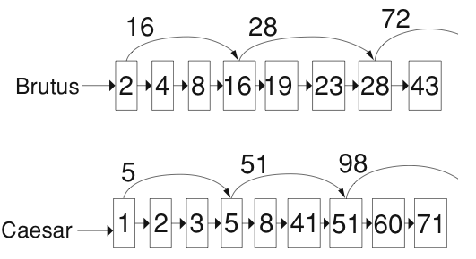
Skip pointers
7

Slide 8
Positional indexes
Postings lists in a nonpositional index: each posting is just a docID
Postings lists in a positional index: each posting is a docID and a list of positions
Example query: “to₁ be₂ or₃ not₄ to₅ be₆”
TO, 993427:
‹ 1: ‹7, 18, 33, 72, 86, 231›;
2: ‹1, 17, 74, 222, 255›;
4: ‹8, 16, 190, 429, 433›;
5: ‹363, 367›;
7: ‹13, 23, 191›; . . . ›
BE, 178239:
‹ 1: ‹17, 25›;
4: ‹17, 191, 291, 430, 434›;
5: ‹14, 19, 101›; . . . › Document 4 is a match!
8

Slide 9
Positional indexes
With a positional index, we can answer phrase queries.
With a positional index, we can answer proximity queries.
9

Slide 10
Take-away
Tolerant retrieval: What to do if there is no exact match between query term and document term
Wildcard queries
Spelling correction
10

Slide 11
Outline
Recap
Dictionaries
Wildcard queries
Edit distance
Spelling correction
Soundex

Slide 12
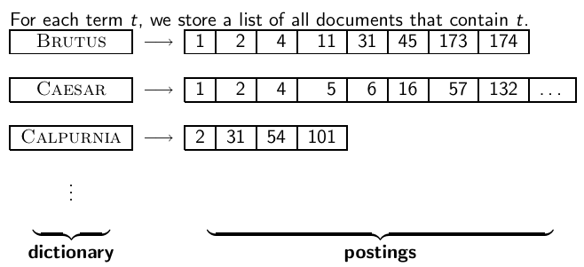
Inverted index
12

Slide 13
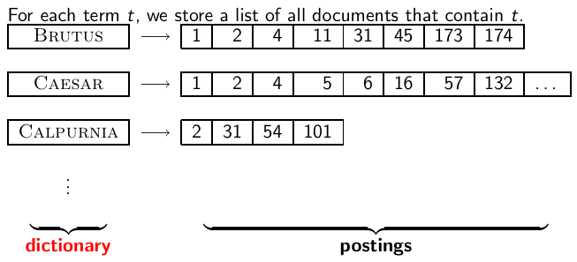
Inverted index
13

Slide 14
Dictionaries
The dictionary is the data structure for storing the term vocabulary.
Term vocabulary: the data
Dictionary: the data structure for storing the term vocabulary
14

Slide 15
Dictionary as array of fixed-width entries
For each term, we need to store a couple of items:
document frequency
pointer to postings list
. . .
Assume for the time being that we can store this information in a fixed-length entry.
Assume that we store these entries in an array.
15

Slide 16
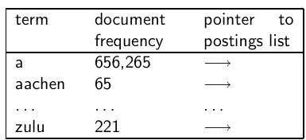
Dictionary as array of fixed-width entries
space needed: 20 bytes 4 bytes 4 bytes
How do we look up a query term q_{i} in this array at query time? That is: which data structure do we use to locate the entry (row) in the array where q_{i} is stored?
16

Slide 17
Data structures for looking up term
Two main classes of data structures: hashes and trees
Some IR systems use hashes, some use trees.
Criteria for when to use hashes vs. trees:
Is there a fixed number of terms or will it keep growing?
What are the relative frequencies with which various keys will be accessed?
How many terms are we likely to have?
17

Slide 18
Hashes
Each vocabulary term is hashed into an integer.
Try to avoid collisions
At query time, do the following: hash query term, resolve collisions, locate entry in fixed-width array
Pros: Lookup in a hash is faster than lookup in a tree.
Lookup time is constant.
Cons
no way to find minor variants (resume vs. résumé)
no prefix search (all terms starting with automat)
need to rehash everything periodically if vocabulary keeps growing
18

Slide 19
Trees
Trees solve the prefix problem (find all terms starting with automat).
Simplest tree: binary tree
Search is slightly slower than in hashes: O(logM), where M is the size of the vocabulary.
O(logM) only holds for balanced trees.
Rebalancing binary trees is expensive.
B-trees mitigate the rebalancing problem.
B-tree definition: every internal node has a number of children in the interval [a, b] where a, b are appropriate positive integers, e.g., [2, 4].
19

Slide 20
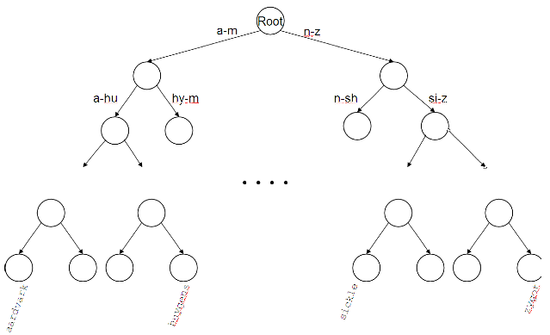
Binary tree
20

Slide 21
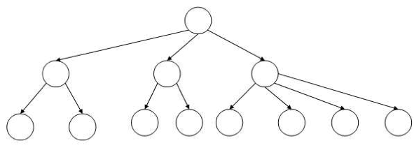
B-tree
21

Slide 22
Outline
Recap
Dictionaries
Wildcard queries
Edit distance
Spelling correction
Soundex

Slide 23
Wildcard queries
mon*: find all docs containing any term beginning with mon
Easy with B-tree dictionary: retrieve all terms t in the range: mon ≤ t < moo
*mon: find all docs containing any term ending with mon
Maintain an additional tree for terms backwards
Then retrieve all terms t in the range: nom ≤ t < non
Result: A set of terms that are matches for wildcard query
Then retrieve documents that contain any of these terms
23

Slide 24
How to handle * in the middle of a term
Example: m*nchen
We could look up m* and *nchen in the B-tree and intersect the two term sets.
Expensive
Alternative: permuterm index
Basic idea: Rotate every wildcard query, so that the * occurs at the end.
Store each of these rotations in the dictionary, say, in a B-tree
24

Slide 25
Permuterm index
For term HELLO: add hello$, ello$h, llo$he, lo$hel, and o$hell to the B-tree where $ is a special symbol
25

Slide 26
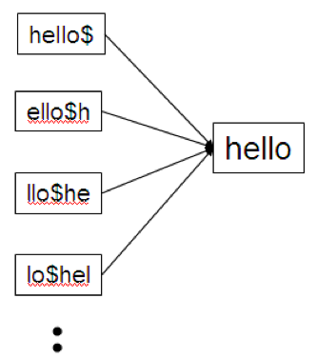
Permuterm → term mapping
26

Slide 27
Permuterm index
For HELLO, we’ve stored: hello$, ello$h, llo$he, lo$hel, and o$hell
Queries
For X, look up X$
For X*, look up X*$
For *X, look up X$*
For *X*, look up X*
For X*Y, look up Y$X*
Example: For hel*o, look up o$hel*
Permuterm index would better be called a permuterm tree.
But permuterm index is the more common name.
27

Slide 28
Processing a lookup in the permuterm index
Rotate query wildcard to the right
Use B-tree lookup as before
Problem: Permuterm more than quadruples the size of the dictionary compared to a regular B-tree. (empirical number)
28

Slide 29
k-gram indexes
More space-efficient than permuterm index
Enumerate all character k-grams (sequence of k characters) occurring in a term
2-grams are called bigrams.
Example: from April is the cruelest month we get the bigrams: $a ap pr ri il l$ $i is s$ $t th he e$ $c cr ru ue el le es st t$ $m mo on nt h$
$ is a special word boundary symbol, as before.
Maintain an inverted index from bigrams to the terms that contain the bigram
29

Slide 30

Postings list in a 3-gram inverted index
30

Slide 31
k-gram (bigram, trigram, . . . ) indexes
Note that we now have two different types of inverted indexes
The term-document inverted index for finding documents based on a query consisting of terms
The k-gram index for finding terms based on a query consisting of k-grams
31

Slide 32
Processing wildcarded terms in a bigram index
Query mon* can now be run as: $m AND mo AND on
Gets us all terms with the prefix mon . . .
. . . but also many “false positives” like MOON.
We must postfilter these terms against query.
Surviving terms are then looked up in the term-document inverted index.
k-gram index vs. permuterm index
k-gram index is more space efficient.
Permuterm index doesn’t require postfiltering.
32

Slide 33
Exercise
Google has very limited support for wildcard queries.
For example, this query doesn’t work very well on Google: [gen* universit*]
Intention: you are looking for the University of Geneva, but don’t know which accents to use for the French words for university and Geneva.
According to Google search basics, 2010-04-29: “Note that the * operator works only on whole words, not parts of words.”
But this is not entirely true. Try [pythag*] and [m*nchen]
Exercise: Why doesn’t Google fully support wildcard queries?
33

Slide 34
Processing wildcard queries in the term-document index
Problem 1: we must potentially execute a large number of Boolean queries.
Most straightforward semantics: Conjunction of disjunctions
For [gen* universit*]: geneva university OR geneva université OR genève university OR genève université OR general universities OR . . .
Very expensive
Problem 2: Users hate to type.
If abbreviated queries like [pyth* theo*] for [pythagoras’ theorem] are allowed, users will use them a lot.
This would significantly increase the cost of answering queries.
Somewhat alleviated by Google Suggest
34

Slide 35
Outline
Recap
Dictionaries
Wildcard queries
Edit distance
Spelling correction
Soundex

Slide 36
Spelling correction
Two principal uses
Correcting documents being indexed
Correcting user queries
Two different methods for spelling correction
Isolated word spelling correction
Check each word on its own for misspelling
Will not catch typos resulting in correctly spelled words, e.g., an asteroid that fell form the sky
Context-sensitive spelling correction
Look at surrounding words
Can correct form/from error above
36

Slide 37
Correcting documents
We’re not interested in interactive spelling correction of documents (e.g., MS Word) in this class.
In IR, we use document correction primarily for OCR’ed documents. (OCR = optical character recognition)
The general philosophy in IR is: don’t change the documents.
37

Slide 38
Correcting queries
First: isolated word spelling correction
Premise 1: There is a list of “correct words” from which the correct spellings come.
Premise 2: We have a way of computing the distance between a misspelled word and a correct word.
Simple spelling correction algorithm: return the “correct” word that has the smallest distance to the misspelled word.
Example: informaton → information
For the list of correct words, we can use the vocabulary of all words that occur in our collection.
Why is this problematic?
38

Slide 39
Alternatives to using the term vocabulary
A standard dictionary (Webster’s, OED etc.)
An industry-specific dictionary (for specialized IR systems)
The term vocabulary of the collection, appropriately weighted
39

Slide 40
Distance between misspelled word and “correct” word
We will study several alternatives.
Edit distance and Levenshtein distance
Weighted edit distance
k-gram overlap
40

Slide 41
Edit distance
The edit distance between string s₁ and string s₂ is the minimum number of basic operations that convert s₁ to s₂.
Levenshtein distance: The admissible basic operations are insert, delete, and replace
Levenshtein distance dog-do: 1
Levenshtein distance cat-cart: 1
Levenshtein distance cat-cut: 1
Levenshtein distance cat-act: 2
Damerau-Levenshtein distance cat-act: 1
Damerau-Levenshtein includes transposition as a fourth possible operation.
41

Slide 42
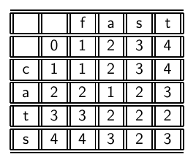
Levenshtein distance: Computation
42

Slide 43
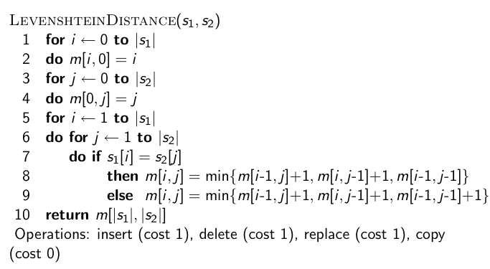
Levenshtein distance: Algorithm
43

Slide 44
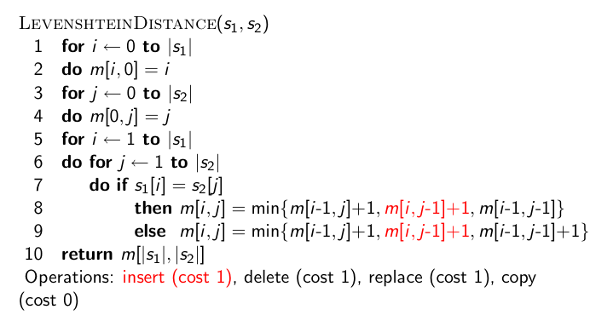
Levenshtein distance: Algorithm
44

Slide 45
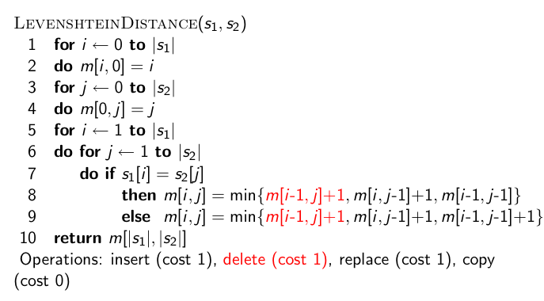
Levenshtein distance: Algorithm
45

Slide 46
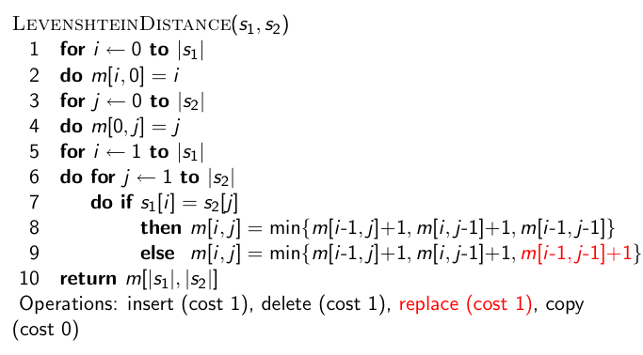
Levenshtein distance: Algorithm
46

Slide 47
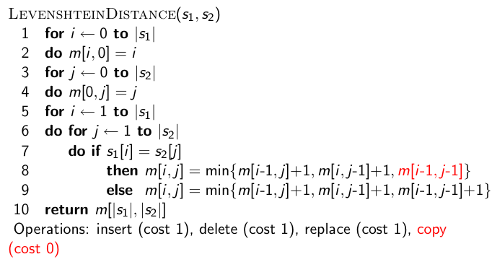
Levenshtein distance: Algorithm
47

Slide 48
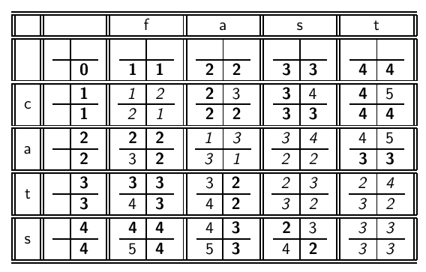
Levenshtein distance: Example
48

Slide 49
Each cell of Levenshtein matrix
cost of getting here from my upper left neighbor (copy or replace) | cost of getting here from my upper neighbor (delete)
cost of getting here from my left neighbor (insert) | the minimum of the three possible “movements”; the cheapest way of getting here
49

Slide 50
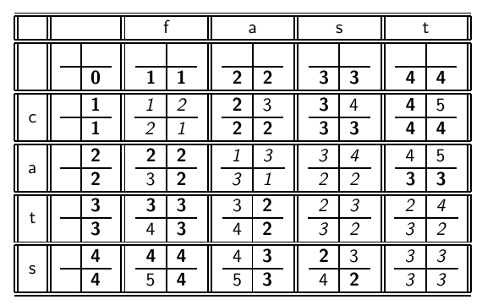
Levenshtein distance: Example
50

Slide 51
Dynamic programming (Cormen et al.)
Optimal substructure: The optimal solution to the problem contains within it subsolutions, i.e., optimal solutions to subproblems.
Overlapping subsolutions: The subsolutions overlap. These subsolutions are computed over and over again when computing the global optimal solution in a brute-force algorithm.
Subproblem in the case of edit distance: what is the edit distance of two prefixes
Overlapping subsolutions: We need most distances of prefixes 3 times – this corresponds to moving right, diagonally, down.
51

Slide 52
Weighted edit distance
As above, but weight of an operation depends on the characters involved.
Meant to capture keyboard errors, e.g., m more likely to be mistyped as n than as q.
Therefore, replacing m by n is a smaller edit distance than by q.
We now require a weight matrix as input.
Modify dynamic programming to handle weights
52

Slide 53
Using edit distance for spelling correction
Given query, first enumerate all character sequences within a preset (possibly weighted) edit distance
Intersect this set with our list of “correct” words
Then suggest terms in the intersection to the user.
→ exercise in a few slides
53

Slide 54
Exercise
Compute Levenshtein distance matrix for OSLO – SNOW
What are the Levenshtein editing operations that transform cat into catcat?
54

Slide 55
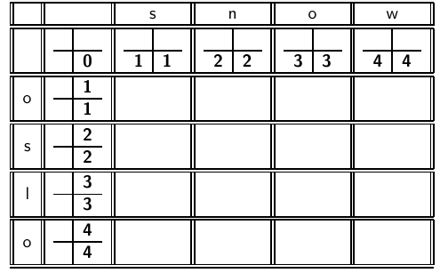
55

Slide 56
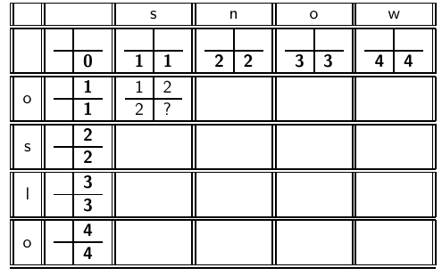
56

Slide 57
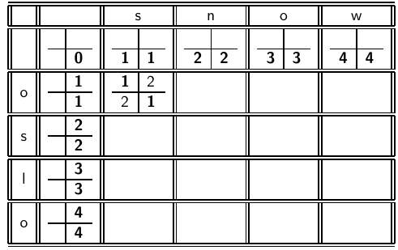
57

Slide 58
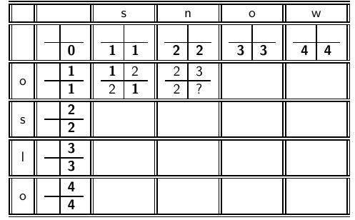
58

Slide 59
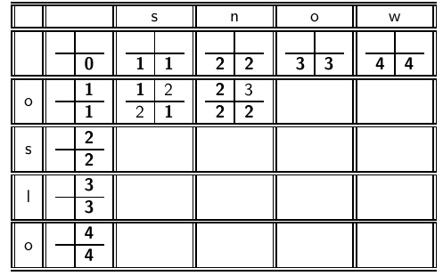
59

Slide 60
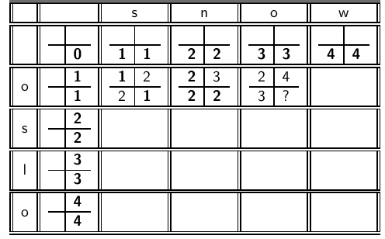
60

Slide 61
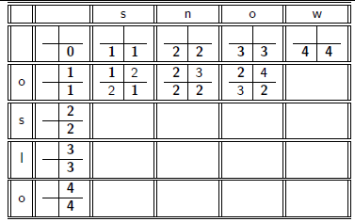
61

Slide 62
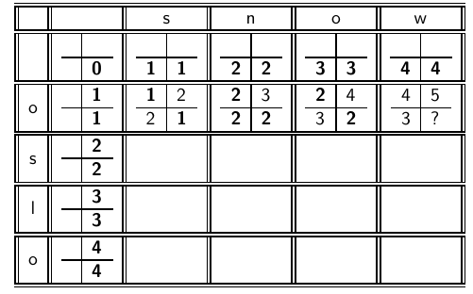
62

Slide 63
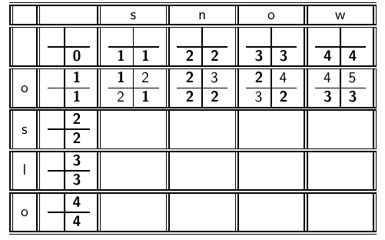
63

Slide 64
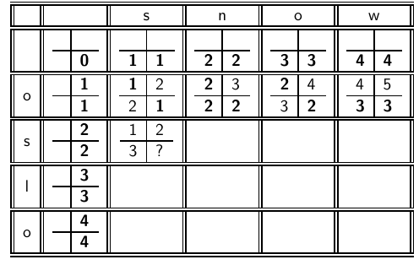
64

Slide 65
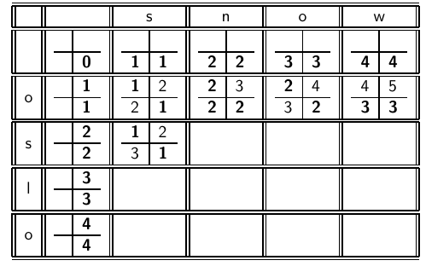
65

Slide 66
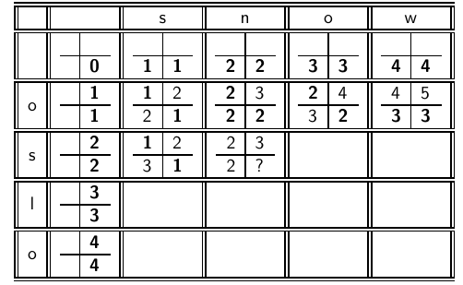
66

Slide 67
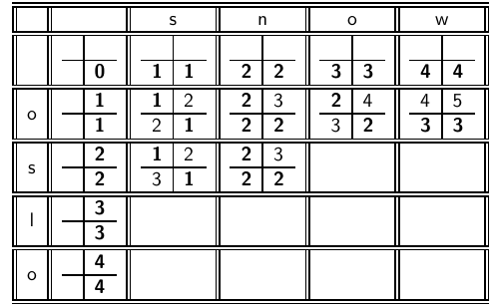
67

Slide 68
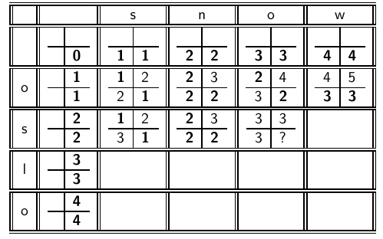
68

Slide 69
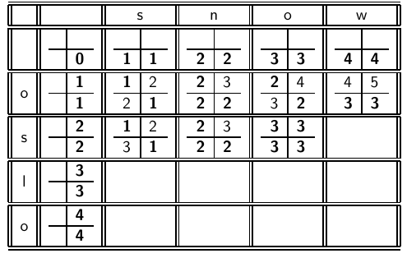
69

Slide 70
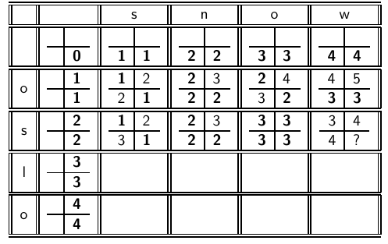
70

Slide 71
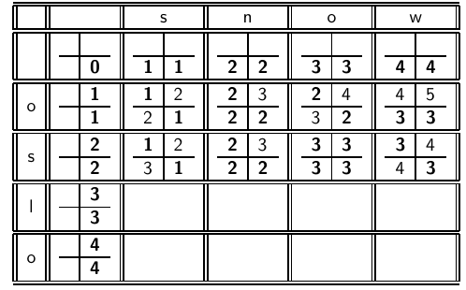
71

Slide 72
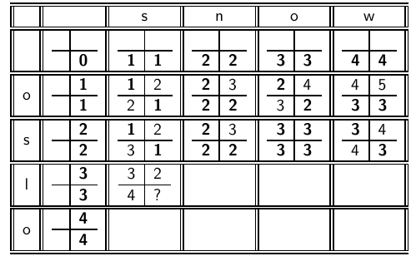
72

Slide 73
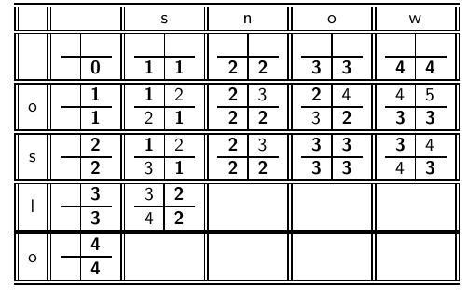
73

Slide 74
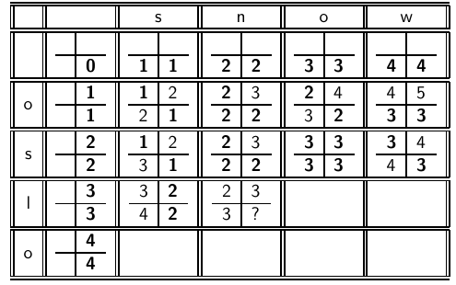
74

Slide 75
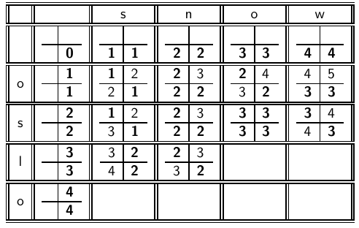
75

Slide 76
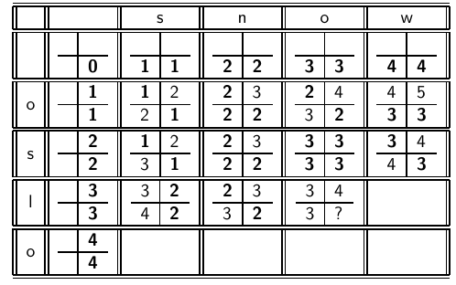
76

Slide 77
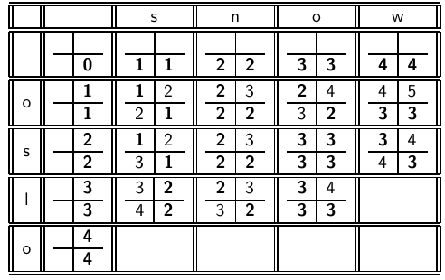
77

Slide 78
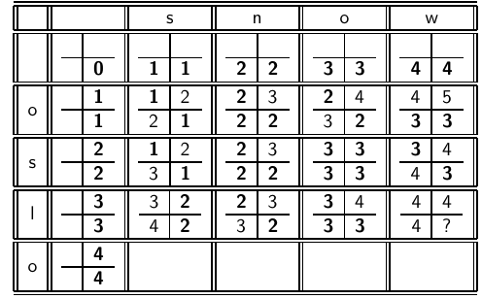
78

Slide 79
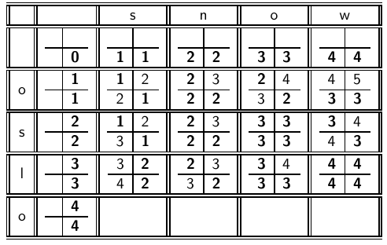
79

Slide 80
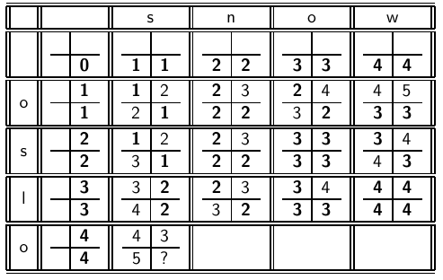
80

Slide 81
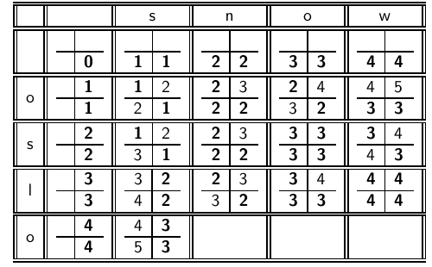
81

Slide 82
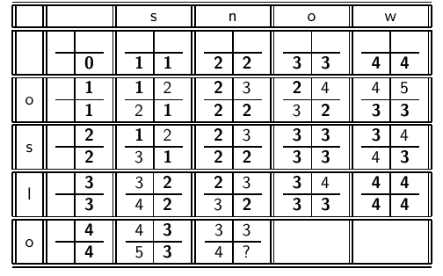
82

Slide 83
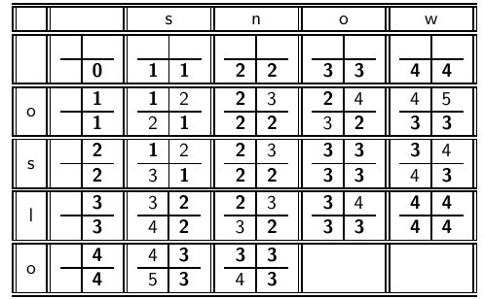
83

Slide 84
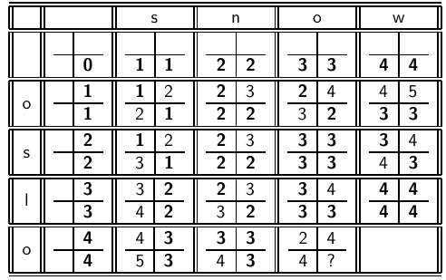
84

Slide 85
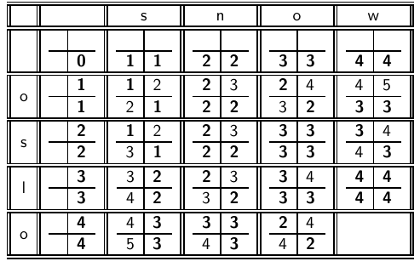
85

Slide 86
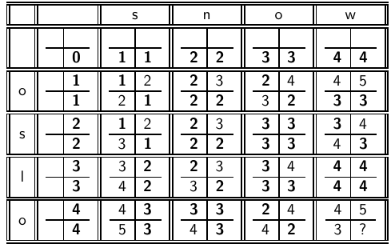
86

Slide 87
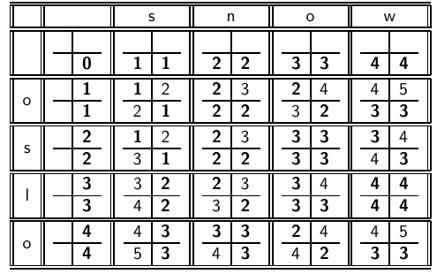
87

Slide 88
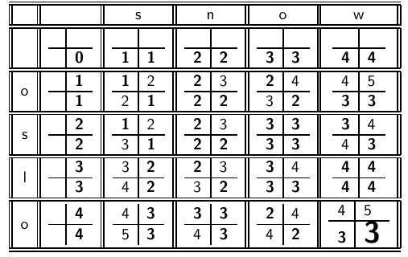
88

Slide 89
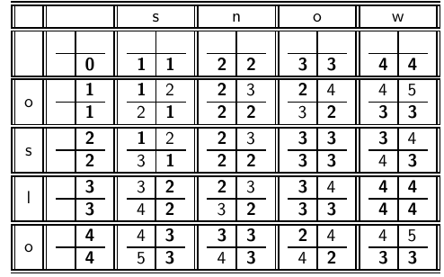
How do
I read out the editing operations that transform OSLO into SNOW?
89

Slide 90


90

Slide 91


91

Slide 92


92

Slide 93


93

Slide 94


94

Slide 95

95

Slide 96


96

Slide 97


97

Slide 98


98

Slide 99


99

Slide 100
Outline
Recap
Dictionaries
Wildcard queries
Edit distance
Spelling correction
Soundex

Slide 101
Spelling correction
Now that we can compute edit distance: how to use it for isolated word spelling correction – this is the last slide in this section.
k-gram indexes for isolated word spelling correction.
Context-sensitive spelling correction
General issues
101

Slide 102
k-gram indexes for spelling correction
Enumerate all k-grams in the query term
Example: bigram index, misspelled word bordroom
Bigrams: bo, or, rd, dr, ro, oo, om
Use the k-gram index to retrieve “correct” words that match query term k-grams
Threshold by number of matching k-grams
E.g., only vocabulary terms that differ by at most 3 k-grams
102

Slide 103

k-gram indexes for spelling correction: bordroom
103

Slide 104
Context-sensitive spelling correction
Our example was: an asteroid that fell form the sky
How can we correct form here?
One idea: hit-based spelling correction
Retrieve “correct” terms close to each query term
for flew form munich: flea for flew, from for form, munch for
munich
Now try all possible resulting phrases as queries with one word “fixed” at a time
Try query “flea form munich”
Try query “flew from munich”
Try query “flew form munch”
The correct query “flew from munich” has the most hits.
Suppose we have 7 alternatives for flew, 20 for form and 3 for munich, how many “corrected” phrases will we enumerate?
104

Slide 105
Context-sensitive spelling correction
The “hit-based” algorithm we just outlined is not very efficient.
More efficient alternative: look at “collection” of queries, not documents
105

Slide 106
General issues in spelling correction
User interface
automatic vs. suggested correction
Did you mean only works for one suggestion.
What about multiple possible corrections?
Tradeoff: simple vs. powerful UI
Cost
Spelling correction is potentially expensive.
Avoid running on every query?
Maybe just on queries that match few documents.
Guess: Spelling correction of major search engines is efficient enough to be run on every query.
106

Slide 107

Exercise: Understand Peter Norvig’s
spelling corrector
107

Slide 108
Outline
Recap
Dictionaries
Wildcard queries
Edit distance
Spelling correction
Soundex

Slide 109
Soundex
Soundex is the basis for finding phonetic (as opposed to orthographic) alternatives.
Example: chebyshev / tchebyscheff
Algorithm:
Turn every token to be indexed into a 4-character reduced form
Do the same with query terms
Build and search an index on the reduced forms
109

Slide 110
Soundex algorithm
Retain the first letter of the term.
Change all occurrences of the following letters to ’0’ (zero): A, E, I, O, U, H, W, Y
Change letters to digits as follows:
B, F, P, V to 1
C, G, J, K, Q, S, X, Z to 2
D,T to 3
L to 4
M, N to 5
R to 6
Repeatedly remove one out of each pair of consecutive identical digits
Remove all zeros from the resulting string; pad the resulting string
with trailing zeros and return the first four positions, which will
consist of a letter followed by three digits
110

Slide 111
Example: Soundex of HERMAN
Retain H
ERMAN → 0RM0N
0RM0N → 06505
06505 → 06505
06505 → 655
Return H655
Note: HERMANN will generate the same code
111

Slide 112
How useful is Soundex?
Not very – for information retrieval
Ok for “high recall” tasks in other applications (e.g., Interpol)
Zobel and Dart (1996) suggest better alternatives for phonetic matching in IR.
112

Slide 113
Exercise
Compute Soundex code of your last name
113

Slide 114
Take-away
Tolerant retrieval: What to do if there is no exact match between query term and document term
Wildcard queries
Spelling correction
114

Slide 115
Resources
Chapter 3 of IIR
Resources at http://ifnlp.org/ir
Soundex demo
Levenshtein distance demo
Peter Norvig’s spelling corrector
115

