Slide 1
Index Construction
Shangsong Liang
Sun Yat-sen University
From Hinrich Schütze and Christina Lioma

Slide 2
Overview
Recap
Introduction
BSBI algorithm
SPIMI algorithm
Distributed indexing
Dynamic indexing

Slide 3
Outline
Recap
Introduction
BSBI algorithm
SPIMI algorithm
Distributed indexing
Dynamic indexing

Slide 4
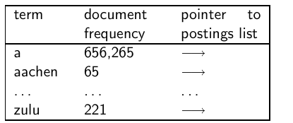
Dictionary as array of fixed-width entries
space needed: 20 bytes 4 bytes 4 bytes
4

Slide 5
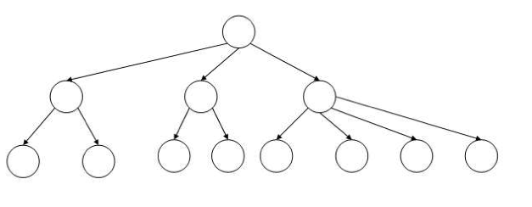
B-tree for looking up entries in array
5

Slide 6
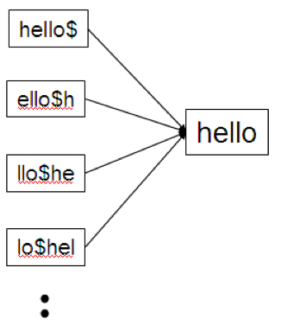
Wildcard queries using a permuterm index
Queries:
For X, look up X$
For X*, look up X*$
For *X, look up X$*
For *X*, look up X*
For X*Y, look up Y$X*
6

Slide 7
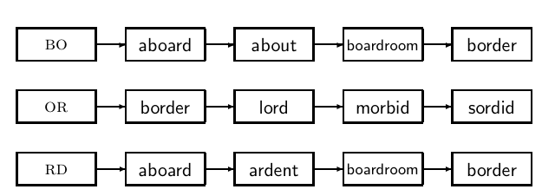
k-gram indexes for spelling correction: bordroom
7

Slide 8
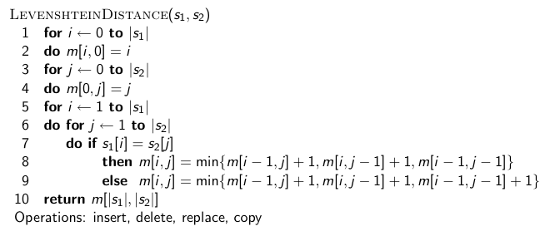
Levenshtein distance for spelling correction
8

Slide 9
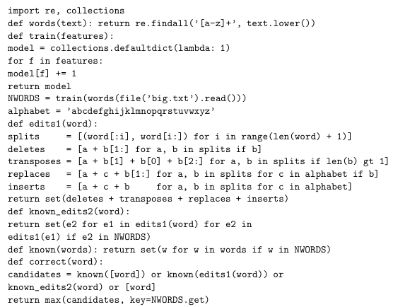
Exercise: Understand Peter Norvig’s
spelling corrector
9

Slide 10
Take-away
Two index construction algorithms: BSBI (Blocked Sort-based Indexing, simple) and SPIMI (Single-pass In-memory Indexing, more realistic)
Distributed index construction: MapReduce
Dynamic index construction: how to keep the index up-to-date as the collection changes
10

Slide 11
Outline
Recap
Introduction
BSBI algorithm
SPIMI algorithm
Distributed indexing
Dynamic indexing

Slide 12
Hardware basics
Many design decisions in information retrieval are based on hardware constraints.
We begin by reviewing hardware basics that we’ll need in this course.
12

Slide 13
Hardware basics
Access to data is much faster in memory than on disk. (roughly a factor of 10)
Disk seeks are “idle” time: No data is transferred from disk while the disk head is being positioned.
To optimize transfer time from disk to memory: one large chunk is faster than many small chunks.
Disk I/O is block-based: Reading and writing of entire blocks (as opposed to smaller chunks). Block sizes: 8KB to 256 KB
Servers used in IR systems typically have several GB of main memory, sometimes tens of GB, and TBs or 100s of GB of disk space.
Fault tolerance is expensive: It’s cheaper to use many regular machines than one fault tolerant machine.
13

Slide 14
Some stats (ca. 2008)
symbol | statistic | value
s b P | average seek time transfer time per byte processor’s clock rate lowlevel operation (e.g., compare & swap a word) size of main memory size of disk space | 5 ms = 5 × 10⁻³ s 0.02 μs = 2 × 10⁻⁸ s 10⁹ s⁻¹ 0.01 μs = 10⁻⁸ s several GB 1 TB or more
14

Slide 15
RCV1 collection
Shakespeare’s collected works are not large enough for demonstrating many of the points in this course.
As an example for applying scalable index construction algorithms, we will use the Reuters RCV1 collection.
English newswire articles sent over the wire in 1995 and 1996 (one year).
15

Slide 16
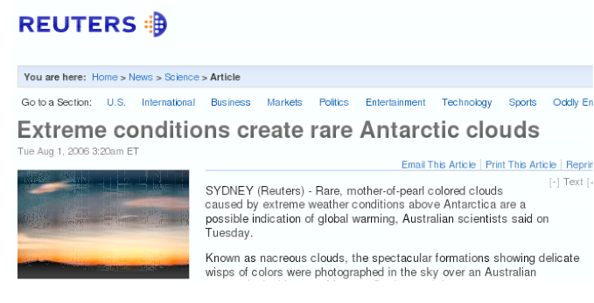
A Reuters RCV1 document
16

Slide 17
Reuters RCV1 statistics
N L M T | documents tokens per document terms (= word types) bytes per token (incl. spaces/punct.) bytes per token (without spaces/punct.) bytes per term (= word type) non-positional postings | 800,000 200 400,000 6 4.5 7.5 100,000,000
Exercise: Average frequency of a term (how many tokens)? 4.5
bytes per word token vs. 7.5 bytes per word type: why the
difference? How many positional postings?
17

Slide 18
Outline
Recap
Introduction
BSBI algorithm
SPIMI algorithm
Distributed indexing
Dynamic indexing

Slide 19
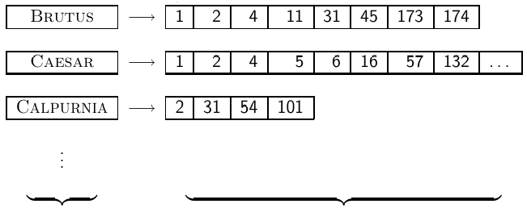
Goal: construct the inverted Index
dictonary postings
19

Slide 20
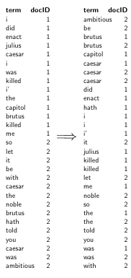
Index construction in IIR 1:
Sort postings in memory
20

Slide 21
Sort-based index construction
As we build index, we parse docs one at a time.
The final postings for any term are incomplete until the end.
Can we keep all postings in memory and then do the sort in-memory at the end?
No, not for large collections
At 10–12 bytes per postings entry, we need a lot of space for large collections.
T = 100,000,000 in the case of RCV1: we can do this in memory on a typical machine in 2010.
But in-memory index construction does not scale for large collections.
Thus: We need to store intermediate results on disk.
21

Slide 22
Same algorithm for disk?
Can we use the same index construction algorithm for larger collections, but by using disk instead of memory?
No: Sorting T = 100,000,000 records on disk is too slow – too many disk seeks.
We need an external sorting algorithm.
22

Slide 23
“External” sorting algorithm
(using few disk seeks)
We must sort T = 100,000,000 non-positional postings.
Each posting has size 12 bytes (4+4+4: termID, docID, document frequency).
Define a block to consist of 10,000,000 such postings
We can easily fit that many postings into memory.
We will have 10 such blocks for RCV1.
Basic idea of algorithm:
For each block: (i) accumulate postings, (ii) sort in memory, (iii) write to disk
Then merge the blocks into one long sorted order.
23

Slide 24
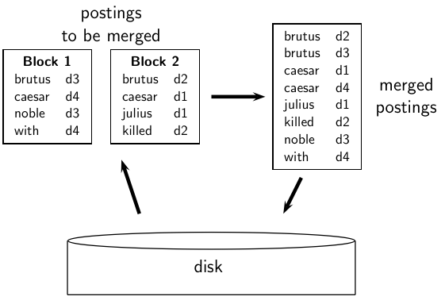
Merging two blocks
24

Slide 25
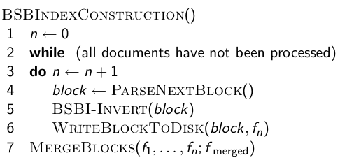
Blocked Sort-Based Indexing
Key decision: What is the size of one block?
25

Slide 26
Outline
Recap
Introduction
BSBI algorithm
SPIMI algorithm
Distributed indexing
Dynamic indexing

Slide 27
Problem with sort-based algorithm
Our assumption was: we can keep the dictionary in memory.
We need the dictionary (which grows dynamically) in order to implement a term to termID mapping.
Actually, we could work with term,docID postings instead of termID,docID postings . . .
. . . but then intermediate files become very large. (We would end up with a scalable, but very slow index construction method.)
27

Slide 28
Single-pass in-memory indexing
Abbreviation: SPIMI
Key idea 1: Generate separate dictionaries for each block – no need to maintain term-termID mapping across blocks.
Key idea 2: Don’t sort. Accumulate postings in postings lists as they occur.
With these two ideas we can generate a complete inverted index for each block.
These separate indexes can then be merged into one big index.
28

Slide 29
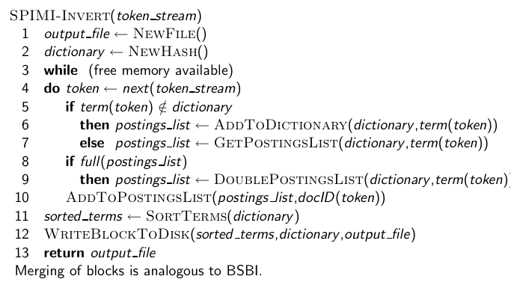
SPIMI-Invert
29

Slide 30
SPIMI: Compression
Compression makes SPIMI even more efficient.
Compression of terms
Compression of postings
See next lecture
30

Slide 31
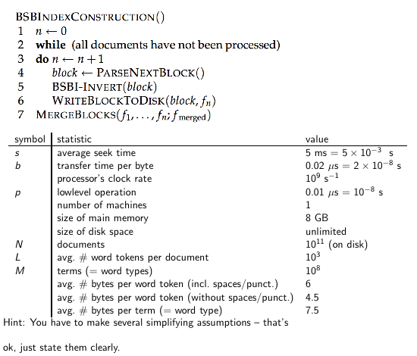
Exercise: Time 1 machine needs for Google size collection
31

Slide 32
Outline
Recap
Introduction
BSBI algorithm
SPIMI algorithm
Distributed indexing
Dynamic indexing

Slide 33
Distributed indexing
For web-scale indexing (don’t try this at home!): must use a distributed computer cluster
Individual machines are fault-prone.
Can unpredictably slow down or fail.
How do we exploit such a pool of machines?
33

Slide 34
Google data centers (2007 estimates; Gartner)
Google data centers mainly contain commodity machines.
Data centers are distributed all over the world.
1 million servers, 3 million processors/cores
Google installs 100,000 servers each quarter.
Based on expenditures of 200–250 million dollars per year
This would be 10% of the computing capacity of the world!
If in a non-fault-tolerant system with 1000 nodes, each node has 99.9% uptime, what is the uptime of the system (assuming it does not tolerate failures)?
Answer: 63%
Suppose a server will fail after 3 years. For an installation of 1 million servers, what is the interval between machine failures?
Answer: less than two minutes
34

Slide 35
Distributed indexing
Maintain a master machine directing the indexing job – considered “safe”
Break up indexing into sets of parallel tasks
Master machine assigns each task to an idle machine from a pool.
35

Slide 36
Parallel tasks
We will define two sets of parallel tasks and deploy two types of machines to solve them:
Parsers
Inverters
Break the input document collection into splits (corresponding to blocks in BSBI/SPIMI)
Each split is a subset of documents.
36

Slide 37
Parsers
Master assigns a split to an idle parser machine.
Parser reads a document at a time and emits (term,docID)-pairs.
Parser writes pairs into j term-partitions.
Each for a range of terms’ first letters
E.g., a-f, g-p, q-z (here: j = 3)
37

Slide 38
Inverters
An inverter collects all (term,docID) pairs (= postings) for one term-partition (e.g., for a-f).
Sorts and writes to postings lists
38

Slide 39
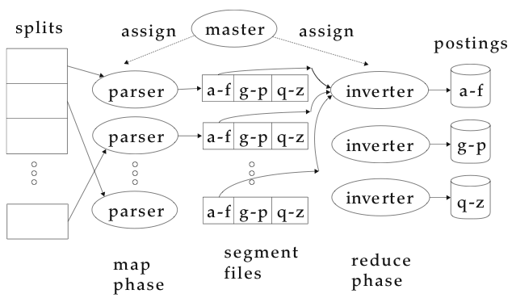
Data flow （Example of Distributed Indexing）
39

Slide 40
MapReduce
The index construction algorithm we just described is an instance of MapReduce.
MapReduce is a robust and conceptually simple framework for distributed computing . . .
. . .without having to write code for the distribution part.
The Google indexing system (ca. 2002) consisted of a number of phases, each implemented in MapReduce.
Index construction was just one phase.
Another phase: transform term-partitioned into document-partitioned index.
40

Slide 41
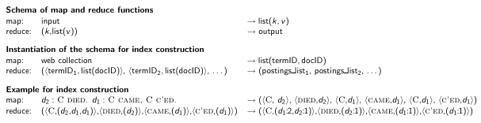
Index construction in MapReduce
41

Slide 42
Exercise
What information does the task description contain that the master gives to a parser?
What information does the parser report back to the master upon completion of the task?
What information does the task description contain that the master gives to an inverter?
What information does the inverter report back to the master upon completion of the task?
42

Slide 43
Outline
Recap
Introduction
BSBI algorithm
SPIMI algorithm
Distributed indexing
Dynamic indexing

Slide 44
Dynamic indexing
Up to now, we have assumed that collections are static.
They rarely are: Documents are inserted, deleted and modified.
This means that the dictionary and postings lists have to be dynamically modified.
44

Slide 45
Dynamic indexing: Simplest approach
Maintain big main index on disk
New docs go into small auxiliary index in memory.
Search across both, merge results
Periodically, merge auxiliary index into big index
Deletions:
Invalidation bit-vector for deleted docs
Filter docs returned by index using this bit-vector
45

Slide 46
Issue with auxiliary and main index
Frequent merges
Poor search performance during index merge
Actually:
Merging of the auxiliary index into the main index is not that costly if we keep a separate file for each postings list.
Merge is the same as a simple append.
But then we would need a lot of files – inefficient.
Assumption for the rest of the lecture: The index is one big file.
In reality: Use a scheme somewhere in between (e.g., split very large postings lists into several files, collect small postings lists in one file etc.)
46

Slide 47
Logarithmic merge
Logarithmic merging amortizes the cost of merging indexes over time.
→ Users see smaller effect on response times.
Maintain a series of indexes, each twice as large as the previous one.
Keep smallest (Z₀) in memory
Larger ones (I₀, I₁, . . . ) on disk
If Z₀ gets too big (> n), write to disk as I₀
. . . or merge with I₀ (if I₀ already exists) and write merger to I₁ etc.
47

Slide 48
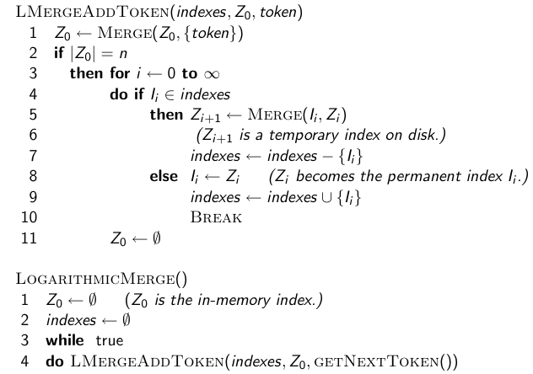
48

Slide 49
Binary numbers: I₃I₂I₁I₀ = 2³2²2¹2⁰
0001
0010
0011
0100
0101
0110
0111
1000
1001
1010
1011
1100
49

Slide 50
Logarithmic merge
Number of indexes bounded by O(log T) (T is total number of postings read so far)
So query processing requires the merging of O(log T) indexes
Time complexity of index construction is O(T log T).
. . . because each of T postings is merged O(log T) times.
Auxiliary index: index construction time is O(T²) as each posting is touched in each merge.
Suppose auxiliary index has size a
So logarithmic merging is an order of magnitude more efficient.
50

Slide 51
Dynamic indexing at large search engines
Often a combination
Frequent incremental changes
Rotation of large parts of the index that can then be swapped in
Occasional complete rebuild (becomes harder with increasing size – not clear if Google can do a complete rebuild)
51

Slide 52
Building positional indexes
Basically the same problem except that the intermediate data structures are large.
52

Slide 53
Take-away
Two index construction algorithms: BSBI (simple) and SPIMI (more realistic)
Distributed index construction: MapReduce
Dynamic index construction: how to keep the index up-to-date as the collection changes
53

Slide 54
Resources
Chapter 4 of IIR
Resources at http://ifnlp.org/ir
Original publication on MapReduce by Dean and Ghemawat (2004)
Original publication on SPIMI by Heinz and Zobel (2003)
YouTube video: Google data centers
54

