Slide 1
Index Compression
Shangsong Liang
Sun Yat-sen University
From Hinrich Schütze and Christina Lioma

Slide 2
Overview
Recap
Compression
Term statistics
Dictionary compression
Postings compression

Slide 3
Outline
Recap
Compression
Term statistics
Dictionary compression
Postings compression

Slide 4
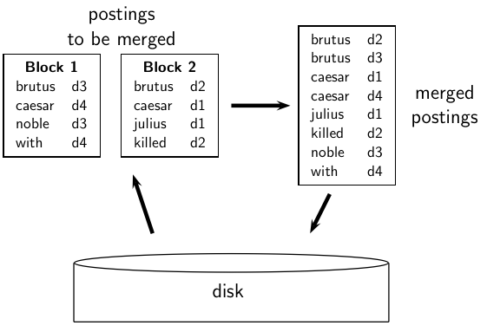
Blocked Sort-Based Indexing
4

Slide 5
Single-pass in-memory indexing
Abbreviation: SPIMI
Key idea 1: Generate separate dictionaries for each block – no need to maintain term-termID mapping across blocks.
Key idea 2: Don’t sort. Accumulate postings in postings lists as they occur.
With these two ideas we can generate a complete inverted index for each block.
These separate indexes can then be merged into one big index.
5

Slide 6
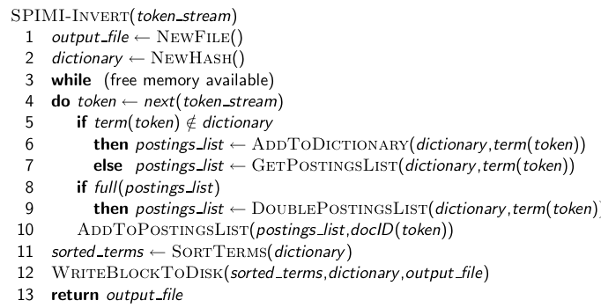
SPIMI-Invert
6

Slide 7
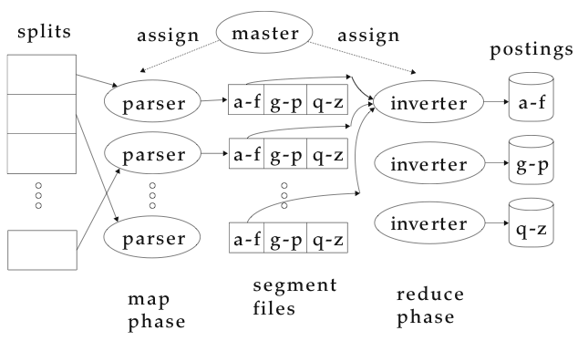
MapReduce for index construction
7

Slide 8
Dynamic indexing: Simplest approach
Maintain big main index on disk
New docs go into small auxiliary index in memory.
Search across both, merge results
Periodically, merge auxiliary index into big index
8

Slide 9
Roadmap
Today: index compression
Next 2 weeks: perspective of the user: how can we give the user relevant results, how can we measure relevance, what types of user interactions are effective?
After Pentecost: statistical classification and clustering in information retrieval
Last 3 weeks: web information retrieval
9

Slide 10
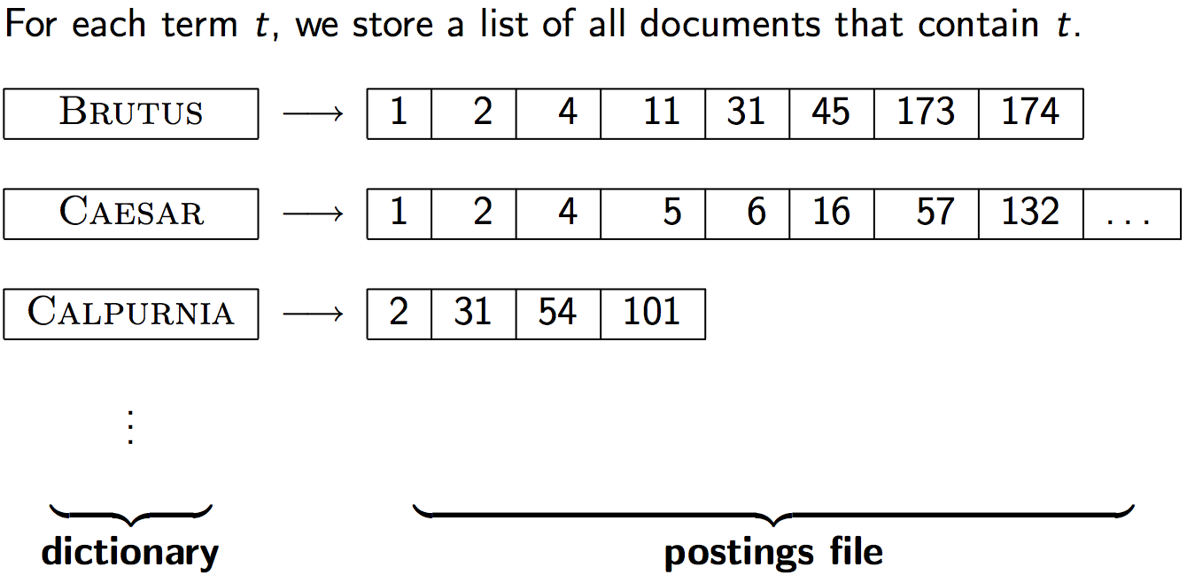
Take-away today
Motivation for compression in information retrieval systems
How can we compress the dictionary component of the inverted index?
How can we compress the postings component of the inverted index?
Term statistics: how are terms distributed in document collections?
10

Slide 11
Outline
Recap
Compression
Term statistics
Dictionary compression
Postings compression

Slide 12
Why compression? (in general)
Use less disk space (saves money)
Keep more stuff in memory (increases speed)
Increase speed of transferring data from disk to memory (again, increases speed)
[read compressed data and decompress in memory] is faster than [read uncompressed data]
Premise: Decompression algorithms are fast.
This is true of the decompression algorithms we will use.
12

Slide 13
Why compression in information retrieval?
First, we will consider space for dictionary
Main motivation for dictionary compression: make it small enough to keep in main memory
Then for the postings file
Motivation: reduce disk space needed, decrease time needed to read from disk
Note: Large search engines keep significant part of postings in memory
We will devise various compression schemes for dictionary and postings.
13

Slide 14
Lossy vs. lossless compression
Lossy compression: Discard some information
Several of the preprocessing steps we frequently use can be viewed as lossy compression:
downcasing, stop words, porter, number elimination
Lossless compression: All information is preserved.
What we mostly do in index compression
14

Slide 15
Outline
Recap
Compression
Term statistics
Dictionary compression
Postings compression

Slide 16
Model collection: The Reuters collection
symbol | statistics | value
N L M T | documents avg. # tokens per document word types avg. # bytes per token (incl. spaces/punct.) avg. # bytes per token (without spaces/punct.) avg. # bytes per term (= word type) non-positional postings | 800,000 200 400,000 6 4.5 7.5 100,000,000
16

Slide 17
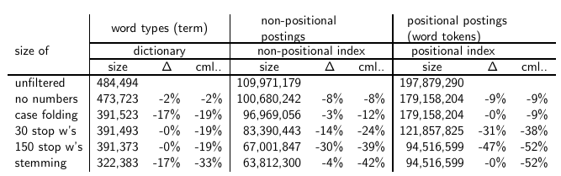
Effect of preprocessing for Reuters
17

Slide 18
How big is the term vocabulary?
That is, how many distinct words are there?
Can we assume there is an upper bound?
Not really: At least 70²⁰ ≈ 10³⁷ different words of length 20.
The vocabulary will keep growing with collection size.
Heaps’ law: M = kT^{b}
M is the size of the vocabulary, T is the number of tokens in the collection.
Typical values for the parameters k and b are: 30 ≤ k ≤ 100 and b ≈ 0.5.
Heaps’ law is linear in log-log space.
It is the simplest possible relationship between collection size and vocabulary size in log-log space.
Empirical law
18

Slide 19
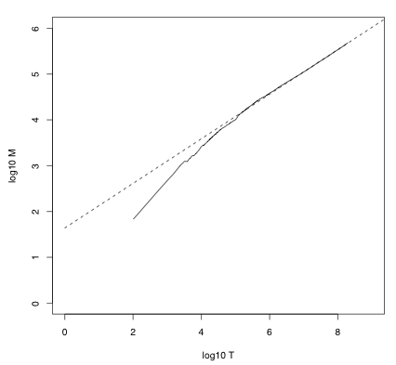
Heaps’ law for Reuters
Vocabulary size M as a
function of collection size
T (number of tokens) for
Reuters-RCV1. For these
data, the dashed line
log₁₀M =
0.49 ∗ log₁₀ T + 1.64 is the
best least squares fit.
Thus, M = 10^{1.64}T^{0.49}
and k = 10^{1.64} ≈ 44 and
b = 0.49.
19

Slide 20
Empirical fit for Reuters
Good, as we just saw in the graph.
Example: for the first 1,000,020 tokens Heaps’ law predicts 38,323 terms:
44 × 1,000,020^{0.49} ≈ 38,323
The actual number is 38,365 terms, very close to the prediction.
Empirical observation: fit is good in general.
20

Slide 21
Exercise
What is the effect of including spelling errors vs. automatically correcting spelling errors on Heaps’ law?
Compute vocabulary size M
Looking at a collection of web pages, you find that there are 3000 different terms in the first 10,000 tokens and 30,000 different terms in the first 1,000,000 tokens.
Assume a search engine indexes a total of 20,000,000,000 (2 × 10¹⁰) pages, containing 200 tokens on average
What is the size of the vocabulary of the indexed collection as predicted by Heaps’ law?
21

Slide 22

Zipf’s law
Now we have characterized the growth of the vocabulary in collections.
We also want to know how many frequent vs. infrequent terms we should expect in a collection.
In natural language, there are a few very frequent terms and very many very rare terms.
Zipf’s law: The i^{th} most frequent term has frequency cf_{i} proportional to 1/i .
cf_{i} is collection frequency: the number of occurrences of the term t_{i} in the collection.
22

Slide 23


Zipf’s law
Zipf’s law: The i^{th} most frequent term has frequency proportional to 1/i .
cf is collection frequency: the number of occurrences of the term in the collection.
So if the most frequent term (the) occurs cf₁ times, then the second most frequent term (of) has half as many occurrences
. . . and the third most frequent term (and) has a third as many occurrences
Equivalent: cf_{i} = ci^{k} and log cf_{i} = log c +k log i (for k = −1)
Example of a power law
23

Slide 24
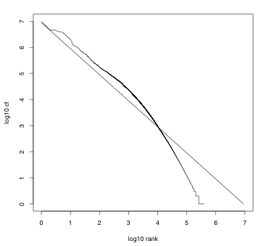
Zipf’s law for Reuters
Fit is not great. What
is important is the
key insight: Few frequent
terms, many
rare terms.
24

Slide 25
Outline
Recap
Compression
Term statistics
Dictionary compression
Postings compression

Slide 26
Dictionary compression
The dictionary is small compared to the postings file.
But we want to keep it in memory.
Also: competition with other applications, cell phones, onboard computers, fast startup time
So compressing the dictionary is important.
26

Slide 27
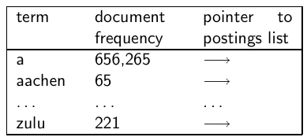
Recall: Dictionary as array of fixed-width entries
Space needed: 20 bytes 4 bytes 4 bytes
for Reuters: (20+4+4)*400,000 = 11.2 MB
27

Slide 28
Fixed-width entries are bad.
Most of the bytes in the term column are wasted.
We allot 20 bytes for terms of length 1.
We can’t handle HYDROCHLOROFLUOROCARBONS and SUPERCALIFRAGILISTICEXPIALIDOCIOUS
Average length of a term in English: 8 characters
How can we use on average 8 characters per term?
28

Slide 29
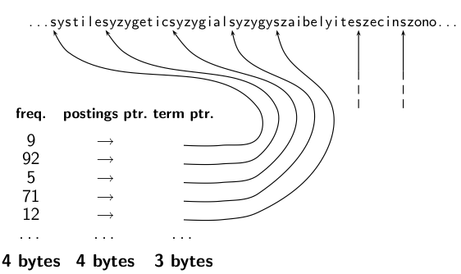
Dictionary as a string
29

Slide 30
Space for dictionary as a string
4 bytes per term for frequency
4 bytes per term for pointer to postings list
8 bytes (on average) for term in string
3 bytes per pointer into string (need log2 8 · 400000 < 24 bits to resolve 8 · 400,000 positions)
Space: 400,000 × (4 +4 +3 + 8) = 7.6MB (compared to 11.2 MB for fixed-width array)
30

Slide 31
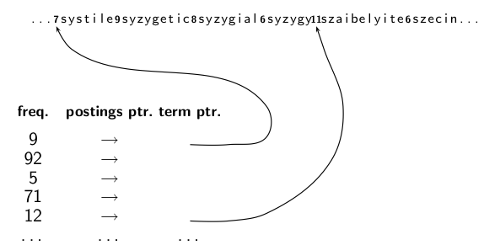
Dictionary as a string with blocking
31

Slide 32
Space for dictionary as a string with blocking
Example block size k = 4
Where we used 4 × 3 bytes for term pointers without blocking . . .
. . .we now use 3 bytes for one pointer plus 4 bytes for indicating the length of each term.
We save 12 − (3 + 4) = 5 bytes per block.
Total savings: 400,000/4 ∗ 5 = 0.5 MB
This reduces the size of the dictionary from 7.6 MB to 7.1
MB.
32

Slide 33
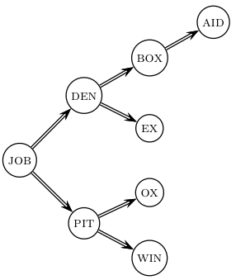
Lookup of a term without blocking
33

Slide 34
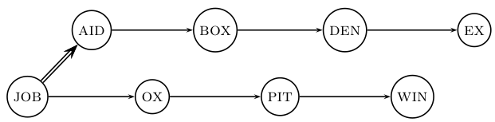
Lookup of a term with blocking: (slightly) slower
34

Slide 35
Front coding
One block in blocked compression (k = 4) . . .
8 a u t o m a t a 8 a u t o m a t e 9 a u t o m a t i c 10 a u t o m a t i o n
⇓
. . . further compressed with front coding.
8 a u t o m a t ∗ a 1 ⋄ e 2 ⋄ i c 3 ⋄ i o n
35

Slide 36
Dictionary compression for Reuters: Summary
data structure | size in MB
dictionary, fixed-width dictionary, term pointers into string ∼, with blocking, k = 4 ∼, with blocking & front coding | 11.2 7.6 7.1 5.9
36

Slide 37
Exercise
Which prefixes should be used for front coding? What are the tradeoffs?
Input: list of terms (= the term vocabulary)
Output: list of prefixes that will be used in front coding
37

Slide 38
Outline
Recap
Compression
Term statistics
Dictionary compression
Postings compression

Slide 39
Postings compression
The postings file is much larger than the dictionary, factor of at least 10.
Key desideratum: store each posting compactly
A posting for our purposes is a docID.
For Reuters (800,000 documents), we would use 32 bits per docID when using 4-byte integers.
Alternatively, we can use log₂ 800,000 ≈ 19.6 < 20 bits per docID.
Our goal: use a lot less than 20 bits per docID.
39

Slide 40
Key idea: Store gaps instead of docIDs
Each postings list is ordered in increasing order of docID.
Example postings list: COMPUTER: 283154, 283159, 283202, . . .
It suffices to store gaps: 283159-283154=5, 283202-283154=43
Example postings list using gaps : COMPUTER: 283154, 5, 43, . . .
Gaps for frequent terms are small.
Thus: We can encode small gaps with fewer than 20 bits.
40

Slide 41
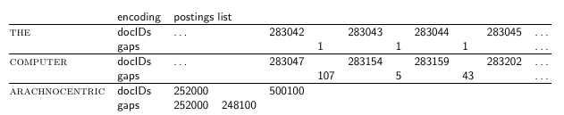
Gap encoding
41

Slide 42
Variable length encoding
Aim:
For ARACHNOCENTRIC and other rare terms, we will use about 20 bits per gap (= posting).
For THE and other very frequent terms, we will use only a few bits per gap (= posting).
In order to implement this, we need to devise some form of variable length encoding.
Variable length encoding uses few bits for small gaps and many bits for large gaps.
42

Slide 43
Variable byte (VB) code
Used by many commercial/research systems
Good low-tech blend of variable-length coding and sensitivity to alignment matches (bit-level codes, see later).
Dedicate 1 bit (high bit) to be a continuation bit c.
If the gap G fits within 7 bits, binary-encode it in the 7 available bits and set c = 1.
Else: encode lower-order 7 bits and then use one or more additional bytes to encode the higher order bits using the same algorithm.
At the end set the continuation bit of the last byte to 1 (c = 1) and of the other bytes to 0 (c = 0).
43

Slide 44
VB code examples
docIDs gaps VB code | 824 00000110 10111000 | 829 5 10000101 | 215406 214577 00001101 00001100 10110001
44

Slide 45
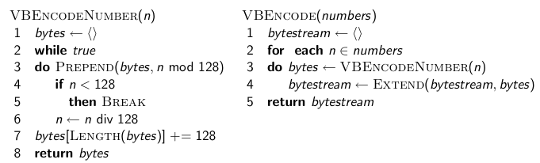
VB code encoding algorithm
45

Slide 46
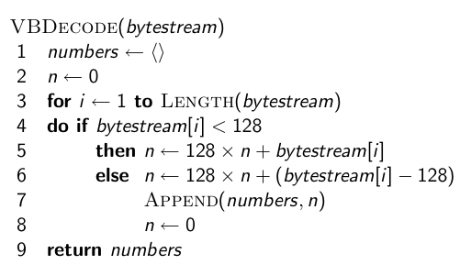
VB code decoding algorithm
46

Slide 47
Other variable codes
Instead of bytes, we can also use a different “unit of alignment”: 32 bits (words), 16 bits, 4 bits (nibbles) etc
Variable byte alignment wastes space if you have many small gaps – nibbles do better on those.
Recent work on word-aligned codes that efficiently “pack” a variable number of gaps into one word – see resources at the end
47

Slide 48
Gamma codes for gap encoding
You can get even more compression with another type of variable length encoding: bitlevel code.
Gamma code is the best known of these.
First, we need unary code to be able to introduce gamma code.
Unary code
Represent n as n 1s with a final 0.
Unary code for 3 is 1110
Unary code for 40 is 11111111111111111111111111111111111111110
Unary code for 70 is:
11111111111111111111111111111111111111111111111111111111111111111111110
48

Slide 49
Gamma code
Represent a gap G as a pair of length and offset.
Offset is the gap in binary, with the leading bit chopped off.
For example 13 → 1101 → 101 = offset
Length is the length of offset.
For 13 (offset 101), this is 3.
Encode length in unary code: 1110.
Gamma code of 13 is the concatenation of length and offset: 1110101.
49

Slide 50
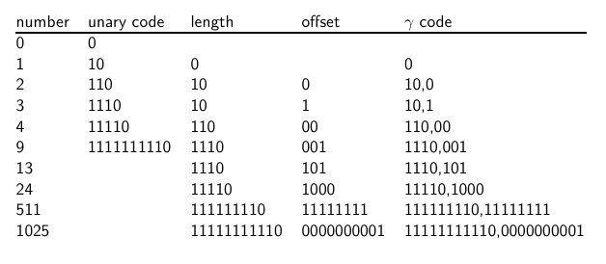
Gamma code examples
50

Slide 51
Exercise
Compute the variable byte code of 130
Compute the gamma code of 130
51

Slide 52
Length of gamma code
The length of offset is ⌊log₂ G⌋ bits.
The length of length is ⌊log₂ G⌋ + 1 bits,
So the length of the entire code is 2 x ⌊log₂ G⌋ + 1 bits.
ϒ codes are always of odd length.
Gamma codes are within a factor of 2 of the optimal encoding length log₂ G.
(assuming the frequency of a gap G is proportional to log₂ G – not really true)
52

Slide 53
Gamma code: Properties
Gamma code is prefix-free: a valid code word is not a prefix of any other valid code.
Encoding is optimal within a factor of 3 (and within a factor of 2 making additional assumptions).
This result is independent of the distribution of gaps!
We can use gamma codes for any distribution. Gamma code is universal.
Gamma code is parameter-free.
53

Slide 54
Gamma codes: Alignment
Machines have word boundaries – 8, 16, 32 bits
Compressing and manipulating at granularity of bits can be slow.
Variable byte encoding is aligned and thus potentially more efficient.
Regardless of efficiency, variable byte is conceptually simpler at little additional space cost.
54

Slide 55
Compression of Reuters
data structure | size in MB
dictionary, fixed-width dictionary, term pointers into string ∼, with blocking, k = 4 ∼, with blocking & front coding collection (text, xml markup etc) collection (text) T/D incidence matrix postings, uncompressed (32-bit words) postings, uncompressed (20 bits) postings, variable byte encoded postings, encoded | 11.2 7.6 7.1 5.9 3600.0 960.0 40,000.0 400.0 250.0 116.0 101.0
55

Slide 56
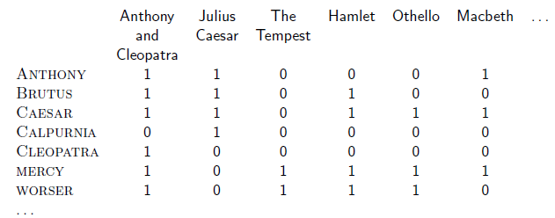
Term-document incidence matrix
Entry is 1 if term occurs. Example: CALPURNIA occurs in Julius
Caesar. Entry is 0 if term doesn’t occur. Example: CALPURNIA
doesn’t occur in The tempest.
56

Slide 57
Compression of Reuters
data structure | size in MB
dictionary, fixed-width dictionary, term pointers into string ∼, with blocking, k = 4 ∼, with blocking & front coding collection (text, xml markup etc) collection (text) T/D incidence matrix postings, uncompressed (32-bit words) postings, uncompressed (20 bits) postings, variable byte encoded postings, encoded | 11.2 7.6 7.1 5.9 3600.0 960.0 40,000.0 400.0 250.0 116.0 101.0
57

Slide 58
Summary
We can now create an index for highly efficient Boolean retrieval that is very space efficient.
Only 10-15% of the total size of the text in the collection.
However, we’ve ignored positional and frequency information.
For this reason, space savings are less in reality.
58

Slide 59
Take-away today
Motivation for compression in information retrieval systems
How can we compress the dictionary component of the inverted index?
How can we compress the postings component of the inverted index?
Term statistics: how are terms distributed in document collections?
59

Slide 60
Resources
Chapter 5 of IIR
Resources at http://ifnlp.org/ir
Original publication on word-aligned binary codes by Anh and Moffat (2005); also: Anh and Moffat (2006a)
Original publication on variable byte codes by Scholer, Williams, Yiannis and Zobel (2002)
More details on compression (including compression of positions and frequencies) in Zobel and Moffat (2006)
60

