Slide 1
Scores in a Complete Retrieval System
Shangsong Liang
Sun Yat-sen University
From Hinrich Schütze and Christina Lioma

Slide 2
Overview
Recap
Why rank?
More on cosine
Implementation of ranking
The complete search system

Slide 3
Outline
Recap
Why rank?
More on cosine
Implementation of ranking
The complete search system

Slide 4

Term frequency weight
The log frequency weight of term t in d is defined as follows
4

Slide 5

idf weight
The document frequency dft is defined as the number of documents that t occurs in.
We define the idf weight of term t as follows:
idf is a measure of the informativeness of the term.
5

Slide 6

tf-idf weight
The tf-idf weight of a term is the product of its tf weight and its idf weight.
6

Slide 7

Cosine similarity between query and document
q_{i} is the tf-idf weight of term i in the query.
d_{i} is the tf-idf weight of term i in the document.
and are the lengths of and
and are length-1 vectors (= normalized).
7

Slide 8
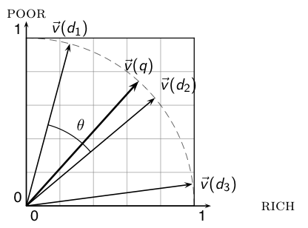
Cosine similarity illustrated
8

Slide 9
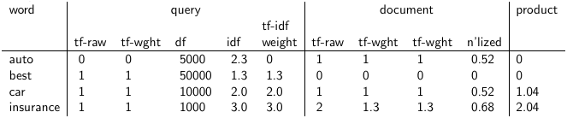
tf-idf example: lnc.ltn
Query: “best car insurance”. Document: “car insurance auto insurance”.
term frequency, df: document frequency, idf: inverse document frequency, weight:the final
weight of the term in the query or document, n’lized: document weights after cosine
normalization, product: the product of final query weight and final document weight
1/1.92 0.52
1.3/1.92 0.68 Final similarity score between query and
document: _{i} w_{qi} · w_{di} = 0 + 0 + 1.04 + 2.04 = 3.08
9

Slide 10
Take-away today
The importance of ranking: User studies at Google
Length normalization: Pivot normalization
Implementation of ranking
The complete search system
10

Slide 11
Outline
Recap
Why rank?
More on cosine
Implementation of ranking
The complete search system

Slide 12
Why is ranking so important?
Last lecture: Problems with unranked retrieval
Users want to look at a few results – not thousands.
It’s very hard to write queries that produce a few results.
Even for expert searchers
→ Ranking is important because it effectively reduces a large set of results to a very small one.
Next: More data on “users only look at a few results”
Actually, in the vast majority of cases they only examine 1, 2, or 3 results.
12

Slide 13
Empirical investigation of the effect of ranking
How can we measure how important ranking is?
Observe what searchers do when they are searching in a controlled setting
Videotape them
Ask them to “think aloud”
Interview them
Eye-track them
Time them
Record and count their clicks
The following slides are from Dan Russell’s JCDL talk
Dan Russell is the “Über Tech Lead for Search Quality & User Happiness” at Google.
13

Slide 14
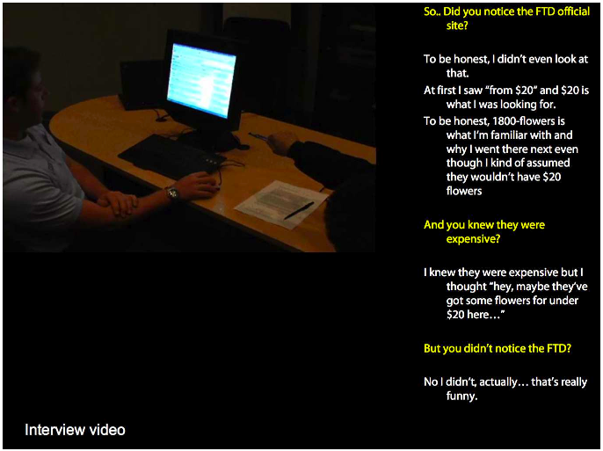
14

Slide 15
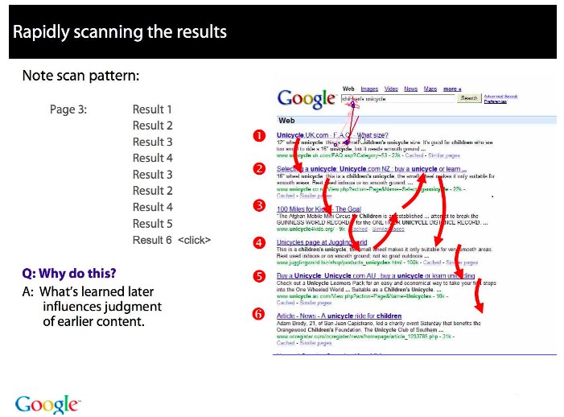
15

Slide 16
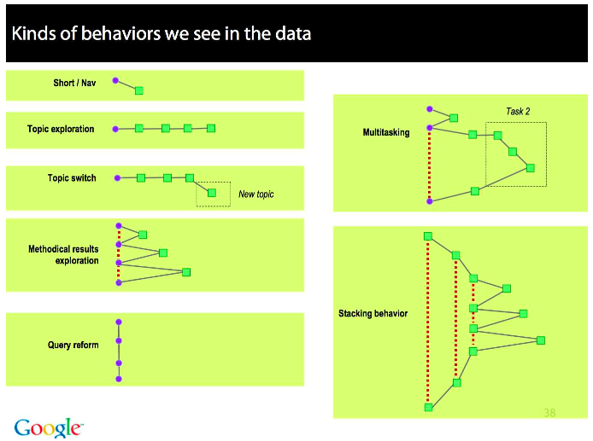
16

Slide 17
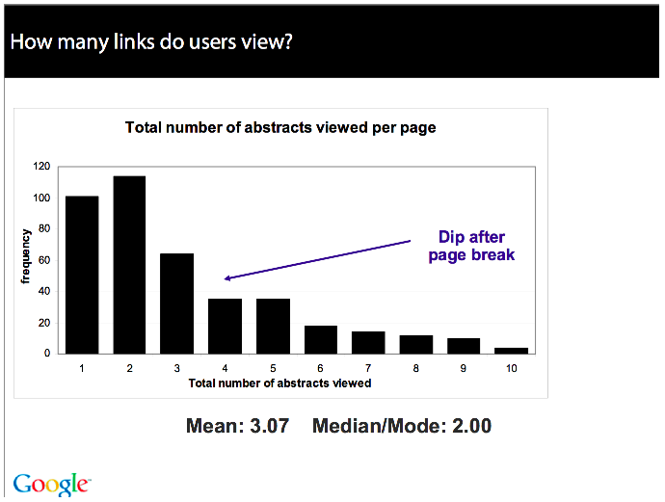
17

Slide 18
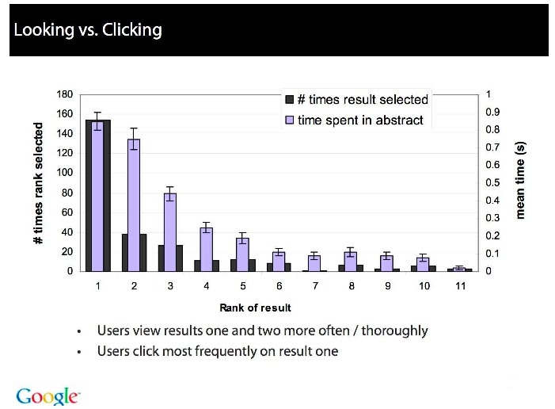
18

Slide 19
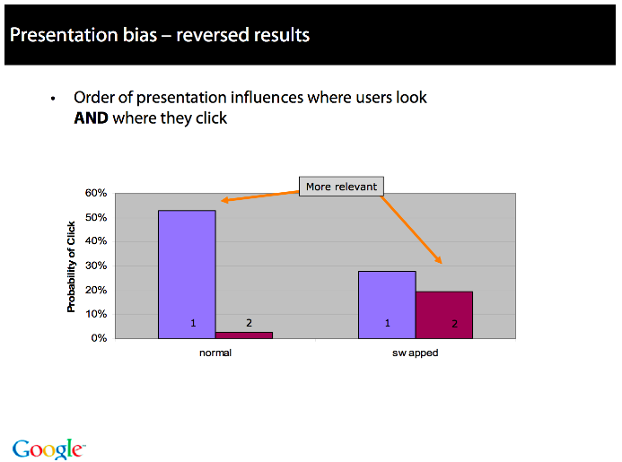
19

Slide 20
Importance of ranking: Summary
Viewing abstracts: Users are a lot more likely to read the abstracts of the top-ranked pages (1, 2, 3, 4) than the abstracts of the lower ranked pages (7, 8, 9, 10).
Clicking: Distribution is even more skewed for clicking
In 1 out of 2 cases, users click on the top-ranked page.
Even if the top-ranked page is not relevant, 30% of users will click on it.
→ Getting the ranking right is very important.
→ Getting the top-ranked page right is most important.
20

Slide 21
Outline
Recap
Why rank?
More on cosine
Implementation of ranking
The complete search system

Slide 22
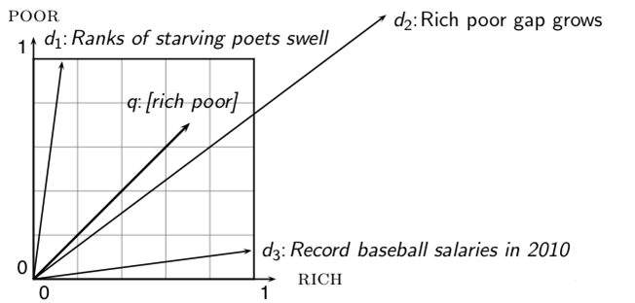
Why distance is a bad idea
The Euclidean distance of and is large although the distribution of terms in the query q and the distribution of terms in the document d₂ are very similar. That’s why we do length normalization or, equivalently, use cosine to compute query-document matching scores.
22

Slide 23
Exercise: A problem for cosine normalization
Query q: “anti-doping rules Beijing 2008 olympics”
Compare three documents
d₁: a short document on anti-doping rules at 2008 Olympics
d₂: a long document that consists of a copy of d₁ and 5 other news stories, all on topics different from Olympics/anti-doping
d₃: a short document on anti-doping rules at the 2004 Athens Olympics
What ranking do we expect in the vector space model?
What can we do about this?
23

Slide 24
Pivot normalization
Cosine normalization produces weights that are too large for short documents and too small for long documents (on average).
Adjust cosine normalization by linear adjustment: “turning” the average normalization on the pivot
Effect: Similarities of short documents with query decrease; similarities of long documents with query increase.
This removes the unfair advantage that short documents have.
24

Slide 25
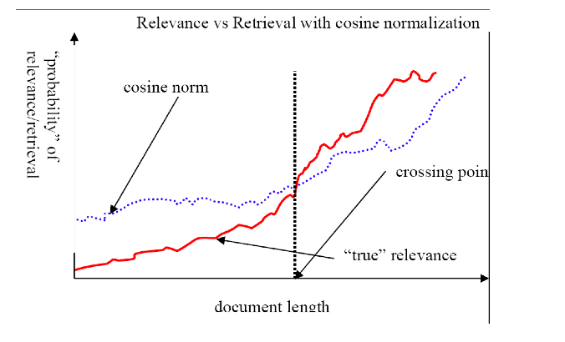
Predicted and true probability of relevance
source:
Lillian Lee
25

Slide 26
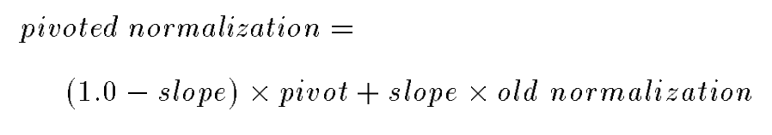
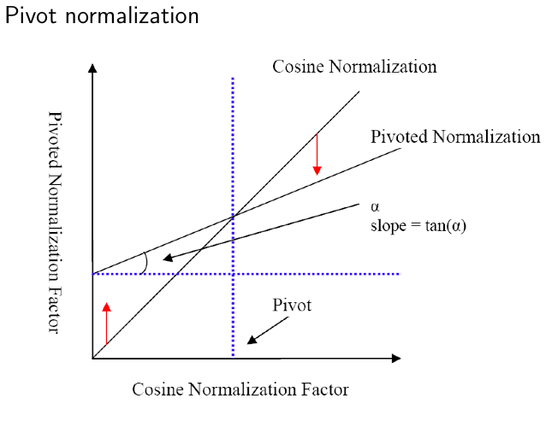
Pivot normalization
source:
Lillian Lee
26

Slide 27
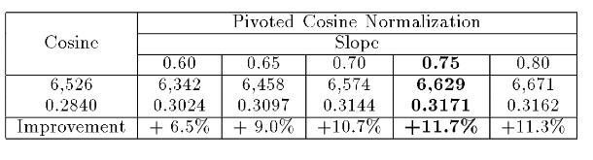
Pivoted normalization: Amit Singhal’s experiments
(relevant documents retrieved and (change in) average precision)
27

Slide 28
Outline
Recap
Why rank?
More on cosine
Implementation of ranking
The complete search system

Slide 29
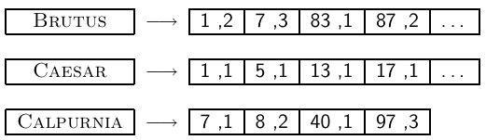
Now we also need term frequncies in the index
term frequencies
We also need positions. Not shown here
29

Slide 30
Term frequencies in the inverted index
In each posting, store tf_{t,d} in addition to docID _{d}
As an integer frequency, not as a (log-)weighted real number . . .
. . . because real numbers are difficult to compress.
Unary code is effective for encoding term frequencies.
Why?
Overall, additional space requirements are small: less than a byte per posting with bitwise compression.
Or a byte per posting with variable byte code
30

Slide 31
Exercise: How do we compute the top k in ranking?
In many applications, we don’t need a complete ranking.
We just need the top k for a small k (e.g., k = 100).
If we don’t need a complete ranking, is there an efficient way of computing just the top k?
Naive:
Compute scores for all N documents
Sort
Return the top k
What’s bad about this?
Alternative?
31

Slide 32
Use min heap for selecting top k out of N
Use a binary min heap
A binary min heap is a binary tree in which each node’s value is less than the values of its children.
Takes O(N log k) operations to construct (where N is the number of documents) . . .
. . . then read off k winners in O(k log k) steps
32

Slide 33
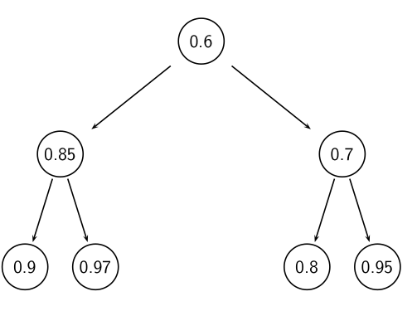
Binary min heap
33

Slide 34
Selecting top k scoring documents in O(N log k)
Goal: Keep the top k documents seen so far
Use a binary min heap
To process a new document d′ with score s′:
Get current minimum h_{m} of heap (O(1))
If s′ ˂ h_{m} skip to next document
If s′ > h_{m} heap-delete-root (O(log k))
Heap-add d′/s′ (O(log k))
34

Slide 35
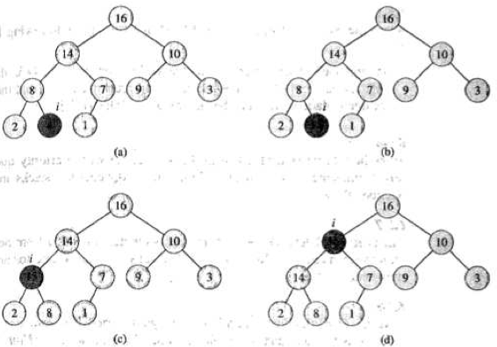
Priority queue example
35

Slide 36
Even more efficient computation of top k?
Ranking has time complexity O(N) where N is the number of documents.
Optimizations reduce the constant factor, but they are still O(N), N > 10¹⁰
Are there sublinear algorithms?
What we’re doing in effect: solving the k-nearest neighbor (kNN) problem for the query vector (= query point).
There are no general solutions to this problem that are sublinear.
We will revisit this issue when we do kNN classification in IIR 14.
36

Slide 37
More efficient computation of top k: Heuristics
Idea 1: Reorder postings lists
Instead of ordering according to docID . . .
. . . order according to some measure of “expected relevance”.
Idea 2: Heuristics to prune the search space
Not guaranteed to be correct . . .
. . . but fails rarely.
In practice, close to constant time.
For this, we’ll need the concepts of document-at-a-time processing and term-at-a-time processing.
37

Slide 38
Non-docID ordering of postings lists
So far: postings lists have been ordered according to docID.
Alternative: a query-independent measure of “goodness” of a page
Example: PageRank g(d) of page d, a measure of how many “good” pages hyperlink to d (chapter 21)
Order documents in postings lists according to PageRank: g(d₁) > g(d₂) > g(d₃) > . . .
Define composite score of a document: net-score(q, d) = g(d) + cos(q, d)
This scheme supports early termination: We do not have to process postings lists in their entirety to find top k.
38

Slide 39
Non-docID ordering of postings lists (2)
Order documents in postings lists according to PageRank: g(d₁) > g(d₂) > g(d₃) > . . .
Define composite score of a document: net-score(q, d) = g(d) + cos(q, d)
Suppose: (i) g → [0, 1]; (ii) g(d) < 0.1 for the document d we’re currently processing; (iii) smallest top k score we’ve found so far is 1.2
Then all subsequent scores will be < 1.1.
So we’ve already found the top k and can stop processing the remainder of postings lists.
Questions?
39

Slide 40
Document-at-a-time processing
Both docID-ordering and PageRank-ordering impose a consistent ordering on documents in postings lists.
Computing cosines in this scheme is document-at-a-time.
We complete computation of the query-document similarity score of document d_{i} before starting to compute the query-document similarity score of d_{i+1}.
Alternative: term-at-a-time processing
40

Slide 41
Weight-sorted postings lists
Idea: don’t process postings that contribute little to final score
Order documents in postings list according to weight
Simplest case: normalized tf-idf weight (rarely done: hard to compress)
Documents in the top k are likely to occur early in these ordered lists.
→ Early termination while processing postings lists is unlikely to change the top k.
But:
We no longer have a consistent ordering of documents in postings lists.
We no longer can employ document-at-a-time processing.
41

Slide 42
Term-at-a-time processing
Simplest case: completely process the postings list of the first query term
Create an accumulator for each docID you encounter
Then completely process the postings list of the second query term
. . . and so forth
42

Slide 43
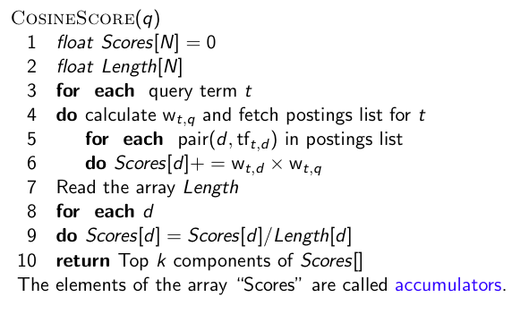
Term-at-a-time processing
43

Slide 44
Computing cosine scores
For the web (20 billion documents), an array of accumulators A in memory is infeasible.
Thus: Only create accumulators for docs occurring in postings lists
This is equivalent to: Do not create accumulators for docs with zero scores (i.e., docs that do not contain any of the query terms)
44

Slide 45
Accumulators: Example
For query: [Brutus Caesar]:
Only need accumulators for 1, 5, 7, 13, 17, 83, 87
Don’t need accumulators for 8, 40, 85
45

Slide 46
Removing bottlenecks
Use heap / priority queue as discussed earlier
Can further limit to docs with non-zero cosines on rare (high idf) words
Or enforce conjunctive search (a la Google): non-zero cosines on all words in query
Example: just one accumulator for [Brutus Caesar] in the example above . . .
. . . because only d₁ contains both words.
46

Slide 47
Outline
Recap
Why rank?
More on cosine
Implementation of ranking
The complete search system

Slide 48
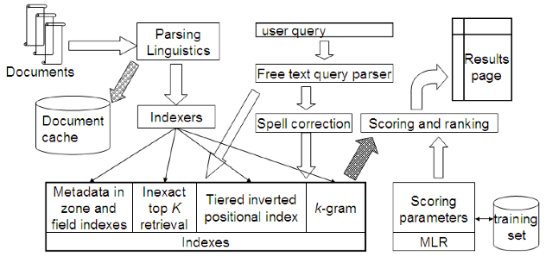
Complete search system
48

Slide 49
Tiered indexes
Basic idea:
Create several tiers of indexes, corresponding to importance of indexing terms
During query processing, start with highest-tier index
If highest-tier index returns at least k (e.g., k = 100) results: stop and return results to user
If we’ve only found < k hits: repeat for next index in tier cascade
Example: two-tier system
Tier 1: Index of all titles
Tier 2: Index of the rest of documents
Pages containing the search words in the title are better hits than pages containing the search words in the body of the text.
49

Slide 50
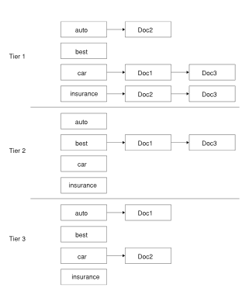
Tiered index
50

Slide 51
Tiered indexes
The use of tiered indexes is believed to be one of the reasons that Google search quality was significantly higher initially (2000/01) than that of competitors.
(along with PageRank, use of anchor text and proximity constraints)
51

Slide 52
Exercise
Design criteria for tiered system
Each tier should be an order of magnitude smaller than the next tier.
The top 100 hits for most queries should be in tier 1, the top 100 hits for most of the remaining queries in tier 2 etc.
We need a simple test for “can I stop at this tier or do I have to go to the next one?”
There is no advantage to tiering if we have to hit most tiers for most queries anyway.
Question 1: Consider a two-tier system where the first tier indexes titles and the second tier everything. What are potential problems with this type of tiering?
Question 2: Can you think of a better way of setting up a multitier system? Which “zones” of a document should be indexed in the different tiers (title, body of document, others?)? What criterion do you want to use for including a document in tier 1?
52

Slide 53
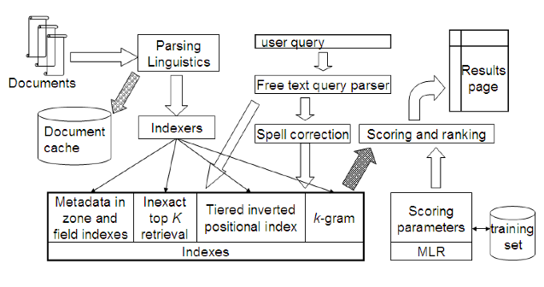
Complete search system
53

Slide 54
Components we have introduced thus far
Document preprocessing (linguistic and otherwise)
Positional indexes
Tiered indexes
Spelling correction
k-gram indexes for wildcard queries and spelling correction
Query processing
Document scoring
Term-at-a-time processing
54

Slide 55
Components we haven’t covered yet
Document cache: we need this for generating snippets (=dynamic summaries)
Zone indexes: They separate the indexes for different zones: the body of the document, all highlighted text in the document, anchor text, text in metadata fields etc
Machine-learned ranking functions
Proximity ranking (e.g., rank documents in which the query terms occur in the same local window higher than documents in which the query terms occur far from each other)
Query parser
55

Slide 56
Vector space retrieval: Interactions
How do we combine phrase retrieval with vector space retrieval?
We do not want to compute document frequency / idf for every possible phrase. Why?
How do we combine Boolean retrieval with vector space retrieval?
For example: “+”-constraints and “-”-constraints
Postfiltering is simple, but can be very inefficient – no easy answer.
How do we combine wild cards with vector space retrieval?
Again, no easy answer
56

Slide 57
Take-away today
The importance of ranking: User studies at Google
Length normalization: Pivot normalization
Implementation of ranking
The complete search system
57

Slide 58
Resources
Chapters 6 and 7 of IIR
Resources at http://ifnlp.org/ir
How Google tweaks its ranking function
Interview with Google search guru Udi Manber
Yahoo Search BOSS: Opens up the search engine to developers. For example, you can rerank search results.
Compare Google and Yahoo ranking for a query
How Google uses eye tracking for improving search
58

