Slide 1
Evaluations and Result Summaries
Shangsong Liang
Sun Yat-sen University
From Hinrich Schütze and Christina Lioma

Slide 2
Overview
Recap
Unranked evaluation
Ranked evaluation
Evaluation benchmarks
Result summaries

Slide 3
Outline
Recap
Unranked evaluation
Ranked evaluation
Evaluation benchmarks
Result summaries

Slide 4
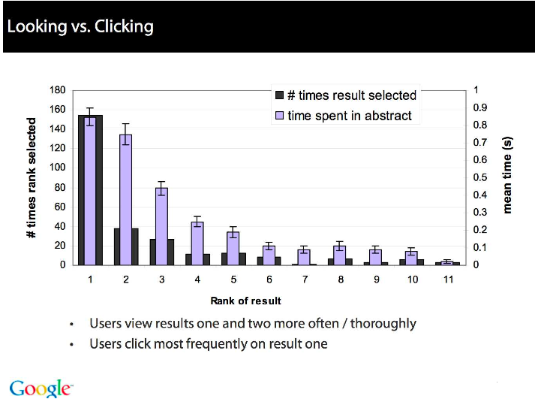
4

Slide 5
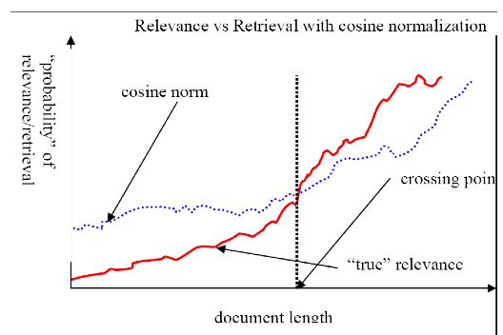
Pivot normalization
source:
Lilian Lee
5

Slide 6
Heuristics for finding the top k even faster
Document-at-a-time processing
We complete computation of the query-document similarity score of document d_{i} before starting to compute the query-document similarity score of d_{i+1}.
Requires a consistent ordering of documents in the postings lists
Term-at-a-time processing
We complete processing the postings list of query term t_{i} before starting to process the postings list of t_{i+1}.
Requires an accumulator for each document “still in the running”
The most effective heuristics switch back and forth between term-at-a-time and document-at-a-time processing.
6

Slide 7
Use min heap for selecting top k ouf of N
Use a binary min heap
A binary min heap is a binary tree in which each node’s value is less than the values of its children.
It takes O(N log k) operations to construct the k-heap containing the k largest values (where N is the number of documents).
Essentially linear in N for small k and large N.
7

Slide 8
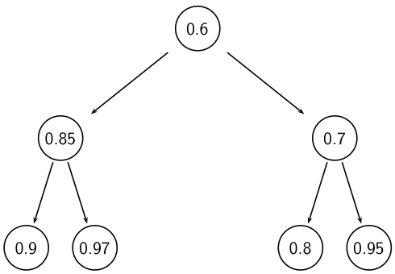
Binary min heap

Slide 9
Selecting k top scoring documents in O(N log k)
Goal: Keep the k top documents seen so far
Use a binary min heap
To process a new document d′ with score s′:
Get current minimum h_{m} of heap (in O(1))
If s′ ≤ h_{m} skip to next document
If s′ > h_{m} heap-delete-root (in O(log k))
Heap-add d′/s′ (in O(1))
Reheapify (in O(log k))
9

Slide 10
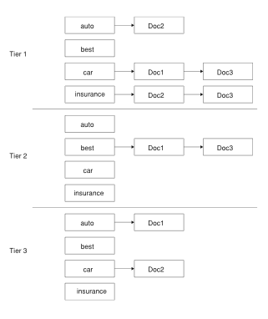
Tiered index
10

Slide 11
Outline
Recap
Unranked evaluation
Ranked evaluation
Evaluation benchmarks
Result summaries

Slide 12
Measures for a search engine
How fast does it index
e.g., number of bytes per hour
How fast does it search
e.g., latency as a function of queries per second
What is the cost per query?
in dollars
12

Slide 13
Measures for a search engine
All of the preceding criteria are measurable: we can quantify speed / size / money
However, the key measure for a search engine is user happiness.
What is user happiness?
Factors include:
Speed of response
Size of index
Uncluttered UI
Most important: relevance
(actually, maybe even more important: it’s free)
Note that none of these is sufficient: blindingly fast, but useless answers won’t make a user happy.
How can we quantify user happiness?
13

Slide 14
Who is the user?
Who is the user we are trying to make happy?
Web search engine: searcher. Success: Searcher finds what she was looking for. Measure: rate of return to this search engine
Web search engine: advertiser. Success: Searcher clicks on ad. Measure: clickthrough rate
Ecommerce: buyer. Success: Buyer buys something. Measures: time to purchase, fraction of “conversions” of searchers to buyers
Ecommerce: seller. Success: Seller sells something. Measure: profit per item sold
Enterprise: CEO. Success: Employees are more productive (because of effective search). Measure: profit of the company
14

Slide 15
Most common definition of user happiness: Relevance
User happiness is equated with the relevance of search results to the query.
But how do you measure relevance?
Standard methodology in information retrieval consists of three elements.
A benchmark document collection
A benchmark suite of queries
An assessment of the relevance of each query-document pair
15

Slide 16
Relevance: query vs. information need
Relevance to what?
First take: relevance to the query
“Relevance to the query” is very problematic.
Information need i : “I am looking for information on whether drinking red wine is more effective at reducing your risk of heart attacks than white wine.”
This is an information need, not a query.
Query q: [red wine white wine heart attack]
Consider document d′: At heart of his speech was an attack on the wine industry lobby for downplaying the role of red and white wine in drunk driving.
d′ is an excellent match for query q . . .
d′ is not relevant to the information need i .
16

Slide 17
Relevance: query vs. information need
User happiness can only be measured by relevance to an information need, not by relevance to queries.
Our terminology is sloppy in these slides and in IIR: we talk about query-document relevance judgments even though we mean information-need-document relevance judgments.
17

Slide 18


Precision and recall
Precision (P) is the fraction of retrieved documents that are relevant
Recall (R) is the fraction of relevant documents that are retrieved
18

Slide 19
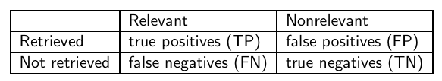
Precision and recall
P = TP / ( TP + FP )
R = TP / ( TP + FN )
19

Slide 20
Precision/recall tradeoff
You can increase recall by returning more docs.
Recall is a non-decreasing function of the number of docs retrieved.
A system that returns all docs has 100% recall!
The converse is also true (usually): It’s easy to get high precision for very low recall.
Suppose the document with the largest score is relevant. How can we maximize precision?
20

Slide 21



A combined measure: F
F allows us to trade off precision against recall.
where
α ϵ [0, 1] and thus β ² ϵ [0,∞]
Most frequently used: balanced F with β = 1 or α = 0.5
This is the harmonic mean of P and R:
What value range of β weights recall higher than precision?
21

Slide 22

F: Example
 | relevant | not relevant
retrieved | 20 | 40 | 60
not retrieved | 60 | 1,000,000 | 1,000,060
 | 80 | 1,000,040 | 1,000,120
P = 20/(20 + 40) = 1/3
R = 20/(20 + 60) = 1/4
22

Slide 23
Accuracy
Why do we use complex measures like precision, recall, and F?
Why not something simple like accuracy?
Accuracy is the fraction of decisions (relevant/nonrelevant) that are correct.
In terms of the contingency table above,
accuracy = (TP + TN)/(TP + FP + FN + TN).
Why is accuracy not a useful measure for web information retrieval?
23

Slide 24

Exercise
Compute precision, recall and F₁ for this result set:
The snoogle search engine below always returns 0 results (“0 matching results found”), regardless of the query. Why does snoogle demonstrate that accuracy is not a useful measure in IR?
 | relevant | not relevant
retrieved | 18 | 2
not retrieved | 82 | 1,000,000,000
24

Slide 25
Why accuracy is a useless measure in IR
Simple trick to maximize accuracy in IR: always say no and return nothing
You then get 99.99% accuracy on most queries.
Searchers on the web (and in IR in general) want to find something and have a certain tolerance for junk.
It’s better to return some bad hits as long as you return something.
→We use precision, recall, and F for evaluation, not accuracy.
25

Slide 26
F: Why harmonic mean?
Why don’t we use a different mean of P and R as a measure?
e.g., the arithmetic mean
The simple (arithmetic) mean is 50% for “return-everything” search engine, which is too high.
Desideratum: Punish really bad performance on either precision or recall.
Taking the minimum achieves this.
But minimum is not smooth and hard to weight.
F (harmonic mean) is a kind of smooth minimum.
26

Slide 27
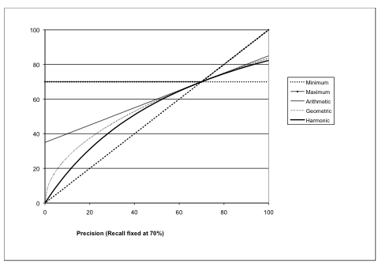
F₁ and other averages
We can view the harmonic mean as a kind of soft minimum
27

Slide 28
Difficulties in using precision, recall and F
We need relevance judgments for information-need-document pairs – but they are expensive to produce.
For alternatives to using precision/recall and having to produce relevance judgments – see end of this lecture.
28

Slide 29
Outline
Recap
Unranked evaluation
Ranked evaluation
Evaluation benchmarks
Result summaries

Slide 30
Precision-recall curve
Precision/recall/F are measures for unranked sets.
We can easily turn set measures into measures of ranked lists.
Just compute the set measure for each “prefix”: the top 1, top 2, top 3, top 4 etc results
Doing this for precision and recall gives you a precision-recall curve.
30

Slide 31
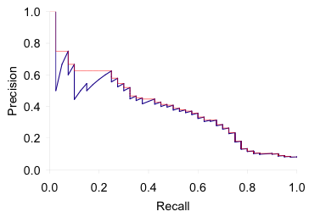
A precision-recall curve
Each point corresponds to a result for the top k ranked hits (k = 1, 2, 3, 4, . . .).
Interpolation (in red): Take maximum of all future points
Rationale for interpolation: The user is willing to look at more stuff if both precision and recall get better.
Questions?
31

Slide 32
11-point interpolated average precision
Recall | Interpolated Precision
0.0 0.1 0.2 0.3 0.4 0.5 0.6 0.7 0.8 0.9 1.0 | 1.00 0.67 0.63 0.55 0.45 0.41 0.36 0.29 0.13 0.10 0.08
11-point average: ≈
0.425
How can precision
at 0.0 be > 0?
32

Slide 33
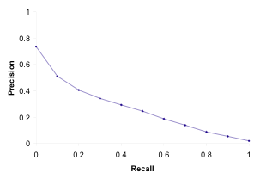
Averaged 11-point precision/recall graph
Compute interpolated precision at recall levels 0.0, 0.1, 0.2, . . .
Do this for each of the queries in the evaluation benchmark
Average over queries
This measure measures performance at all recall levels.
The curve is typical of performance levels at TREC.
Note that performance is not very good!
33

Slide 34
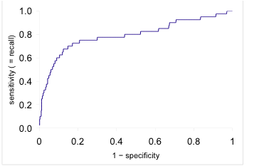
ROC curve
Similar to precision-recall graph
But we are only interested in the small area in the lower left corner.
Precision-recall graph “blows up” this area.
34

Slide 35
Variance of measures like precision/recall
For a test collection, it is usual that a system does badly on some information needs (e.g., P = 0.2 at R = 0.1) and really well on others (e.g., P = 0.95 at R = 0.1).
Indeed, it is usually the case that the variance of the same system across queries is much greater than the variance of different systems on the same query.
That is, there are easy information needs and hard ones.
35

Slide 36
Outline
Recap
Unranked evaluation
Ranked evaluation
Evaluation benchmarks
Result summaries

Slide 37
What we need for a benchmark
A collection of documents
Documents must be representative of the documents we expect to see in reality.
A collection of information needs
. . .which we will often incorrectly refer to as queries
Information needs must be representative of the information needs we expect to see in reality.
Human relevance assessments
We need to hire/pay “judges” or assessors to do this.
Expensive, time-consuming
Judges must be representative of the users we expect to see in reality.
37

Slide 38
Standard relevance benchmark: Cranfield
Pioneering: first testbed allowing precise quantitative measures of information retrieval effectiveness
Late 1950s, UK
1398 abstracts of aerodynamics journal articles, a set of 225 queries, exhaustive relevance judgments of all query-document-pairs
Too small, too untypical for serious IR evaluation today
38

Slide 39
Standard relevance benchmark: TREC
TREC = Text Retrieval Conference (TREC)
Organized by the U.S. National Institute of Standards and Technology (NIST)
TREC is actually a set of several different relevance benchmarks.
Best known: TREC Ad Hoc, used for first 8 TREC evaluations between 1992 and 1999
1.89 million documents, mainly newswire articles, 450 information needs
No exhaustive relevance judgments – too expensive
Rather, NIST assessors’ relevance judgments are available only for the documents that were among the top k returned for some system which was entered in the TREC evaluation for which the information need was developed.
39

Slide 40
Standard relevance benchmarks: Others
GOV2
Another TREC/NIST collection
25 million web pages
Used to be largest collection that is easily available
But still 3 orders of magnitude smaller than what Google/Yahoo/MSN index
NTCIR
East Asian language and cross-language information retrieval
Cross Language Evaluation Forum (CLEF)
This evaluation series has concentrated on European languages and cross-language information retrieval.
Many others
40

Slide 41
Validity of relevance assessments
Relevance assessments are only usable if they are consistent.
If they are not consistent, then there is no “truth” and experiments are not repeatable.
How can we measure this consistency or agreement among judges?
→ Kappa measure
41

Slide 42

Kappa measure
Kappa is measure of how much judges agree or disagree.
Designed for categorical judgments
Corrects for chance agreement
P(A) = proportion of time judges agree
P(E) = what agreement would we get by chance
k =? for (i) chance agreement (ii) total agreement
42

Slide 43
Kappa measure (2)
Values of k in the interval [2/3, 1.0] are seen as acceptable.
With smaller values: need to redesign relevance assessment methodology used etc.
43

Slide 44
Calculating the kappa statistic
Judge 1 Relevance | Judge 2 Relevance
 |  | Yes | No | Total
 | Yes | 300 | 20 | 320
 | No | 10 | 70 | 80
 | Total | 310 | 90 | 400
Observed proportion of
the times the judges agreed
P(A) = (300 + 70)/400 = 370/400 = 0.925
Pooled marginals
P(nonrelevant) = (80 + 90)/(400 + 400) = 170/800 = 0.2125
P(relevant) = (320 + 310)/(400 + 400) = 630/800 = 0.7878
Probability that the two judges agreed by chance P(E) =
P(nonrelevant)² + P(relevant)² = 0.2125² + 0.7878² = 0.665
Kappa statistic к = (P(A) − P(E))/(1 − P(E)) =
(0.925 − 0.665)/(1 − 0.665) = 0.776 (still in acceptable range)
44

Slide 45
Interjudge agreement at TREC
Information need | number of docs judged | disagreements
51 62 67 95 127 | 211 400 400 400 400 | 6 157 68 110 106
45

Slide 46
Impact of interjudge disagreement
Judges disagree a lot. Does that mean that the results of information retrieval experiments are meaningless?
No.
Large impact on absolute performance numbers
Virtually no impact on ranking of systems
Suppose we want to know if algorithm A is better than algorithm B
An information retrieval experiment will give us a reliable answer to this question . . .
. . . even if there is a lot of disagreement between judges.
46

Slide 47
Evaluation at large search engines
Recall is difficult to measure on the web
Search engines often use precision at top k, e.g., k = 10 . . .
. . . or use measures that reward you more for getting rank 1 right than for getting rank 10 right.
Search engines also use non-relevance-based measures.
Example 1: clickthrough on first result
Not very reliable if you look at a single clickthrough (you may realize after clicking that the summary was misleading and the document is nonrelevant) . . .
. . . but pretty reliable in the aggregate.
Example 2: Ongoing studies of user behavior in the lab – recall last lecture
Example 3: A/B testing
47

Slide 48
A/B testing
Purpose: Test a single innovation
Prerequisite: You have a large search engine up and running.
Have most users use old system
Divert a small proportion of traffic (e.g., 1%) to the new system that includes the innovation
Evaluate with an “automatic” measure like clickthrough on first result
Now we can directly see if the innovation does improve user happiness.
Probably the evaluation methodology that large search engines trust most
48

Slide 49
Critique of pure relevance
We’ve defined relevance for an isolated query-document pair.
Alternative definition: marginal relevance
The marginal relevance of a document at position k in the result list is the additional information it contributes over and above the information that was contained in documents d₁ . . . d_{k−1}.
Exercise
Why is marginal relevance a more realistic measure of user happiness?
Give an example where a non-marginal measure like precision or recall is a misleading measure of user happiness, but marginal relevance is a good measure.
In a practical application, what is the difficulty of using marginal measures instead of non-marginal measures?
49

Slide 50
Outline
Recap
Unranked evaluation
Ranked evaluation
Evaluation benchmarks
Result summaries

Slide 51
How do we present results to the user?
Most often: as a list – aka “10 blue links”
How should each document in the list be described?
This description is crucial.
The user often can identify good hits (= relevant hits) based on the description.
No need to “click” on all documents sequentially
51

Slide 52
Doc description in result list
Most commonly: doc title, url, some metadata . . .
. . . and a summary
How do we “compute” the summary?
52

Slide 53
Summaries
Two basic kinds: (i) static (ii) dynamic
A static summary of a document is always the same, regardless of the query that was issued by the user.
Dynamic summaries are query-dependent. They attempt to explain why the document was retrieved for the query at hand.
53

Slide 54
Static summaries
In typical systems, the static summary is a subset of the document.
Simplest heuristic: the first 50 or so words of the document
More sophisticated: extract from each document a set of “key” sentences
Simple NLP heuristics to score each sentence
Summary is made up of top-scoring sentences.
Machine learning approach: see IIR 13
Most sophisticated: complex NLP to synthesize/generate a summary
For most IR applications: not quite ready for prime time yet
54

Slide 55
Dynamic summaries
Present one or more “windows” or snippets within the document that contain several of the query terms.
Prefer snippets in which query terms occurred as a phrase
Prefer snippets in which query terms occurred jointly in a small window
The summary that is computed this way gives the entire content of the window – all terms, not just the query terms.
55

Slide 56
A dynamic summary
Query: “new guinea economic development” Snippets (in bold)
that were extracted from a document: . . . In recent years, Papua
New Guinea has faced severe economic difficulties and
economic growth has slowed, partly as a result of weak governance
and civil war, and partly as a result of external factors such as the
Bougainville civil war which led to the closure in 1989 of the
Panguna mine (at that time the most important foreign exchange
earner and contributor to Government finances), the Asian
financial crisis, a decline in the prices of gold and copper, and a fall
in the production of oil. PNG’s economic development record
over the past few years is evidence that governance issues
underly many of the country’s problems. Good governance, which
may be defined as the transparent and accountable management of
human, natural, economic and financial resources for the purposes
of equitable and sustainable development, flows from proper public
sector management, efficient fiscal and accounting mechanisms,
and a willingness to make service delivery a priority in practice. . . .
56

Slide 57
Google example for dynamic summaries
57

Slide 58
Generating dynamic summaries
Where do we get these other terms in the snippet from?
We cannot construct a dynamic summary from the positional inverted index – at least not efficiently.
We need to cache documents.
The positional index tells us: query term occurs at position 4378 in the document.
Byte offset or word offset?
Note that the cached copy can be outdated
Don’t cache very long documents – just cache a short prefix
58

Slide 59
Dynamic summaries
Real estate on the search result page is limited ! Snippets must be short . . .
. . . but snippets must be long enough to be meaningful.
Snippets should communicate whether and how the document answers the query.
Ideally: linguistically well-formed snippets
Ideally: the snippet should answer the query, so we don’t have to look at the document.
Dynamic summaries are a big part of user happiness because . . .
. . .we can quickly scan them to find the relevant document we then click on.
. . . in many cases, we don’t have to click at all and save time.
59

Slide 60
Resources
Chapter 8 of IIR
Resources at http://ifnlp.org/ir
The TREC home page – TREC had a huge impact on information retrieval evaluation.
Originator of F-measure: Keith van Rijsbergen
More on A/B testing
Too much A/B testing at Google?
Tombros & Sanderson 1998: one of the first papers on dynamic summaries
Google VP of Engineering on search quality evaluation at Google
60

