Slide 1
Language Model for IR
Lectured by Shangsong Liang
Sun Yat-sen University
Slides from Hinrich Schütze and Christina Lioma

Slide 2
Overview
Recap
Language models
Language Models for IR
Discussion

Slide 3
Overview
Recap
Language models
Language Models for IR
Discussion

Slide 4
Indexing anchor text
Anchor text is often a better description of a page’s content than the page itself.
Anchor text can be weighted more highly than the text page.
A Google bomb is a search with “bad” results due to maliciously manipulated anchor text.
[dangerous cult] on Google, Bing, Yahoo
4

Slide 5
PageRank
Model: a web surfer doing a random walk on the web
Formalization: Markov chain
PageRank is the long-term visit rate of the random surfer or the steady-state distribution.
Need teleportation to ensure well-defined PageRank
Power method to compute PageRank.
PageRank is the principal left eigenvector of the transition probability matrix.
5

Slide 6
Computing PageRank: Power method
 | x₁ P_{t}(d₁) | x₂ P_{t}(d₂)
 |  |  | P₁₁ = 0.1 P₂₁ = 0.3 | P₁₂ = 0.9 P₂₂ = 0.7
t₀ | 0 | 1 | 0.3 | 0.7 | = xP
t₁ | 0.3 | 0.7 | 0.24 | 0.76 | = xP²
t₂ | 0.24 | 0.76 | 0.252 | 0.748 | = xP³
t₃ | 0.252 | 0.748 | 0.2496 | 0.7504 | = xP⁴
 |  |  | . . . |  | . . .
t∞ | 0.25 | 0.75 | 0.25 | 0.75 | = xP∞
PageRank vector = π = (π₁, π₂) = (0.25, 0.75)
P_{t}(d₁) = P_{t-1}(d₁) · P₁₁ + P_{t-1}(d₂) · P₂₁
P_{t}(d₂) = P_{t-1}(d₁) · P₁₂ + P_{t-1}(d₂) · P₂₂
6

Slide 7
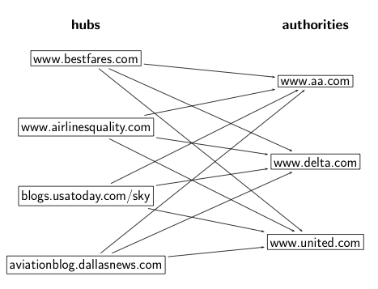
HITS: Hubs and authorities
7

Slide 8
HITS update rules
A: link matrix
h: vector of hub scores
a: vector of authority scores
HITS algorithm:
Compute h = Aa
Compute a = A^{T}h
Iterate until convergence
Output (i) list of hubs ranked according to hub score and (ii) list of authorities ranked according to authority score
8

Slide 9
Outline
Recap
Language models
Language Models for IR
Discussion

Slide 10
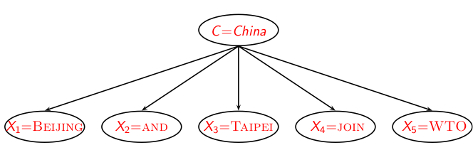
Recall: Naive Bayes generative model
10

Slide 11
Naive Bayes and LM generative models
We want to classify document d.
We want to classify a query q.
Classes: geographical regions like China, UK, Kenya.
Each document in the collection is a different class.
Assume that d was generated by the generative model.
Assume that q was generated by a generative model.
Key question: Which of the classes is most likely to have generated the document? Which document (=class) is most likely to have generated the query q?
Or: for which class do we have the most evidence? For which document (as the source of the query) do we have the most evidence?
11

Slide 12
Using language models (LMs) for IR
LM = language model
We view the document as a generative model that generates the query.
What we need to do:
Define the precise generative model we want to use
Estimate parameters (different parameters for each document’s model)
Smooth to avoid zeros
Apply to query and find document most likely to have generated the query
Present most likely document(s) to user
Note that x – y is pretty much what we did in Naive Bayes.

Slide 13
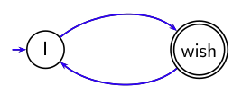
What is a language model?
We can view a finite state automaton as a deterministic language
model.
I wish I wish I wish I wish . . . Cannot generate: “wish I wish”
or “I wish I”. Our basic model: each document was generated by a different automaton like this except that these automata are probabilistic.
13

Slide 14
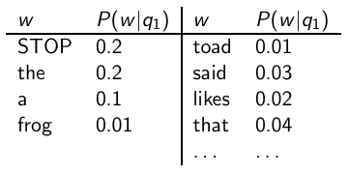

A probabilistic language model
This is a one-state probabilistic finite-state automaton – a unigram language model – and the state emission distribution for its one state q₁. STOP is not a word, but a special symbol indicating that the automaton stops. frog said that toad likes frog STOP
P(string) = 0.01 · 0.03 · 0.04 · 0.01 · 0.02 · 0.01 · 0.02
= 0.0000000000048
14

Slide 15
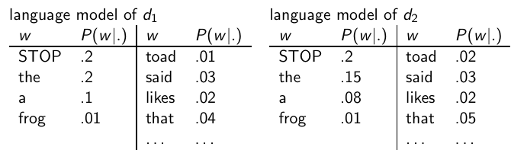
A different language model for each document
frog said that toad likes frog STOP P(string|M_{d1} ) = 0.01 · 0.03 · 0.04 · 0.01 · 0.02 · 0.01 · 0.02 = 0.0000000000048 = 4.8 · 10⁻¹²
P(string|M_{d2} ) = 0.01 · 0.03 · 0.05 · 0.02 · 0.02 · 0.01 · 0.02 = 0.0000000000120 = 12 · 10⁻¹² P(string|M_{d1} ) < P(string|M_{d2} )
Thus, document d₂ is “more relevant” to the string “frog said that toad likes frog STOP” than d₁ is.
15

Slide 16
Outline
Recap
Language models
Language Models for IR
Discussion

Slide 17

Using language models in IR
Each document is treated as (the basis for) a language model.
Given a query q
Rank documents based on P(d|q)
P(q) is the same for all documents, so ignore
P(d) is the prior – often treated as the same for all d
But we can give a prior to “high-quality” documents, e.g., those with high PageRank.
P(q|d) is the probability of q given d.
So to rank documents according to relevance to q, ranking according to P(q|d) and P(d|q) is equivalent.
17

Slide 18
Where we are
In the LM approach to IR, we attempt to model the query generation process.
Then we rank documents by the probability that a query would be observed as a random sample from the respective document model.
That is, we rank according to P(q|d).
Next: how do we compute P(q|d)?
18

Slide 19


How to compute P(q|d)
We will make the same conditional independence assumption as for Naive Bayes.
(|q|: length of q; t_{k} : the token occurring at position k in q)
This is equivalent to:
tf_{t,q}: term frequency (# occurrences) of t in q
Multinomial model (omitting constant factor)
19

Slide 20
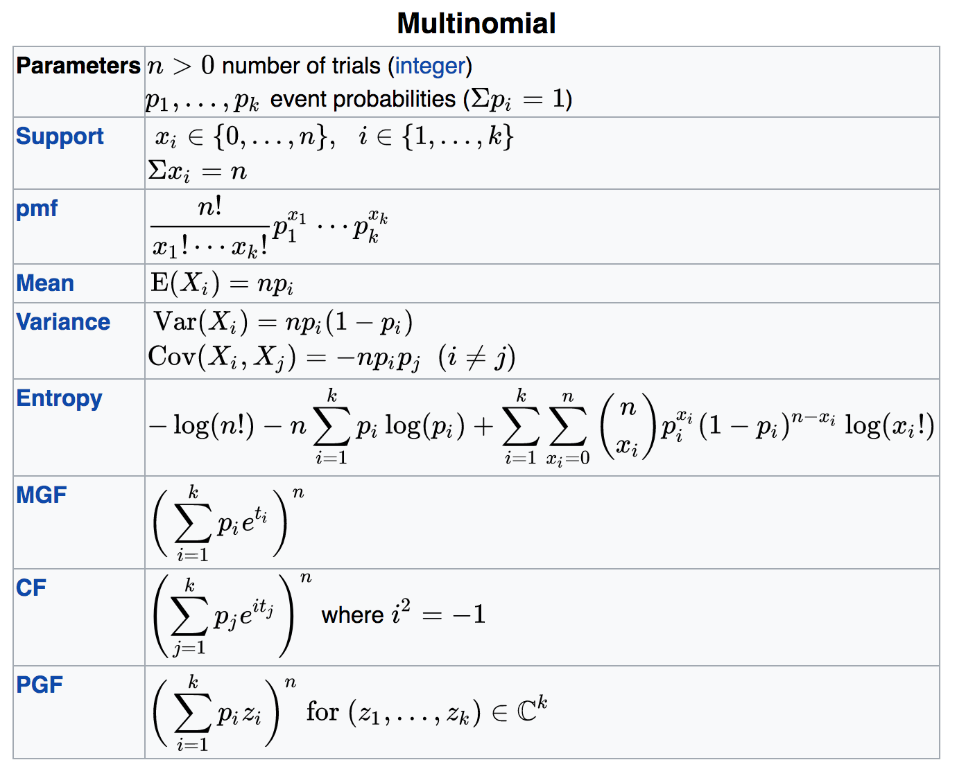

Slide 21

Parameter estimation
Missing piece: Where do the parameters P(t|M_{d}) come from?
Start with maximum likelihood estimates (as we did for Naive Bayes)
(|d|: length of d; tf_{t,d} : # occurrences of t in d)
As in Naive Bayes, we have a problem with zeros.
A single t with P(t|M_{d}) = 0 will make zero.
We would give a single term “veto power”.
For example, for query [Michael Jackson top hits] a document about “top songs” (but not using the word “hits”) would have P(t|M_{d}) = 0. – That’s bad.
We need to smooth the estimates to avoid zeros.
21

Slide 22

Smoothing
Key intuition: A nonoccurring term is possible (even though it didn’t occur), . . .
. . . but no more likely than would be expected by chance in the collection.
Notation: M_{c}: the collection model; cf_{t}: the number of occurrences of t in the collection; : the total number of tokens in the collection.
We will use to “smooth” P(t|d) away from zero.
22

Slide 23
Mixture model
P(t|d) = λP(t|M_{d}) + (1 - λ)P(t|M_{c})
Mixes the probability from the document with the general collection frequency of the word.
High value of λ: “conjunctive-like” search – tends to retrieve documents containing all query words.
Low value of λ: more disjunctive, suitable for long queries
Correctly setting λ is very important for good performance.
23

Slide 24

Mixture model: Summary
What we model: The user has a document in mind and generates the query from this document.
The equation represents the probability that the document that the user had in mind was in fact this one.
24

Slide 25
Example
Collection: d₁ and d₂
d₁ : Jackson was one of the most talented entertainers of all time
d₂: Michael Jackson anointed himself King of Pop
Query q: Michael Jackson
Use mixture model with λ = 1/2
P(q|d₁) = [(0/11 + 1/18)/2] · [(1/11 + 2/18)/2] ≈ 0.003
P(q|d₂) = [(1/7 + 1/18)/2] · [(1/7 + 2/18)/2] ≈ 0.013
Ranking: d₂ > d₁
25

Slide 26
Exercise: Compute ranking
Collection: d₁ and d₂
d₁ : Xerox reports a profit but revenue is down
d₂: Lucene narrows quarter loss but decreases further
Query q: revenue down
Use mixture model with λ = 1/2
P(q|d₁) = [(1/8 + 2/16)/2] · [(1/8 + 1/16)/2] = 1/8 · 3/32 =
3/256
P(q|d₂) = [(1/8 + 2/16)/2] · [(0/8 + 1/16)/2] = 1/8 · 1/32 =
1/256
Ranking: d₂ > d₁
26

Slide 27
Outline
Recap
Language models
Language Models for IR
Discussion

Slide 28
LMs vs. Naive Bayes
Different smoothing methods: mixture model vs. add-one
We classify the query in LMs; we classify documents in text classification.
Each document is a class in LMs vs. classes are human-defined in text classification
The formal model is the same: multinomial model.
Actually: The way we presented Naive Bayes, it’s not a true multinomial model, but it’s equivalent.
28

Slide 29
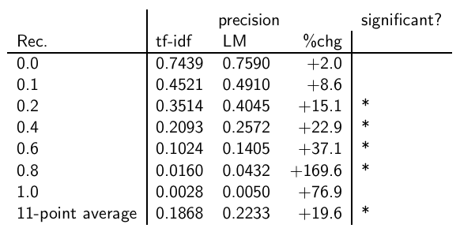
Vector space (tf-idf) vs. LM
The language modeling approach always does better in these experiments . . . . . . but note that where the approach shows significant gains is at higher levels of recall.
29

Slide 30
LMs vs. vector space model (1)
LMs have some things in common with vector space models.
Term frequency is directed in the model.
But it is not scaled in LMs.
Probabilities are inherently “length-normalized”.
Cosine normalization does something similar for vector space.
Mixing document and collection frequencies has an effect similar to idf.
Terms rare in the general collection, but common in some documents will have a greater influence on the ranking.
30

Slide 31
LMs vs. vector space model (2)
LMs vs. vector space model: commonalities
Term frequency is directly in the model.
Probabilities are inherently “length-normalized”.
Mixing document and collection frequencies has an effect similar to idf.
LMs vs. vector space model: differences
LMs: based on probability theory
Vector space: based on similarity, a geometric/ linear algebra notion
Collection frequency vs. document frequency
Details of term frequency, length normalization etc.
31

Slide 32
Language models for IR: Assumptions
Simplifying assumption: Queries and documents are objects of same type. Not true!
There are other LMs for IR that do not make this assumption.
The vector space model makes the same assumption.
Simplifying assumption: Terms are conditionally independent.
Again, vector space model (and Naive Bayes) makes the same assumption.
Cleaner statement of assumptions than vector space
Thus, better theoretical foundation than vector space
… but “pure” LMs perform much worse than “tuned” LMs.
32

Slide 33
Resources
Chapter 12 of IR
Resources at http://ifnlp.org/ir
Ponte and Croft’s 1998 SIGIR paper (one of the first on LMs in IR)
Lemur toolkit (good support for LMs in IR)
33

Slide 34
