Slide 1
Introduction to Information Retrieval
Lectured by Shangsong Liang
Sun Yat-sen University
From Jian-Yun Nie University of Montreal Canada

Slide 2
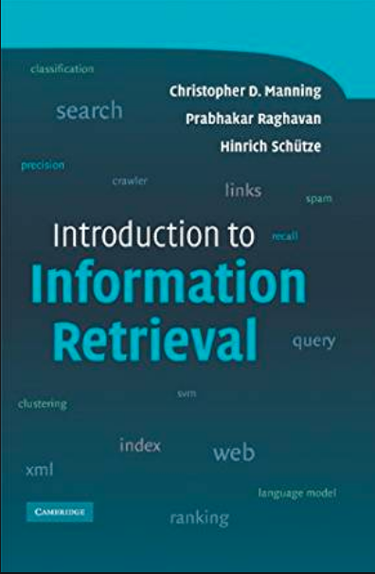
Textbook
Introduction to Information Retrieval. Christopher D. Manning, Prabhakar Raghavan, and Hinrich Schutze, Cambridge University Press, 2008.

Slide 3
References
SIGIR, KDD, WWW, WSDM, CIKM, NeurIPS, ICML, ICLR
IEEE TKDE, ACM TOIS
Modern Information Retrieval (2nd ed.). Baeza-Yates, R. A., and Ribeiro-Neto, B., Reading, Massachusetts: Addison-Wesley, 2010

Slide 4
Information Retrieval: Implementing and Evaluating Search Engines, Stefan Buttcher, Charles L. A. Clarke, and Gordon V. Cormack, MIT Press, 2016.
Information Retrieval and Management: Concepts, Methodologies, Tools, and Applications. IGI Publishing Hershey, PA, USA., 2018.
An Introduction to Neural Information Retrieval. Bhaskar Mitra, and Nick Craswell, Foundations and Trends in Information Retrieval, 2018.

Slide 5
Outline
What is the IR problem?
How to organize an IR system? (Or the main processes in IR)
Indexing
Retrieval
System evaluation
Some current research topics

Slide 6
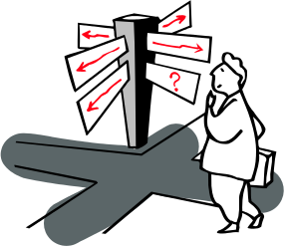

The problem of IR
Goal = find documents relevant to an information need from a large document set
Info. need
Query
Document
collection
IR system
Retrieval
Answer list

Slide 7

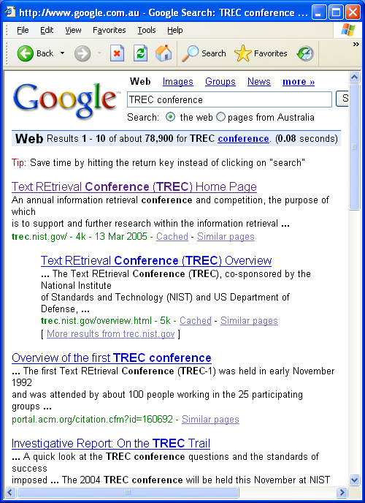
Example
Google
Web

Slide 8
IR problem
First applications: in libraries (1950s)
ISBN: 0-201-12227-8
Author: Salton, Gerard
Title: Automatic text processing: the transformation,
analysis, and retrieval of information by computer
Editor: Addison-Wesley
Date: 1989
Content: <Text>
external attributes and internal attribute (content)
Search by external attributes = Search in DB
IR: search by content

Slide 9
Possible approaches
  1. String matching (linear search in documents)
  - Slow
  - Difficult to improve
  2. Indexing (*)
    - Fast
    - Flexible to further improvement

Slide 10
Indexing-based IR
Document Query
indexing indexing
(Query analysis)
Representation Representation
(keywords) Query (keywords)
evaluation

Slide 11
Main problems in IR
Document and query indexing
  How to best represent their contents?
Query evaluation (or retrieval process)
  To what extent does a document correspond to a query?
System evaluation
  How good is a system?
  Are the retrieved documents relevant? (precision)
  Are all the relevant documents retrieved? (recall)

Slide 12
Document indexing
Goal = Find the important meanings and create an internal representation
Factors to consider:
  Accuracy to represent meanings (semantics)
  Exhaustiveness (cover all the contents)
  Facility for computer to manipulate
What is the best representation of contents?
  Char. string (char trigrams): not precise enough
  Word: good coverage, not precise
  Phrase: poor coverage, more precise
  Concept: poor coverage, precise
Coverage
(Recall)
Accuracy
(Precision)
String Word Phrase Concept

Slide 13
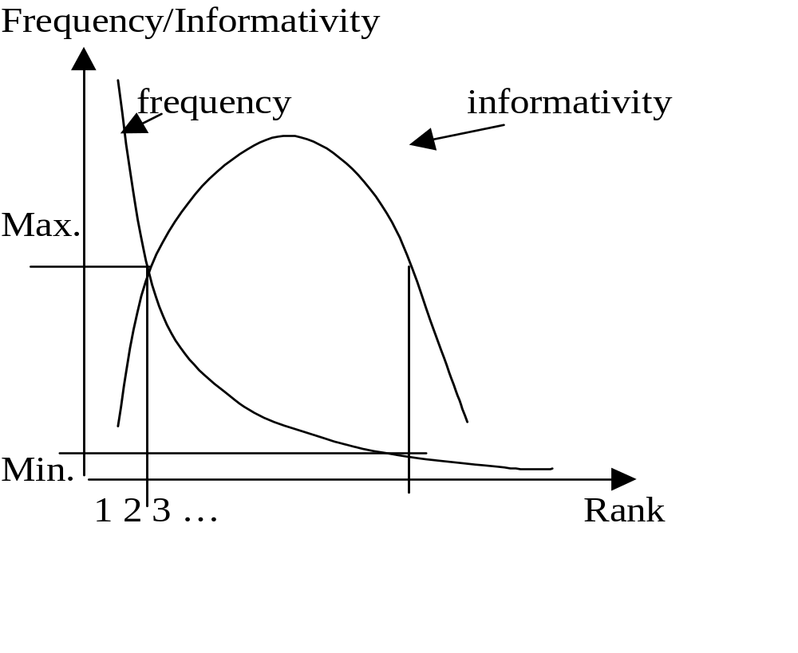
Keyword selection and weighting
How to select important keywords?
  Simple method: using middle-frequency words

Slide 14
tf*idf weighting schema
tf = term frequency
  frequency of a term/keyword in a document
The higher the tf, the higher the importance (weight) for the doc.
df = document frequency
  no. of documents containing the term
  distribution of the term
idf = inverse document frequency
  the unevenness of term distribution in the corpus
  the specificity of term to a document
The more the term is distributed evenly, the less it is specific to a document
weight(t,D) = tf(t,D) * idf(t)

Slide 15
Some common tf*idf schemes
tf(t, D)=freq(t,D) idf(t) = log(N/n)
tf(t, D)=log[freq(t,D)] n = #docs containing t
tf(t, D)=log[freq(t,D)]+1 N = #docs in corpus
tf(t, D)=freq(t,d)/Max[f(t,d)]
weight(t,D) = tf(t,D) * idf(t)
Normalization: Cosine normalization, /max, …

Slide 16
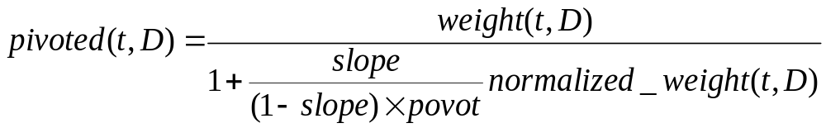
Document Length Normalization
Sometimes, additional normalizations e.g. length:
Probability
of relevance
slope
pivot
Probability of retrieval
Doc. length

Slide 17
Stopwords / Stoplist
function words do not bear useful information for IR
of, in, about, with, I, although, …
Stoplist: contain stopwords, not to be used as index
  Prepositions
  Articles
  Pronouns
  Some adverbs and adjectives
  Some frequent words (e.g. document)
The removal of stopwords usually improves IR effectiveness
A few “standard” stoplists are commonly used.

Slide 18
Stemming
Reason:
  Different word forms may bear similar meaning (e.g. search, searching): create a “standard” representation for them
Stemming:
  Removing some endings of word
  computer
  compute
  computes
  computing
  computed
  computation
comput

Slide 19
Porter algorithm
(Porter, M.F., 1980, An algorithm for suffix stripping, Program, 14(3) :130-137)
Step 1: plurals and past participles
  SSES -> SS caresses -> caress
  (*v*) ING -> motoring -> motor
Step 2: adj->n, n->v, n->adj, …
  (m>0) OUSNESS -> OUS callousness -> callous
  (m>0) ATIONAL -> ATE relational -> relate
Step 3:
  (m>0) ICATE -> IC triplicate -> triplic
Step 4:
  (m>1) AL -> revival -> reviv
  (m>1) ANCE -> allowance -> allow
Step 5:
  (m>1) E -> probate -> probat
  (m > 1 and *d and *L) -> single letter controll -> control

Slide 20
Lemmatization (词形归并)
transform to standard form according to syntactic category.
  E.g. verb + ing → verb
    noun + s → noun
  Need POS tagging
  More accurate than stemming, but needs more resources
crucial to choose stemming/lemmatization rules
noise v.s. recognition rate
compromise between precision and recall
light/no stemming severe stemming
-recall +precision +recall -precision

Slide 21
Result of indexing
Each document is represented by a set of weighted keywords (terms):
  D₁ → {(t₁, w₁), (t₂,w₂), …}
  e.g. D₁ → {(comput, 0.2), (architect, 0.3), …}
  D₂ → {(comput, 0.1), (network, 0.5), …}
Inverted file:
  comput → {(D₁,0.2), (D₂,0.1), …}
  Inverted file is used during retrieval for higher efficiency.

Slide 22
Retrieval
The problems underlying retrieval
  Retrieval model
    How is a document represented with the selected keywords?
    How are document and query representations compared to calculate a score?
  Implementation

Slide 23
Cases
1-word query:
  The documents to be retrieved are those that include the word
  Retrieve the inverted list for the word
  Sort in decreasing order of the weight of the word
Multi-word query?
  Combining several lists
  How to interpret the weight?
  (IR model)

Slide 24
IR models
Matching score model
  Document D = a set of weighted keywords
  Query Q = a set of non-weighted keywords
  R(D, Q) = Σ_{i} w(t_{i} , D)
where t_{i} is in Q.

Slide 25
Boolean model
  Document = Logical conjunction of keywords
  Query = Boolean expression of keywords
  R(D, Q) = D →Q
e.g. D = t₁ ∧ t₂ ∧ … ∧ t_{n}
Q = (t₁ ∧ t₂) ∨ (t₃ ∧ ¬t₄)
D →Q, thus R(D, Q) = 1.
Problems:
  R is either 1 or 0 (unordered set of documents)
  many documents or few documents
  End-users cannot manipulate Boolean operators correctly
  E.g. documents about kangaroos and koalas

Slide 26
Extensions to Boolean model
(for document ordering)
D = {…, (t_{i}, w_{i}), …}: weighted keywords
Interpretation:
  D is a member of class t_{i} to degree w_{i}.
  In terms of fuzzy sets: μ_{ti}(D) = w_{i}
A possible Evaluation:
R(D, t_{i}) = μ_{ti}(D);
R(D, Q₁ ∧ Q₂) = min(R(D, Q₁), R(D, Q₂));
R(D, Q₁ ∨ Q₂) = max(R(D, Q₁), R(D, Q₂));
R(D, ¬Q₁) = 1 - R(D, Q₁).

Slide 27
Vector space model
Vector space = all the keywords encountered
<t₁, t₂, t₃, …, t_{n}>
Document
D = < a₁, a₂, a₃, …, a_{n}>
a_{i} = weight of t_{i} in D
Query
Q = < b₁, b₂, b₃, …, b_{n}>
b_{i} = weight of t_{i} in Q
R(D,Q) = Sim(D,Q)

Slide 28
Matrix representation
Document space
t₁ t₂ t₃ … t_{n}
D₁ a₁₁ a₁₂ a₁₃ … a_{1n}
D₂ a₂₁ a₂₂ a₂₃ … a_{2n}
D₃ a₃₁ a₃₂ a₃₃ … a_{3n}
…
D_{m} a_{m1} a_{m2} a_{m3} … a_{mn}
Q b₁ b₂ b₃ … b_{n}
Term vector space

Slide 29
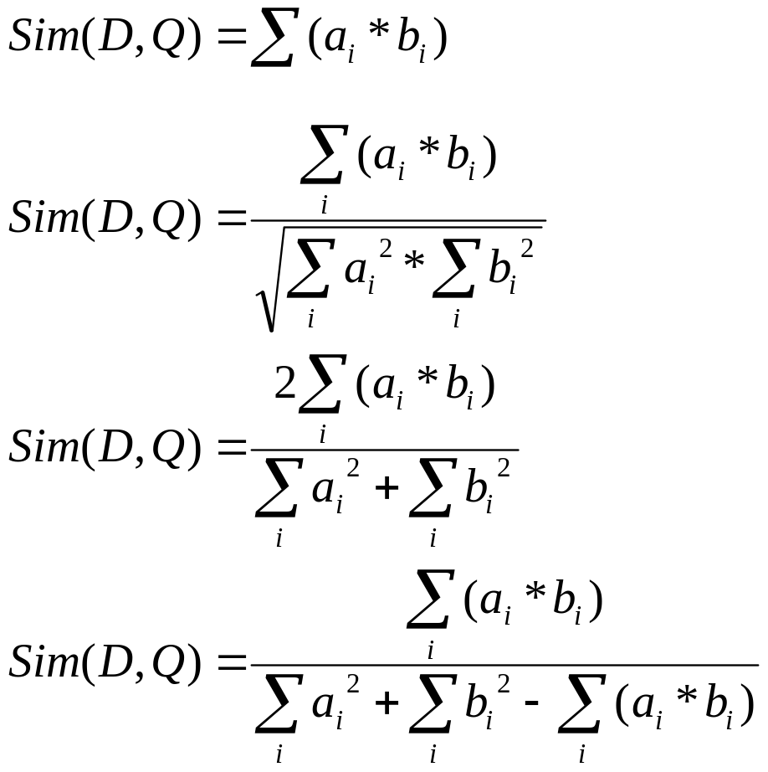
Some formulas for Sim
Dot product
Cosine
Dice
Jaccard
t1
D
Q
t2

Slide 30
Implementation (space)
Matrix is very sparse: a few 100s terms for a document, and a few terms for a query, while the term space is large (~100k)
Stored as:
D1 → {(t1, a1), (t2,a2), …}
t1 → {(D1,a1), …}

Slide 31
Implementation (time)
The implementation of VSM with dot product:
  Naïve implementation: O(m*n)
  Implementation using inverted file:
Given a query = {(t1,b1), (t2,b2)}:
  1. find the sets of related documents through inverted file for t1 and t2
  2. calculate the score of the documents to each weighted term
  (t1,b1) → {(D1,a1 *b1), …}
  3. combine the sets and sum the weights (∑)
  O(|Q|*n)

Slide 32
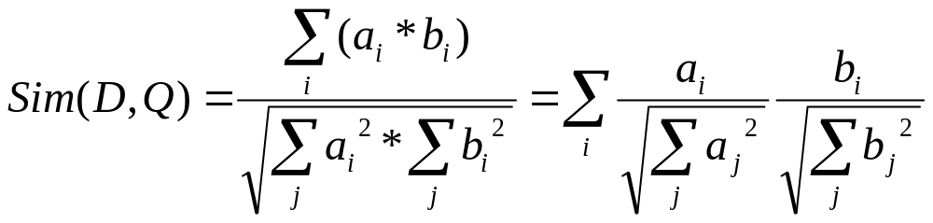
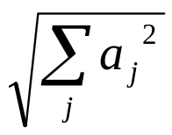
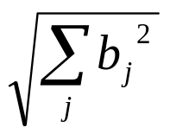
Other similarities
Cosine:
use and to normalize the weights after indexing
Dot product
(Similar operations do not apply to Dice and Jaccard)

Slide 33
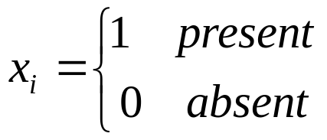
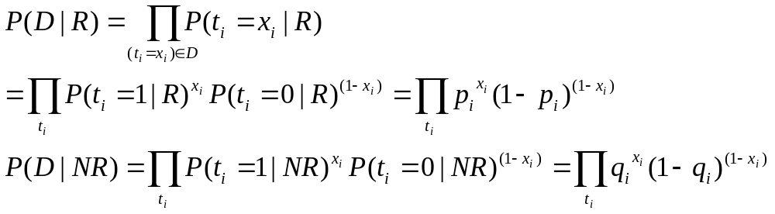
Probabilistic model
Given D, estimate P(R|D) and P(NR|D)
P(R|D)=P(D|R)*P(R)/P(D) (P(D), P(R) constant)
∝ P(D|R)
D = {t₁=x₁, t₂=x₂, …}

Slide 34
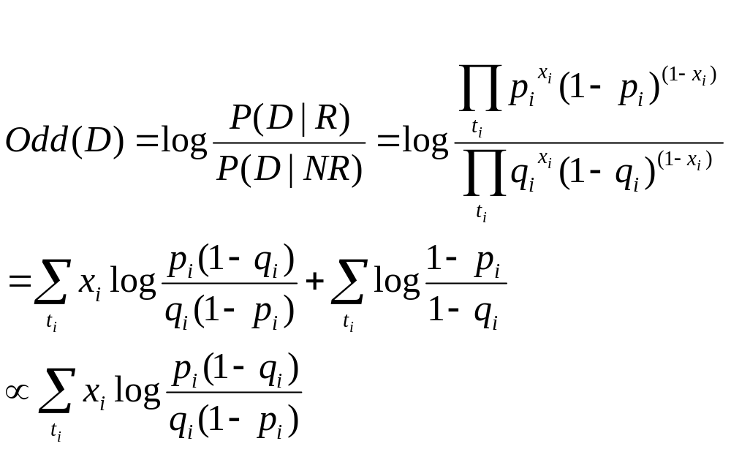
Prob. model (cont’d)
For document ranking

Slide 35
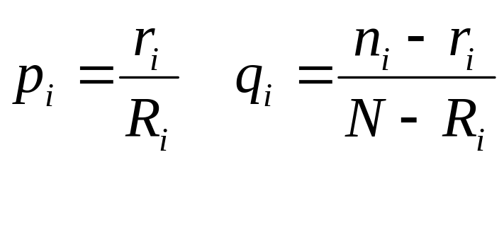
Prob. model (cont’d)
r_{i} Rel. doc. with t_{i} | n_{i}-r_{i} Irrel.doc. with t_{i} | n_{i} Doc. with t_{i}
R_{i}-r_{i} Rel. doc. without t_{i} | N-R_{i}–n+r_{i} Irrel.doc. without t_{i} | N-n_{i} Doc. without ti
R_{i} Rel. doc | N-R_{i} Irrel.doc. | N Samples
How to estimate p_{i} and q_{i}?
A set of N relevant and irrelevant samples:

Slide 36
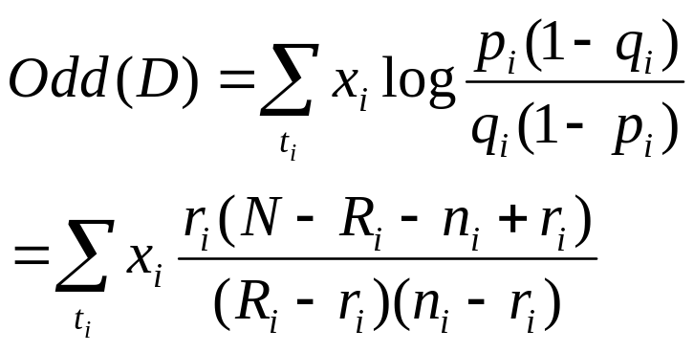
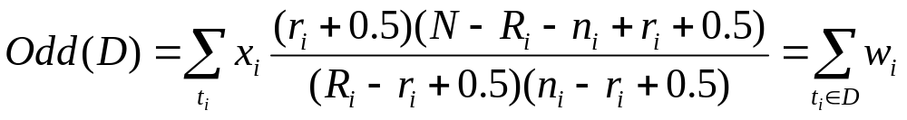
Prob. model (cont’d)
Smoothing (Robertson-Sparck-Jones formula)
When no sample is available:
p_{i}=0.5,
q_{i}=(n_{i}+0.5)/(N+0.5)≈n_{i}/N
May be implemented as VSM

Slide 37
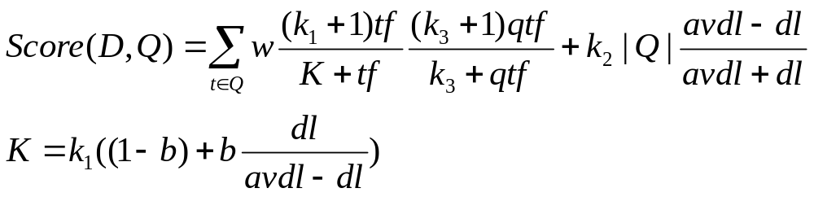
BM25
k1, k2, k3, d: parameters
qtf: query term frequency
dl: document length
avdl: average document length

Slide 38
(Classic) Presentation of results
Query evaluation result is a list of documents, sorted by their similarity to the query.
E.g.
doc1 0.67
doc2 0.65
doc3 0.54
…

Slide 39
System evaluation
Efficiency: time, space
Effectiveness:
  How is a system capable of retrieving relevant documents?
  Is a system better than another one?
Metrics often used (together):
  Precision = retrieved relevant docs / retrieved docs
  Recall = retrieved relevant docs / relevant docs
  relevant retrieved
retrieved relevant

Slide 40
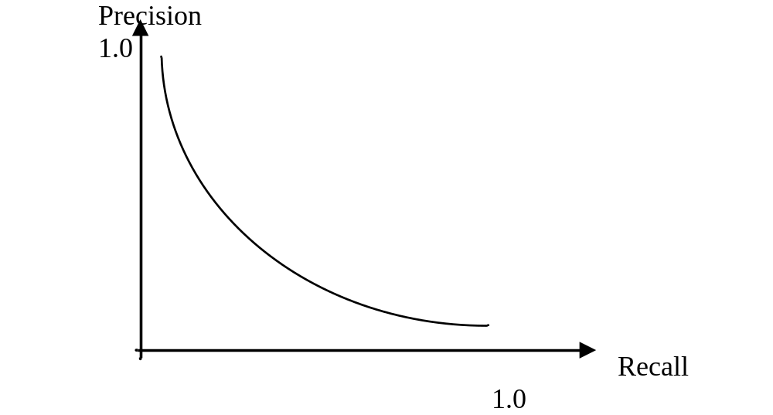
General form of precision/recall
Precision change w.r.t. Recall (not a fixed point)
Systems cannot compare at one Precision/Recall point
Average precision (on 11 points of recall: 0.0, 0.1, …, 1.0)

Slide 41
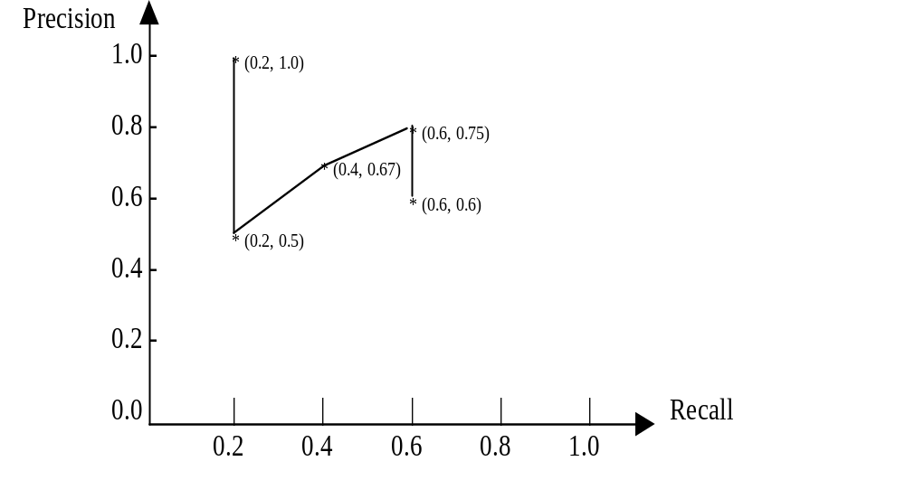
An illustration of P/R calculation
List | Rel?
Doc1 | Y
Doc2
Doc3 | Y
Doc4 | Y
Doc5
…
Assume: 5 relevant docs.

Slide 42
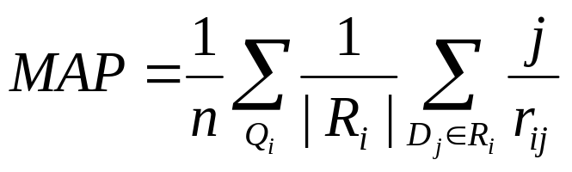
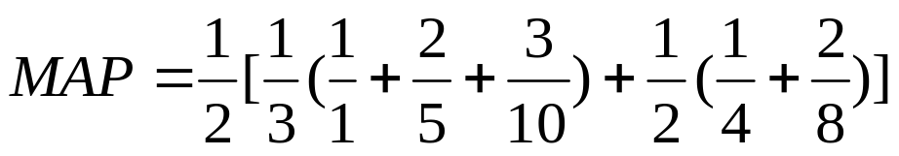
MAP (Mean Average Precision)
r_{ij} = rank of the j-th relevant document for Q_{i}
|R_{i}| = #rel. doc. for Q_{i}
n = # test queries
E.g. Rank: 1 4 1st rel. doc.
5 8 2nd rel. doc.
10 3rd rel. doc.

Slide 43
Some other measures
Noise = retrieved irrelevant docs / retrieved docs
Silence = non-retrieved relevant docs / relevant docs
  Noise = 1 – Precision; Silence = 1 – Recall
Fallout = retrieved irrel. docs / irrel. docs
Single value measures:
  F-measure = 2 P * R / (P + R)
  Average precision = average at 11 points of recall
  Precision at n document (often used for Web IR)
  Expected search length (no. irrelevant documents to read before obtaining n relevant doc.)

Slide 44
Test corpus
Compare different IR systems on the same test corpus
A test corpus contains:
  A set of documents
  A set of queries
  Relevance judgment for every document-query pair (desired answers for each query)
The results of a system is compared with the desired answers.

Slide 45
An evaluation example (SMART)
Run number: 1 2
Num_queries: 52 52
Total number of documents over all queries
Retrieved: 780 780
Relevant: 796 796
Rel_ret: 246 229
Recall - Precision Averages:
at 0.00 0.7695 0.7894
at 0.10 0.6618 0.6449
at 0.20 0.5019 0.5090
at 0.30 0.3745 0.3702
at 0.40 0.2249 0.3070
at 0.50 0.1797 0.2104
at 0.60 0.1143 0.1654
at 0.70 0.0891 0.1144
at 0.80 0.0891 0.1096
at 0.90 0.0699 0.0904
at 1.00 0.0699 0.0904
Average precision for all points
11-pt Avg: 0.2859 0.3092
% Change: 8.2
Recall:
Exact: 0.4139 0.4166
at 5 docs: 0.2373 0.2726
at 10 docs: 0.3254 0.3572
at 15 docs: 0.4139 0.4166
at 30 docs: 0.4139 0.4166
Precision:
Exact: 0.3154 0.2936
At 5 docs: 0.4308 0.4192
At 10 docs: 0.3538 0.3327
At 15 docs: 0.3154 0.2936
At 30 docs: 0.1577 0.1468

Slide 46
The TREC experiments
Once per year
A set of documents and queries are distributed to the participants (the standard answers are unknown) (April)
Participants work (very hard) to construct, fine-tune their systems, and submit the answers (1000/query) at the deadline (July)
NIST people manually evaluate the answers and provide correct answers (and classification of IR systems) (July – August)
TREC conference (November)

Slide 47
TREC evaluation methodology
Known document collection (>100K) and query set (50)
Submission of 1000 documents for each query by each participant
Merge 100 first documents of each participant -> global pool
Human relevance judgment of the global pool
The other documents are assumed to be irrelevant
Evaluation of each system (with 1000 answers)
  Partial relevance judgments
  But stable for system ranking

Slide 48
Tracks (tasks)
Ad Hoc track: given document collection, different topics
Routing (filtering): stable interests (user profile), incoming document flow
CLIR: Ad Hoc, but with queries in a different language
Web: a large set of Web pages
Question-Answering: When did Nixon visit China?
Interactive: put users into action with system
Spoken document retrieval
Image and video retrieval
Information tracking: new topic / follow up

Slide 49
CLEF and NTCIR
CLEF = Cross-Language Experimental Forum
  for European languages
  organized by Europeans
  Each per year (March – Oct.)
NTCIR:
  Organized by NII (Japan)
  For Asian languages
  cycle of 1.5 year

Slide 50
Impact of TREC
Provide large collections for further experiments
Compare different systems/techniques on realistic data
Develop new methodology for system evaluation
Similar experiments are organized in other areas (NLP, Machine translation, Summarization, …)

Slide 51
Some techniques to improve IR effectiveness
Interaction with user (relevance feedback)
- Keywords only cover part of the contents
- User can help by indicating relevant/irrelevant document
The use of relevance feedback
  To improve query expression:
  Q_{new} = α*Q_{old} + β*Rel_d - γ*Nrel_d
  where Rel_d = centroid of relevant documents
  NRel_d = centroid of non-relevant documents

Slide 52
Effect of RF
2nd retrieval
1st retrieval
* x * x x
* * * x x
* * R* Q * NR x
* x * x x
* * x
* * *
* *
* *
* *
Q_{new}

Slide 53
Modified relevance feedback
Users usually do not cooperate (e.g. AltaVista in early years)
Pseudo-relevance feedback (Blind RF)
  Using the top-ranked documents as if they are relevant:
    Select m terms from n top-ranked documents
  One can usually obtain about 10% improvement

Slide 54
Query expansion
A query contains part of the important words
Add new (related) terms into the query
  Manually constructed knowledge base/thesaurus (e.g. Wordnet)
    Q = information retrieval
    Q’ = (information + data + knowledge + …)
    (retrieval + search + seeking + …)
  Corpus analysis:
    two terms that often co-occur are related (Mutual information)
    Two terms that co-occur with the same words are related (e.g. T-shirt and coat with wear, …)

Slide 55
Global vs. local context analysis
Global analysis: use the whole document collection to calculate term relationships
Local analysis: use the query to retrieve a subset of documents, then calculate term relationships
  Combine pseudo-relevance feedback and term co-occurrences
  More effective than global analysis

Slide 56
Some current research topics:
Go beyond keywords
Keywords are not perfect representatives of concepts
  Ambiguity:
  table = data structure, furniture?
  Lack of precision:
  “operating”, “system” less precise than “operating_system”
Suggested solution
  Sense disambiguation (difficult due to the lack of contextual information)
  Using compound terms (no complete dictionary of compound terms, variation in form)
  Using noun phrases (syntactic patterns + statistics)
Still a long way to go

Slide 57
Theory …
Bayesian networks
  P(Q|D)
  D1 D2 D3 … Dm
  t1 t2 t3 t4 …. tn
  c1 c2 c3 c4 … cl
  Inference Q revision
Language models

Slide 58
Logical models
How to describe the relevance relation as a logical relation?
D => Q
What are the properties of this relation?
How to combine uncertainty with a logical framework?
The problem: What is relevance?

Slide 59
Related applications:
Information filtering
IR: changing queries on stable document collection
IF: incoming document flow with stable interests (queries)
  yes/no decision (in stead of ordering documents)
  Advantage: the description of user’s interest may be improved using relevance feedback (the user is more willing to cooperate)
  Difficulty: adjust threshold to keep/ignore document
  The basic techniques used for IF are the same as those for IR – “Two sides of the same coin”
keep
… doc3, doc2, doc1
IF
ignore
User profile

Slide 60
IR for (semi-)structured documents
Using structural information to assign weights to keywords (Introduction, Conclusion, …)
  Hierarchical indexing
Querying within some structure (search in title, etc.)
  INEX experiments
Using hyperlinks in indexing and retrieval (e.g. Google)
…

Slide 61
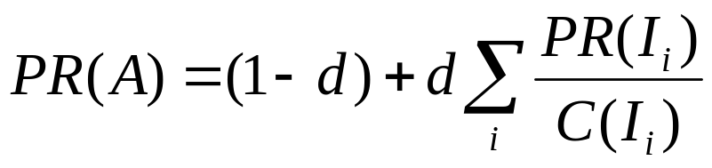
PageRank in Google
I₁
A
B
I₂
Assign a numeric value to each page
The more a page is referred to by important pages, the more this page is important
d: damping factor (0.85)
Many other criteria: e.g. proximity of query words
  “…information retrieval …” better than “… information … retrieval …”

Slide 62
IR on the Web
No stable document collection (spider, crawler)
Invalid document, duplication, etc.
Huge number of documents (partial collection)
Multimedia documents
Great variation of document quality
Multilingual problem
…

Slide 63
Final remarks on IR
IR is related to many areas:
  NLP, AI, database, machine learning, user modeling…
  library, Web, multimedia search, …
Relatively week theories
Very strong tradition of experiments
Many remaining (and exciting) problems
Difficult area: Intuitive methods do not necessarily improve effectiveness in practice

Slide 64
Why is IR difficult
Vocabularies mismatching
  Synonymy: e.g. car v.s. automobile
  Polysemy: table
Queries are ambiguous, they are partial specification of user’s need
Content representation may be inadequate and incomplete
The user is the ultimate judge, but we don’t know how the judge judges…
  The notion of relevance is imprecise, context- and user-dependent
But how much it is rewarding to gain 10% improvement!

