Slide 1
GPP Exam: Zombie AI
By Miguel Lozano

Slide 2
WHAT IS (GOAP)
Hungry==
true
Hungry
==
false
HasWeapon
==
true
HasMedkits
==
true
HasWeapon==
false
IsInPurgeZone
==
false
HasFood
==
true
Was Bitten
==
false
Has Med Kits
==
true
You define Goals as desired world states.
Is In PurgZone ==
true

Slide 3
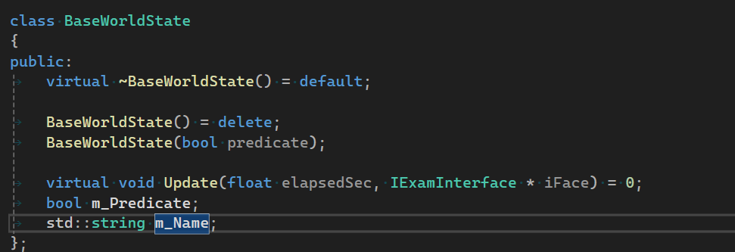
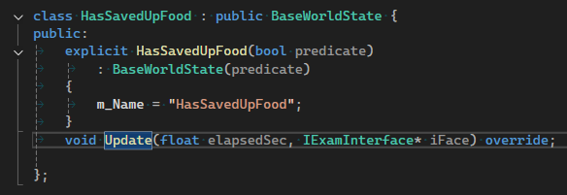

World States

Slide 4
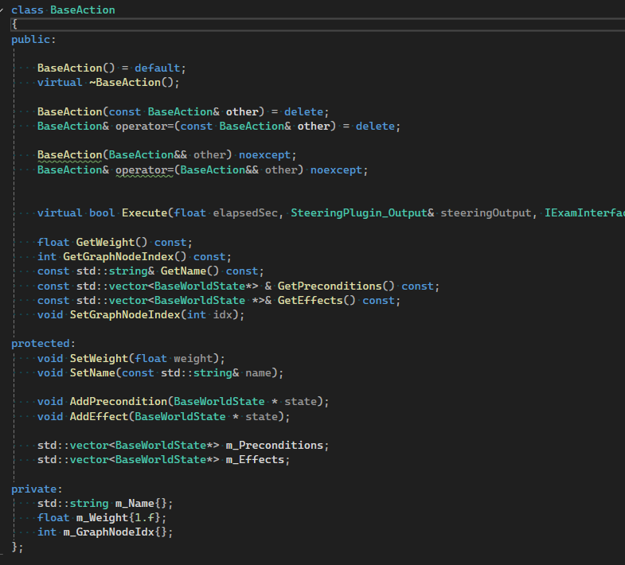
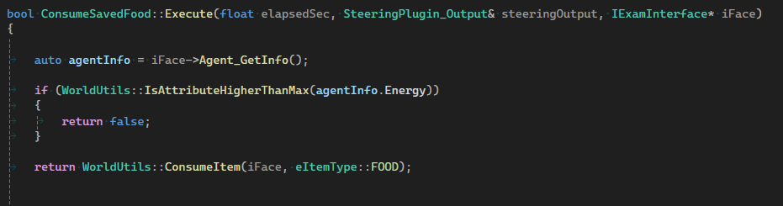
Actions

Slide 5
Actions
PRECONDITIONS
HUNGRY == FALSE
Has Food ==
true
CONSUME FOOD
Hungry
==
true
EFFECTS ON WORLD
Hungry
==
false
Have Preconditions (when the action can be done).
Have Effects (what the action changes).
(Optionally) Have costs.

Slide 6
Planning
So GOAP is about building a plan (sequence of actions) that takes the world from “now” to “desired”.
Hungry
==
true
Hungry
==
False
Consume Food
Search Foor Food
Go To Food

Slide 7
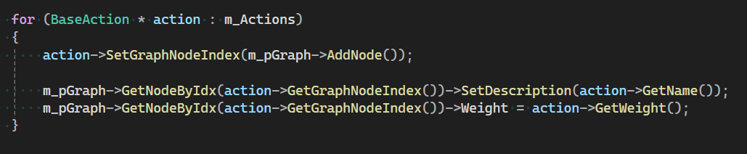

Slide 8
Planning

Slide 9
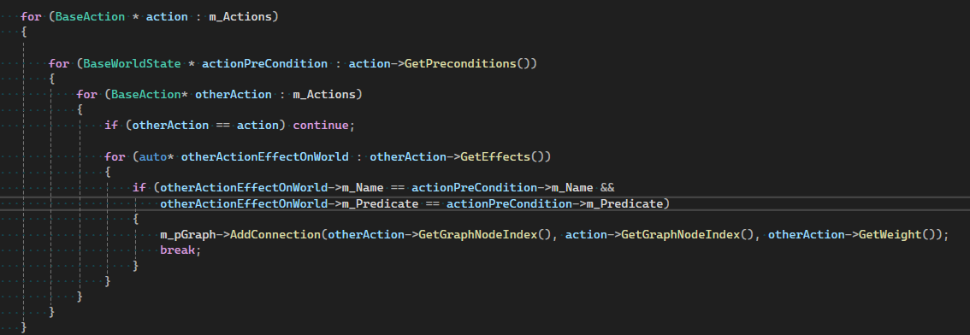

Slide 10
Planning
Next To Weapon
Pick Up Weapon
Has Weapon
Knows weapon Location
Next To Weapon
Go To Nearest Gun

Slide 11
Planning
Next To Weapon
Pick Up Weapon
Has Weapon
Knows weapon Location
Next To Weapon
Go To Nearest Gun

Slide 12
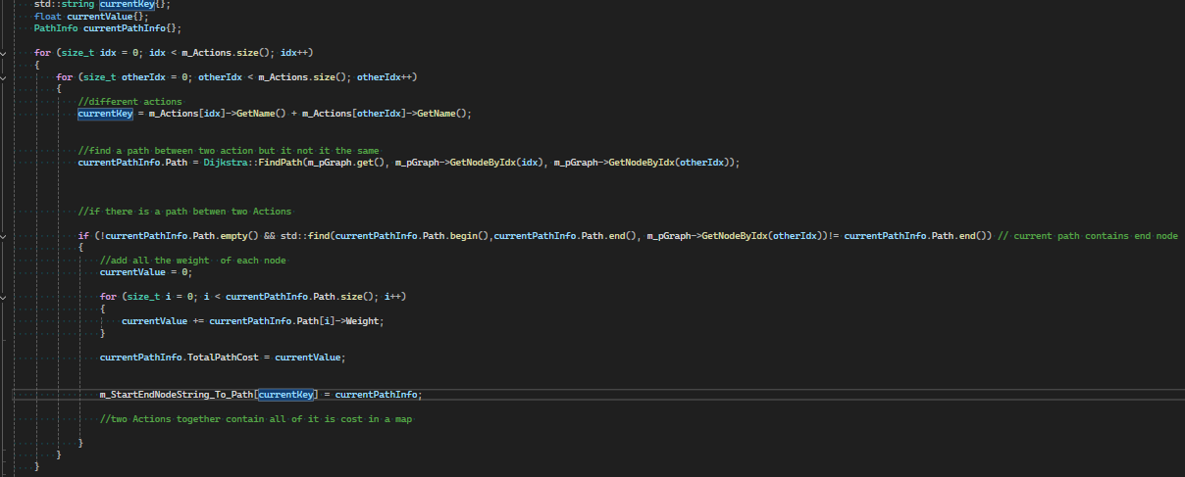
Code Insert Picture OF Ading a node for each Action that we can take

Slide 13
Planning
Next To Weapon
Pick Up Weapon
Has Weapon
Knows weapon Location
Next To Weapon
Go To Nearest Gun

Slide 14
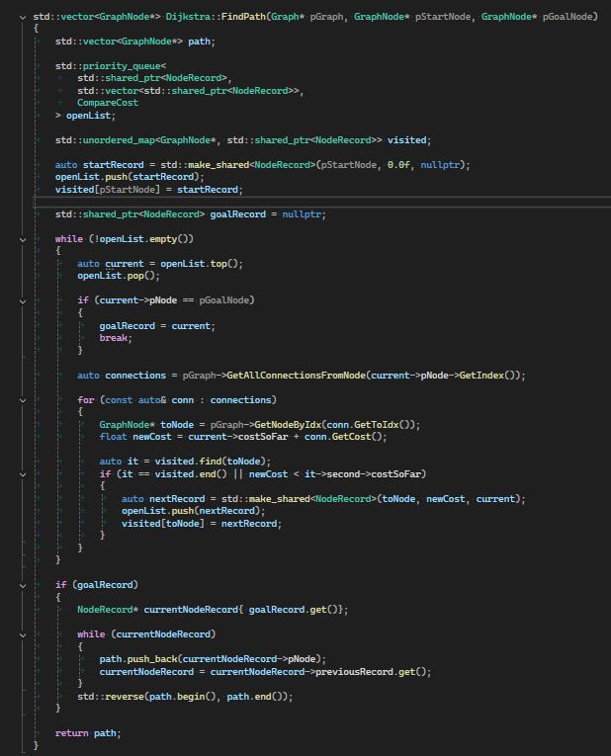
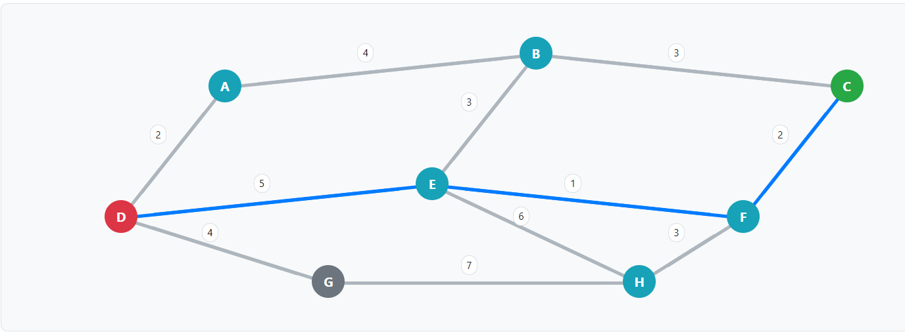
Affter we have all the connection we have a Grpah we need to use the Djstra algorithm to see if there is a path in outr graph and see if our goal can be achieved
Hungry
==
false
m_CurrentGoal =

Slide 15
Affter we have all the connection we have a Grpah we need to use the Djstra algorithm to see if there is a path in outr graph and see if our goal can be achieved
Hungry
==
false
m_CurrentGoal =

Slide 16
Code Insert Picture OF Ading a node for each Action that we can take

Slide 17
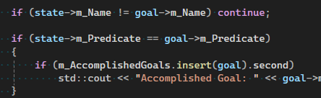
Hungry
==
false
Hungry
==
true
CAN THIS GOAL BE ACHIEVED ?
We need to create A Graph , that will be Connected throught Actions and will link the
Start Node and the end Node
Start Node
End Node
Index 0
Index
1
Create Path

Slide 18
Code Insert Picture linking the action that can be executed right now

Slide 19
This Actions can be used right Away
Start Node
End Node
Index 0
Index
1

Slide 20
Code Insert Picture Check If Any Action has a effect that lets don’t forget that joint with the end
Hungry
==
false

Slide 21
Hungry
==
false
EAT FOOD
Start Node
End Node
Index 0
Index
1

Slide 22
Inset picyure of Last part where connections ate made

Slide 23
EAT FOOD
Start Node
End Node
Index 0
Index
1

Slide 24
DIJKSTRA VS A*
Djistra vs A*

Slide 25
CONSUME FOOD
CONSUME FOOD
CONSUME FOOD
CONSUME FOOD
Hungry
==
false

