Slide 1
GPP Exam: Zombie AI
By Miguel Lozano

Slide 2
WHAT IS (GOAP)
Hungry==
true
Hungry
==
false
HasWeapon
==
true
HasMedkits
==
true
HasWeapon==
false
IsInPurgeZone
==
false
HasFood
==
true
Was Bitten
==
false
Has Med Kits
==
true
You define Goals as desired world states.
Is In PurgZone ==
true

Slide 3
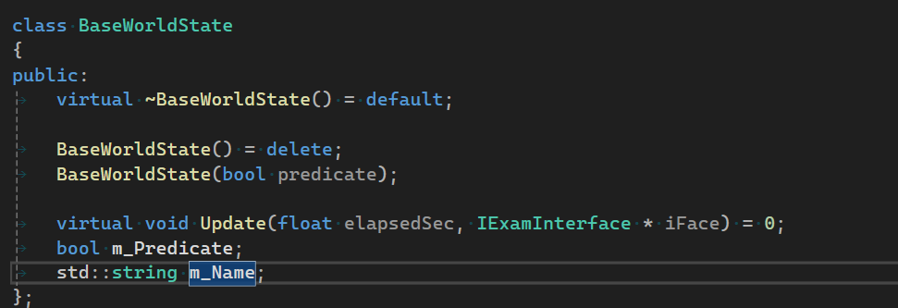
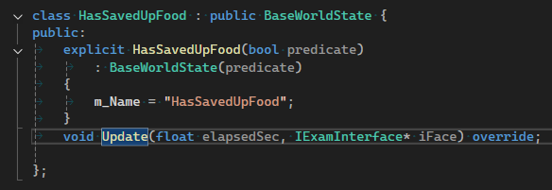

World States

Slide 4
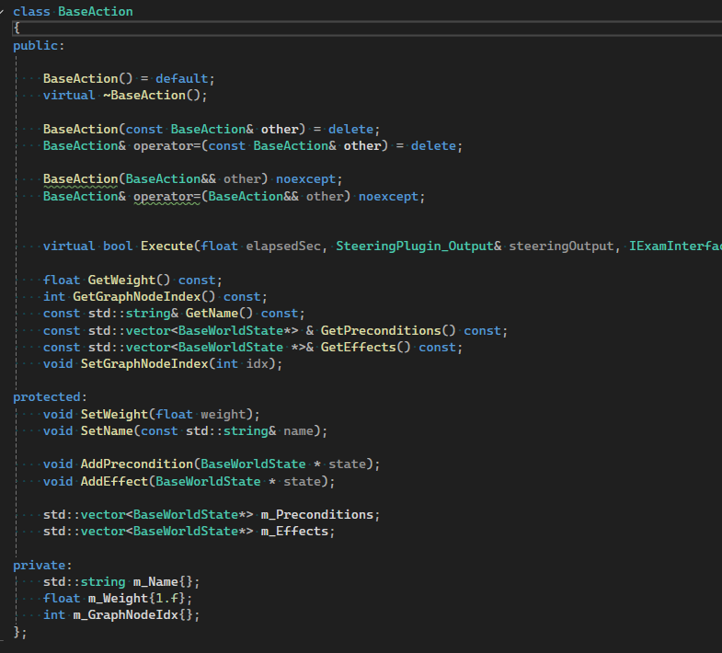
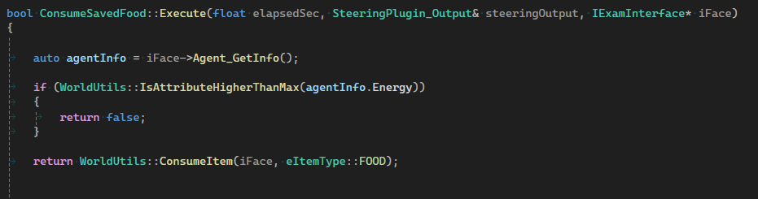
Actions

Slide 5
Actions
PRECONDITIONS
HUNGRY == FALSE
Has Food ==
true
CONSUME FOOD
Hungry
==
true
EFFECTS ON WORLD
Hungry
==
false
Have Preconditions (when the action can be done).
Have Effects (what the action changes).
(Optionally) Have costs.

Slide 6
Planning
So GOAP is about building a plan (sequence of actions) that takes the world from “now” to “desired”.
Hungry
==
true
Hungry
==
False
Consume Food
Search Foor Food
Go To Food

Slide 7
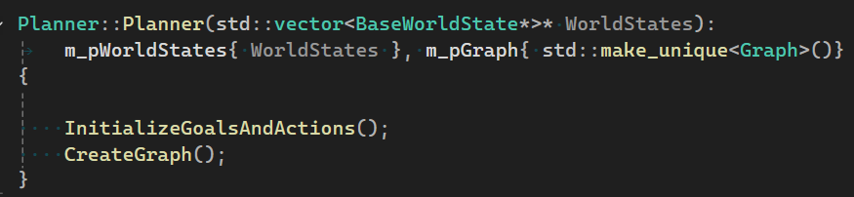
GOAP OpTIMIZation

Slide 8
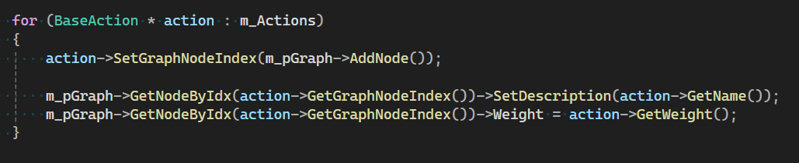
ADD aCTIONS

Slide 9
Planning

Slide 10
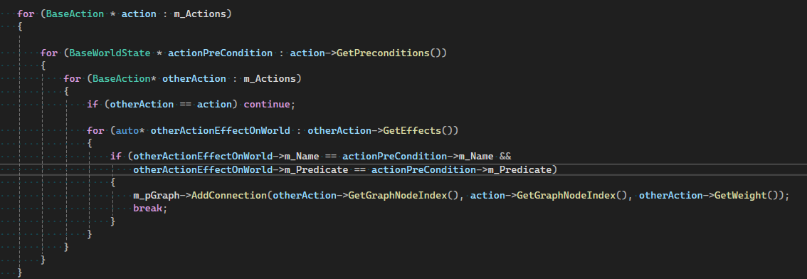

Slide 11
Planning
Next To Weapon
Pick Up Weapon
Has Weapon
Knows weapon Location
Next To Weapon
Go To Nearest Gun

Slide 12
Planning
Next To Weapon
Pick Up Weapon
Has Weapon
Knows weapon Location
Next To Weapon
Go To Nearest Gun

Slide 13
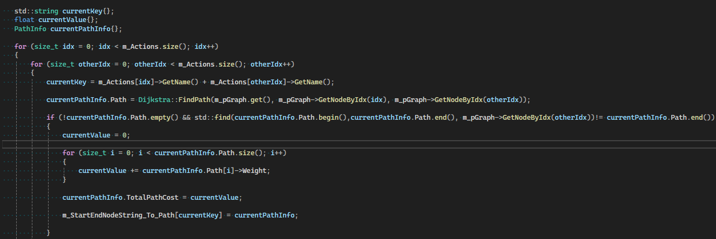
Find Connections

Slide 14
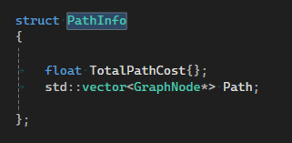
Go To Weapon
Pick Up weapon
Is there a path
Go To Weapon
Pick Up weapon
KEY
+

Slide 15
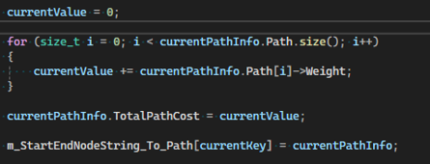
Calculating Weight
Node
Node
Node
Node
Total Weight
+
+
+
=

Slide 16
Why DiJkstra ?

Slide 17
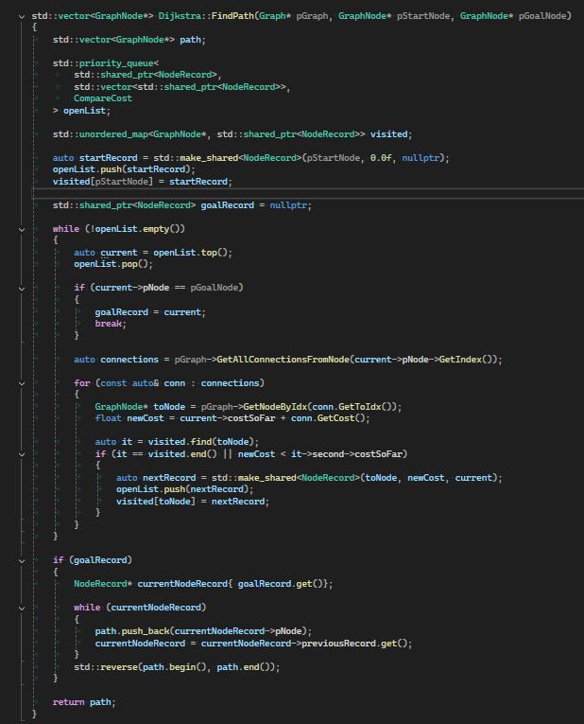
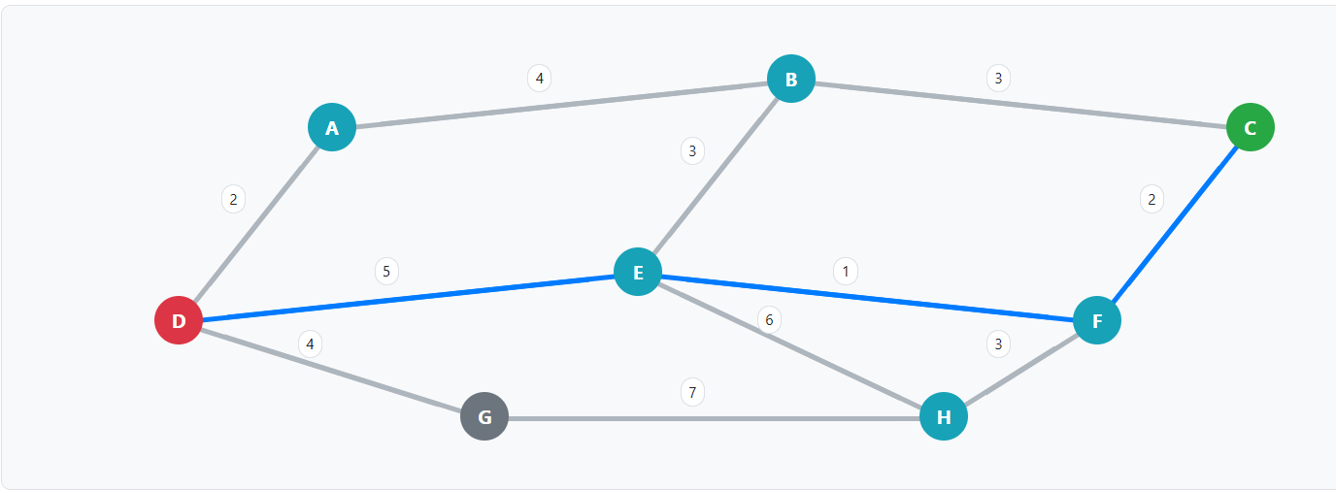
Djikstra
Dijkstra’s Algorithm
Finds the shortest path from a source node to all other nodes in a weighted graph.
Does not use heuristics → it explores all reachable nodes systematically.
Guarantees the optimal path, but can be inefficient because it explores more than needed.

Slide 18
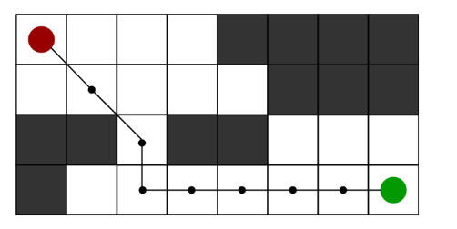
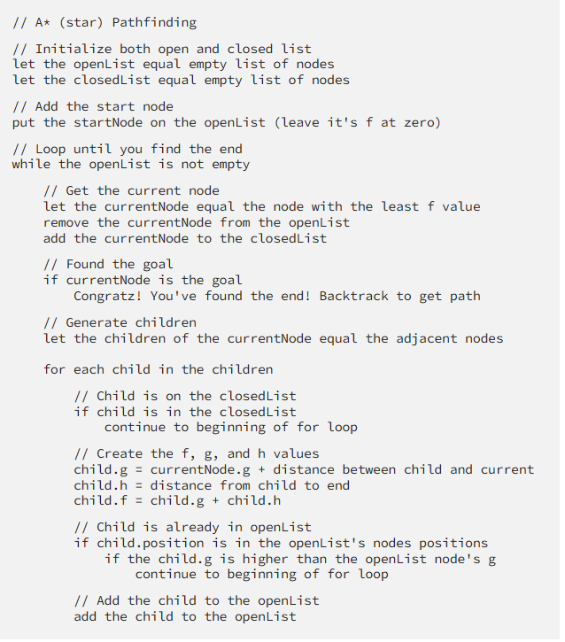
A *
A* (A-star)
Designed for shortest path from a source to a specific target/goal.
Uses a heuristic function h(n)h(n)h(n) to estimate cost to goal.
Much faster than Dijkstra when a good heuristic is available.
A* only helps if you can design a good heuristic — which is rare in abstract action planning, but common in spatial pathfinding.

Slide 19
DIJKSTRA VS A *
We don’t usually use A* in GOAP because heuristics are hard to design for abstract world states,
Dijkstra is safer and simpler → guarantees correct plans for any goal without extra work.
A* can be used in GOAP if you have a meaningful heuristic.

Slide 20
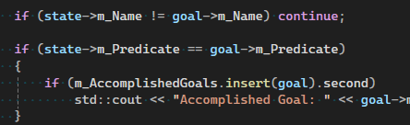
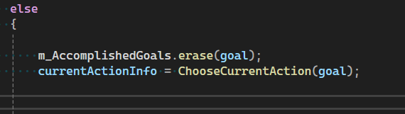
Hungry
==
false
Hungry
==
true
Desired
World State
CAN THIS GOAL BE ACHIEVED ?

Slide 21

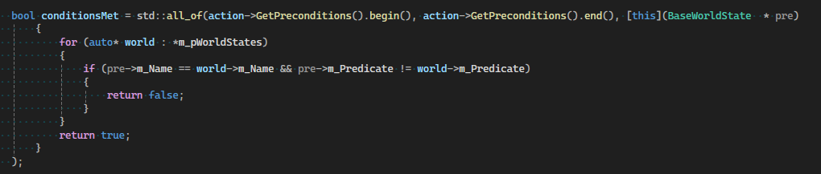
Hungry
==
true
Actions that we can Take Right Now
Actions that will FullFill Goal

Slide 22
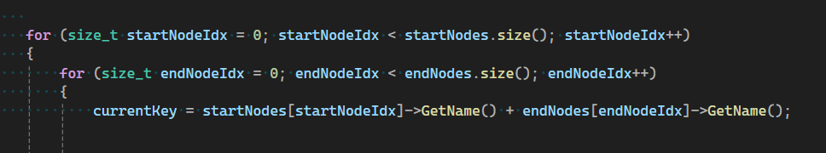
Code Structure

Slide 23
Name 1
Name2

Slide 24
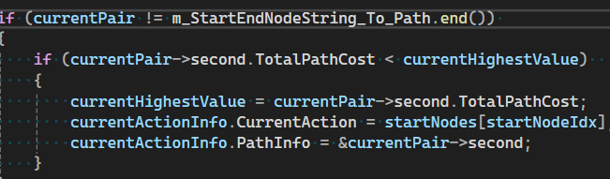
Calculate Total Weight
Total Weight

Slide 25
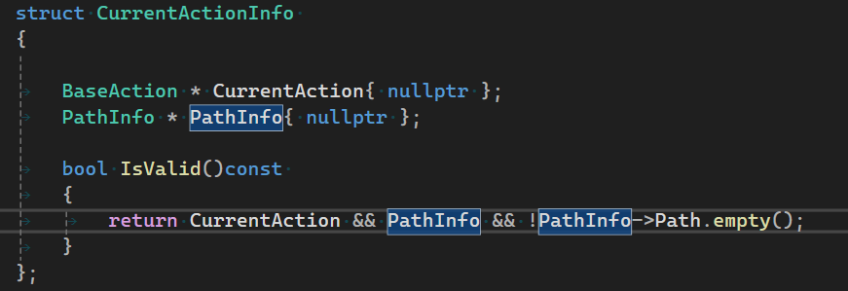
Hungry
==
false
CAN THIS GOAL BE ACHIEVED ?
YESSSS !!!!!!!!

Slide 26
Execute Action and loop again
Next Too Food
Go To Food
Consume Food
This Add one effect on the world that meets next action preconditions

Slide 27
SOURCES
https://www.youtube.com/watch?v=qaIF0iaDWRQ&t=59s
https://www.youtube.com/watch?v=DF4dxwqfF1k
https://medium.com/@vedantchaudhari/goal-oriented-action-planning-34035ed40d0b
https://www.youtube.com/watch?v=gm7K68663rA
https://www.geeksforgeeks.org/dsa/introduction-to-dijkstras-shortest-path-algorithm/
https://www.geeksforgeeks.org/dsa/difference-between-dijkstras-algorithm-and-a-search-algorithm/
https://www.youtube.com/watch?v=jUSrVF8mve4
A* Search Algorithm - GeeksforGeeks

Slide 28
