Slide 1
GPP Exam: Zombie AI
By Miguel Lozano

Slide 2
WHAT IS (GOAP)
Hungry==
true
Hungry
==
false
HasWeapon
==
true
HasMedkits
==
true
HasWeapon==
false
IsInPurgeZone
==
false
HasFood
==
true
Was Bitten
==
false
Has Med Kits
==
true
You define Goals as desired world states.
Is In PurgZone ==
true

Slide 3
World States Picture

Slide 4
gwegwegwegwegwegewgwegweg

Slide 5
Actions
PRECONDITIONS
HUNGRY == FALSE
Has Food ==
true
CONSUME FOOD
Hungry
==
true
EFFECTS ON WORLD
Hungry
==
false
Have Preconditions (when the action can be done).
Have Effects (what the action changes).
(Optionally) Have costs.

Slide 6
Planning
So GOAP is about building a plan (sequence of actions) that takes the world from “now” to “desired”.
Hungry
==
true
Hungry
==
False
Consume Food
Search Foor Food
Go To Food

Slide 7
Hungry
==
false
Hungry
==
true
CAN THIS GOAL BE ACHIEVED ?
We need to create A Graph , that will be Connected throught Actions and will link the
Start Node and the end Node
Start Node
End Node
Index 0
Index
1
Create Path

Slide 8
Code Insert Picture OF Ading a node for each Action that we can take

Slide 9
Planning
Start Node
End Node
Index 0
Index
1

Slide 10
Code Insert Picture linking the action that can be executed right now

Slide 11
This Actions can be used right Away
Start Node
End Node
Index 0
Index
1

Slide 12
Code Insert Picture Check If Any Action has a effect that lets don’t forget that joint with the end
Hungry
==
false

Slide 13
Hungry
==
false
EAT FOOD
Start Node
End Node
Index 0
Index
1

Slide 14
Inset picyure of Last part where connections ate made

Slide 15
EAT FOOD
Start Node
End Node
Index 0
Index
1

Slide 16
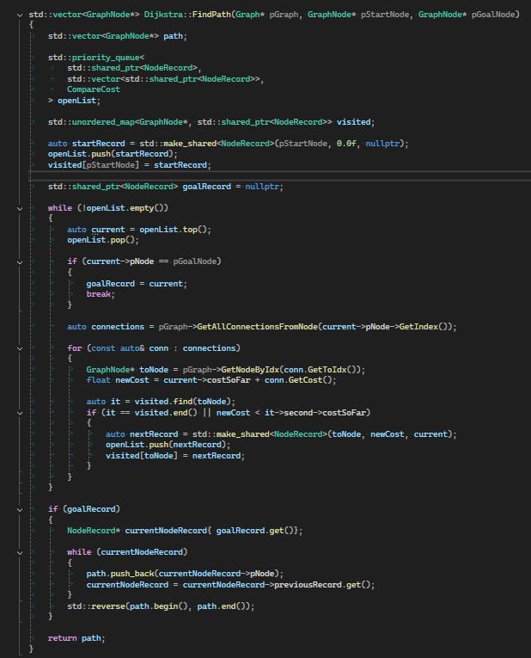
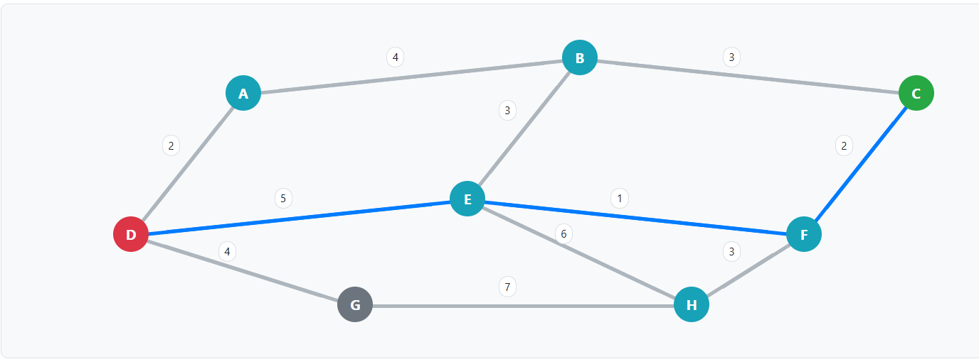
Affter we have all the connection we have a Grpah we need to use the Djstra algorithm to see if there is a path in outr graph and see if our goal can be achieved
Hungry
==
false
m_CurrentGoal =

Slide 17
CONSUME FOOD
CONSUME FOOD
CONSUME FOOD
CONSUME FOOD
Hungry
==
false

