Slide 1
Reinforcement Learning in Continuous Representation Spaces
// 30-MINUTES PLENARY TALK
Miguel A. Solís
Universidad Andrés Bello, Chile
miguel.solis@unab.cl
www.miguelsolis.info → Invited Talks
Notes:
Time: ~20 s. Introduce yourself, your affiliation and the paper title. Total talk: 5 minutes (about 45–60 s per content slide).

Slide 2
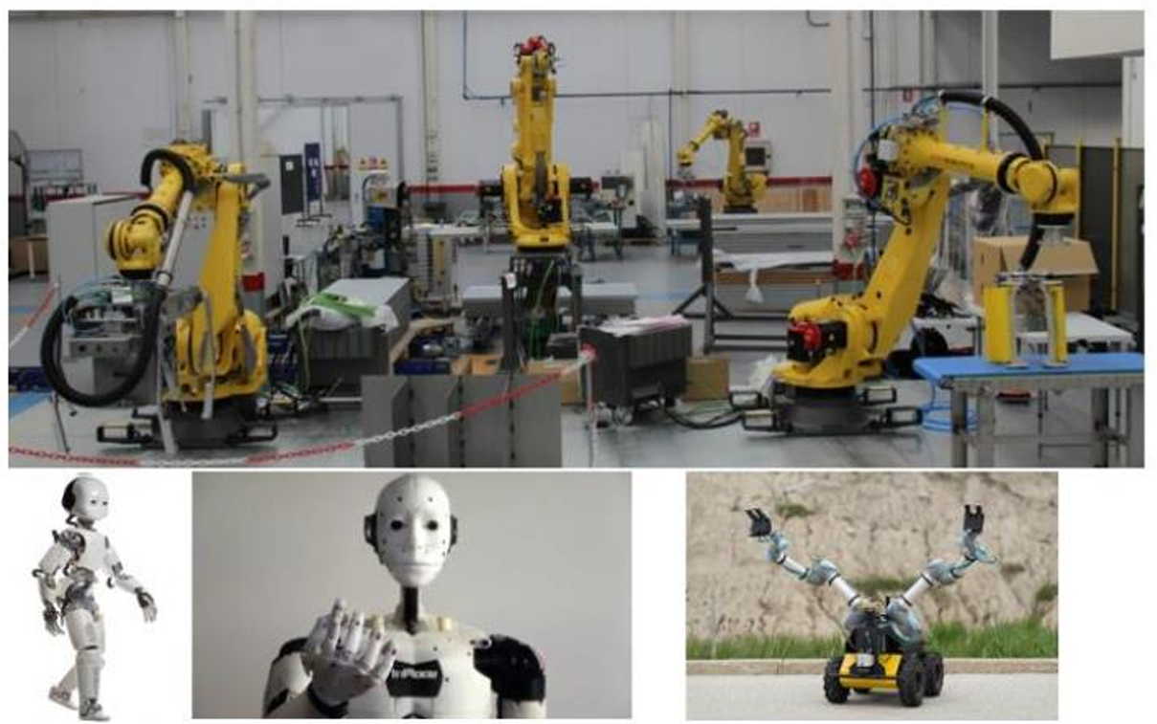
Robotics
// MOTIVATION
[ INSERT FIGURE OR DIAGRAM ]
Areas
Mobile Robotics
Bio-inspired Robotics
Cognitive Robotics
Intelligent Robotics
Human-Robot Interaction
Tele-operated Robotics
Swarm Robotics
…
Notes:
Time: ~45 s. Max. 3 short ideas. Use one image that explains the problem at a glance.

Slide 3
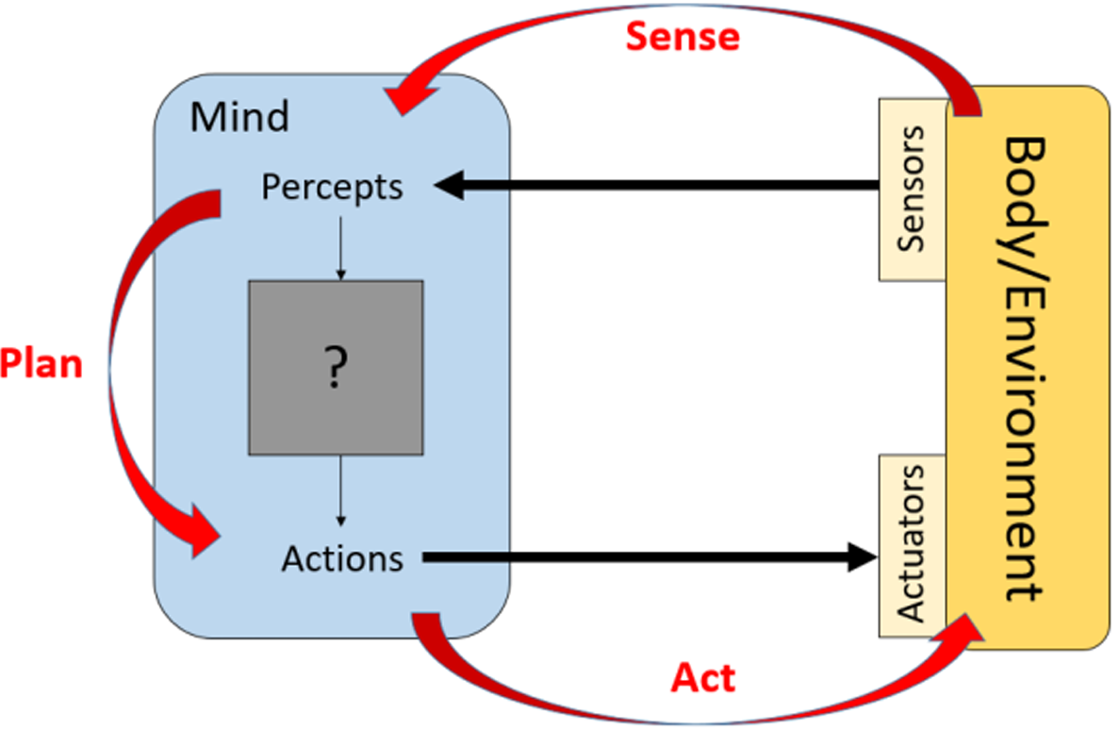
Perception and Action
// SCHEME
Image extracted from “Robotic Systems” de Kris Hauser, University of Illinois at Urbana-Champaign.
Notes:
Time: ~60 s. Explain only what the audience needs to understand the results. Details are in the paper.

Slide 4
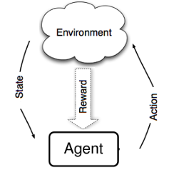
Reinforcement Learning
// SCHEME
Agent interacts with the environment through trial and error.
Receives an input (perception), with current state “s”.
Then, decides (acts) with an action “a” as output.
Receives a reward (reinforcement) “r”.
Notes:
Time: ~45 s. Max. 3 short ideas. Use one image that explains the problem at a glance.

Slide 5




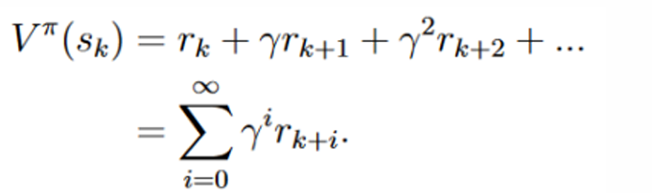
Sequential Decision Problem
// SCHEME
Reinforcement Learning Problem
S: set of states.
A: set of actions.
transition function (unknown)
rewards function
policy
state “s” belongs to a Markovian Decision Process if and only if:
Return
Notes:
Time: ~45 s. Max. 3 short ideas. Use one image that explains the problem at a glance.

Slide 6
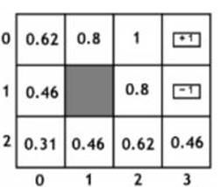
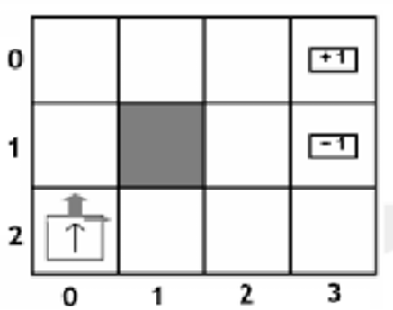
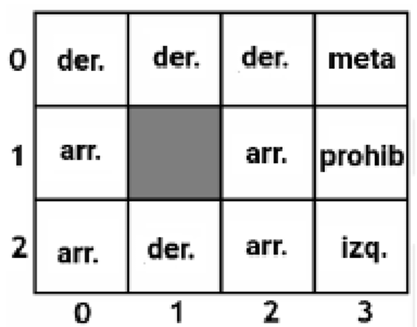
Example
// TABULAR METHODS
Value Iteration
Grid-world
States: location on the grid.
Actions: up, down, left, right.
Rewards: +1 on the goal
-1 on prohibited zone
-0.1 otherwise
Policy Iteration
Basic (and tabular) methods: Value Iteration, Policy Iteration
Notes:
Time: ~60 s. One main figure + one or two headline numbers. Make axis labels readable from the back of the room.

Slide 7

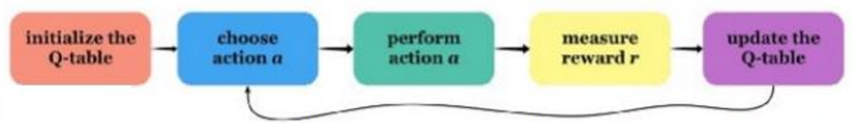
Q-learning
// TABULAR METHODS
Update rule:
Then, policy should be given by:
Image extracted from “Introduction to Q-learning with OpenAI Gym”, Gelana Tostaeva, Medium.
Notes:
Time: ~60 s. Explain only what the audience needs to understand the results. Details are in the paper.

Slide 8
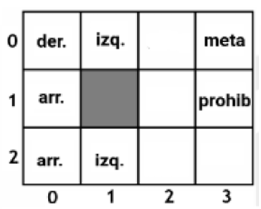
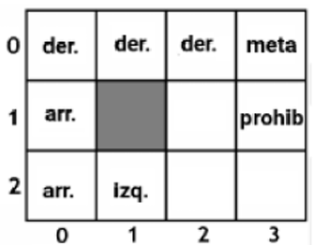
Example
// TABULAR METHODS
Q-learning
Visited (state,action) pairs are the only ones updated.
Including exploration:
Grid-world
States: location on the grid.
Actions: up, down, left, right.
Rewards: +1 on the goal
-1 on prohibited zone
-0.1 otherwise
Basic (and tabular) methods: Value Iteration, Policy Iteration
Notes:
Time: ~60 s. One main figure + one or two headline numbers. Make axis labels readable from the back of the room.

Slide 9
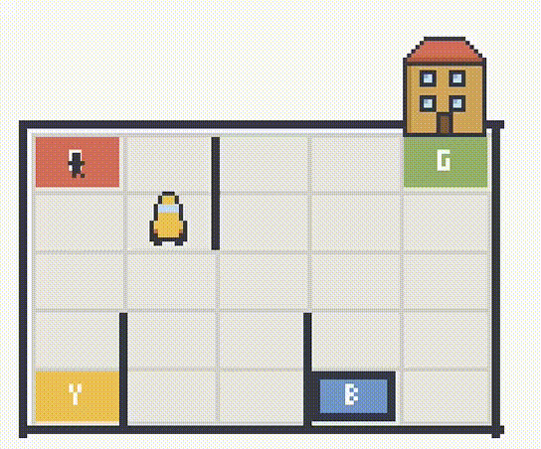
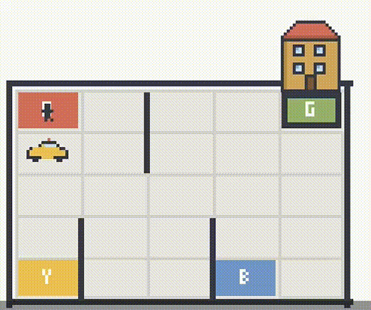
Example
// TABULAR METHODS
Taxi
Notes:
Time: ~60 s. One main figure + one or two headline numbers. Make axis labels readable from the back of the room.

Slide 10
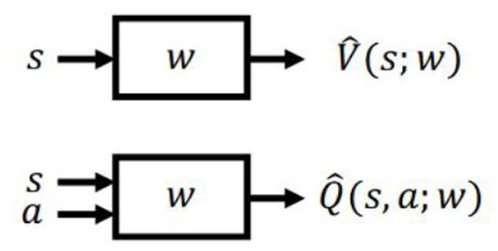
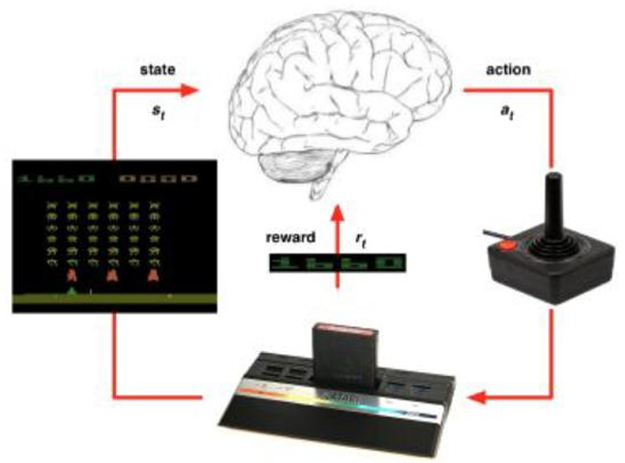
Deep Reinforcement Learning
// CONTINUOUS OBSERVATIONS SPACE
Need of function approximators
(such as artificial neural networks)
General scheme
(pretty much the same)
Notes:
Time: ~60 s. One main figure + one or two headline numbers. Make axis labels readable from the back of the room.

Slide 11
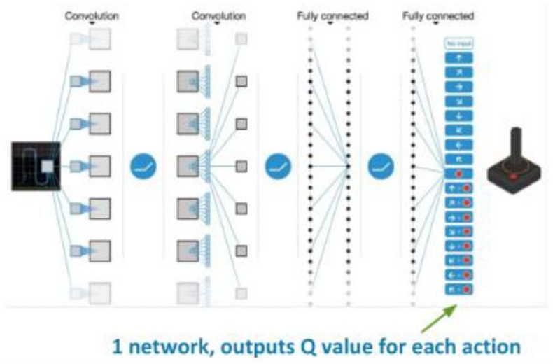
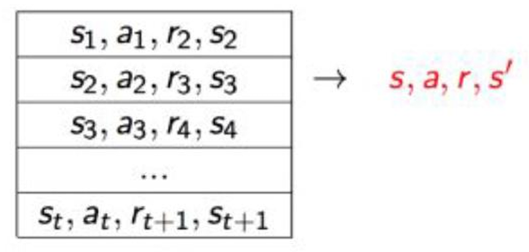
Deep Reinforcement Learning
// CONTINUOUS OBSERVATIONS SPACE
Replay buffer
so… discrete action space
Notes:
Time: ~60 s. One main figure + one or two headline numbers. Make axis labels readable from the back of the room.

Slide 12
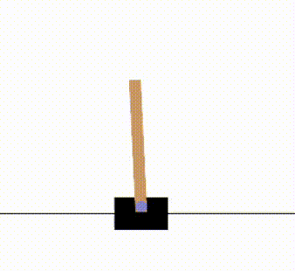
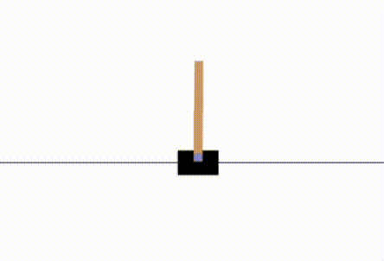
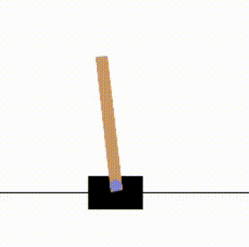
Deep Reinforcement Learning
// CONTINUOUS OBSERVATIONS SPACE
Inverted pendulum
Random policies
Notes:
Time: ~60 s. One main figure + one or two headline numbers. Make axis labels readable from the back of the room.

Slide 13


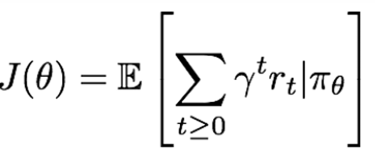
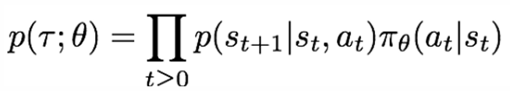
REINFORCE
// CONTINUOUS OBSERVATIONS AND ACTIONS SPACES
Policy parametrization:
we always are looking for optimal policy:
but now we have transition probability given by:
for every policy we would have:
Notes:
Time: ~60 s. One main figure + one or two headline numbers. Make axis labels readable from the back of the room.

Slide 14
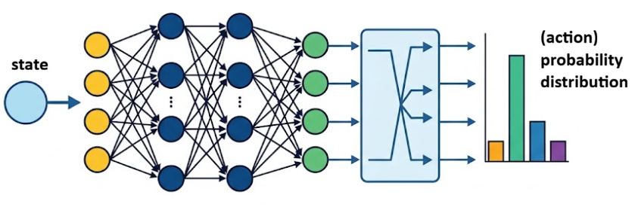
REINFORCE
// CONTINUOUS OBSERVATIONS AND ACTIONS SPACES
on the hands-on side:
Notes:
Time: ~60 s. One main figure + one or two headline numbers. Make axis labels readable from the back of the room.

Slide 15
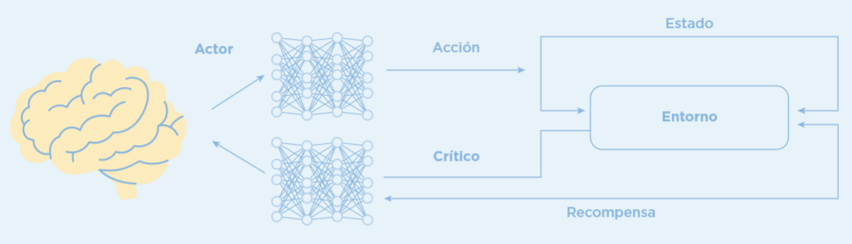
ACTOR-CRITIC
// MORE ON CONTINUOUS OBSERVATIONS AND ACTIONS SPACES
Notes:
Time: ~60 s. One main figure + one or two headline numbers. Make axis labels readable from the back of the room.

Slide 16
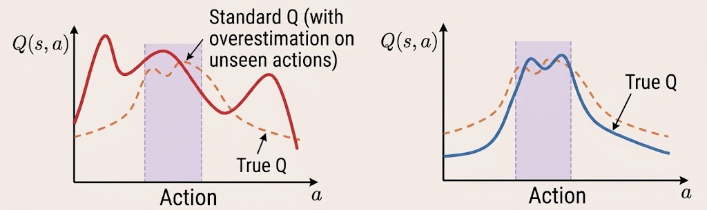
CONSERVATIVE APPROACHES
// MORE ON CONTINUOUS OBSERVATIONS AND ACTIONS SPACES
Notes:
Time: ~60 s. One main figure + one or two headline numbers. Make axis labels readable from the back of the room.

Slide 17
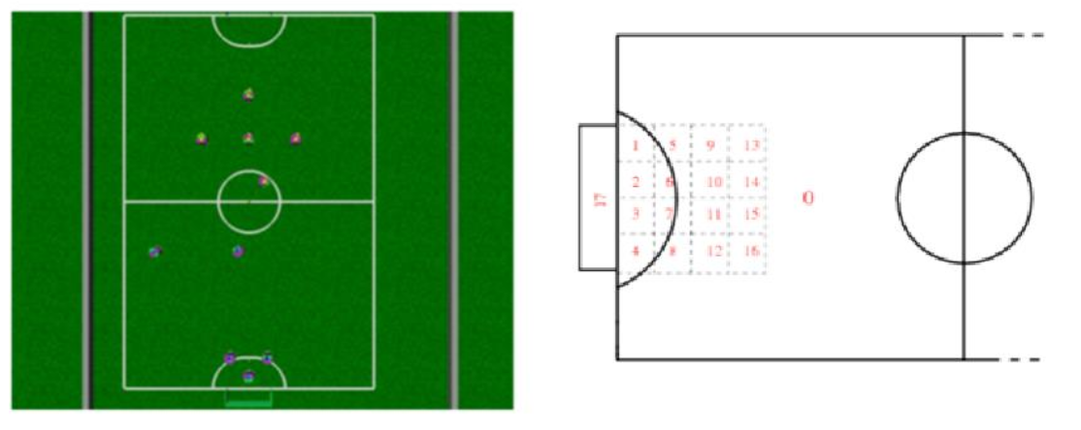
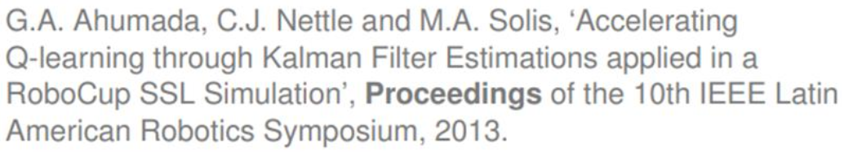
APPLICATIONS
// some examples
Notes:
Time: ~60 s. One main figure + one or two headline numbers. Make axis labels readable from the back of the room.

Slide 18
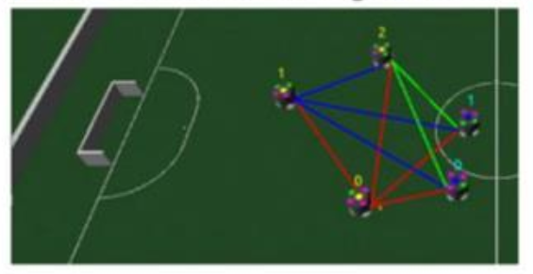
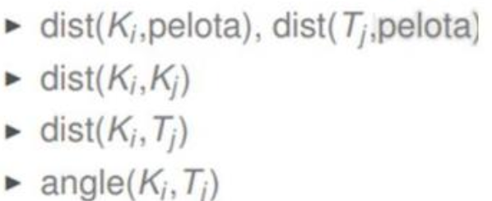
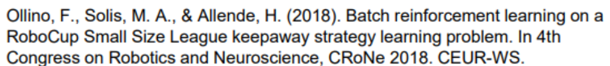
APPLICATIONS
// some examples
Notes:
Time: ~60 s. One main figure + one or two headline numbers. Make axis labels readable from the back of the room.

Slide 19
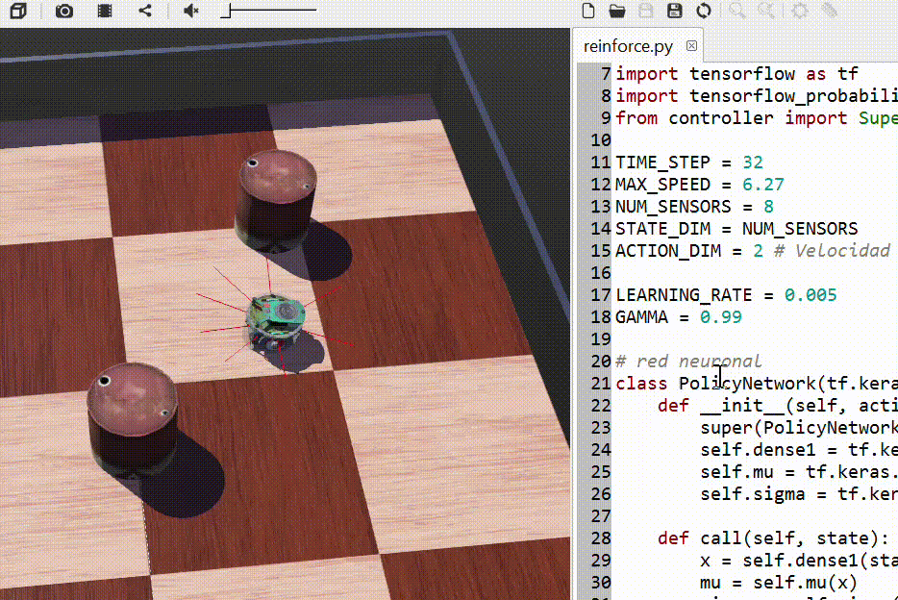
Closing remarks
// CONCLUSIONS
ANNs are the most popular function approximators for RL on continuous spaces, but there is room for other techniques (such as fuzzy logic).
Specific RL algorithm to be applied would depend on the given problem.
don’t miss the workshop tomorrow Saturday Oct 7th, 9am at Library Auditorium
Notes:
Time: ~45 s. Close with the one message you want people to remember.

Slide 20
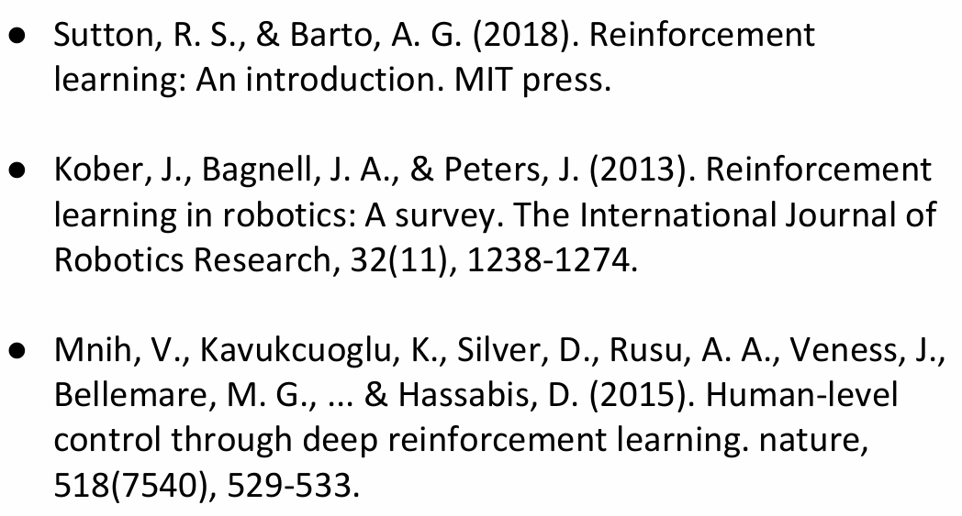
Thank you! Questions?
References
// Q&A
Miguel A. Solís
miguel.solis@unab.cl
www.miguelsolis.info → Invited Talks
Notes:
Time: ~30 s. Leave this slide up during Q&A.

