Slide 1
Implementation of Reinforcement Learning Algorithms in Gymnasium Simulations
Technical Workshop
Miguel A. Solís
Universidad Andrés Bello, Chile
miguel.solis@unab.cl
www.miguelsolis.info → Invited Talks
Notes:
Time: ~20 s. Introduce yourself, your affiliation and the paper title. Total talk: 5 minutes (about 45–60 s per content slide).

Slide 2
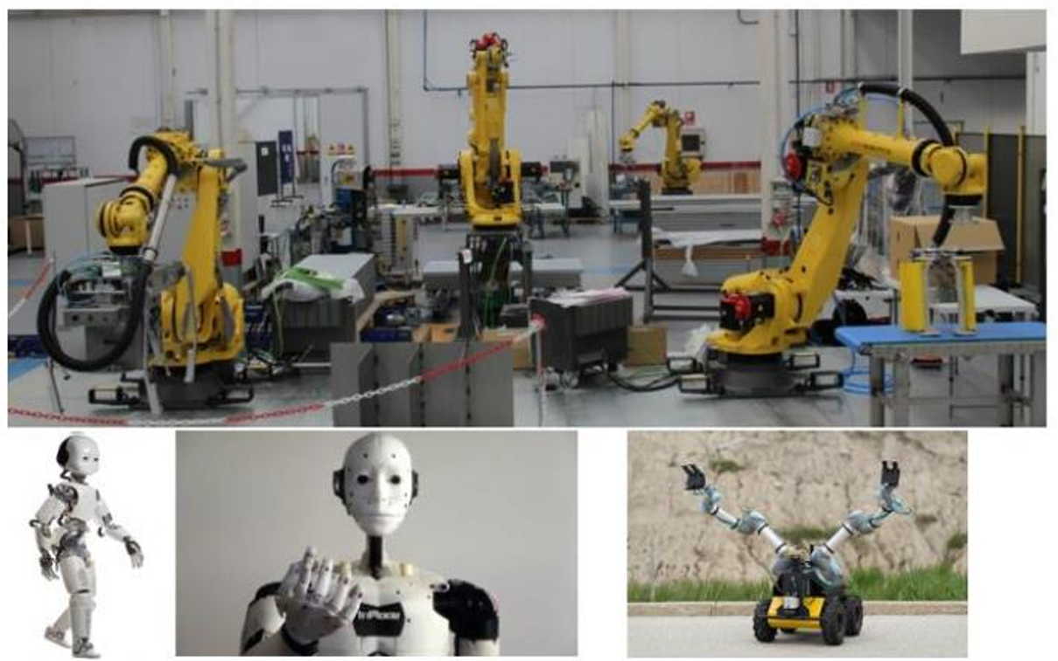
Robotics
// MOTIVATION
[ INSERT FIGURE OR DIAGRAM ]
Areas
Mobile Robotics
Bio-inspired Robotics
Cognitive Robotics
Intelligent Robotics
Human-Robot Interaction
Tele-operated Robotics
Swarm Robotics
…
Notes:
Time: ~45 s. Max. 3 short ideas. Use one image that explains the problem at a glance.

Slide 3
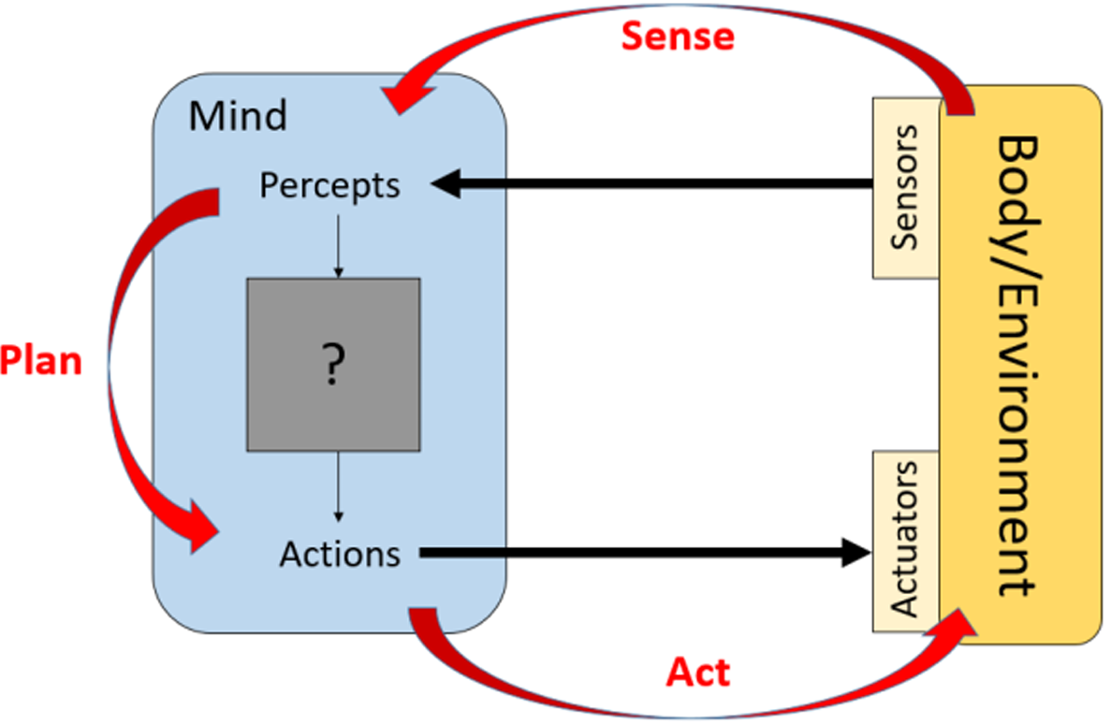
Perception and Action
// SCHEME
Image extracted from “Robotic Systems” de Kris Hauser, University of Illinois at Urbana-Champaign.
Notes:
Time: ~60 s. Explain only what the audience needs to understand the results. Details are in the paper.

Slide 4
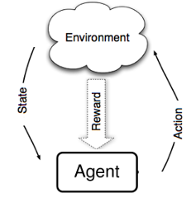
Reinforcement Learning
// SCHEME
Agent interacts with the environment through trial and error.
Receives an input (perception), with current state “s”.
Then, decides (acts) with an action “a” as output.
Receives a reward (reinforcement) “r”.
Notes:
Time: ~45 s. Max. 3 short ideas. Use one image that explains the problem at a glance.

Slide 5




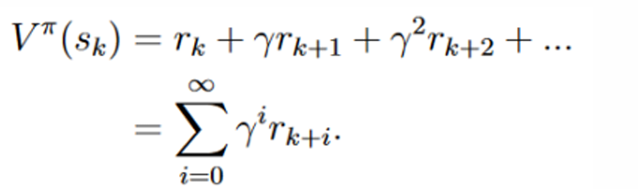
Sequential Decision Problem
// SCHEME
Reinforcement Learning Problem
S: set of states.
A: set of actions.
transition function (unknown)
rewards function
policy
state “s” belongs to a Markovian Decision Process if and only if:
Return
Notes:
Time: ~45 s. Max. 3 short ideas. Use one image that explains the problem at a glance.

Slide 6
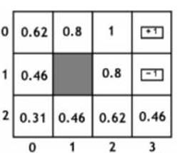
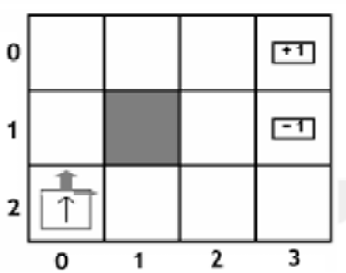
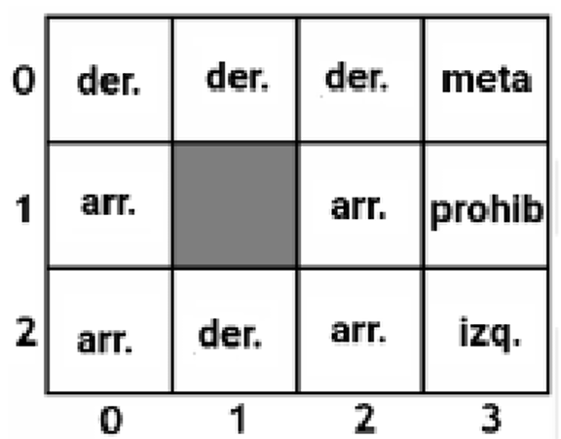
Example
// TABULAR METHODS
Value Iteration
Grid-world
States: location on the grid.
Actions: up, down, left, right.
Rewards: +1 on the goal
-1 on prohibited zone
-0.1 otherwise
Policy Iteration
Basic (and tabular) methods: Value Iteration, Policy Iteration
Notes:
Time: ~60 s. One main figure + one or two headline numbers. Make axis labels readable from the back of the room.

Slide 7

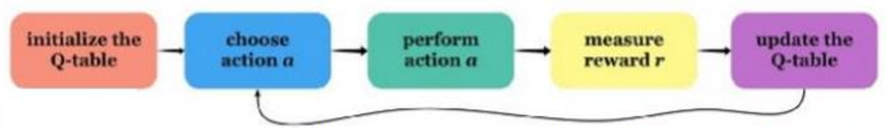
Q-learning
// TABULAR METHODS
Update rule:
Then, policy should be given by:
Image extracted from “Introduction to Q-learning with OpenAI Gym”, Gelana Tostaeva, Medium.
Notes:
Time: ~60 s. Explain only what the audience needs to understand the results. Details are in the paper.

Slide 8
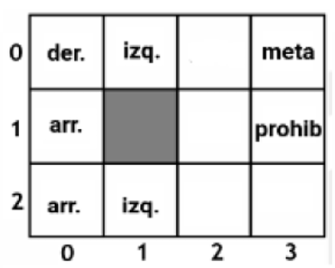
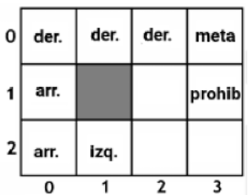
Example
// TABULAR METHODS
Q-learning
Visited (state,action) pairs are the only ones updated.
Including exploration:
Grid-world
States: location on the grid.
Actions: up, down, left, right.
Rewards: +1 on the goal
-1 on prohibited zone
-0.1 otherwise
Basic (and tabular) methods: Value Iteration, Policy Iteration
Notes:
Time: ~60 s. One main figure + one or two headline numbers. Make axis labels readable from the back of the room.

Slide 9
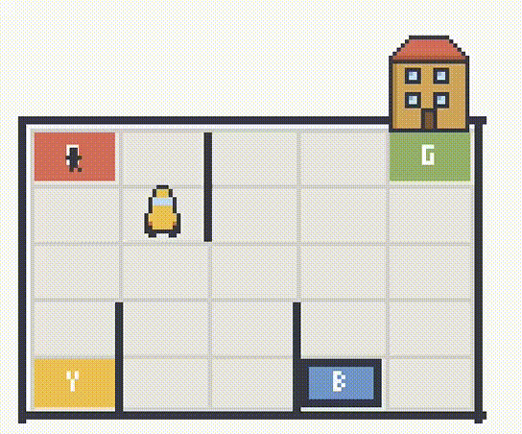
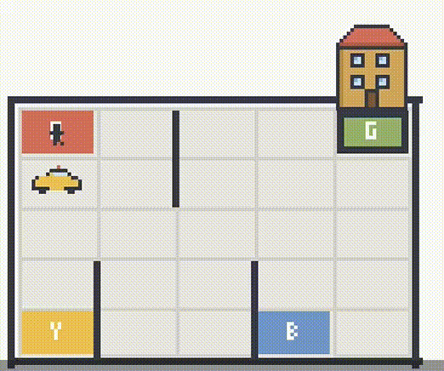
Example
// TABULAR METHODS
Taxi (let’s see a Python Notebook)
Notes:
Time: ~60 s. One main figure + one or two headline numbers. Make axis labels readable from the back of the room.

Slide 10
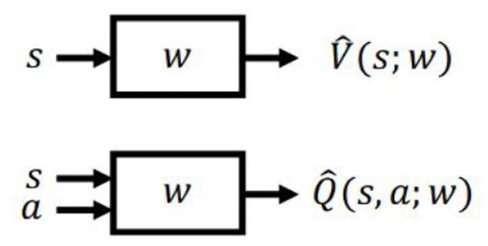
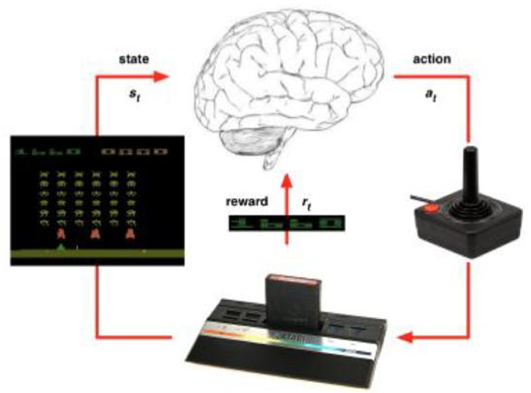
Deep Reinforcement Learning
// CONTINUOUS OBSERVATIONS SPACE
Need of function approximators
(such as artificial neural networks)
General scheme
(pretty much the same)
Notes:
Time: ~60 s. One main figure + one or two headline numbers. Make axis labels readable from the back of the room.

Slide 11
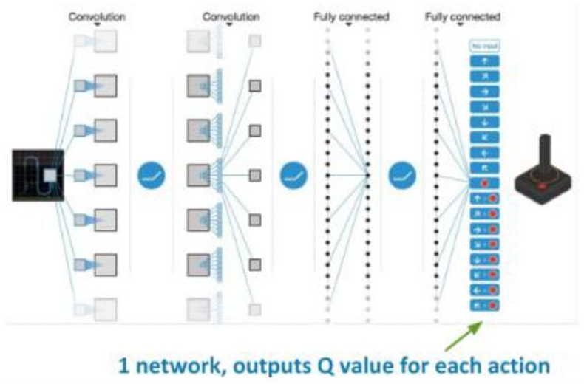
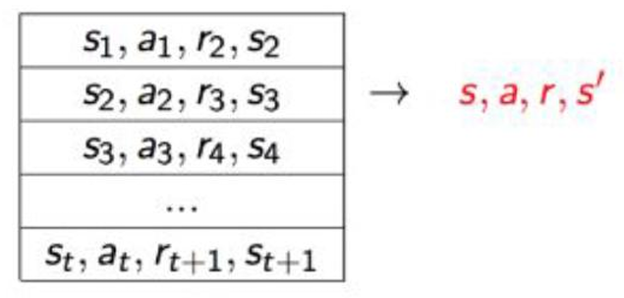
Deep Reinforcement Learning
// CONTINUOUS OBSERVATIONS SPACE
Replay buffer
so… discrete action space
Notes:
Time: ~60 s. One main figure + one or two headline numbers. Make axis labels readable from the back of the room.

Slide 12
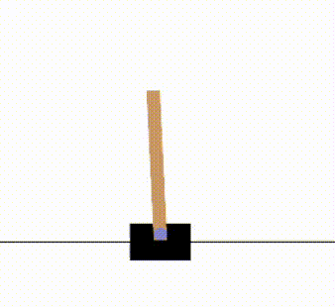
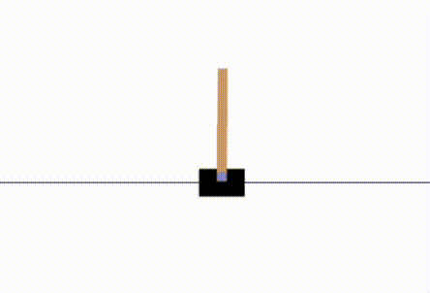
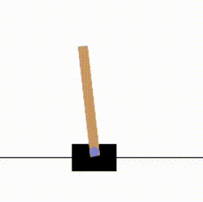
Deep Reinforcement Learning
// CONTINUOUS OBSERVATIONS SPACE
Inverted pendulum
(let’s see a Python Notebook)
Random policies
Notes:
Time: ~60 s. One main figure + one or two headline numbers. Make axis labels readable from the back of the room.

Slide 13

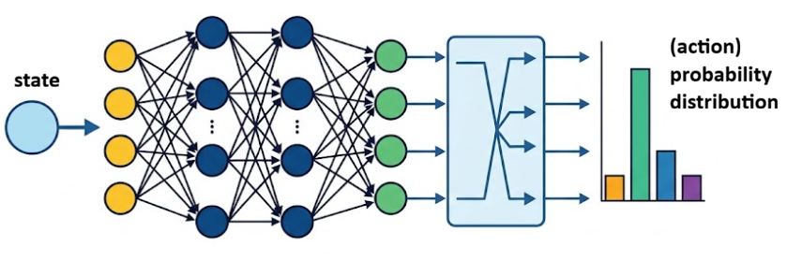
REINFORCE
// CONTINUOUS OBSERVATIONS AND ACTIONS SPACES
Policy parametrization:
Notes:
Time: ~60 s. One main figure + one or two headline numbers. Make axis labels readable from the back of the room.

Slide 14
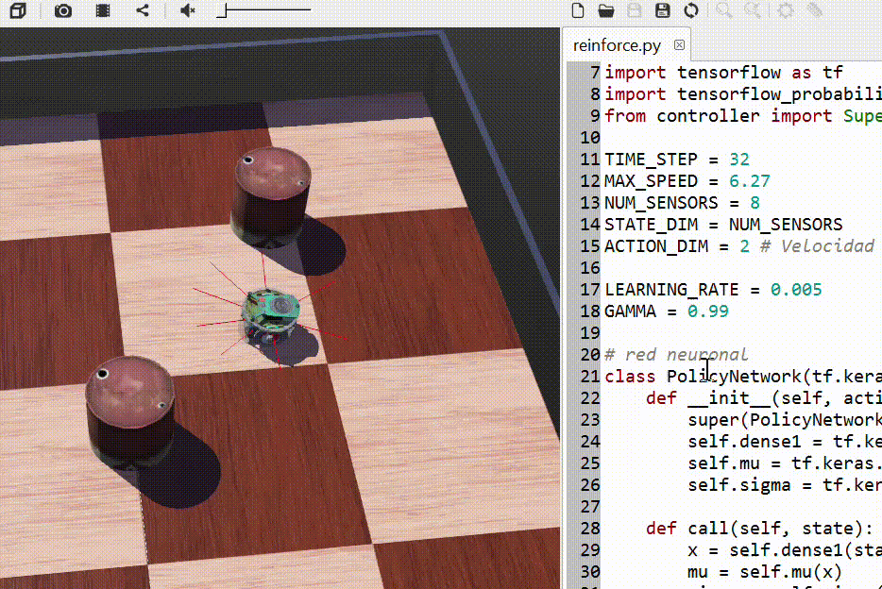
Closing remarks
// CONCLUSIONS
Gymnasium is very useful for testing RL algorithms on a environment that you don’t need to program/simulate.
Specific RL algorithm to be applied would depend on the given problem.
Same applies to other simulators: Webots, CoppeliaSim, Gazebo.
Notes:
Time: ~45 s. Close with the one message you want people to remember.

Slide 15
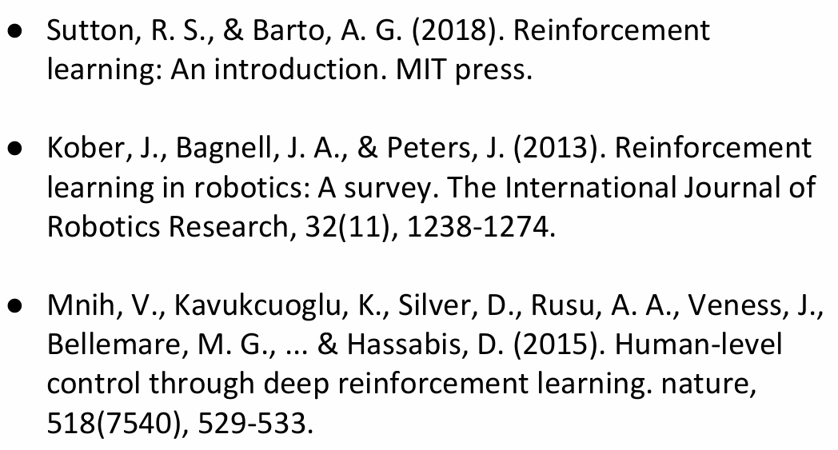
Thank you! Questions?
References
// Q&A
Miguel A. Solís
miguel.solis@unab.cl
www.miguelsolis.info → Invited Talks
Notes:
Time: ~30 s. Leave this slide up during Q&A.

