Slide 1

Tópicos de Desenvolvimento de Software Desenvolvimento, Validação e Manutenção de Software (SDVM)
Universidade do Minho
Mestrado em Engenharia Informática
4º ano | 2º semestre
Miguel Ângelo Martins Guimarães
PG55986
Março 2024

Slide 2
Project structure
Desenvolvimento, Validação e Manutenção de Software (SDVM)
0. Machine specifications
Exercise #1
Exercise #2
Extra exercise
Conclusion
Gathered data
References

Slide 3
0. Machine specifications
Desenvolvimento, Validação e Manutenção de Software (SDVM)
The specifications of the machine that is being used for the exercises are the following:
Operating System: Ubuntu 22.04.4 LTS Kernel Version: 5.15.0-107-generic
CPU: Intel Core i5-4460 (4 cores, 4 threads, Haswell architecture)
Memory (RAM): 15.49GB
GPU: Intel Xeon E3-1200 v3/4th Gen Core Integrated Graphics (i915 driver)
Notes:
Contextualização

Slide 4
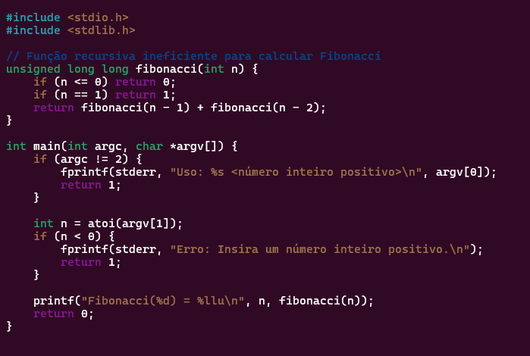
1. Exercise #1
Desenvolvimento, Validação e Manutenção de Software (SDVM)
The chosen programming language to write the fibonacci function was the C programming language.
Fig 1. Recursive fibonacci function (Slow)
Notes:
Contextualização

Slide 5
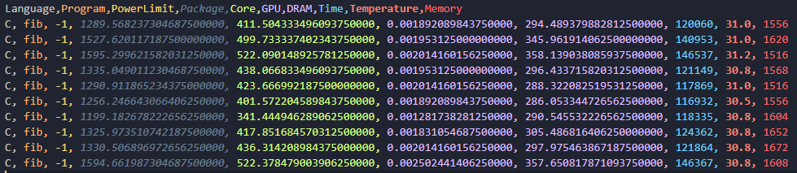
1. Exercise #1
Desenvolvimento, Validação e Manutenção de Software (SDVM)
Procedure for the first measurement:
For the execution time of approximately one minute, the fibonacci function was executed for an input of 47.
For the calibration of the temperatures of the cores i used a cooldown of 30 seconds.
The average temperature after calibration was about 29.5ºC.
Using RAPL i measured the energy consumption of the program.
The program was executed 10 times to gather data.
Fig 2. RAPL data for input 47 and ntimes 10.
Notes:
Contextualização

Slide 6
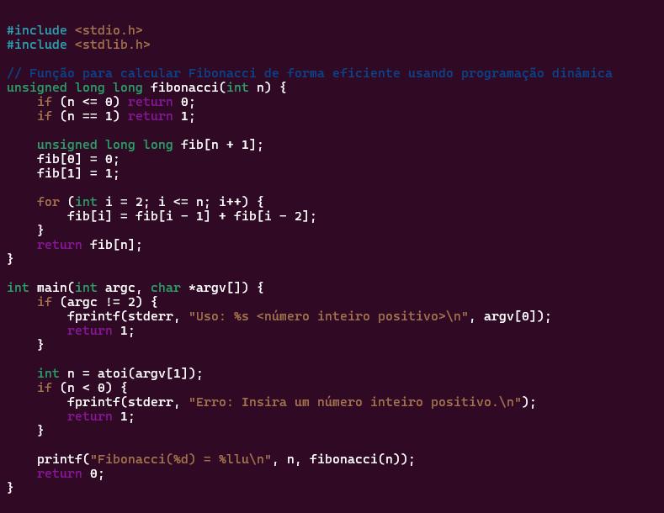
1. Exercise #1
Desenvolvimento, Validação e Manutenção de Software (SDVM)
An optimized version of the fibonacci fucntion was written to execute in linear time.
Fig 3. Recursive fibonacci function
Fig 4. Optimized fibonacci function
Notes:
Contextualização

Slide 7
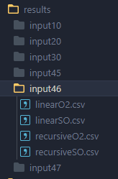
1. Exercise #1
Desenvolvimento, Validação e Manutenção de Software (SDVM)
A variety of inputs were used to gather the data. For each input, the energy consumption of both the recursive and the optimized Fibonacci implementations were measured, with and without compiler optimizations.
The compiler optimization flag used was `-O2`.
The input values tested were: 47, 46, 45, 30, 20, and 10.
The program was executed 10 times to ensure accurate data collection.
To calibrate the core temperatures, a 30-second cooldown period was applied before measurement.
This procedure resulted in about 24 csv files and around 240 individual measurements.
Fig 5. Preview of the results
Notes:
Contextualização

Slide 8
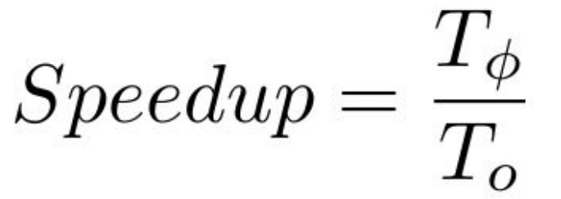
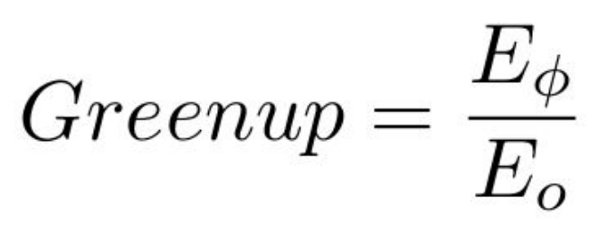
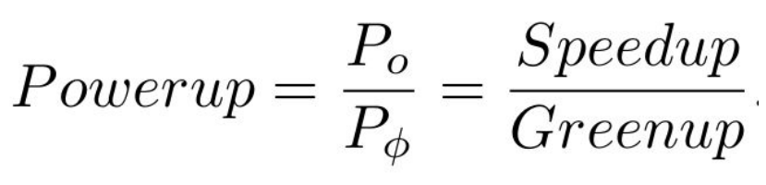
1. Exercise #1
Desenvolvimento, Validação e Manutenção de Software (SDVM)
For each CSV file, a Python script was used to remove the rows containing the maximum and minimum values in the 'Package' column. This column exhibited the greatest variation among all columns, making it the best choice for filtering out extreme values and obtaining more concise and reliable results.
With the remaining lines the median of each column was calculated, and the output was saved as a file.
The results of this procedure allowed to gather data to create graphs and measure trends in energy consumption, providing a clearer understanding of the impact of different inputs and optimizations on performance.
The following formulas were used to compare the performance of the fibonacci functions:
Fig 6. Speedup formula
Fig 7. Greenup formula
Fig 8. Powerup formula
Notes:
Contextualização

Slide 9
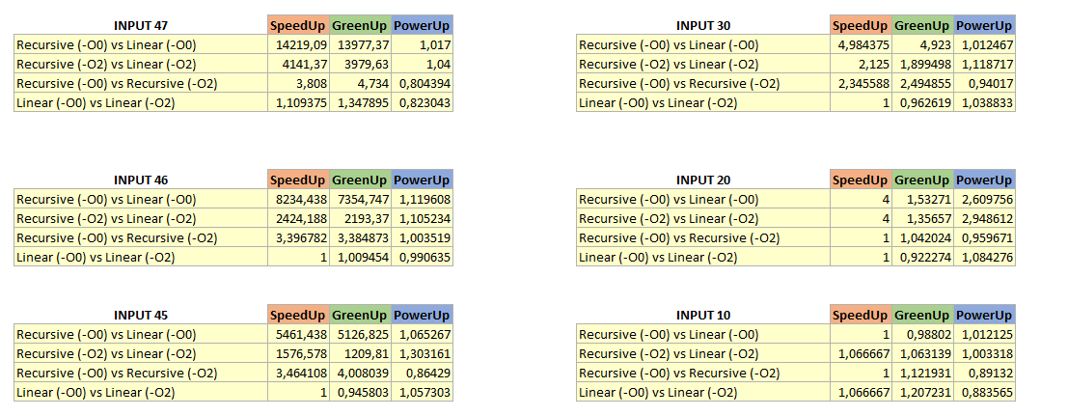
1. Exercise #1
Desenvolvimento, Validação e Manutenção de Software (SDVM)
The following results were obtained: `-O0` corresponds to execution without compiler optimizations and `-O2` corresponds to execution with compiler optimizations.
Fig 9. Results for the metrics
Notes:
Contextualização

Slide 10
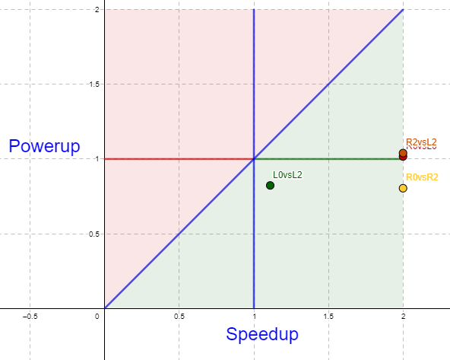
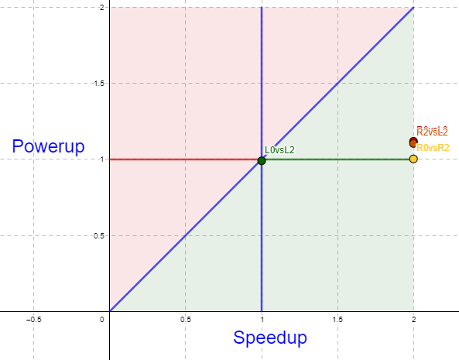
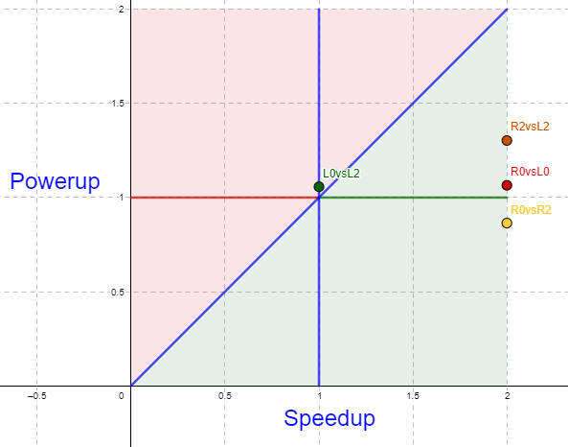
1. Exercise #1
Desenvolvimento, Validação e Manutenção de Software (SDVM)
GPS-UP Software Energy Efficiency Quadrant Graphs were created to visualize the data.
The speedup was greater than 2 in most cases. So, I decided to cap the x axis value to 2 (the graph's boundary).
Fig 10. Results for input 47
Fig 11. Results for input 46
Fig 12. Results for input 45
Notes:
Contextualização

Slide 11
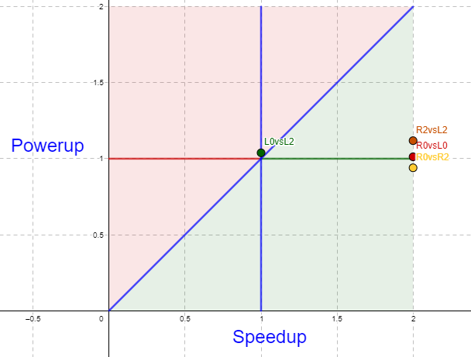
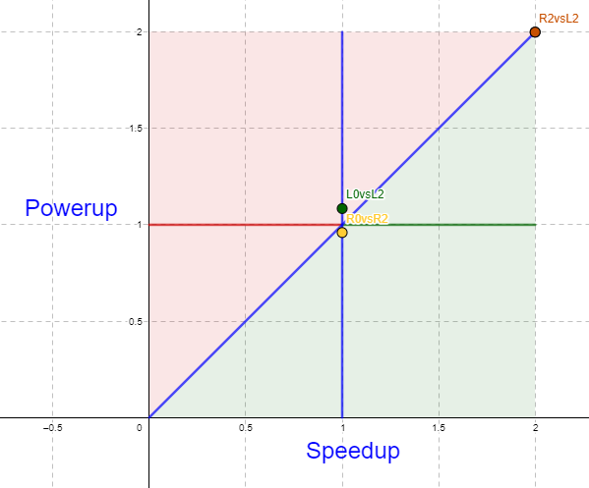
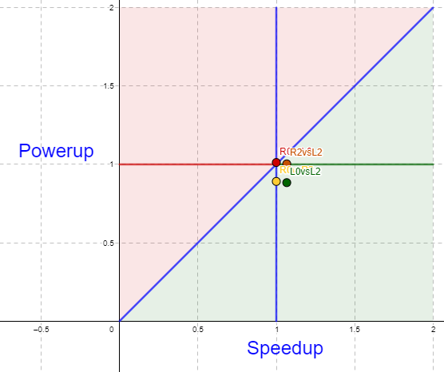
1. Exercise #1
Desenvolvimento, Validação e Manutenção de Software (SDVM)
Legend:
Red: Recursive ‘-O0’ vs. Linear ‘-O0’.
Orange: Recursive ‘-O2’ vs. Linear ‘-O2’.
Yellow: Recursive ‘-O0’ vs. Recursive ‘-O2’.
Green: Linear ‘-O0’ vs. Linear ‘-O2’.
Fig 13. Results for input 30
Fig 14. Results for input 20
Fig 15. Results for input 10
Notes:
Contextualização

Slide 12
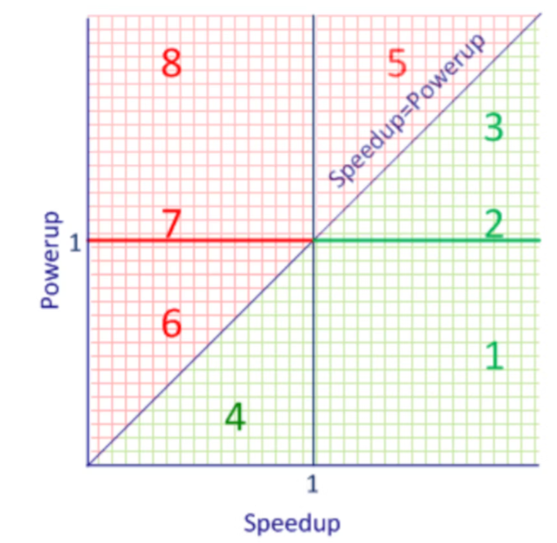
1. Exercise #1
Desenvolvimento, Validação e Manutenção de Software (SDVM)
Conclusions from the GPS-UP Software Energy Efficiency Quadrant Graphs:
The points in the upper left quadrant are not desirable because they represent the program optimizations that had more power usage and worse performance. This only happened in the case Linear ‘-O0’ vs Linear ‘-O2’.
Most data points ended up in section 3, where higher power usage was balanced by a faster program execution.
Some points ended up in section 5, which is undesirable because the increase
in power was not compensated by an increase in speed.
Points in the region 6 and 4 didn’t occur.
A few points occurred in section 1, which is the ideal scenario: we observed
both an increase in speedup and a decrease in power usage that is precisely what
we aim for in Green Software.
Figure: GPS-UP Graph
Notes:
Contextualização

Slide 13
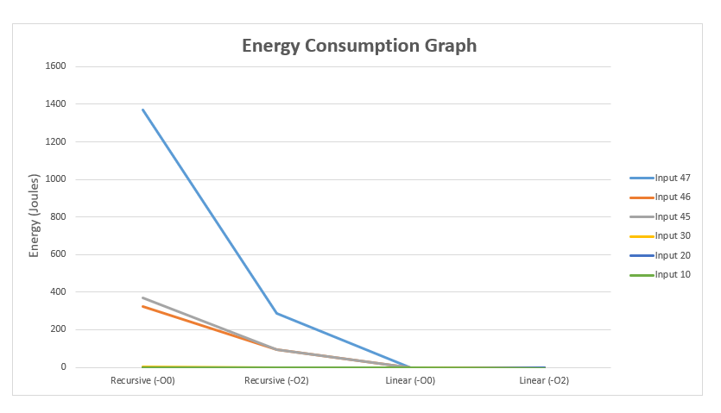
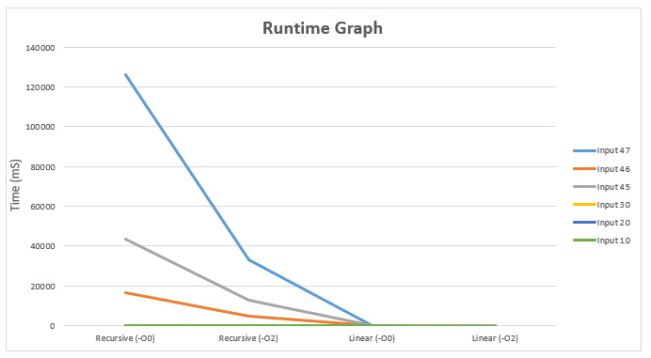
1. Exercise #1
Desenvolvimento, Validação e Manutenção de Software (SDVM)
Energy consumption and runtime graphs were created to analyze the results.
As shown in the figures below, as the input size increased, execution time and energy consumption also grew.
Fig 16. Energy consumption graph
Fig 17. Runtime graph
Notes:
Contextualização

Slide 14
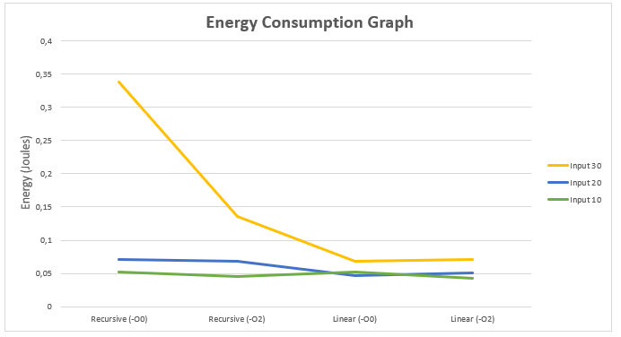
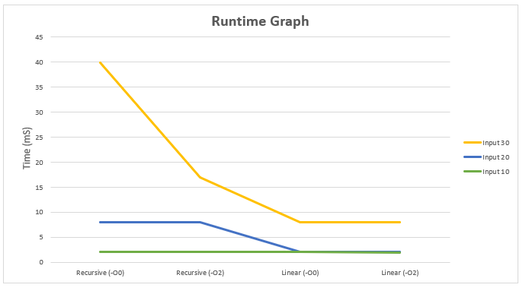
1. Exercise #1
Desenvolvimento, Validação e Manutenção de Software (SDVM)
In the graphs shown on the previous slide, inputs with lower time and energy values overlapped and were hidden, making it difficult to analyze their variation in the results. To improve clarity, I generated the following graphs without inputs 47, 46, and 45.
Fig 18. Energy consumption graph (without high value inputs)
Fig 19. Runtime graph (without high value inputs)
Notes:
Contextualização

Slide 15
1. Exercise #1
Desenvolvimento, Validação e Manutenção de Software (SDVM)
Conclusions from the Energy consumption and runtime graphs:
It can be observed that for each input of the recursive function, the execution time and energy consumption increased exponentially. This behavior is due to the exponential nature of the Fibonacci algorithm that was implemented.
The `-O2` flag significantly reduced both execution time and energy consumption in both the linear and recursive functions.
It is also noticeable that for inputs of 30 and below, energy consumption and execution times become very similar.
Notes:
One key observation is that for input 45, both energy consumption and execution time were higher than for input 46, which is unexpected. Further analysis revealed this may have happened due to the nature of the values used, as they were derived from a median.
By examining the data obtained from RAPL, I noticed significantly more variation for input 45 compared to input 46. I also analyzed the date/time of creation of the csv files and I noticed that for input 45 the measurements were obtained during a class and for input 46 the inputs were taken during midnight, which leads me to the conclusion that this fluctuation may have happened due to the usage of the machine by other students.
Notes:
Contextualização

Slide 16
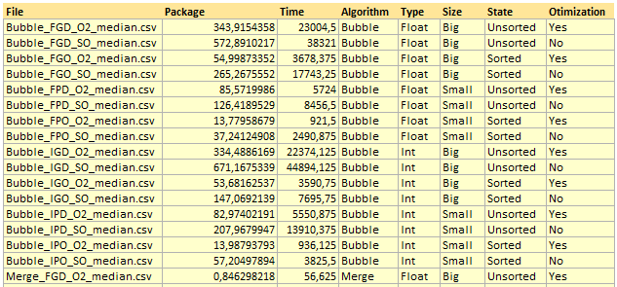
2. Exercise #2
Desenvolvimento, Validação e Manutenção de Software (SDVM)
For exercise #2 the following algorithms with different time complexities were chosen:
Bubble sort: O(n²) in the worst case, and O(n) in the best case.
Merge sort: O(n log n).
Shell sort: Around O(n^(3/2)) on average. Can reach O(n²) with simpler gap sequences.
The parameters used for the algorithms were as follows:
Array sizes: 25k vs. 50k elements.
Data types: Int vs. Float.
Array order: Sorted vs. unsorted.
Optimization level: No compiler flags vs. the ‘-O2’ flag.
Fig 20. Preview of the obtained results
Notes:
Contextualização

Slide 17
2. Exercise #2
Desenvolvimento, Validação e Manutenção de Software (SDVM)
Just like in the previous exercise the program was executed 10 times to ensure accurate data collection and to calibrate the core temperatures a 30-second cooldown period was applied before measurement.
The algorithms that this exercise used were implemented in the C programming language.
For each CSV file, the rows containing the maximum and minimum values of 'Package’ were removed.
With the remaining lines the median of each column was calculated.
The results of this procedure allowed to gather data to create graphs and measure trends in energy consumption, providing a clearer understanding of the impact of different inputs, optimizations and algorithms on performance.
Notes:
Contextualização

Slide 18
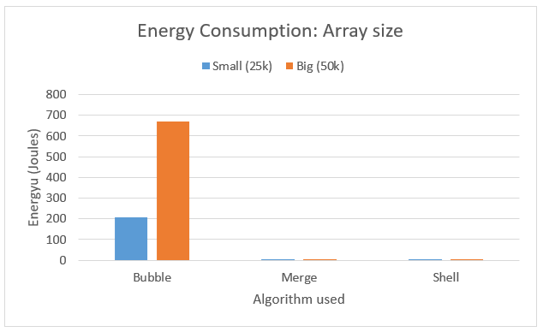
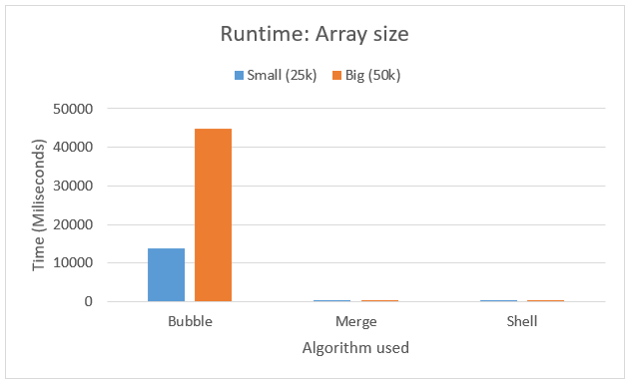
2. Exercise #2
Desenvolvimento, Validação e Manutenção de Software (SDVM)
The following graphs illustrate the impact of the array size:
Fig 20. Energy Consumption graph
Fig 21. Runtime graph
Parameters used:
No optimizations
Unsorted
Int array
Parameters used:
No optimizations
Unsorted
Int array
Notes:
Contextualização

Slide 19
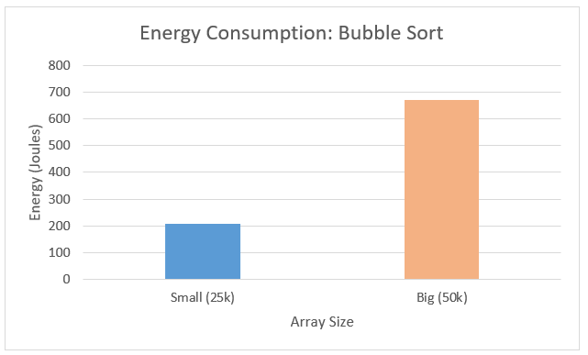
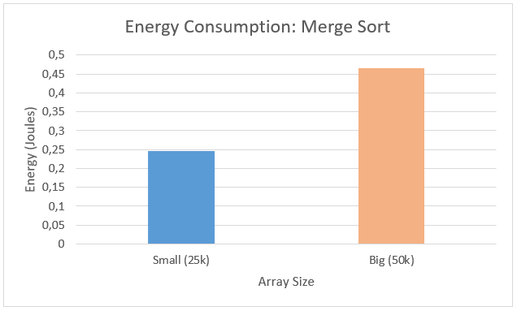
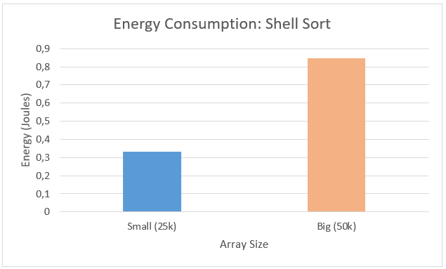
2. Exercise #2
Desenvolvimento, Validação e Manutenção de Software (SDVM)
To better illustrate how each algorithm responded to changes in array size, I created individual graphs. In the combined graph, the faster algorithms were overshadowed/hidden, so separate plots provide a clearer comparison.
Figs 22. Individual Energy Consumption graphs
Parameters used:
No optimizations
Unsorted
Int array
Notes:
Contextualização

Slide 20
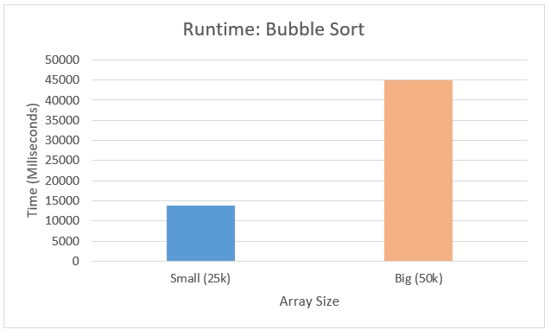
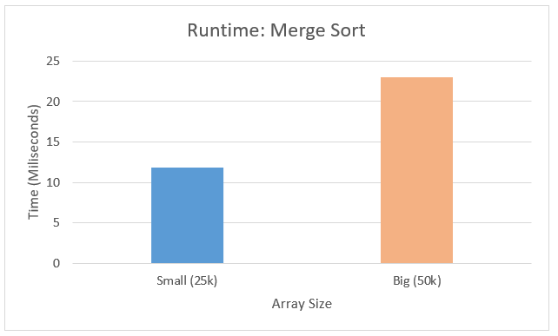
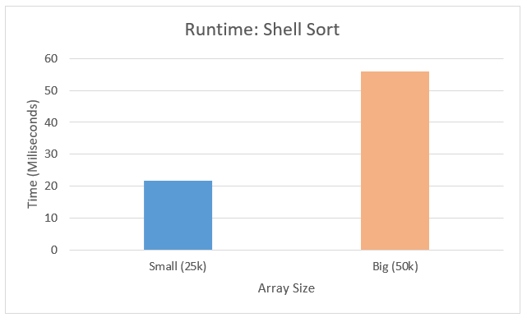
2. Exercise #2
Desenvolvimento, Validação e Manutenção de Software (SDVM)
For the previous reasons, the following individual runtime plots were created:
Figs 23. Individual Runtime plots
Parameters used:
No optimizations
Unsorted
Int array
Notes:
Contextualização

Slide 21
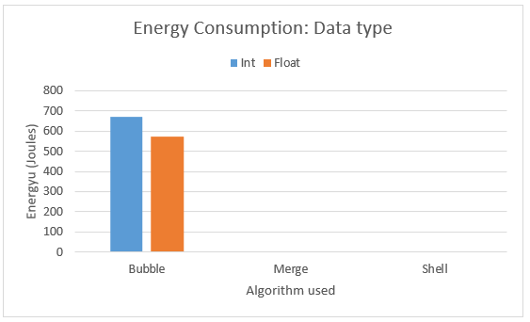
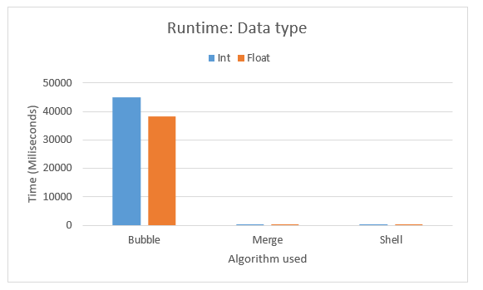
2. Exercise #2
Desenvolvimento, Validação e Manutenção de Software (SDVM)
The following graphs illustrate the impact of the different data types on the results:
Fig 24. Energy Consumption graph
Fig 25. Runtime graph
Parameters used:
No optimizations
Unsorted
Big array (50k elements)
Parameters used:
No optimizations
Unsorted
Big array (50k elements)
Notes:
Contextualização

Slide 22
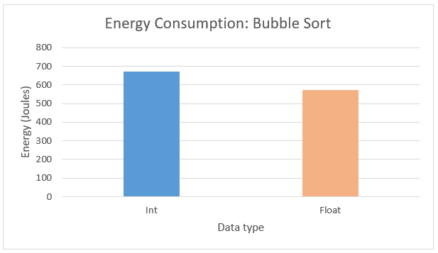
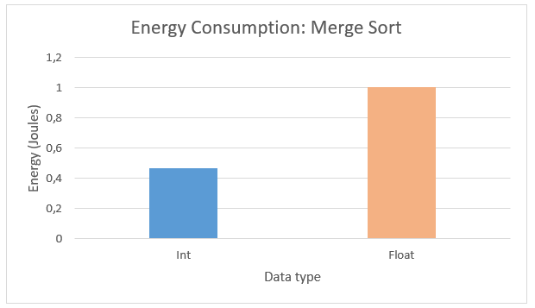
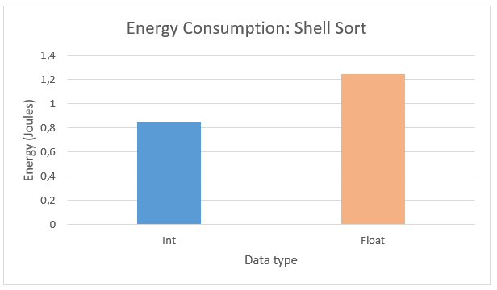
2. Exercise #2
Desenvolvimento, Validação e Manutenção de Software (SDVM)
It’s noticeable that, for Bubble Sort, the float array showed lower energy consumption, which wasn’t expected. This might be due to external factors such as concurrent machine usage, since the float array results varied significantly.
Figs 26. Individual Energy Consumption graphs
Parameters used:
No optimizations
Unsorted
Big array (50k elements)
Notes:
Contextualização

Slide 23
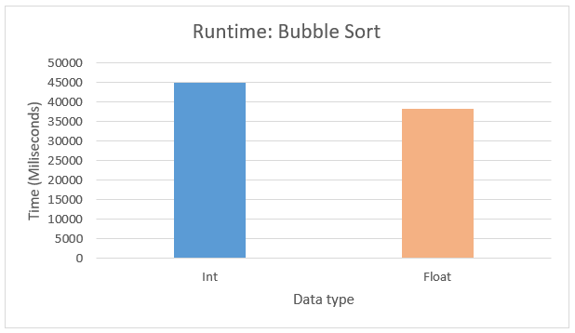
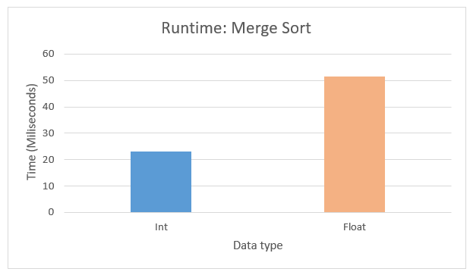
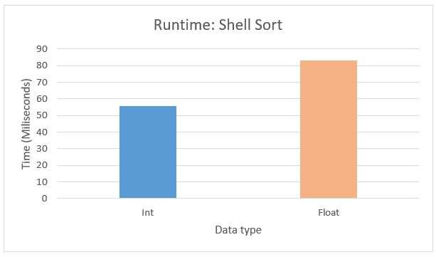
2. Exercise #2
Desenvolvimento, Validação e Manutenção de Software (SDVM)
Just like in the last slide its possible to notice the effects of concurrent machine usage in the bubble sort graph, this time in a runtime plot.
Figs 27. Individual Runtime plots
Parameters used:
No optimizations
Unsorted
Big array (50k elements)
Notes:
Contextualização

Slide 24
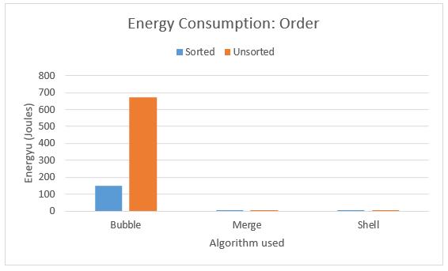
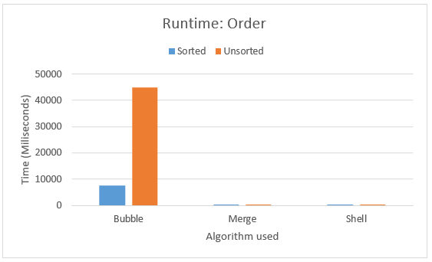
2. Exercise #2
Desenvolvimento, Validação e Manutenção de Software (SDVM)
The following graphs illustrate the impact of different array orders on the results:
Fig 28. Energy Consumption graph
Fig 29. Runtime graph
Parameters used:
No optimizations
Int array
Big array (50k elements)
Parameters used:
No optimizations
Int array
Big array (50k elements)
Notes:
Contextualização

Slide 25
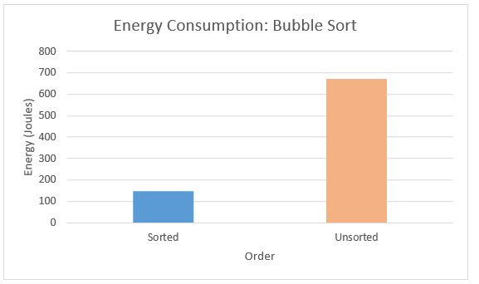
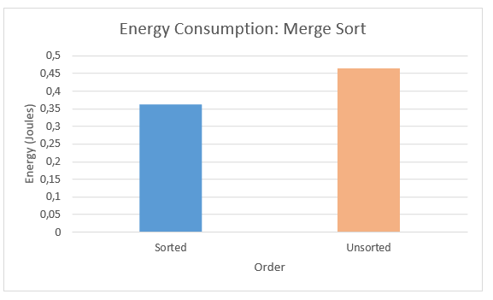
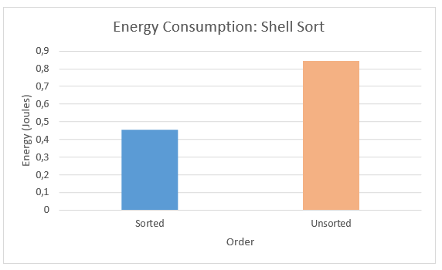
2. Exercise #2
Desenvolvimento, Validação e Manutenção de Software (SDVM)
Here we can see once again the individual values in closer detail:
Figs 30. Individual Energy Consumption graphs
Parameters used:
No optimizations
Int array
Big array (50k elements)
Notes:
Contextualização

Slide 26
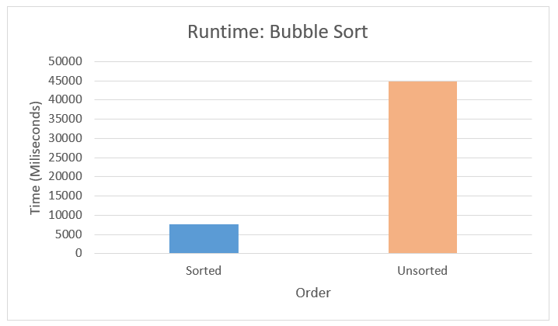
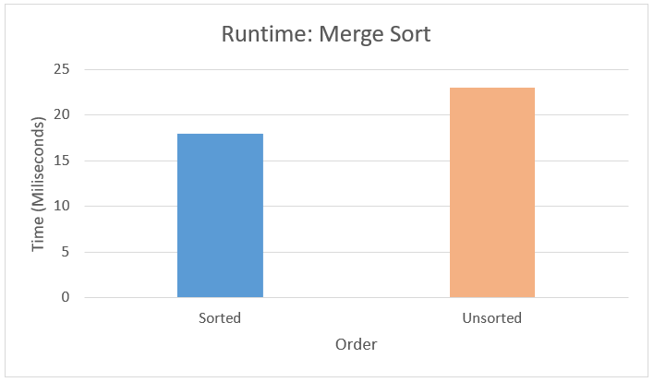
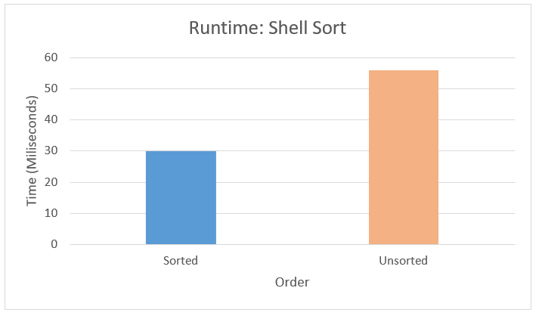
2. Exercise #2
Desenvolvimento, Validação e Manutenção de Software (SDVM)
Here we can see once again the individual values in closer detail.
Figs 31. Individual Runtime plots
Parameters used:
No optimizations
Int array
Big array (50k elements)
Notes:
Contextualização

Slide 27
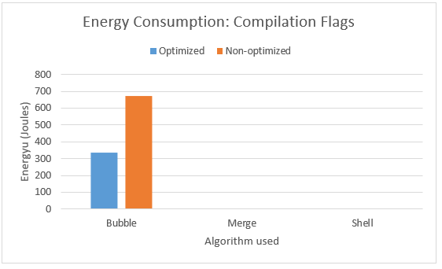
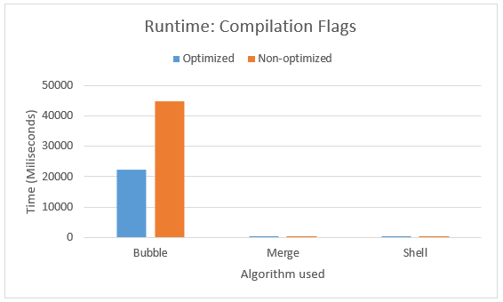
2. Exercise #2
Desenvolvimento, Validação e Manutenção de Software (SDVM)
The following graphs illustrate the impact of different compilation flags on the results:
Fig 32. Energy consumption graph
Fig 33. Runtime graph
Parameters used:
Unsorted array
Int array
Big array (50k elements)
Parameters used:
Unsorted array
Int array
Big array (50k elements)
Notes:
Contextualização

Slide 28
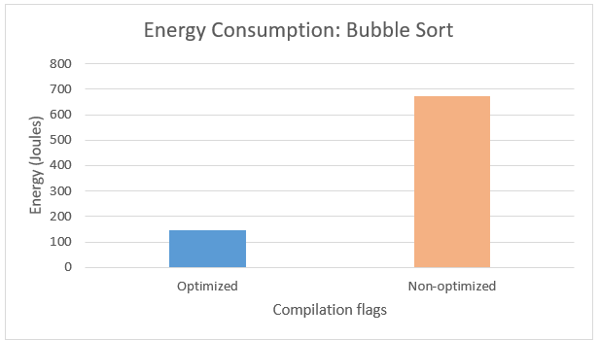
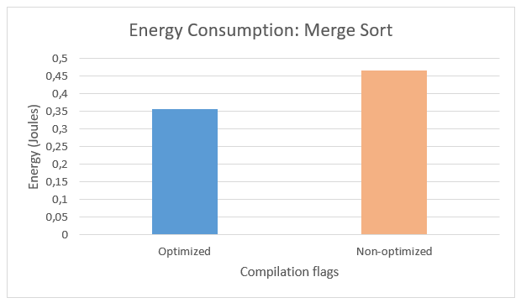
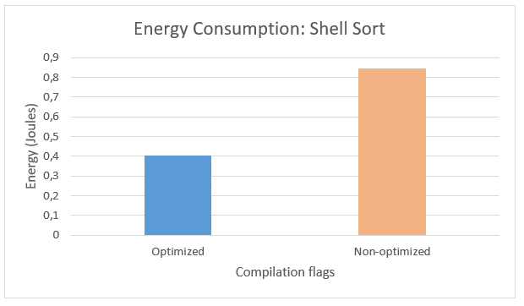
2. Exercise #2
Desenvolvimento, Validação e Manutenção de Software (SDVM)
Here we can see once again the individual values in closer detail:
Figs 34. Individual Energy consumption graphs
Parameters used:
Unsorted array
Int array
Big array (50k elements)
Notes:
Contextualização

Slide 29
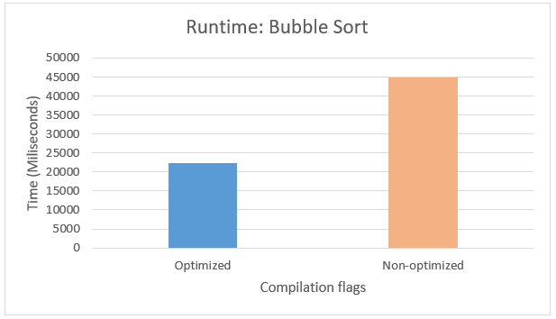


2. Exercise #2
Desenvolvimento, Validação e Manutenção de Software (SDVM)
Like in the last slide here we can see the individual values in closer detail.
Figs 35. Individual Runtime plots
Parameters used:
Unsorted array
Int array
Big array (50k elements)
Notes:
Contextualização

Slide 30
3. Extra exercise
Desenvolvimento, Validação e Manutenção de Software (SDVM)
For the exercise 1.11. the CLI program that was chosen for analysis is the ‘find’ program.
This program allows a user to search for a specific file or group of files on its system.
To test this program 5 different inputs were used: Commands:
Find existing folder “pg55986”. sudo find "/" -name "pg55986“
Find all files with 2 letters ‘A’. sudo find / -regextype posix-extended -regex '.*/[^/]*a[^a]*a[^a]*$' 2>/dev/null
Find all files with 1 letter ‘A’. sudo find / -regextype posix-extended -regex '.*/[^/]*a[^a]*a[^a]*$$' 2>/d>
Find all files with 3 letters and 2 numbers. sudo find / -regextype posix-extended -regex '.*/[0-9]{3}[A-Za-z]{2}$$' 2>/dev/null
Find non-existent file. sudo find "/" -name "ficheiroquenaoexiste"
Notes:
Contextualização

Slide 31


3. Extra exercise
Desenvolvimento, Validação e Manutenção de Software (SDVM)
Legend:
Find ‘pg55986’: Find existing folder “pg55986”.
Find ‘1a’: Find all files with 2 letters ‘A’.
Find ‘2a’: Find all files with 1 letter ‘A’.
Find ‘2l3n’: Find all files with 3 letters and 2 numbers.
Find ‘noexist’: Find non-existent file.
Figs 36. Energy consumption
Figs 37. Runtime
Notes:
Contextualização

Slide 32
4. Conclusion
Desenvolvimento, Validação e Manutenção de Software (SDVM)
With this practical work it was possible to measure the impact of various parameters in the energy consumption and the runtime of a program.
In exercise 1 its possible to conclude that:
The compilation flags greatly improve the runtime and energy consumption of the program
The linear version of the program was very efficient allowing for a massive reduction in energy consumption and runtime.
With the increase of the size of the inputs the energy consumption and runtime scaled exponentially.
The most efficient version of the program is the linear Fibonacci implementation using the ‘–o2’ flag.
In exercise 2 its possible to conclude that:
The size of the array impacted the runtime and the energy consumption of the program, the greater the array size the bigger the impact.
Sorting float arrays had a bigger impact in energy consumption and runtime than sorting int arrays.
If the array is unsorted there’s a massive impact in energy consumption and runtime.
The ‘-O2’ optimization reduced the energy consumption of the program and its runtime.
In the extra exercise its possible to conclude that:
For find queries with more complex regex expressions the energy consumption and runtime was bigger.
For a specific file, the ‘find’ program was faster and consumed less energy than when searching for a nonexistent file.
The ‘find’ program consumes more energy than sorting 50k elements in an unordered int array (not considering bubble sort), which is concerning.
Notes:
Contextualização

Slide 33
5. Gathered Data
Desenvolvimento, Validação e Manutenção de Software (SDVM)
All of the gathered data can be accessed via github.
https://github.com/miguel-amg/tds-data
Notes:
Contextualização

Slide 34
6. References
Desenvolvimento, Validação e Manutenção de Software (SDVM)
[1] Cody Blakeney, “GPS-UP: A better metric for comparing software energy efficiency,” Green Software Foundation, [Online]. Available: https://greensoftware.foundation/articles/gps-up-a-better-metric-for-comparing-software-energy-efficiency.
J. Saraiva, Green Software, Topics on Software Development, Departamento de Informática, Universidade do Minho, Portugal, 2024.
Notes:
Contextualização

Slide 35
Tópicos de Desenvolvimento de Software Desenvolvimento, Validação e Manutenção de Software (SDVM)
Universidade do Minho
Mestrado em Engenharia Informática
4º ano | 2º semestre
Miguel Ângelo Martins Guimarães
PG55986
Março 2024

