Slide 1

Scoring Commercial Banking Leads
Miguel Chacón
IronHack Data Analytics - 2020
Notes:
Good morning. IronHackers and members of the Jury. I’ll be presenting my project on Lead Scoring. Le’ts get to it.

Slide 2






Background
Fixe Banco
Lead-Gen
Phone Sales
Revenue
Notes:
Fixe Banco, a commercial banking institution in Portugal, has just finished its second direct sales campaign, promoting a new term deposit product.
The bank generated leads through several campaigns, collecting a variety of data for each one.
During the campaign, the bank’s sales representatives made around 45,000 phone calls to these leads in order to sell the product.
The campaign’s conversion rate was 11%. This is very satisfactory to the Marketing Department. They have decided to increase revenue by increasing lead volume rather than conversion rate. Nevertheless, the sales team does not have the capacity to make more than 45,000 phone calls per campaign.

Slide 3
Business Question
How can Fixe Banco increase its campaigns’ lead volume without decreasing its conversion rate or hiring more sales representatives?
Notes:
Because the CMO has been hanging out on Medium and Quora a lot, he has decided to hire a team of Data Scientists to solve this.

Slide 4
Machine Learning Lifecycle
1. Define Goals
2. Data Preparation
4. Evaluate Model
5. Refine Model
6. Implement and Test
3. Create Model
Notes:
We’ll take this problem through the Machine Learning Lifecycle

Slide 5

Defining the Goals

Slide 6
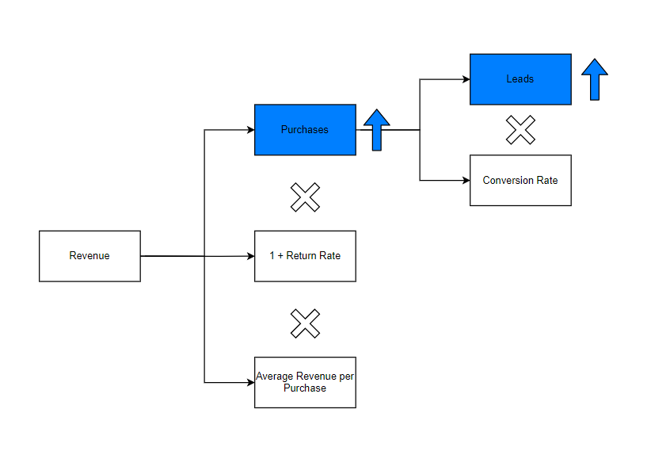
Notes:
Lead scoring.

Slide 7


The Answer?
Lead Scoring
Notes:
1. The answer? Lead Scoring!
2. Lead scoring allows us to assign scores to leads based on the predicted benefit they will bring to the business. In this case, we’ll assume that every conversion generates the same amount of revenue, and so the criteria for our score will be the probability that the lead will convert to a sale.

Slide 8

Preparing the Data

Slide 9
What Data?
Unit of Analysis:
Instances of Sales Phone Calls
Prediction Target:
Term Deposit (Binary)
Model Criteria:
F1 Score
Recall

Slide 10
Data Pipeline
Clean Data and Dimensionality Reduction
80/20 Data Split
No dropped Rows

Slide 11

Building and Evaluating the Model

Slide 12
Choosing a Scale and Algorithm
Scalers
Standard Scaler | Min-Max Scaler | Max Absolute Scaler
Normalizer | Quantile Transformer | Robust Scaler
Algorithms
Decision Tree | Random Forest | Logistic Regression
Stochastic Gradient Descent | Support Vector Machines | Linear Discriminant Analysis
Naïve-Bayes | Gradient Boosting | K-Nearest Neighbor
Notes:
54 combinations of six scalers and 9 algorithms.

Slide 13
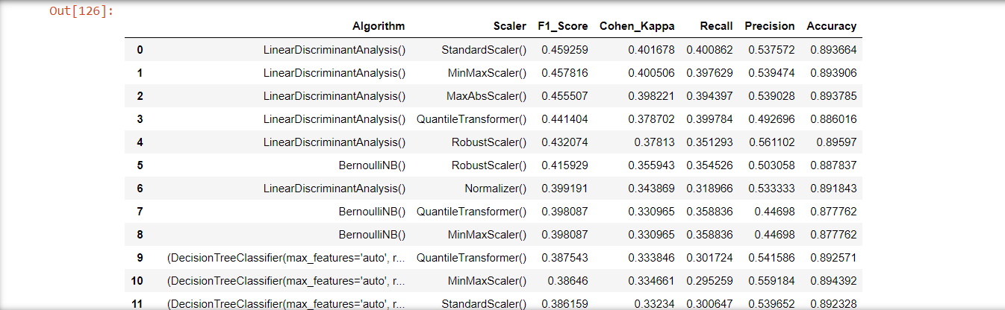
Results
Notes:
This is the resulting table. Linear Discriminant wins the F1 Score game, followed by Naïve Bayes. Unfortunately, neither of these allow hyperparameter tuning, so we’ll move forward with Random Forest.

Slide 14

Refining the Model

Slide 15
Random Search
Hyper-Parameters Combinations:
3960
Candidates
100
Cross-validation
3 per candidate

Slide 16
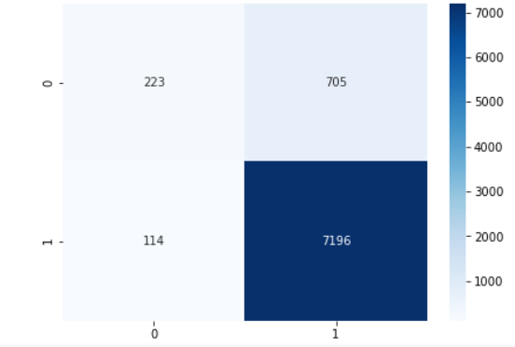
Random Forest Classifier
Recall: 66%
65%
F1 Score: 35%
22%
Notes:
Increase in Recall, decrease in F1
This is an improvement, since we care about not letting good leads escape.
How do we know if this is good, though? We CANNOT use Cohen’s Kappa or random chance. This is cheating, as sales teams do not assign leads randomly. Sales managers have experience, and their intuition allows them to accurately predict whether a lead will convert or not. We need to evaluate our model by testing it in this real world.

Slide 17



Testing and Deploying the Model
Notes:
Let’s talk about testing and deployment.
So, what did I do? I conducted an experiment

Slide 18
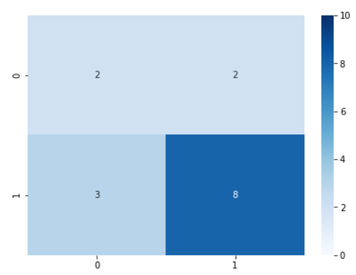
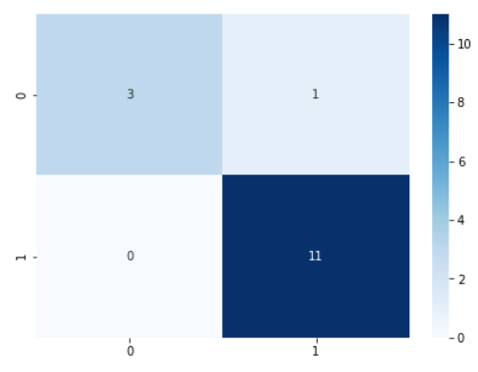
The Model vs. The Salesman’s Gut
EDUCATED GUESS
MODEL
Notes:
Disclaimer, I’m a performance marketer who’s not supposed to believe in intuition, not a sales guy.
I took a random sample of 15 leads, and I guessed whether they would convert or not.
Guess
I rated 2 positives and 8 negatives correctly.
I got 2 true positives right and 2 wrong.
I was too optimistic about three outcomes
Model
Got 3 positives and 11 negatives right
Got 1 positive wrong
Got no false positives
Financial impact:
I would have made 5 phone calls and converted 2 for a 40% CVR
Model would have made 4 phone calls and converted 3 for a 75% CVR.
90% higher CVR.

Slide 19
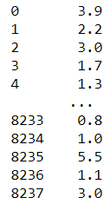
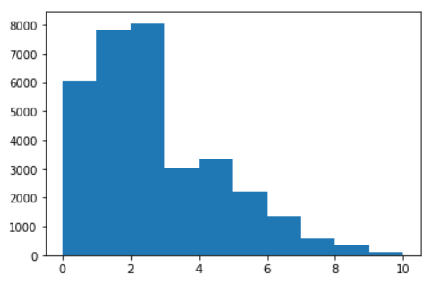
Lead Scoring Deliverable
Notes:
How do we actually use this? The beauty is that we don’t just classify.
Once we’re happy with the model, we:
Predict probabilities of Y from our dataset.
Fit a Min-Max scaler with the results and multiply it by 10.
Once we get a new lead, we simply predict the probability and fit it with the scaler.
We end up with a beautiful, easy to read 1-10 score for each lead.

Slide 20

Conclusion
Notes:
Difficulties whenever classifying conversions, given the very skewed distribution towards non-conversion in the data.
The model does a good job at predicting when a lead will convert, but it let to fewer phone calls than intuition. Further efforts should go towards further increasing Recall with more tuning and under/oversampling.

