Slide 1

Oauth 2.0
client server authorization

Slide 2
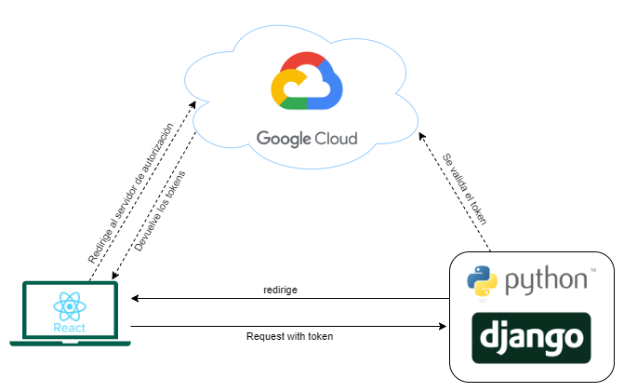
Arquitectura básica

Slide 3
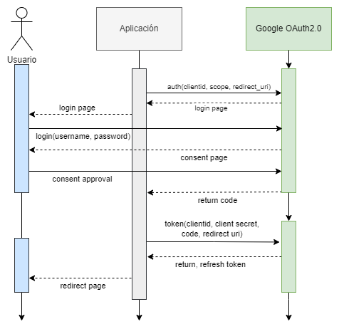
Diagrama de flujo

Slide 4
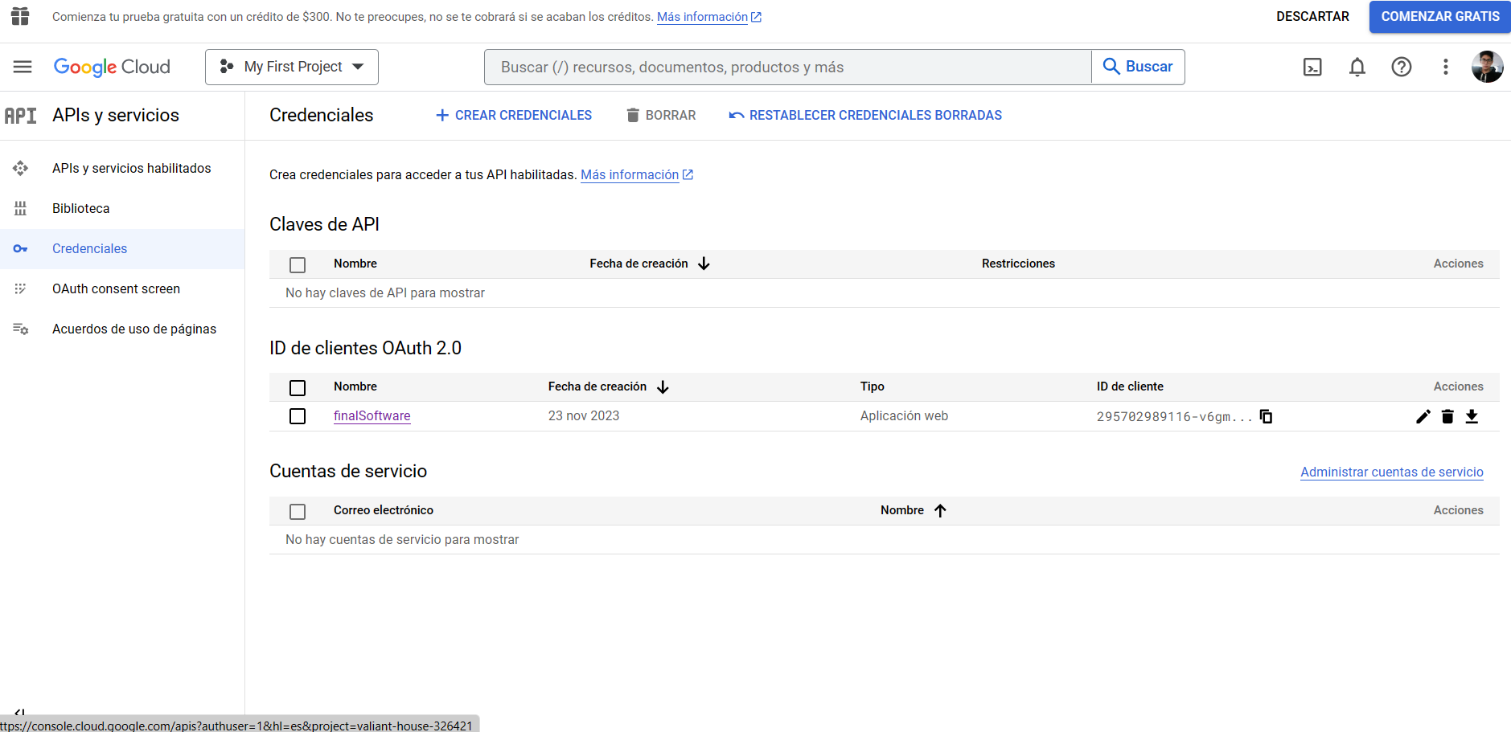

Slide 5
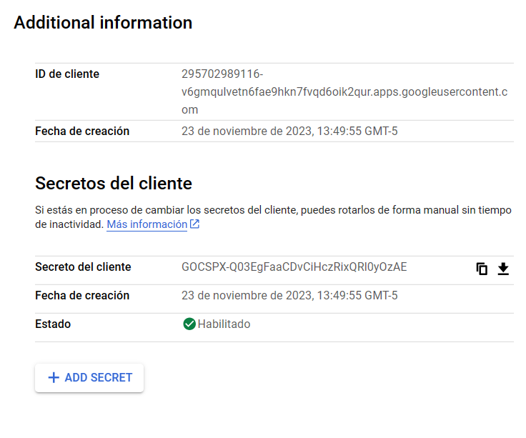
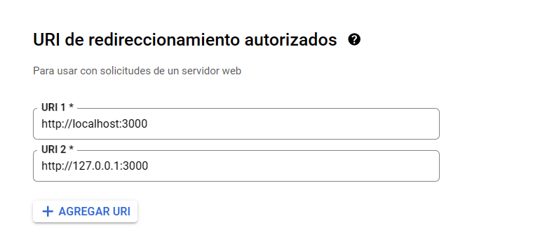

Slide 6
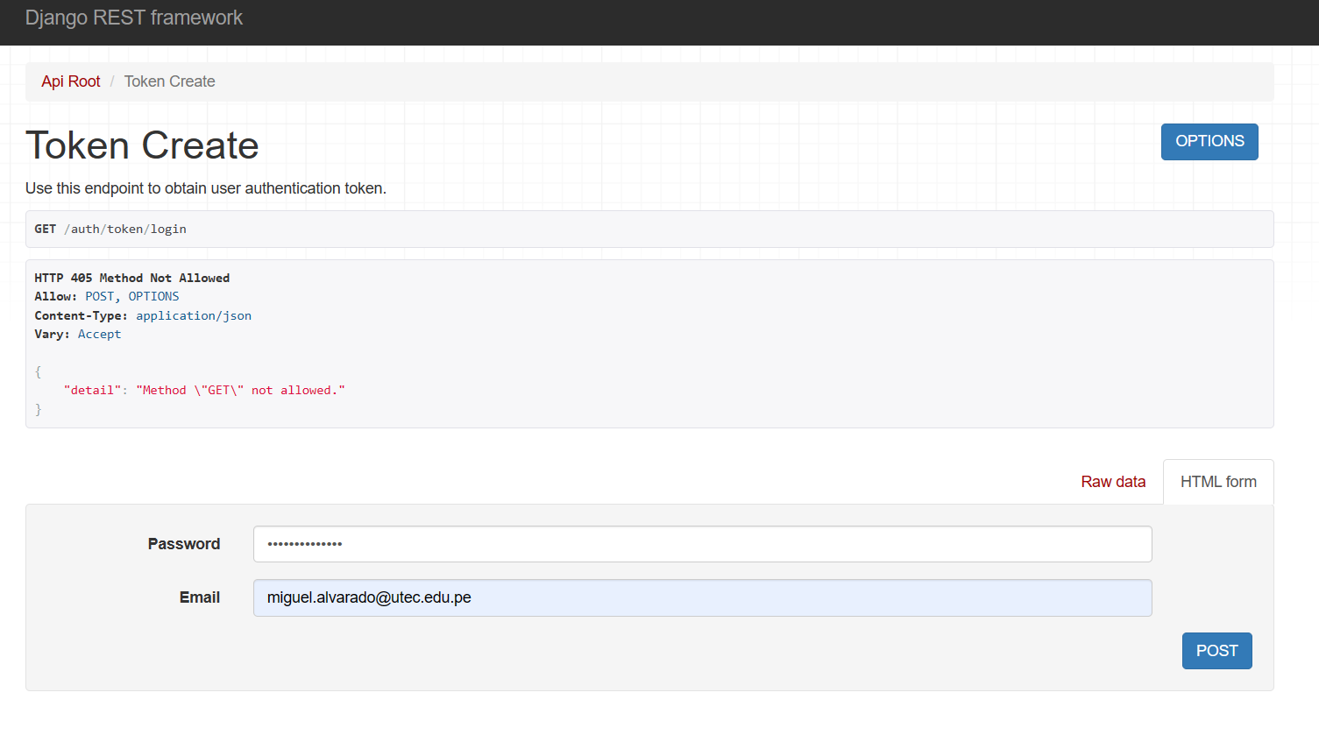

Slide 7
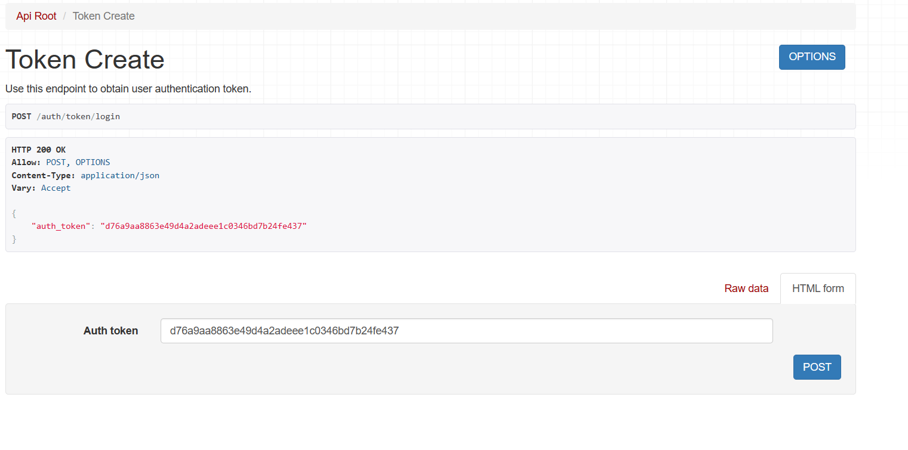

Slide 8
get
http://127.0.0.1:8000/auth/o/google-oauth2/?redirect_uri=http://127.0.0.1:3000

Slide 9
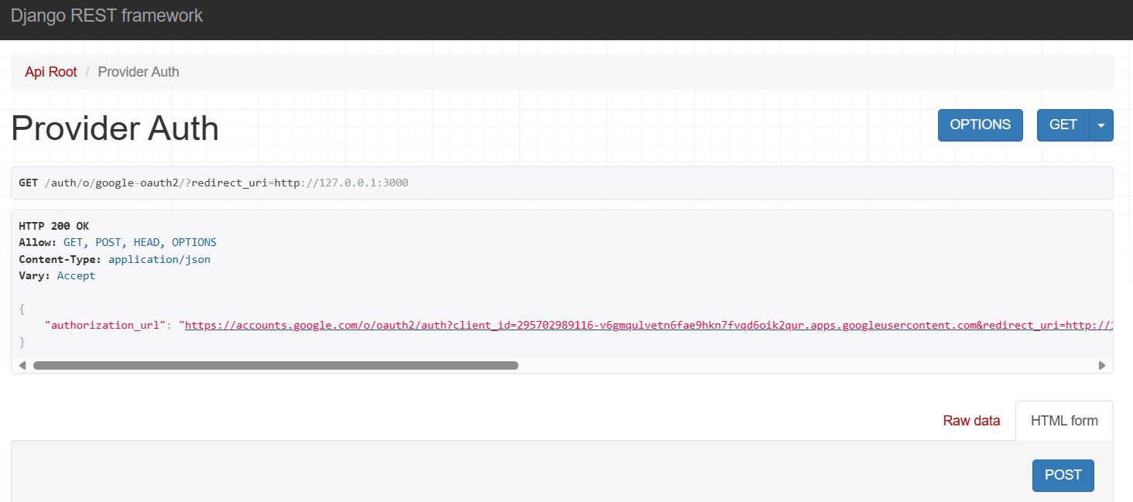

Slide 10
Authorization URL
"https://accounts.google.com/o/oauth2/auth?
client_id=295702989116-v6gmqulvetn6fae9hkn7fvqd6oik2qur.apps.googleusercontent.com&
redirect_uri=http%3A%2F%2F127.0.0.1%3A3000&
state=DQq8SeywXfxgcIiCAxxP7TSliQjfWXvb&
response_type=code&
scope=
https%3A%2F%2Fwww.googleapis.com%2Fauth%2Fuserinfo.email+
https%3A%2F%2Fwww.googleapis.com%2Fauth%2Fuserinfo.profile+
openid+openid+email+profile"

Slide 11
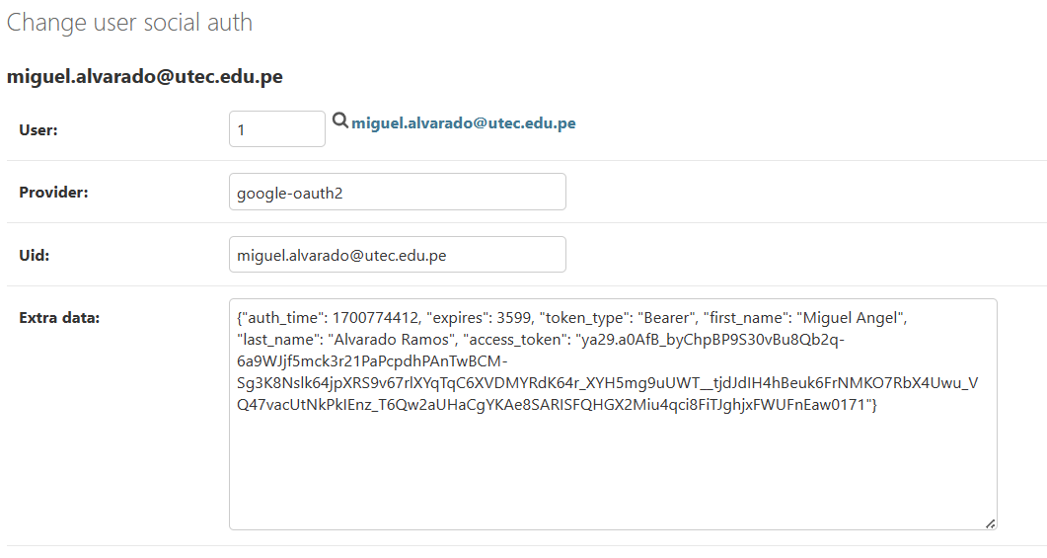

Slide 12
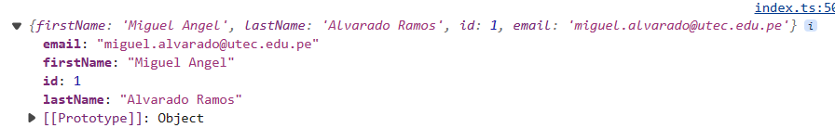
Get -> /auth/users/me/

Slide 13
demo

Slide 14
gracias
Link Github: miguel23022001/Final_SW2 (github.com)

