Slide 1
Statistical Process Control (SPC) Algorithm Implementation
Data Stream Mining
Ana Catarina Gomes - up201804545
Miguel Silva - up201403909

Slide 2
Contents
SPC Overview
Data
Implementation and Demo
Findings and Conclusions

Slide 3
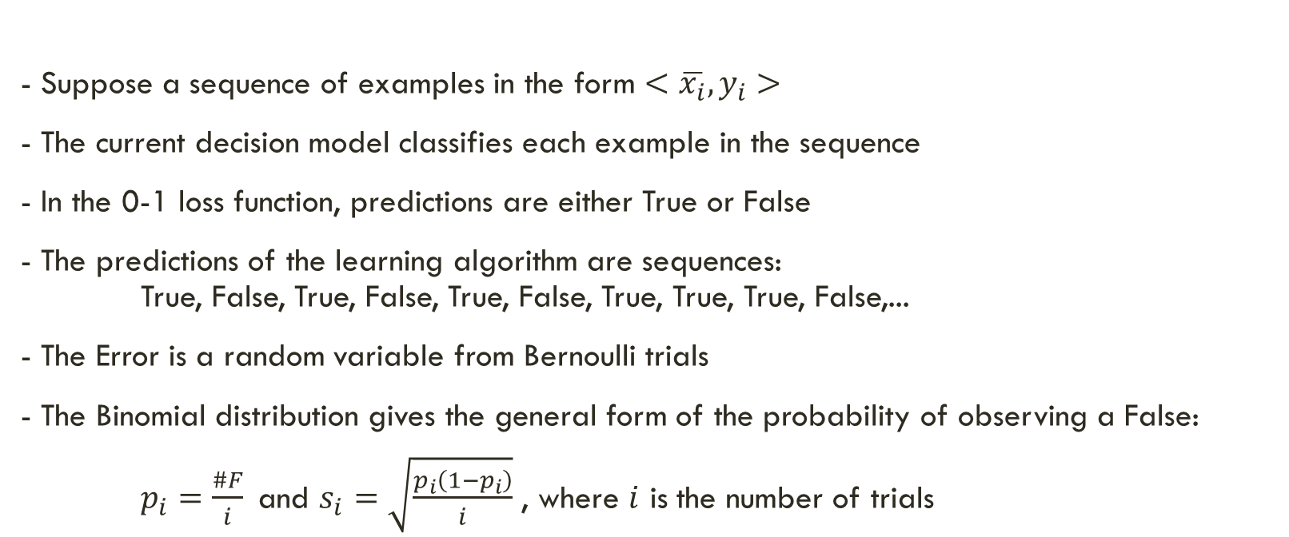
SPC Overview
Theoretical Refresher from Change Detection class (05/03/2024) Gama, et. al, Learning with Drift Detection, Lecture Notes in Computer Science 3171, Springer.
- Suppose a sequence of examples in the form $<\overline{x_{i}},y_{i}>$
- The current decision model classifies each example in the sequence
- In the 0-1 loss function, predictions are either True or False
- The predictions of the learning algorithm are sequences: True, False, True, False, True, False, True, True, True, False,...
- The Error is a random variable from Bernoulli trials
- The Binomial distribution gives the general form of the probability of observing a False:
$p_{i}=\frac{\#F}{i}$and $s_{i}=\sqrt{\frac{p_{i}\left(1−p_{i}\right)}{i}}$ , where $i$ is the number of trials

Slide 4
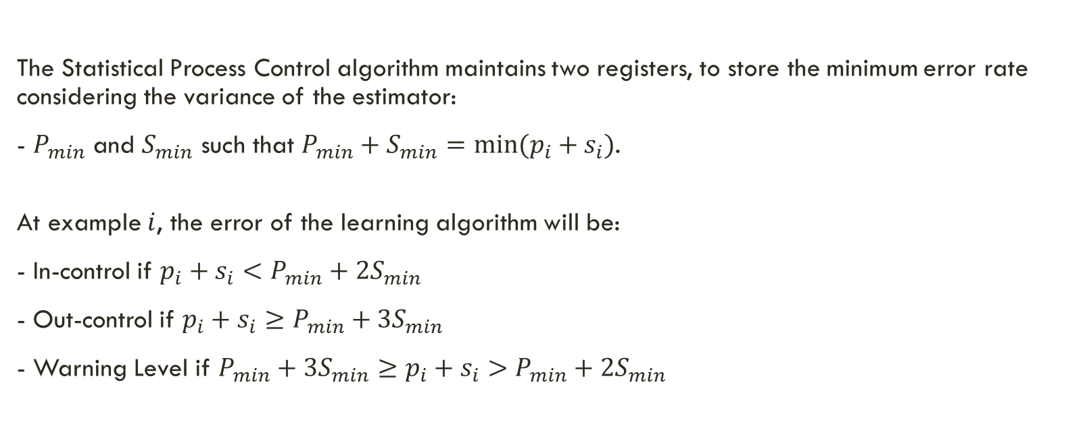
SPC Overview
Theoretical Refresher from Change Detection class (05/03/2024) Gama, et. al, Learning with Drift Detection, Lecture Notes in Computer Science 3171, Springer.
The Statistical Process Control algorithm maintains two registers, to store the minimum error rate considering the variance of the estimator:
- $P_{min}$ and $S_{min}$ such that $P_{min}+S_{min}=min⁡(p_{i}+s_{i})$.
At example $i$, the error of the learning algorithm will be:
- In-control if $p_{i}+s_{i}<P_{min}+2S_{min}$
- Out-control if $p_{i}+s_{i}≥P_{min}+3S_{min}$
- Warning Level if $P_{min}+3S_{min}≥p_{i}+s_{i}>P_{min}+2S_{min}$

Slide 5
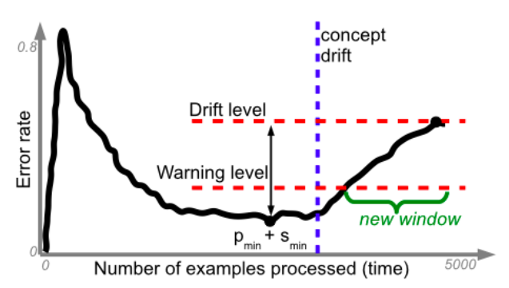
SPC Overview
Theoretical Refresher from Change Detection class (05/03/2024) Gama, et. al, Learning with Drift Detection, Lecture Notes in Computer Science 3171, Springer.

Slide 6
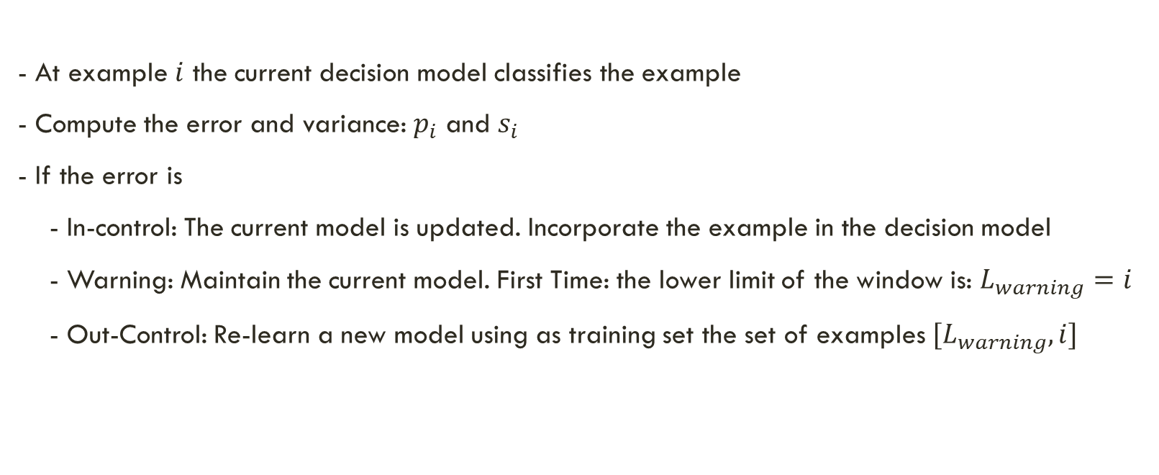
SPC Overview
Theoretical Refresher from Change Detection class (05/03/2024) Gama, et. al, Learning with Drift Detection, Lecture Notes in Computer Science 3171, Springer.
- At example $i$ the current decision model classifies the example
- Compute the error and variance: $p_{i}$ and $s_{i}$
- If the error is
- In-control: The current model is updated. Incorporate the example in the decision model
- Warning: Maintain the current model. First Time: the lower limit of the window is: $L_{warning}=i$
- Out-Control: Re-learn a new model using as training set the set of examples $[L_{warning},i]$

Slide 7
Data - Based on the SEA Concepts
120.000 examples
3 attributes (only 2 are relevant)
numeric between 0 and 10
2 classes
4 concepts
each repeated twice
defined by the sum of the 2 relevant attributes
if sum > threshold, then class = 0
concept thresholds: 8, 9, 7, 10
noise: 10%

Slide 8
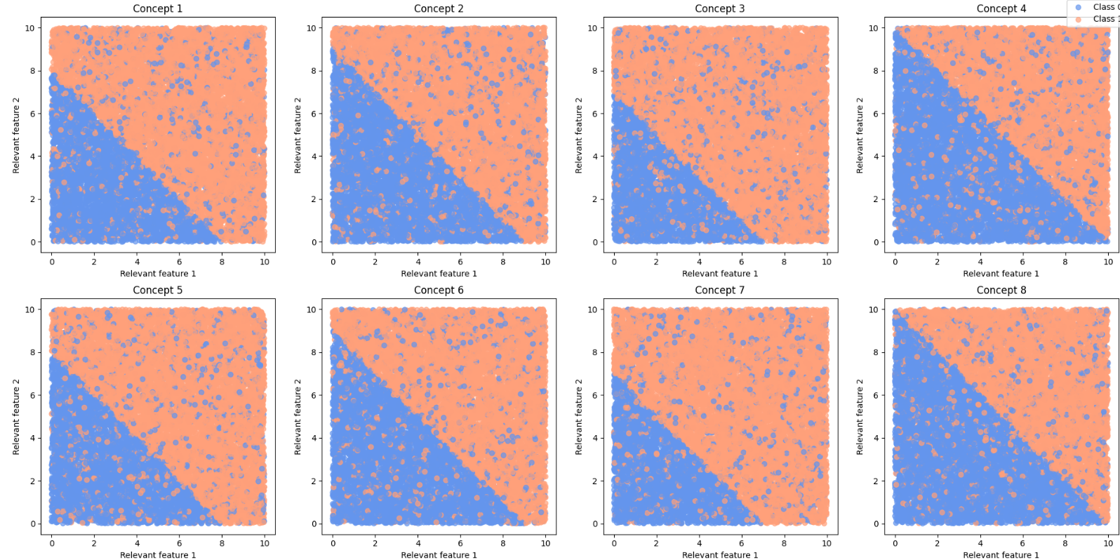
Data

Slide 9
Implementation and Demo
demo.ipynb

Slide 10
Findings and Conclusions

