Slide 1
Statistical Process Control (SPC) Algorithm Implementation
Data Stream Mining
Ana Catarina Gomes - up201804545
Miguel Silva - up201403909

Slide 2
Contents
SPC Overview
Data
Implementation and Demo
Findings and Conclusions

Slide 3
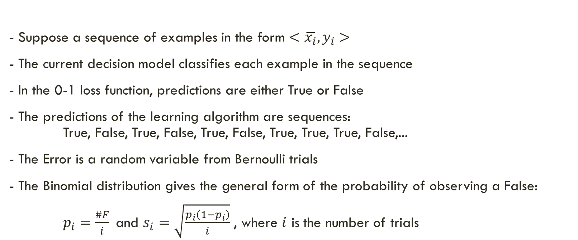
SPC Overview
Theoretical Refresher from Change Detection class (05/03/2024) Gama, et. al, Learning with Drift Detection, Lecture Notes in Computer Science 3171, Springer.
- Suppose a sequence of examples in the form $<\overline{x_{i}},y_{i}>$
- The current decision model classifies each example in the sequence
- In the 0-1 loss function, predictions are either True or False
- The predictions of the learning algorithm are sequences: True, False, True, False, True, False, True, True, True, False,...
- The Error is a random variable from Bernoulli trials
- The Binomial distribution gives the general form of the probability of observing a False:
$p_{i}=\frac{\#F}{i}$and $s_{i}=\sqrt{\frac{p_{i}\left(1−p_{i}\right)}{i}}$ , where $i$ is the number of trials

Slide 4
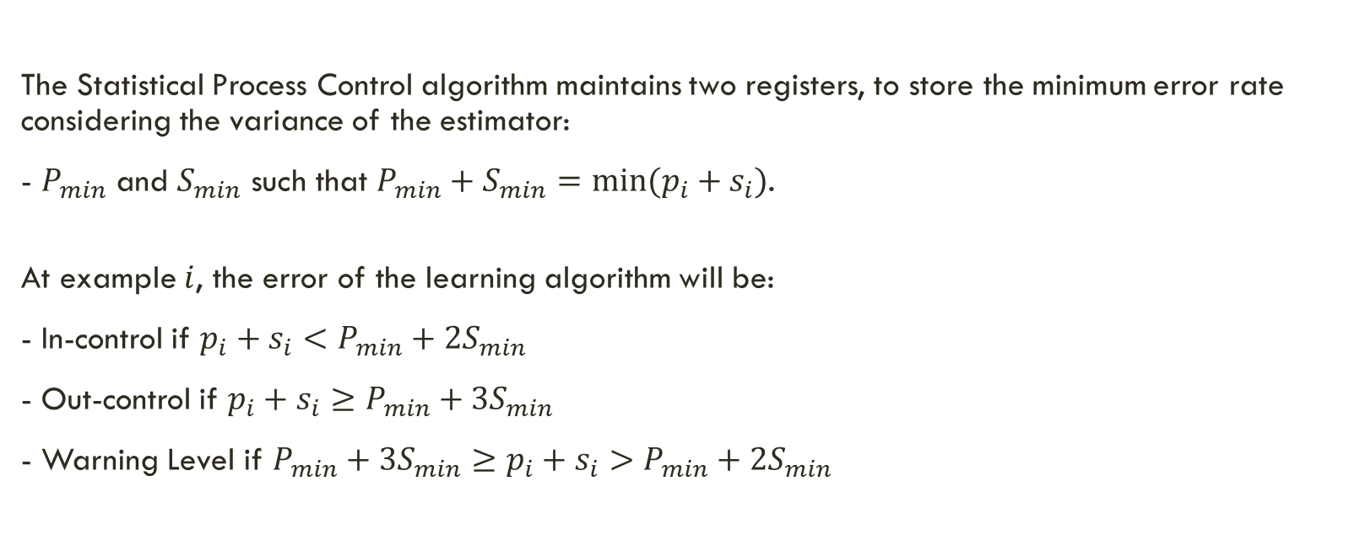
SPC Overview
Theoretical Refresher from Change Detection class (05/03/2024) Gama, et. al, Learning with Drift Detection, Lecture Notes in Computer Science 3171, Springer.
The Statistical Process Control algorithm maintains two registers, to store the minimum error rate considering the variance of the estimator:
- $P_{min}$ and $S_{min}$ such that $P_{min}+S_{min}=min⁡(p_{i}+s_{i})$.
At example $i$, the error of the learning algorithm will be:
- In-control if $p_{i}+s_{i}<P_{min}+2S_{min}$
- Out-control if $p_{i}+s_{i}≥P_{min}+3S_{min}$
- Warning Level if $P_{min}+3S_{min}≥p_{i}+s_{i}>P_{min}+2S_{min}$

Slide 5
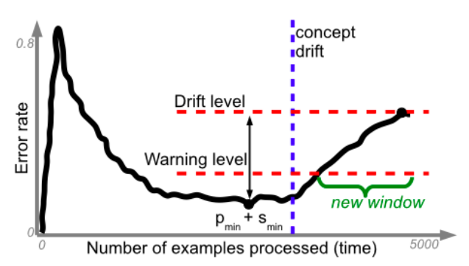
SPC Overview
Theoretical Refresher from Change Detection class (05/03/2024) Gama, et. al, Learning with Drift Detection, Lecture Notes in Computer Science 3171, Springer.

Slide 6
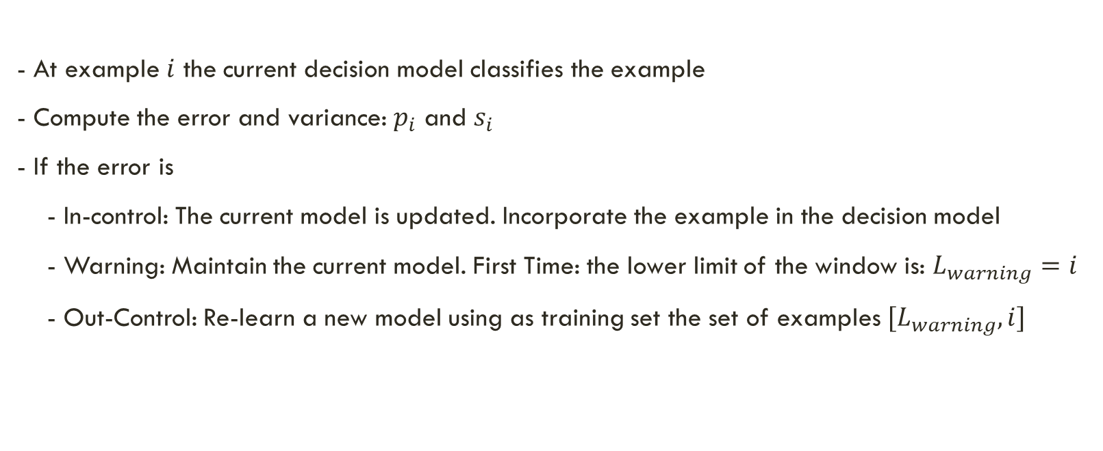
SPC Overview
Theoretical Refresher from Change Detection class (05/03/2024) Gama, et. al, Learning with Drift Detection, Lecture Notes in Computer Science 3171, Springer.
- At example $i$ the current decision model classifies the example
- Compute the error and variance: $p_{i}$ and $s_{i}$
- If the error is
- In-control: The current model is updated. Incorporate the example in the decision model
- Warning: Maintain the current model. First Time: the lower limit of the window is: $L_{warning}=i$
- Out-Control: Re-learn a new model using as training set the set of examples $[L_{warning},i]$

Slide 7
Data - Based on the SEA Concepts
120.000 examples
3 attributes (only 2 are relevant)
numeric between 0 and 10
2 classes
4 concepts
each repeated twice
defined by the sum of the 2 relevant attributes
if sum > threshold, then class = 0
concept thresholds: 8, 9, 7, 10
noise: 10%

Slide 8
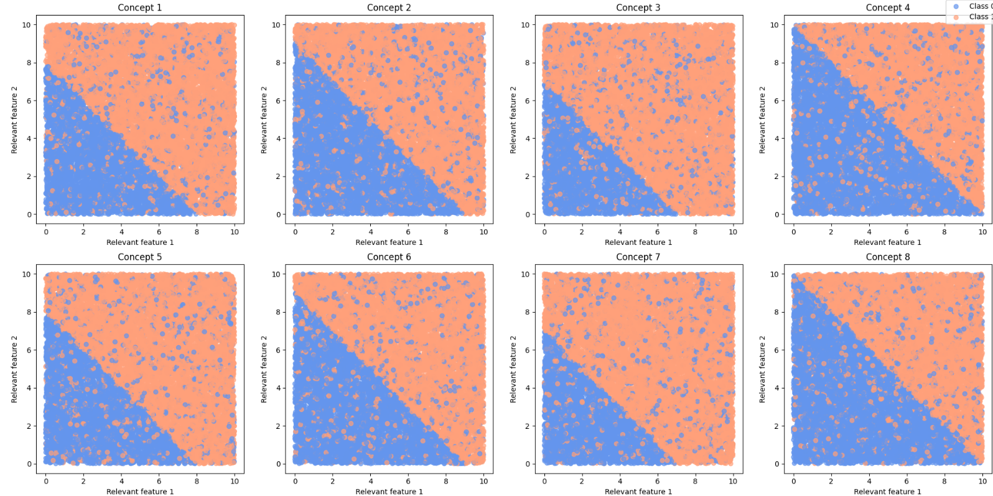
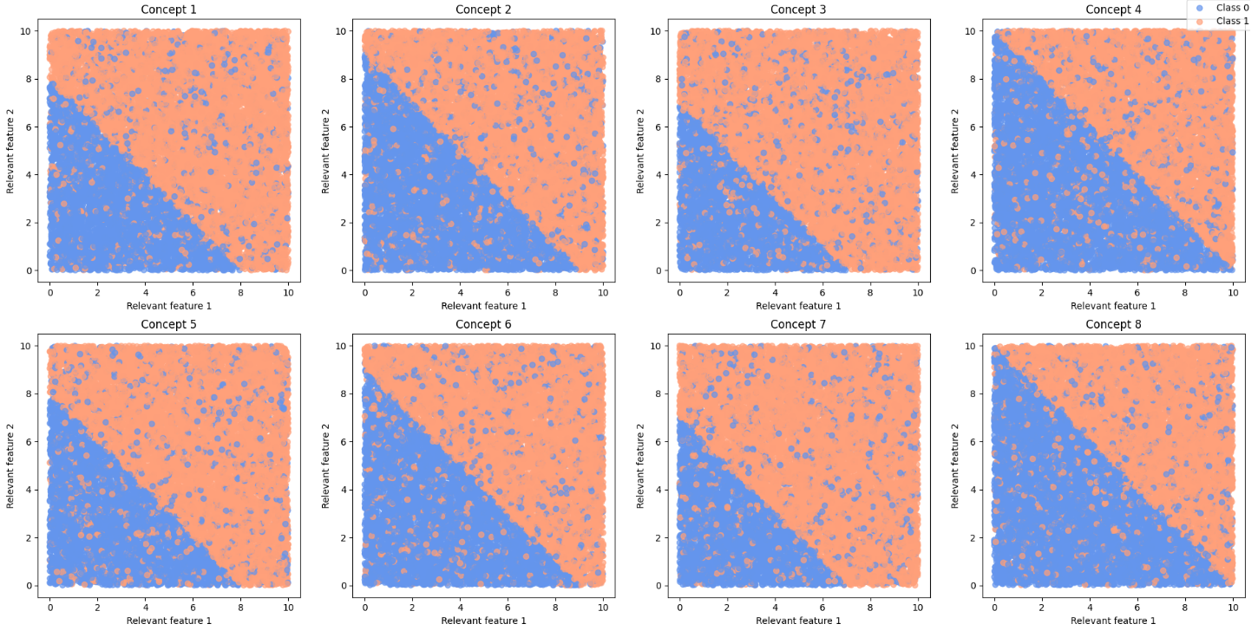
Data

Slide 9
Implementation and Demo
demo.ipynb

Slide 10
Findings and Conclusions
Effect of model choices
Effect of exponentially smoothing the error
Effect of a sliding window strategy to update the error
Detecting concept drift in hidden variables

Slide 11
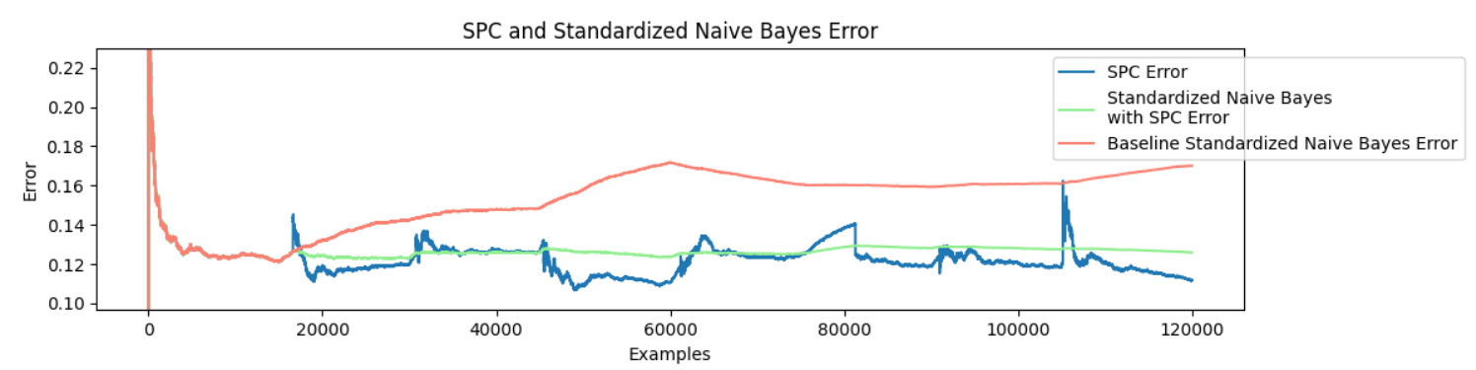
Effect of model choices - standardization
Naïve Bayes with standardized data
Effective drift detection

Slide 12
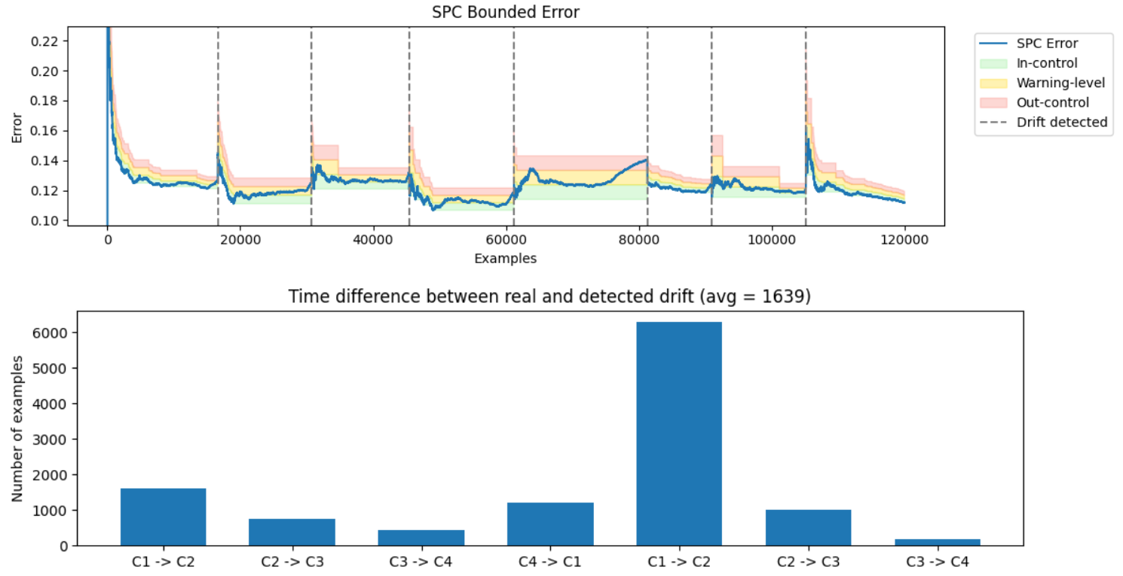
Fifth drift detected significantly later
Standardization might minimize the effect of different concepts

Slide 13
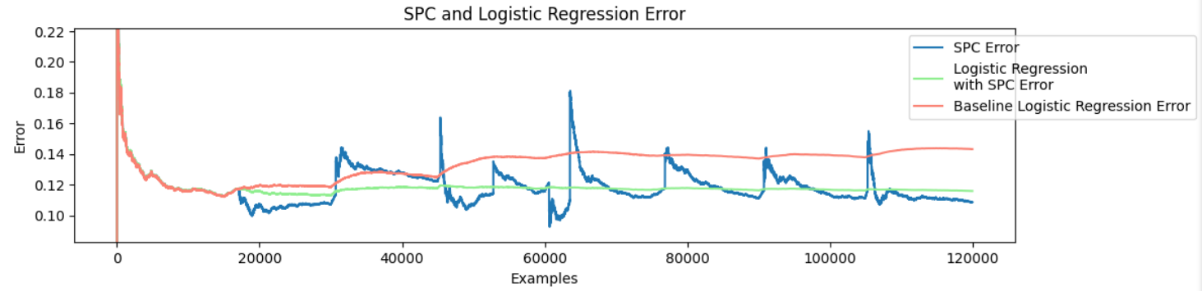
Effect of model choices – SGD Classifier
Logistic Regression with SGD
Effectively reduced the error

Slide 14
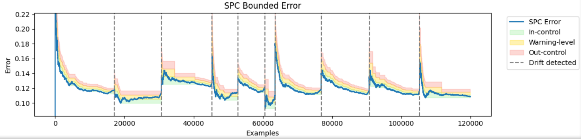
Slower error decrease
False alarms increased
Instability from 45000 to 62000 examples
Balanced classes from 45000 to 60000 – challenging (confirmar)

Slide 15
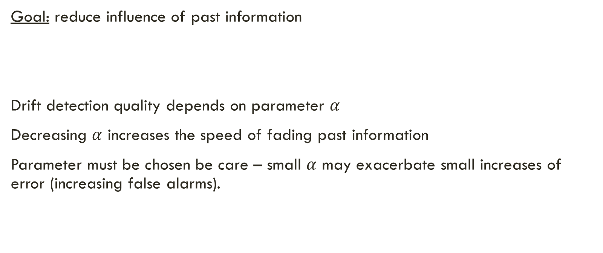
Effect of exponentially smoothing the error
Goal: reduce influence of past information
Drift detection quality depends on parameter $α$
Decreasing $α$ increases the speed of fading past information
Parameter must be chosen be care – small $α$ may exacerbate small increases of error (increasing false alarms).
$$p_{i}=(\#F_{i−1}∗α+\#F_{i})/i$$

Slide 16
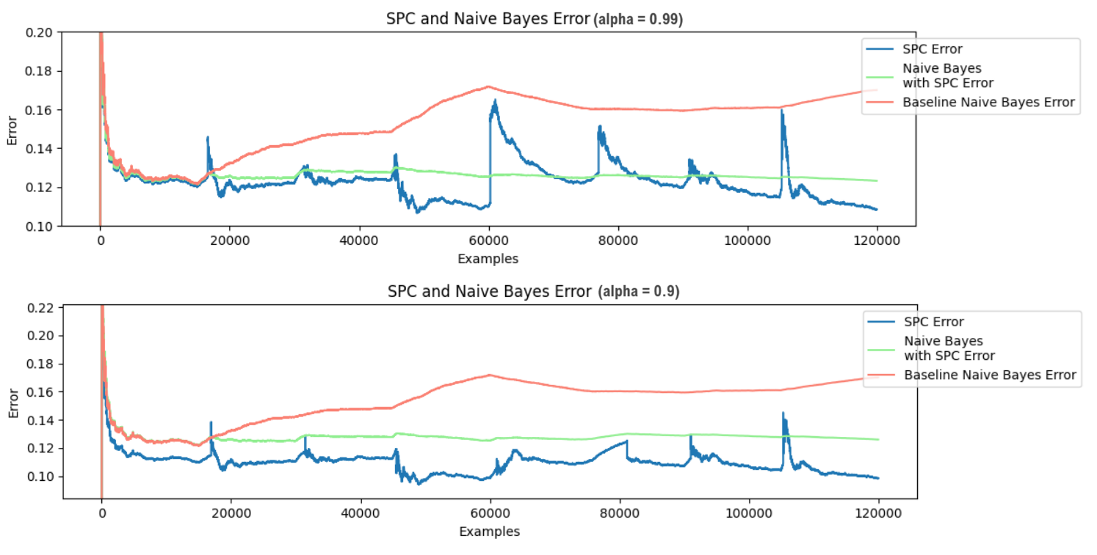

For $α≥0.9$, SPC effectively detects all concept drifts

Slide 17
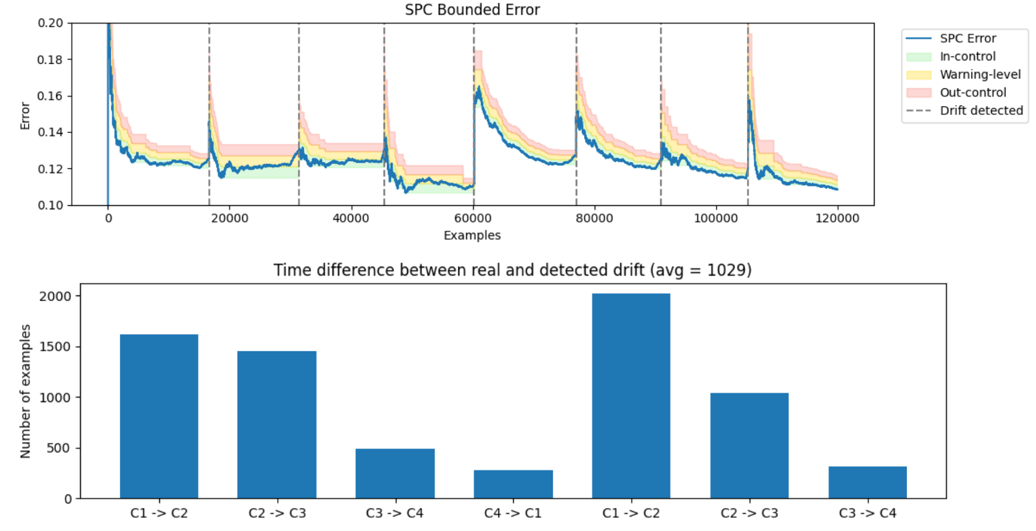

Parameter $α=0.99$

Slide 18
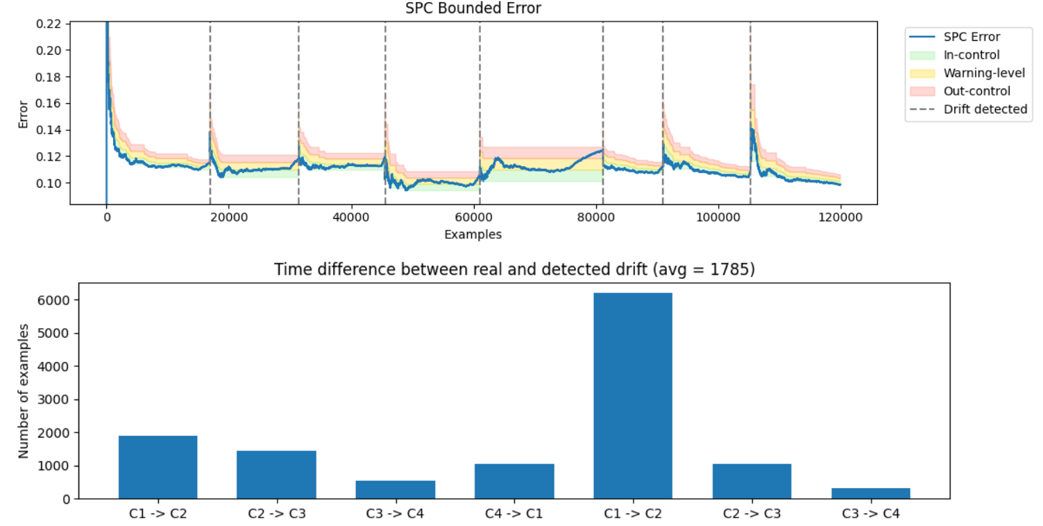

Parameter $α=0.9$

Slide 19
Effect of USING A SLIDING WINDOW
Goal: eliminate past information from the process
Drift detection quality depends on the window size parameter
Decreasing the window size increases the amount of eliminated information
Parameter must be chosen be care – small window size may exacerbate small increases of error (increasing false alarms).
Processing speed: window management may introduce computational overhead

Slide 20
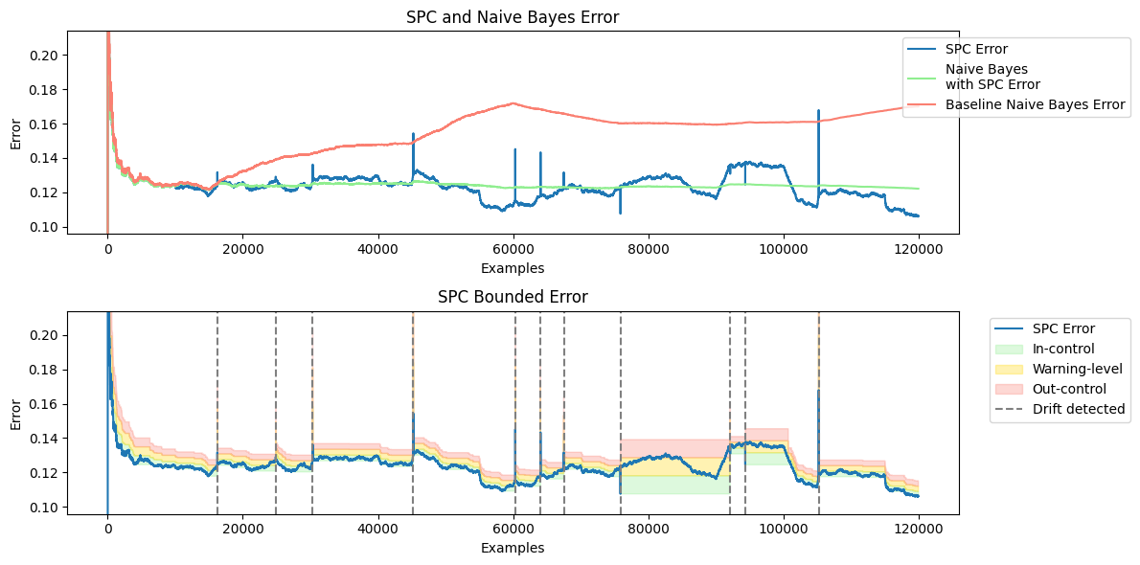
Window Size = 10.000

