Slide 1
Statistical Process Control (SPC) Algorithm Implementation
Data Stream Mining
Ana Catarina Gomes - up201804545
Miguel Silva - up201403909

Slide 2
Contents
SPC Overview
Data
Implementation and Demo
Findings and Conclusions

Slide 3
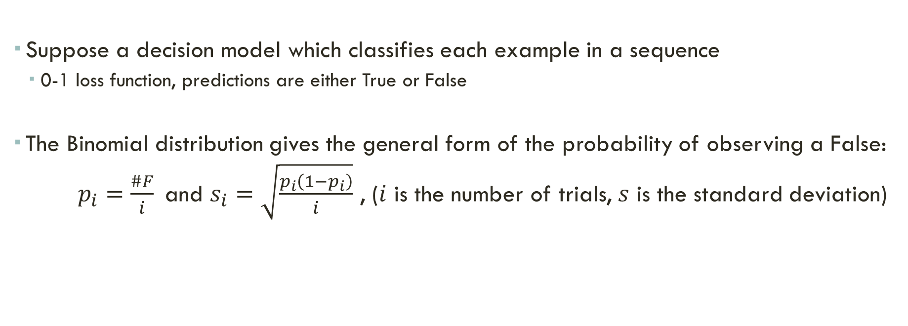
SPC Overview
Theoretical Refresher from Change Detection class (05/03/2024) Gama, et. al, Learning with Drift Detection, Lecture Notes in Computer Science 3171, Springer.
Suppose a decision model which classifies each example in a sequence
0-1 loss function, predictions are either True or False
The Binomial distribution gives the general form of the probability of observing a False:
$p_{i}=\frac{\#F}{i}$and $s_{i}=\sqrt{\frac{p_{i}\left(1−p_{i}\right)}{i}}$ , ($i$ is the number of trials, $s$ is the standard deviation)

Slide 4
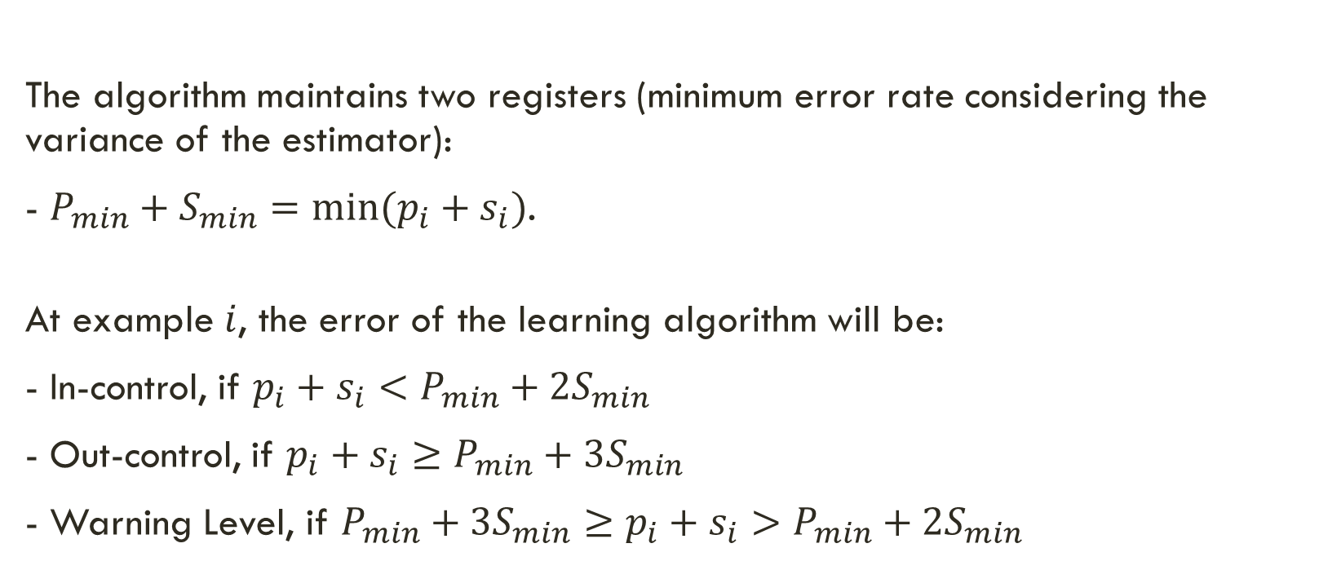
SPC Overview
Theoretical Refresher from Change Detection class (05/03/2024) Gama, et. al, Learning with Drift Detection, Lecture Notes in Computer Science 3171, Springer.
The algorithm maintains two registers (minimum error rate considering the variance of the estimator):
- $P_{min}+S_{min}=min⁡(p_{i}+s_{i})$.
At example $i$, the error of the learning algorithm will be:
- In-control, if $p_{i}+s_{i}<P_{min}+2S_{min}$
- Out-control, if $p_{i}+s_{i}≥P_{min}+3S_{min}$
- Warning Level, if $P_{min}+3S_{min}≥p_{i}+s_{i}>P_{min}+2S_{min}$

Slide 5
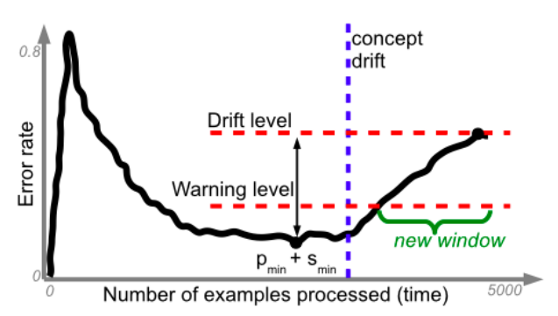

SPC Overview
Theoretical Refresher from Change Detection class (05/03/2024) Gama, et. al, Learning with Drift Detection, Lecture Notes in Computer Science 3171, Springer.
- In-control: The current model is updated. Incorporate the example in the decision model
- Warning: Maintain the current model. First Time: the lower limit of the window is: $L_{warning}=i$
- Out-Control: Re-learn a new model using as training set the set of examples $[L_{warning},i]$

Slide 6
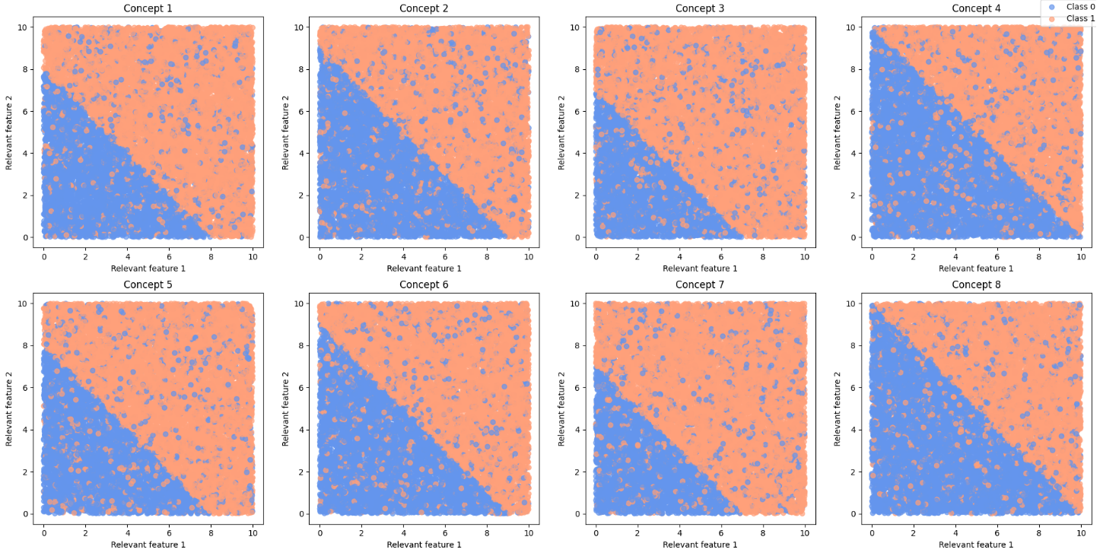
Data - Based on the SEA Concepts
120.000 examples
3 attributes (only 2 relevant)
numeric between 0 and 10
2 classes
4 concepts
each repeated twice
defined by the sum of the 2 relevant attributes
if sum > threshold: class = 0
concept thresholds: 8, 9, 7, 10
noise: 10%

Slide 7
Implementation and Demo
demo.ipynb
Module Implementation
Demo

Slide 8
Findings and Conclusions
Effect of model choices
Effect of exponentially smoothing the error
Effect of a sliding window strategy to update the error
Detecting concept drift in hidden variables

Slide 9
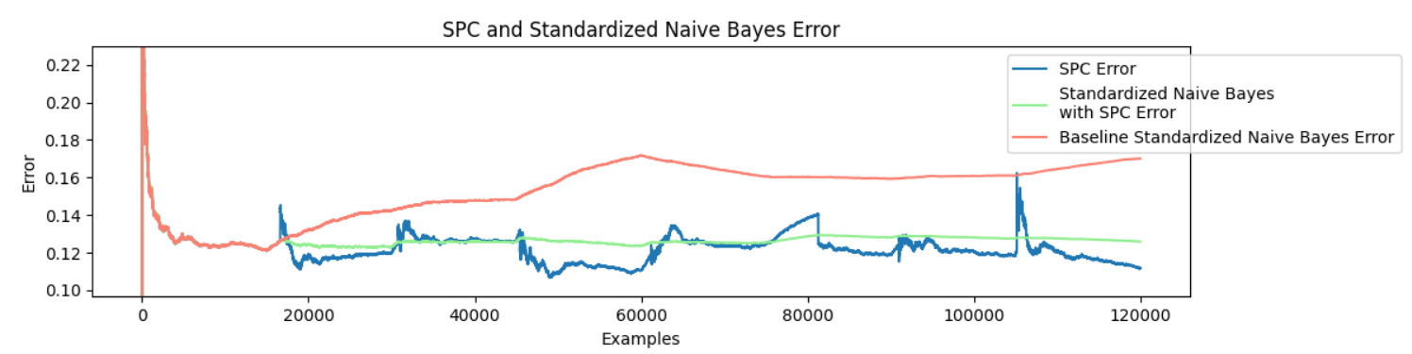
Effect of model choices - standardization
Naïve Bayes with standardized data
Effective error reduction

Slide 10
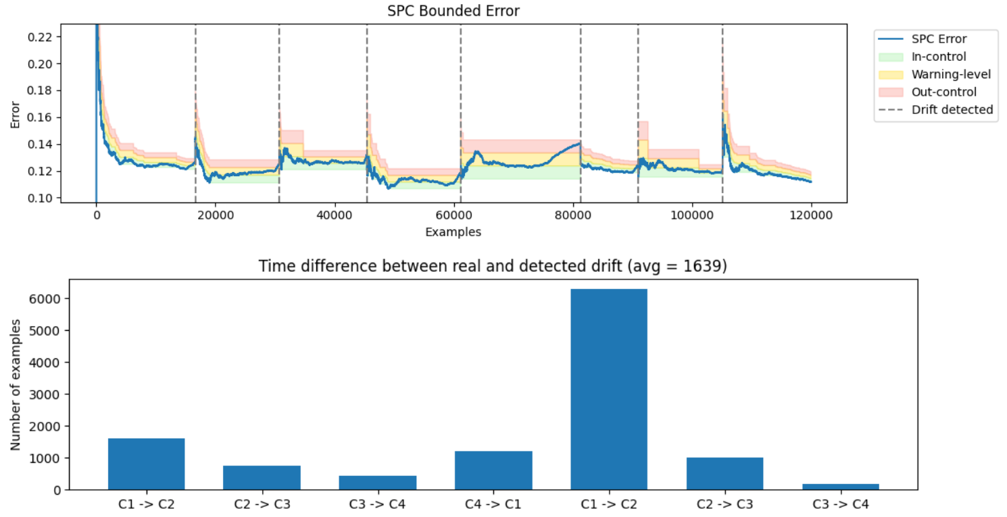
Fifth drift detected significantly later
Standardization might minimize the effect of different concepts

Slide 11
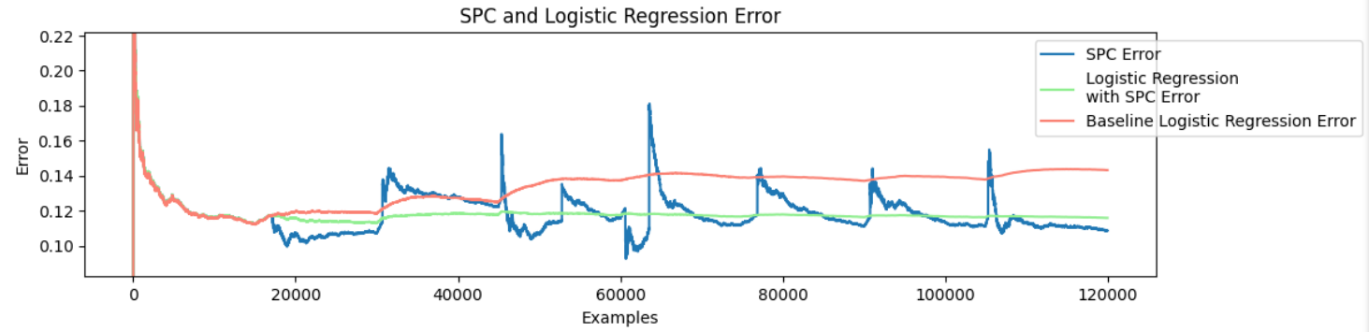
Effect of model choices – SGD Classifier
Logistic Regression with SGD
Effective error reduction

Slide 12
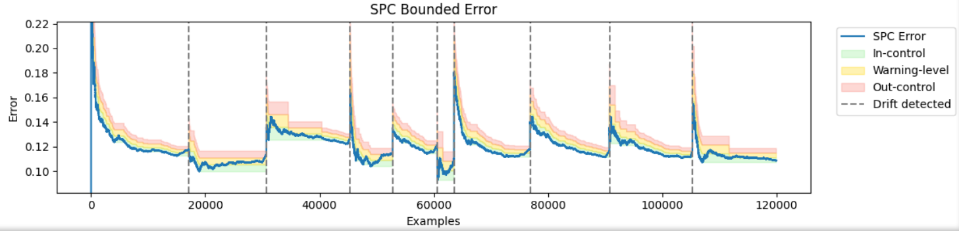
Slower error decrease
False alarms increased
Instability from 45000 to 62000 examples
Balanced classes from 45000 to 60000 – challenging

Slide 13
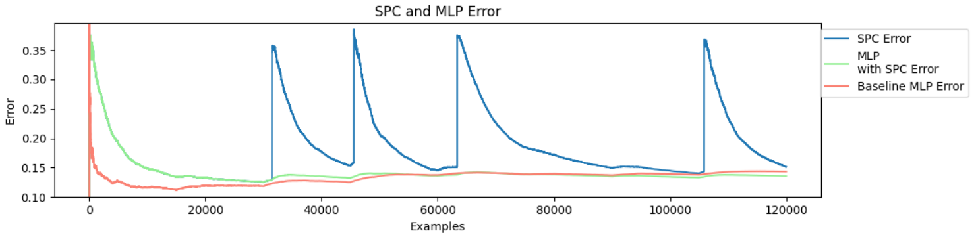
Effect of model choices – mlp Classifier
MLP with no hidden layers – linear boundary
Non effective error reduction

Slide 14

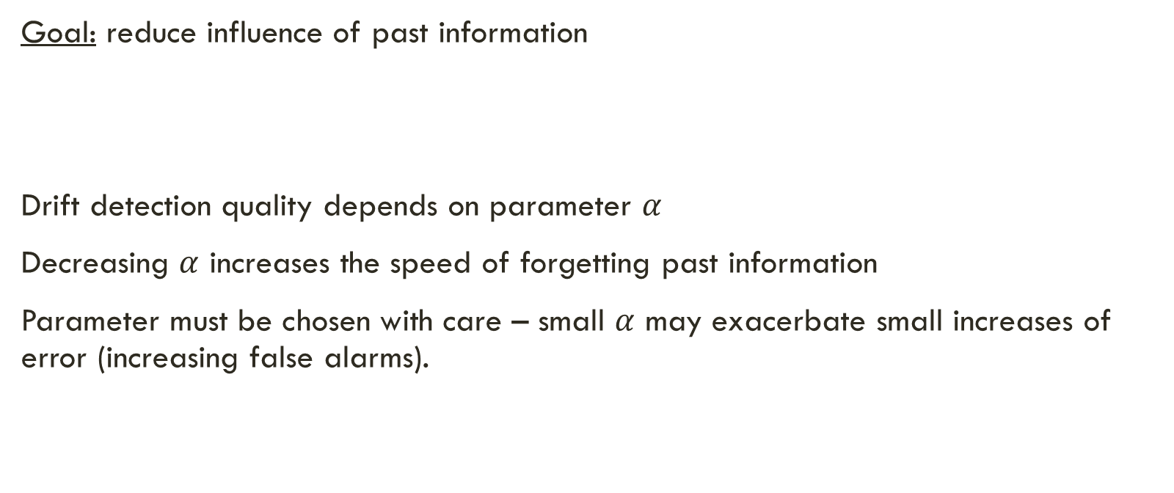
Effect of exponentially smoothing the error
Goal: reduce influence of past information
Drift detection quality depends on parameter $α$
Decreasing $α$ increases the speed of forgetting past information
Parameter must be chosen with care – small $α$ may exacerbate small increases of error (increasing false alarms).
$$p_{i}=\frac{F_{i−1}∗α+𝕝(y_{i}=y_{pred_{i}})}{N_{i−1}∗α+1}$$

Slide 15
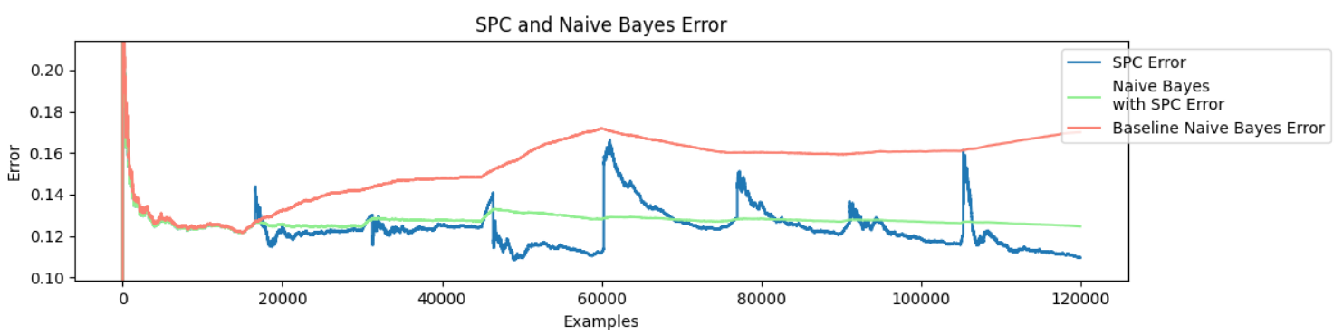
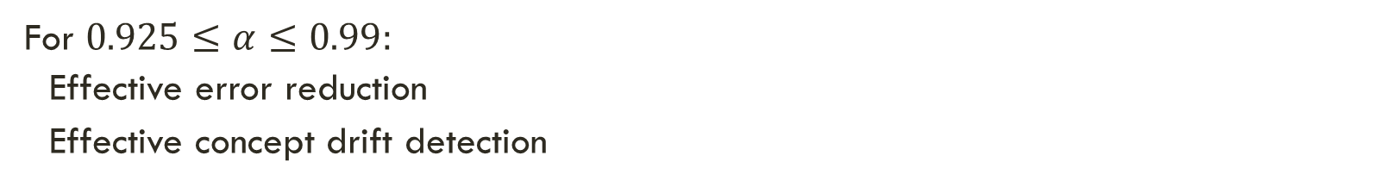
For $0.925≤α≤0.99:$
Effective error reduction
Effective concept drift detection

Slide 16
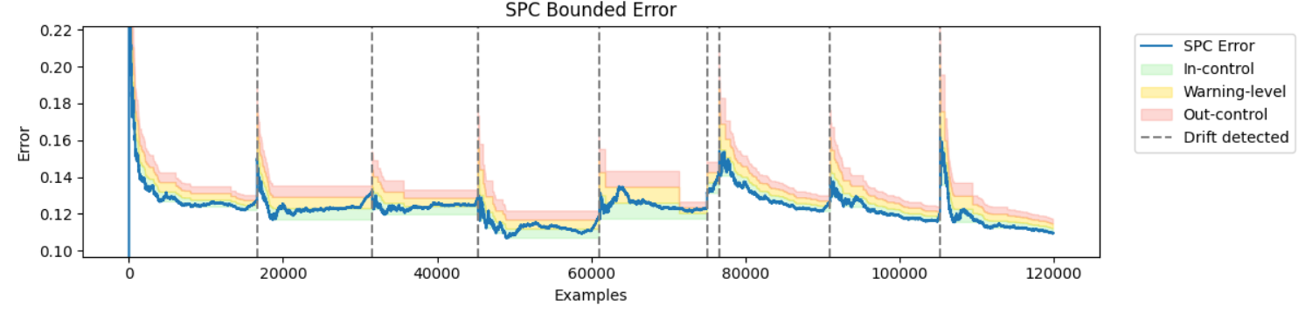
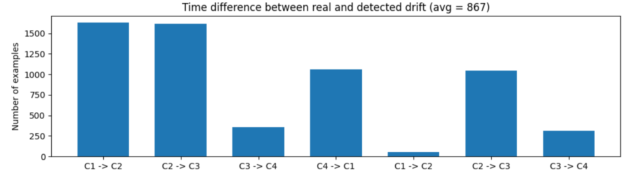
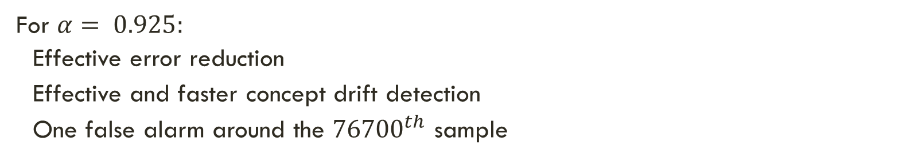
For $α= 0.925:$
Effective error reduction
Effective and faster concept drift detection
One false alarm around the ${76700}^{th}$ sample

Slide 17
Effect of USING A SLIDING WINDOW
Goal: eliminate past information from the process
Drift detection quality depends on the window size parameter
Decreasing the window size increases the amount of eliminated information
Parameter must be chosen be care – small window size may exacerbate small increases of error (increasing false alarms).
Processing speed: window management may introduce computational overhead

Slide 18
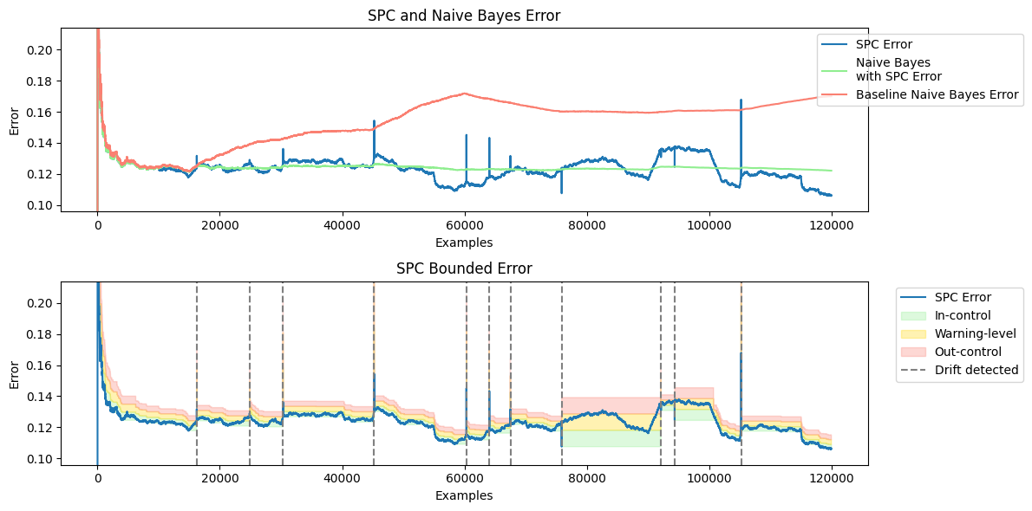
Window Size = 10.000

Slide 19
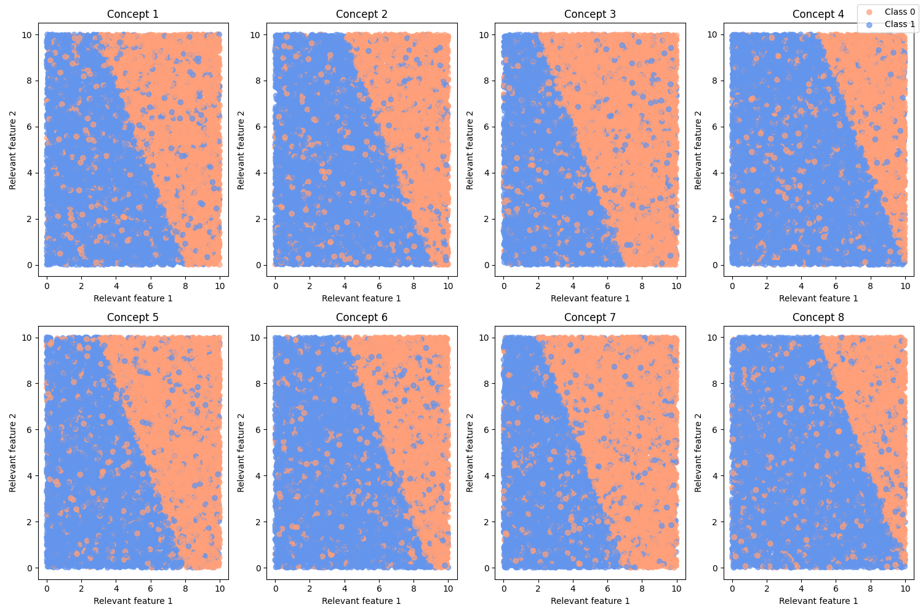

Drift on hidden variables
$$x_{1}∗1+x_{2}∗0.5=threshold$$
Relevant feature 2 is a hidden variable

Slide 20
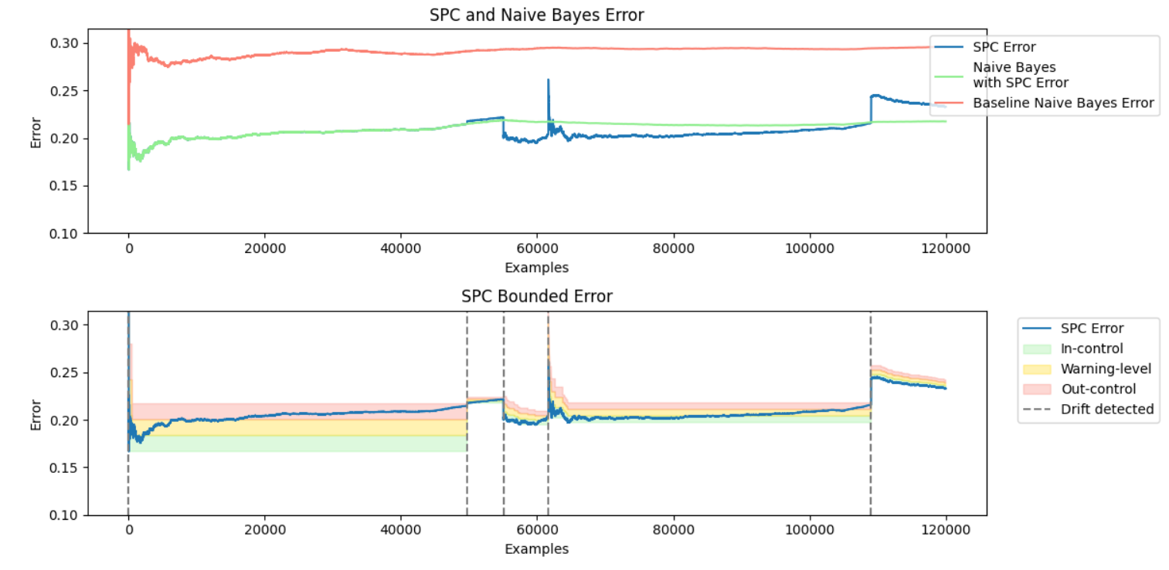
Standard spc
Effective error reduction
Ineffective drift detection

Slide 21
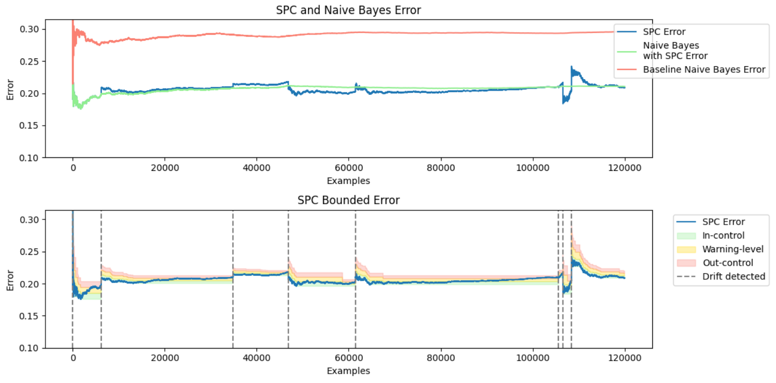
Exponential smoothing spc
Effective error reduction
Improved drift detection
Increased false alarms

Slide 22
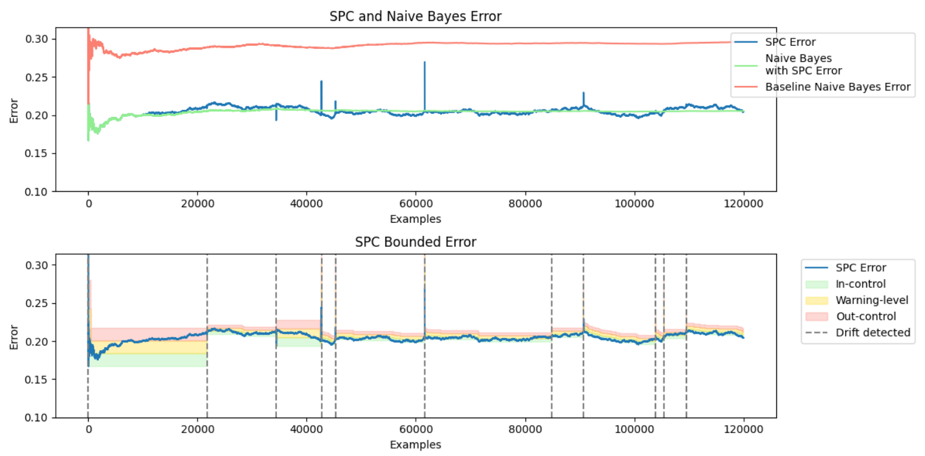
Sliding window spc
Effective error reduction
Improved drift detection
Increased false alarms

Slide 23
summary
Effectively detects concept drifts with statistical properties.
Suitable for online learning.
Effectively reduces the error.
Works best with well-generalized models.
Gradually or abruptly forgetting past information may improve drift detection at a cost of increasing false alarms.

