Slide 1

Tree-Based Machine Learning Regression Models for Predicting Marathon Race Times
Miguel Abela & Daren Scerri
Institute of Information & Communication Technology
MCAST, Paola, Malta
Notes:
Good morning, today I will be presenting my research on Tree-Based Machine Learning Regression Models for Predicting Marathon Race Times.

Slide 2
Background, Hypothesis & Questions
Background: The popularity of long-distance endurance running led to the importance of predictive race-day algorithms. Such algorithm development remains a challenge.
Hypothesis: XGBoost will achieve the best predictive performance compared to Random Forest, specifically at Week 16.
Research Questions:
RQ1: Which tree-based machine learning regressor obtains the highest predictive performance when forecasting an athlete’s marathon race time?
RQ2: To what extent does the amount of weekly historical data affect the predictive accuracy?
Notes:
In recent years, marathon running has increased in popularity, making technology and predictive algorithms a staple within the sport, yet such algorithms remain highly challenging to develop.
This led to this study in which it is hypothesized that XGBoost will achieve better predictive performance than Random Forest, specifically when using 16 weeks of aggregated training data. To address this hypothesis, the following research questions were formulated, establishing a superior model by assessing the effects of time frame-reduced datasets.

Slide 3
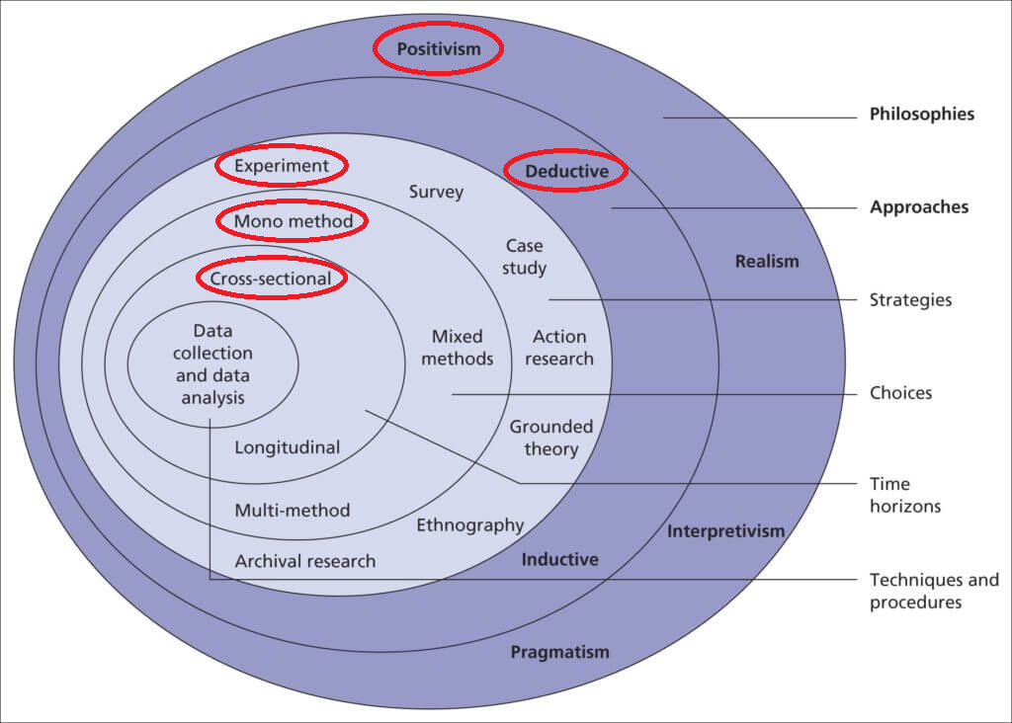
Methodological Framework
Notes:
In view of the hypothesis and research questions, this study adopted a positivist philosophy, driving a deductive approach, and executed via a cross-sectional and mono-method experimental setup.

Slide 4
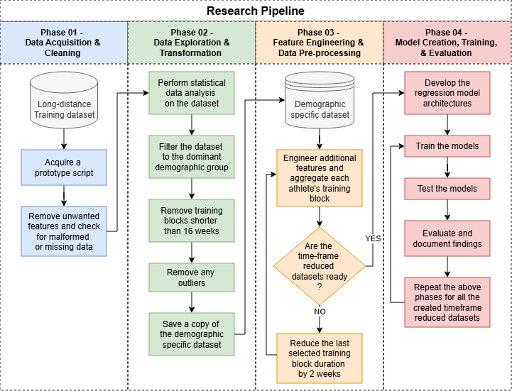
Research Pipeline
Notes:
Subsequently, a research pipeline was developed to create multiple datasets.

Slide 5
Methodology
Dataset: Anonymised daily athlete training data consisting of training-specific features
Experimental Setup:
Demographic-specific athlete data
Six datasets of different training block lengths (16 weeks to 6 weeks) [1], and new engineered features, as recommended by [2]
Consistent model architectures as in the reference solution [3]
10-fold cross-validation technique, and repeated experiments, as adopted by [1] and [4], respectively
Data Collection: Mean Absolute Error (MAE), Root Mean Squared Error (RMSE), and R-squared [1, 2, 5, 6]
Notes:
Moving on to the methodology, a sequentially ordered dataset comprising daily running activities was initially acquired.
To achieve this study’s objectives, a filtered dataset emerged, consisting of male runners aged 35 to 54. After viewing other studies, from this demographic-specific data source, six condensed datasets with additional features were developed, starting from 16 weeks until reaching 6 weeks in 2-week intervals. Every athlete’s data was thus aggregated to match model requirements.
Using the reference solution, model architectures were established and kept the same throughout the experiments, for an unbiased comparison. As adopted by other studies, the experiments were repeated 3 times using a 10-fold cross-validation technique to mitigate any random errors and validate the results.
Before conducting these six experiments, benchmark models were created to facilitate evaluation through the Mean Absolute Error, Root Mean Squared Error, and R-squared values.

Slide 6
Benchmark Model Results
Weeks | Model | MAE (mins) | RMSE (mins) | R-squared Score
N/A | Linear Regression | 27.98 | 36.76 | 0.47
 | Random Forest | 21.84 | 30.15 | 0.64
 | XGBoost | 21.39 | 29.68 | 0.65
Notes:
These were the results obtained by the benchmark models. Notably, the best model was XGBoost, having the predicted average marathon race time off by approximately 21 minutes.

Slide 7
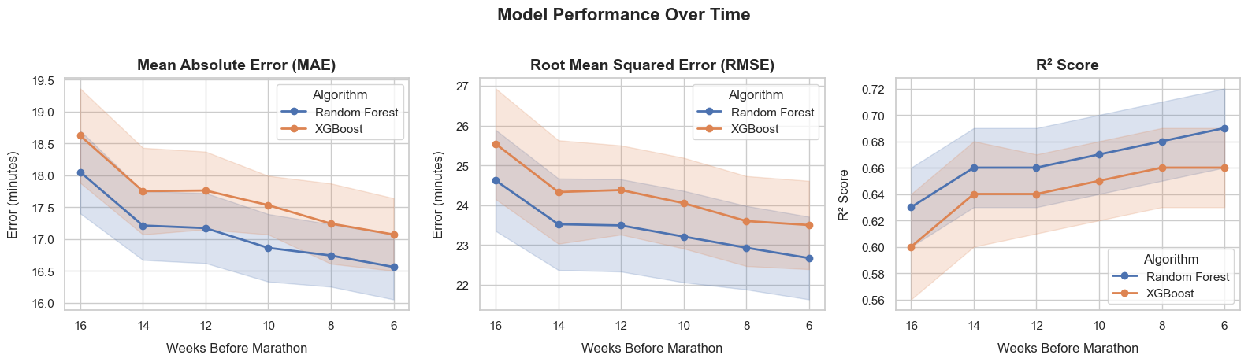
Results & Findings
Notes:
On the other hand, when having a controlled environment, with aligned training block data, and a repeated k-fold cross-validation technique, the results show otherwise.
The Random Forest regressor showed a continuously better predictive performance compared to XGBoost across all time steps, reaching an average prediction of almost 16.5 minutes, with the RMSE following this trend. Also, the R-squared value shows that 69% of the variance in the dependent variable was explained by the input features. This clearly showed that data quality is preferred over quantity by both models.
Moreover, with a best benchmark MAE of 21.39 minutes, such methodological decisions and experimental designs in this study improved the predictive capabilities of the models by nearly 4 minutes and showed that Linear Regression is less applicable in this domain. One can also argue that XGBoost might be better when given a diverse demographic dataset.
It is important to note that the shaded area within the graphs is the standard deviation obtained from the repeated experiments.

Slide 8
Conclusions
RQ1: Which tree-based machine learning regressor obtains the highest predictive performance when forecasting an athlete’s marathon race time?
Random Forest consistently outperformed XGBoost across all time steps
RQ2: To what extent does the amount of weekly historical data affect the predictive accuracy?
Predictive accuracy improved across all timesteps, reaching its peak at Week 6
Hypothesis: The original hypothesis was rejected, proving the contrary, with Random Forest being the superior model, achieving the best predictive performance at Week 6.
Notes:
Reflecting on the first research question, it can be confidently said that Random Forest was the superior model in this specific scenario. Also, for the second research question, the amount of historical data does affect the predictive accuracy of the models since it improved closer to race day.
In addressing the original hypothesis, this can be rejected, and it can be stated that Random Forest achieved the best predictive performance at Week 6, rather than XGBoost being the superior model at Week 16. Thus, this shows the strength of simpler tree-based machine learning models.

Slide 9
Limitations & Future Work
Limitations:
Data availability
Generalizability
Future Work:
Explore other demographic groups
Hyperparameter tuning
Utilization of other tree-based machine learning regressors
Notes:
Despite successful results, the model faces two main limitations:
Its focus on a single demographic restricts generalizability
And a lack of data excludes the Tokyo Marathon, limiting its applicability to the other five majors
Future work should expand to broader demographics, optimize predictions through hyperparameter tuning, and explore alternative tree-based regressors like LightGBM.

Slide 10
References
[1] D. Ruiz-Mayo, E. Pulido, and G. Martınez-Munoz, “Marathon Performance Prediction of Amateur Runners based on Training Session Data.”
[2] C. Feely, B. Caulfield, A. Lawlor, and B. Smyth, “Providing Explainable Race-Time Predictions and Training Plan Recommendations to Marathon Runners,” in Fourteenth ACM Conference on Recommender Systems. Virtual Event Brazil: ACM, Sep. 2020, pp. 539–544. [Online]. Available: https://dl.acm.org/doi/10.1145/3383313.3412220
[3] zuskakluska, “Intelligent marathon race predictions,” https://www. kaggle.com/code/zuskakluska/intelligent-marathon-race-predictions, 2025, [Online; accessed 11-April-2026].
[4] S. Dash, “Win Your Race Goal: A Generalized Approach to Prediction of Running Performance,” Sports Medicine International Open, vol. 08, no. CP, pp. a–2401–6234, Oct. 2024. [Online]. Available: http://www.thieme-connect.de/DOI/DOI?10.1055/a-2401-6234
[5] L. Lerebourg, D. Saboul, M. Cl´emenc¸on, and J. B. Coquart, “Prediction of Marathon Performance using Artificial Intelligence,” International Journal of Sports Medicine, vol. 44, no. 05, pp. 352–360, May 2023. [Online]. Available: http://www.thieme-connect.de/DOI/DOI?10.1055/ a-1993-2371
[6] H. T. El-Kassabi, K. Khalil, and M. A. Serhani, “Deep Learning Approach for Forecasting Athletes’ Performance in Sports Tournaments,” in Proceedings of the 13th International Conference on Intelligent Systems: Theories and Applications. Rabat Morocco: ACM, Sep. 2020, pp. 1–6. [Online]. Available: https://dl.acm.org/doi/10.1145/3419604.3419786
Notes:
These were the references used within this presentation.

Slide 11
Thank you Miguel Abela, Daren Scerri
Notes:
Thank you

