Slide 1

Analyzing Bank Marketing Campaigns
Miguel Santana
Flatiron School
Data Science | FT Cohort

Slide 2
Introduction
Methodology
OSEMN Framework
The Data | Cleaning
Exploratory Data Analysis
Modeling
Interpret | Analyze
Features: Age & Number of Employees
Features: Campaign Contact & Days Since Last Contact
Business Recommendations
Conclusions & Limitations
Thank you

Slide 3
Methodology
A Portuguese financial institution provided telemarketing data concerning marketing campaigns with the goal of predicting subscriber term deposits.
Dataset included client, campaign, social and economic data
Leveraged OSEMN framework to analyze the dataset and make key business recommendations

Slide 4
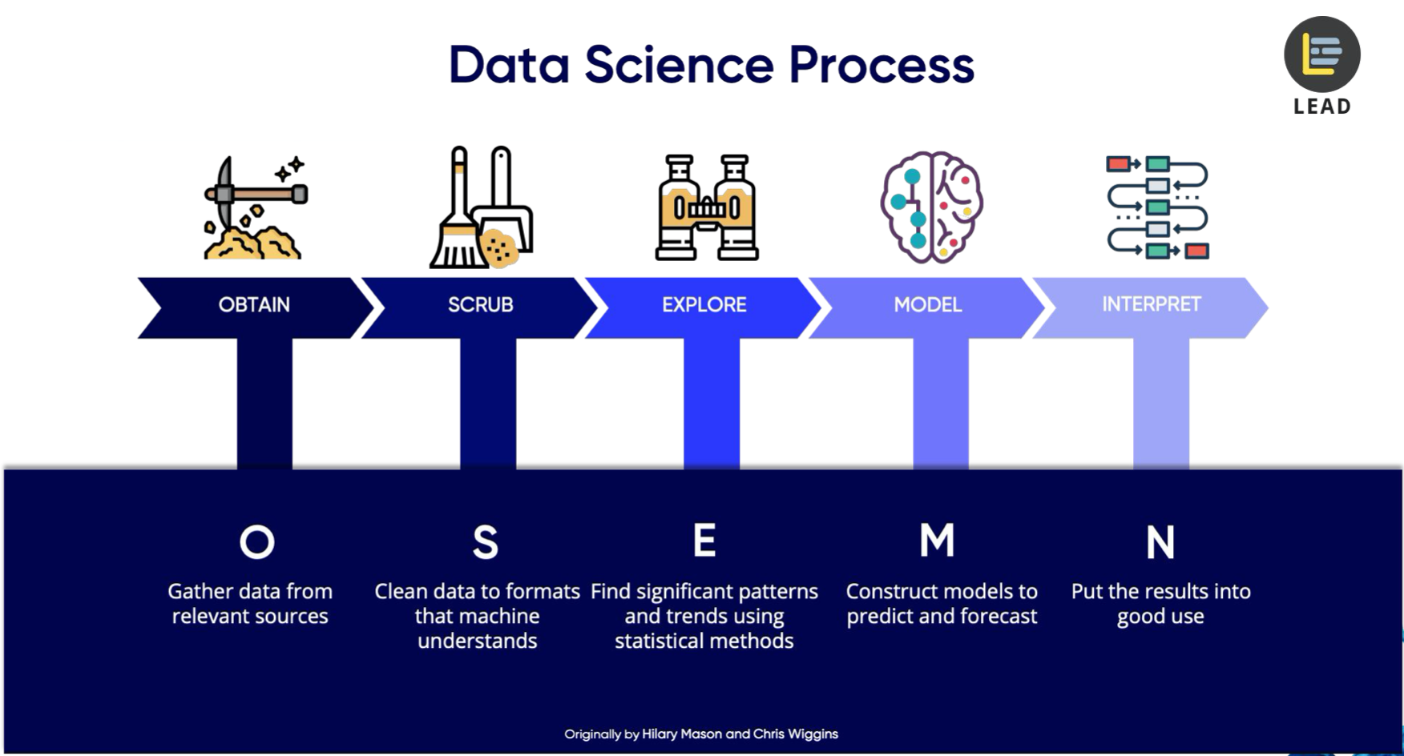
OSEMN Framework

Slide 5


The Data | Cleaning
Available via UCI’s Machine Learning Archive and Kaggle
http://archive.ics.uci.edu/ml/datasets/Bank+Marketing#
https://www.kaggle.com/henriqueyamahata/bank-marketing
Cleaning the data
Addressing “unknown” values
Focused on consumers who provided customer profile answers
Removed Outliers
Age
Feature Selection

Slide 6
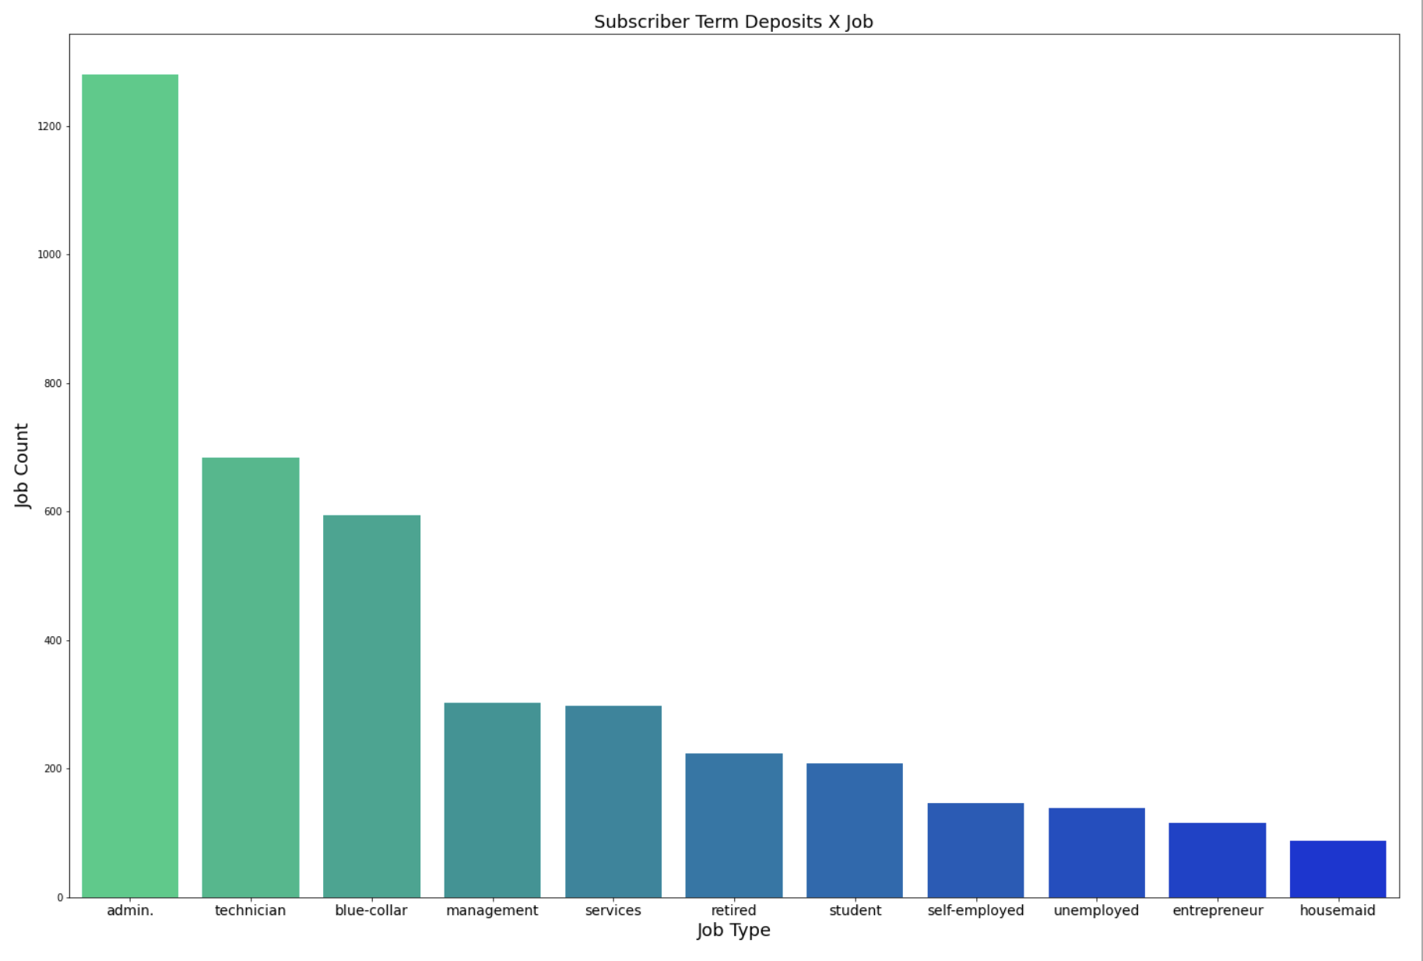
EXPLORATORY DATA ANALYSIS
Most Common Client Features
Job Type: admin
Age: early thirties
Education Level: university degree
(see appendix for education)

Slide 7
Modeling
Machine Learning Algorithms
Gradient Boosting Classifier
AdaBoost Classifier
Logistic Regression
Support Vector Machine
K-Nearest Neighbors
Random Forest
Guassian Naïve Bayes
Decision Tree
Accuracy Score
90.92%
90.70%
90.58%
90.30%
89.92%
89.73%
88.19%
84.47%
The top models selected for feature evaluation were Gradient Boosting Classifier and Adaboost Classifier

Slide 8
Interpret | Analyze
Generated top 25 features (per model)
Observed overlap | selected features
Selected Top Features
Age
Number of Employees
Number of times contacted during the current campaign
Number of days since last contact (999 = no contact)

Slide 9
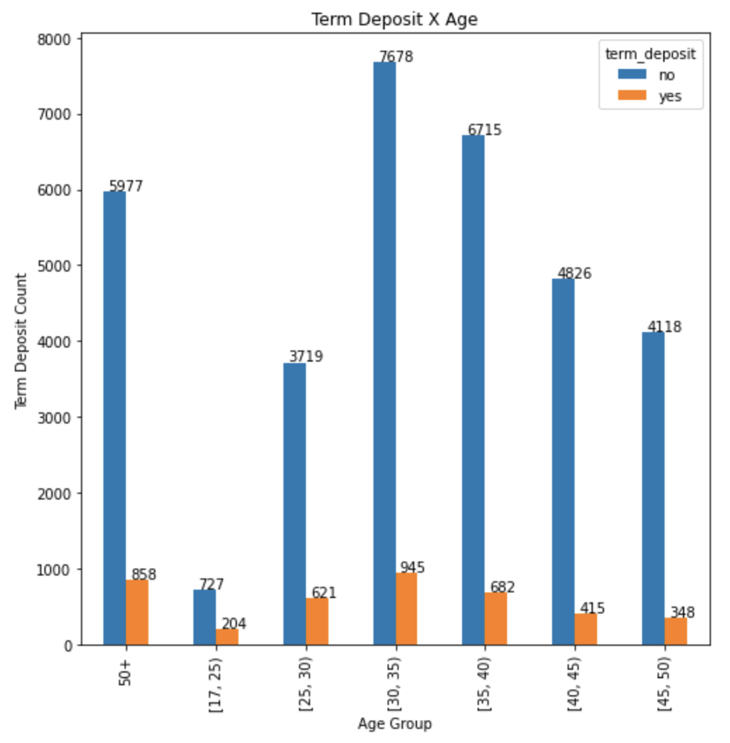
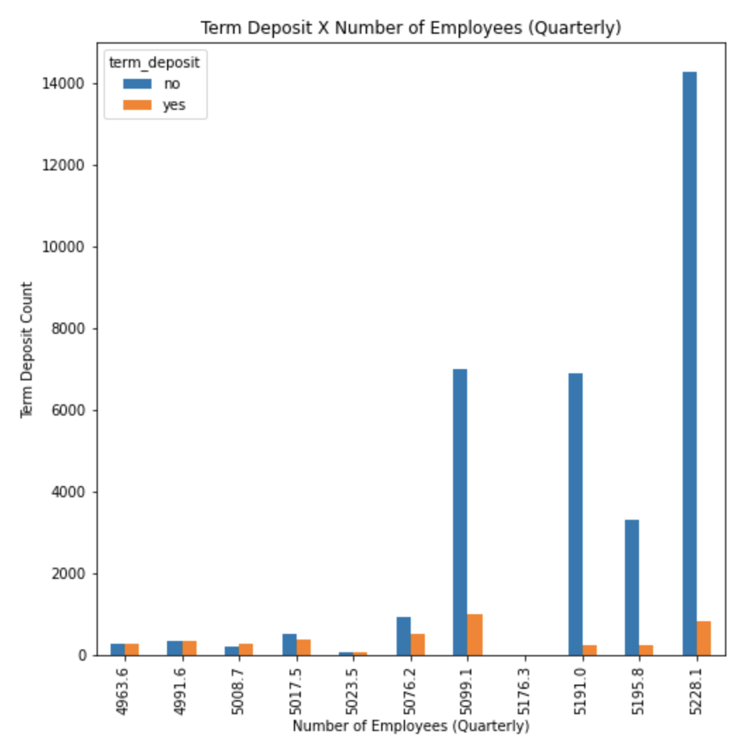
Features: Age & Number of Employees

Slide 10
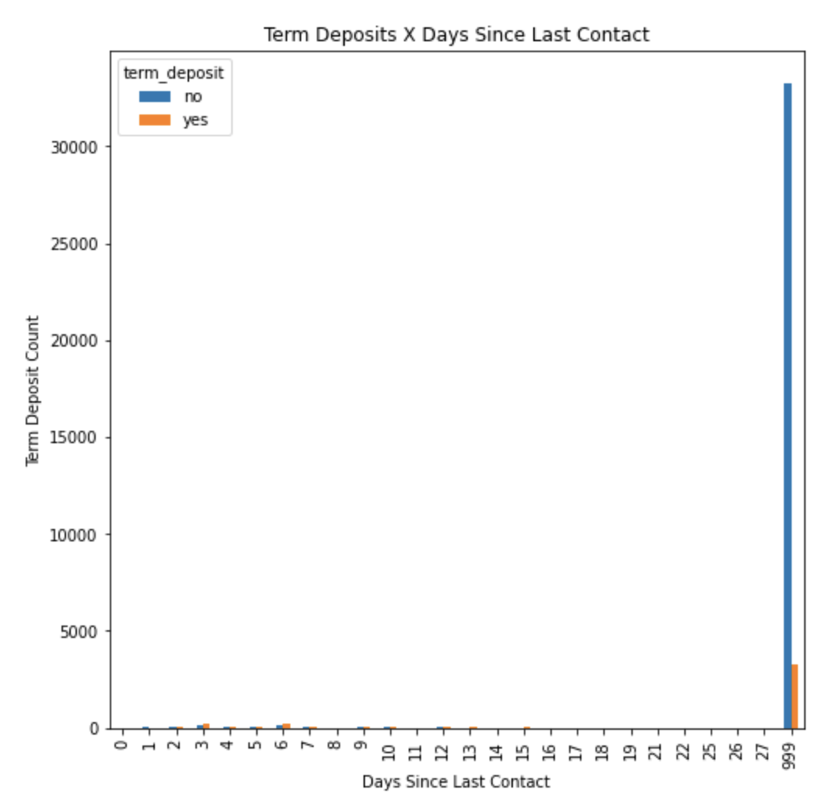
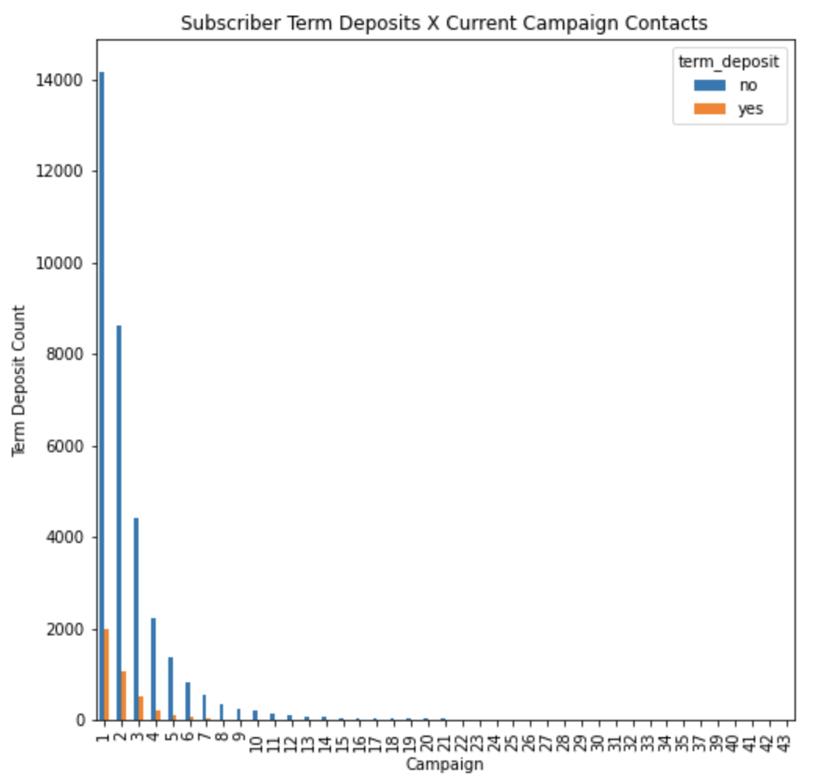
Features: Campaign Contact & Days Since Last Contact

Slide 11
Business Recommendations
1) Observe current marketing on consumers age 17-25. Use similarly structured marketing on consumers age 30-40.
2) Maintain an average employee level of 5076 or lower. Focus on productivity when employee levels go over 5076.
3) Deploy an A team to handle first 3 telemarketing contacts per customer.
4) Deploy B team to handle new callers and first-time bank clients.

Slide 12
Conclusions & Limitations
Conclusions
Feature trends illustrate high subscriber counts but higher non-subscriber counts as volume increases.
Employee effectiveness decreases as additional employees are hired (over 5076 quarterly) and volume increases.
Limited to consumers that:
Cite job type, marital status and education level
Between the ages of 17 and 69

Slide 13
THANK YOU!
Questions? Miguel Santana | contact: msantana269@gmail.com
Github Repo: https://github.com/msantana269/Module-3-Project

Slide 14

Appendix

Slide 15
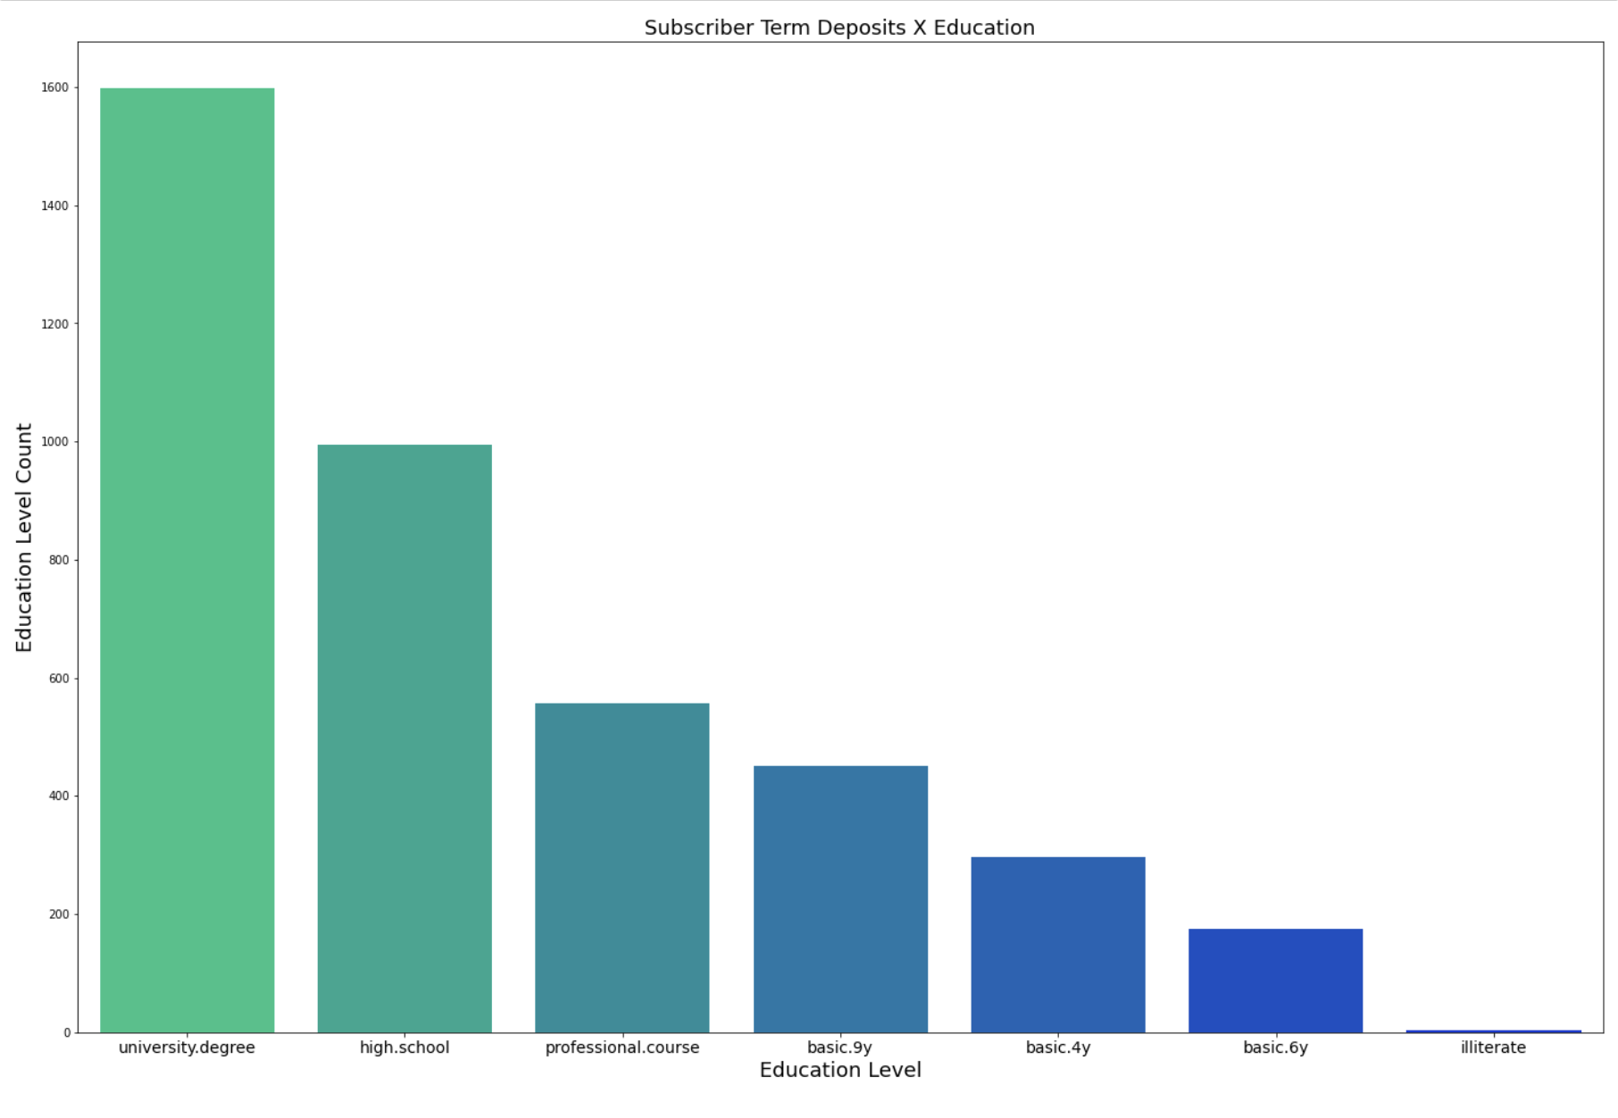
Appendix: Educational Trends

