Slide 1
(MAIN TITLE)
Miguel Angel Santana II, MBA
(Month), 2021
Medium Blog: (here)

Slide 2
Introduction
Methodology
OSEMN Framework
Obtain | Scrub
Exploratory Data Analysis
Statistical Modeling
Validation
Interpret Results
Conclusions & Limitations
Future Work
Thank You

Slide 3
Methodology
(data) from () has been provided in order to ().
(dataset) includes (features)
The OSEMN framework is used to process, analyze, model and gain insight into () with respect to potential (use in business).

Slide 4
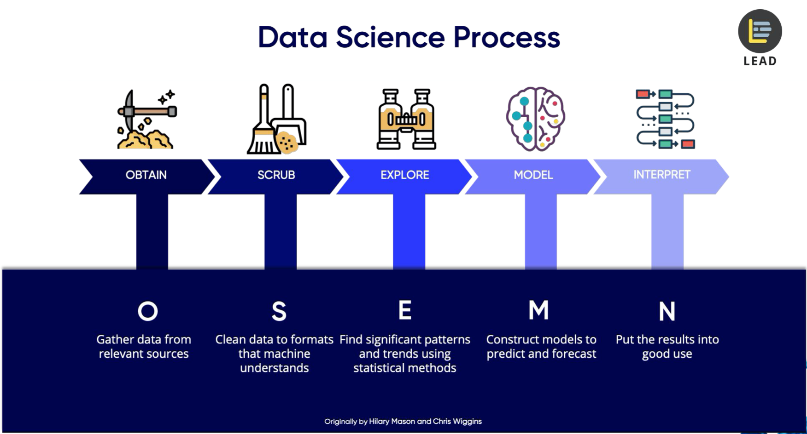
OSEMN Framework

Slide 5
Obtain | Scrub
The dataset can be found ()
The dataset was provided in Udemy course () by ().
Scrubbing / Data Cleaning
Key Decisions
(key decision)
(key decision)

Slide 6
Exploratory Data Analysis
(feature relationship 1)
(something to note)
(something to note)
VISUAL

Slide 7
Exploratory Data Analysis Continued
(feature relationship 1)
(something to note)
(something to note)
VISUAL

Slide 8
Statistical Modeling
Machine Learning Algorithms
ML 1
ML 2
Top Model: ()
Validation Metric
(score1)
(score2)
(Validation Illustrations)

Slide 9
Interpret Results | Actionable Insights
Model metric good because
Metric compared to (average)
Potential used cases
Benefits

Slide 10
Conclusions, Limitations & Future Work

Slide 11
THANK YOU!
Questions? Miguel Santana | Contact: santana2.miguel@gmail.com
Additional projects can be found on Github.
Username: miguelangelsantana

