Slide 1
Movie Review Text Classification
Miguel Angel Santana II, MBA
February 2, 2021

Slide 2
Introduction
Methodology
OSEMN Framework
Obtain | Scrub
Exploratory Data Analysis
Statistical Modeling
Validation
Interpret Results
Limitations & Future Work
Thank You

Slide 3
Methodology
Process text data – 6000 movie reviews
Classify the reviews as positive or negative
The OSEMN framework is used to process, analyze, model and gain insight into text classification with respect to natural language processing.

Slide 4
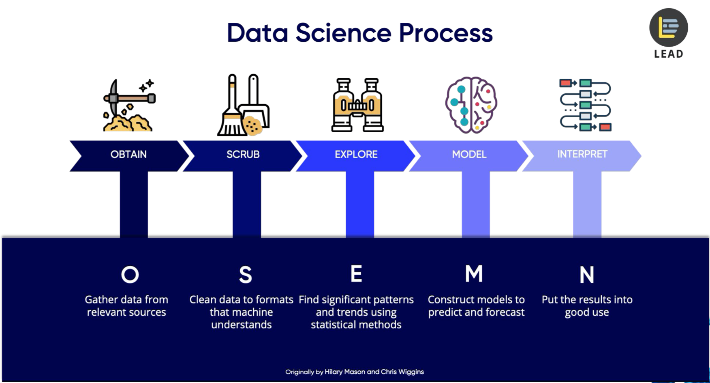
OSEMN Framework

Slide 5
Obtain | Scrub
Stanford Artificial Intelligence Laboratory (SAIL)
http://ai.stanford.edu/~amaas/data/sentiment/
Udemy Course: NLP – Natural Language Processing
by Jose Portilla.
Scrubbing | Data Cleaning
Key Decisions
search/address whitespace strings
drop null values

Slide 6
Exploratory Data Analysis
Length of Reviews
Positive and negative reviews appear to have the same general length in text.
VISUAL

Slide 7
Exploratory Data Analysis Continued
Outlier Data
There are no significant outliers in positive or negative text lengths.
VISUAL

Slide 8
Statistical Modeling
Machine Learning Algorithms
Multinomial NB Classifier
LinearSVC Classifier
LinearSVC using TF-IDF
Top Model: LinearSVC
Accuracy was used as a validation metric.
Accuracy Score: 92%
(Validation Illustrations)

Slide 9
Interpret Results | Actionable Insights
Accuracy
Accuracy was used as a validation metric due to the class balance between positive and negative reviews.
Potential use cases
Web scraping movie review sites and gaining insight on consumer trends.

Slide 10
Limitations & Future Work
Limitations
The classifier is for illustrative purposes due to data preprocessing
Pre-Labeled Data
Future Work
Web scraping of additional sources to get a broader view of the classifier's potential with respect to larger datasets and multiple sources.

Slide 11
THANK YOU!
Questions? Miguel Santana | Contact: santana2.miguel@gmail.com
Additional projects can be found on Github.
Username: miguelangelsantana

