Slide 1


Telecommunications Analysis Customer Churn
Miguel Santana
Flatiron School
Data Science | FT Cohort

Slide 2


Introduction
Methodology
OSEMN Framework
The Data | Cleaning
Exploratory Data Analysis
Modeling
Interpret | Analyze
Features: Age & Number of Employees
Features: Campaign Contact & Days Since Last Contact
Business Recommendations
Conclusions & Limitations
Future Work
Thank you

Slide 3

Methodology
A telecommunications company (SyriaTel) is looking to improve upon customer churn ratios. SyriaTel provided client data to better understand why customers stop doing business with the company.
Our team leveraged the OSEMN framework to analyze the dataset and make key business recommendations .

Slide 4
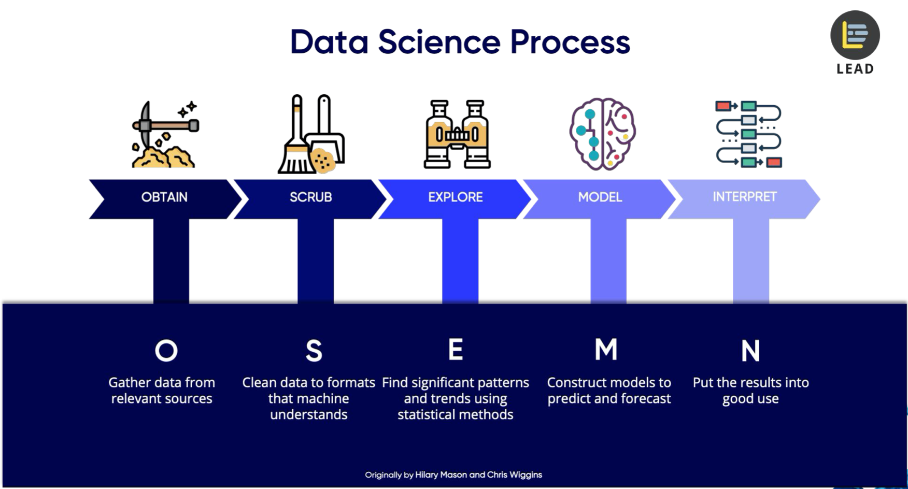
OSEMN Framework

Slide 5
The Data | Cleaning
The SyriaTel dataset is available on Kaggle’s website. The dataset can be found:
https://www.kaggle.com/becksddf/churn-in-telecoms-dataset
Cleaning the data
Addressing null and abnormal values
Feature Selection
Maintaining as many of the dataset values as possible

Slide 6
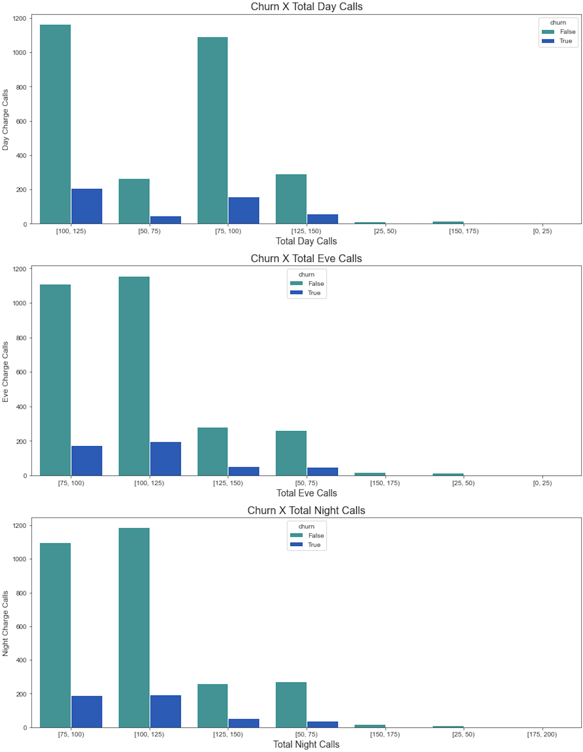
EXPLORATORY DATA ANALYSIS
Most Common Client Features
Day, Eve & Night Calls:
Highest churn occurs when customers make between 75-125 days calls per billing cycle.

Slide 7
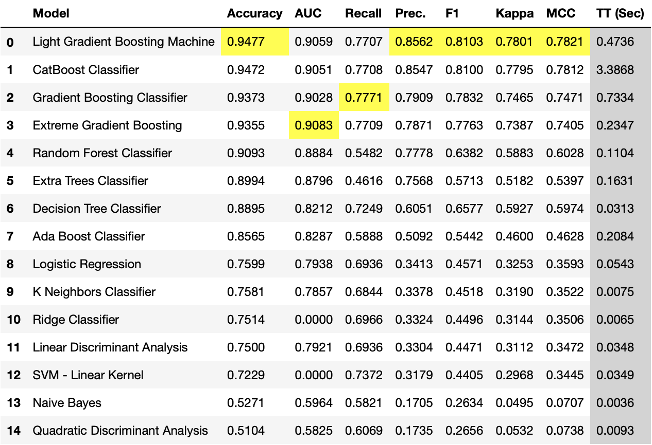
Modeling
The top model selected for feature evaluation is Light Gradient Boosting Machine

Slide 8
Interpret | Analyze
Generated most impactful features
Top Features Include
Customer Service Calls
Total Day Minutes
Total International Minutes

Slide 9
Business Recommendations
Churn is highest during the first 3 customer service interactions. SyriaTel should deploy an A-Team of high performers to address incoming service calls from new customers.
Total day minutes make up the majority of the minutes consumed and therefore relay to the largest percentage of the total cost. SyriaTel can create and market advertisements for consuming minutes during low peak business hours or consider changing their day pricing (adjusting eve, night and intl costs to compensate).
Churn grows exponentially as consumers go over 7 international minutes. SyriaTel should create an outreach campaign to inform customers when they are going over the 5 international minute threshold. SyriaTel should also consider creating a forgiveness program for first time customers who consumed large amounts of international minutes without knowing the cost (one time only).

Slide 10
Conclusion
The dataset offered various consumer trends and illustrated multiple areas of opportunity. Two areas of opportunity addressed common retail business pitfalls; customer service and high cost products (international minutes being the most expensive). Lastly, day minutes are the most common of the available categories and directly influenced the majority of consumer costs. These and future trends can be used to prepare for future business.

Slide 11
Future Work
Future Work In order to more accurately define the boundaries of our features it is important to understand what customs and cultural influences are tied to this dataset. SyriaTel is not a United States based cell phone carrier and cultural influences may impact the way we perceive the information. In addition, it would be helpful to have more client specific data in order to understand on an individual level which client segments are leaving the company and what features they share.

Slide 12
THANK YOU!
Questions? Miguel Santana | contact: msantana269@gmail.com
Github Repo: https://github.com/msantana269/Module-3-Project

Slide 13

Appendix

Slide 14
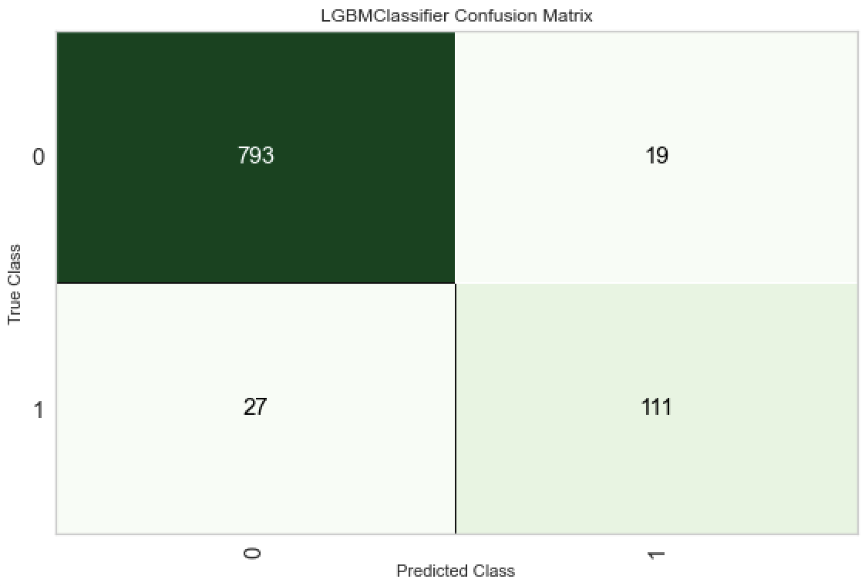
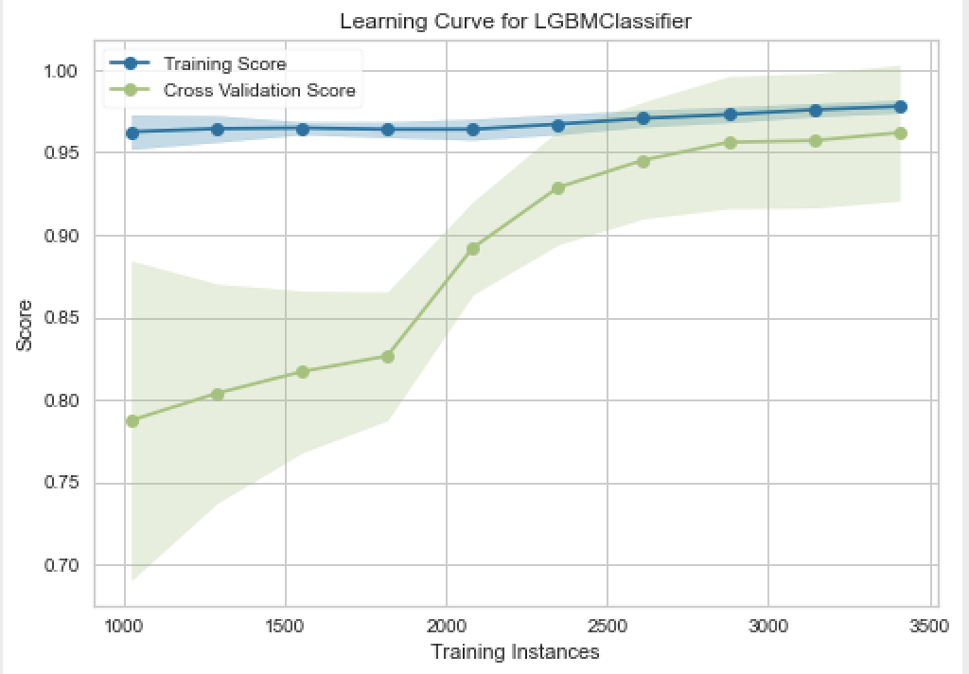
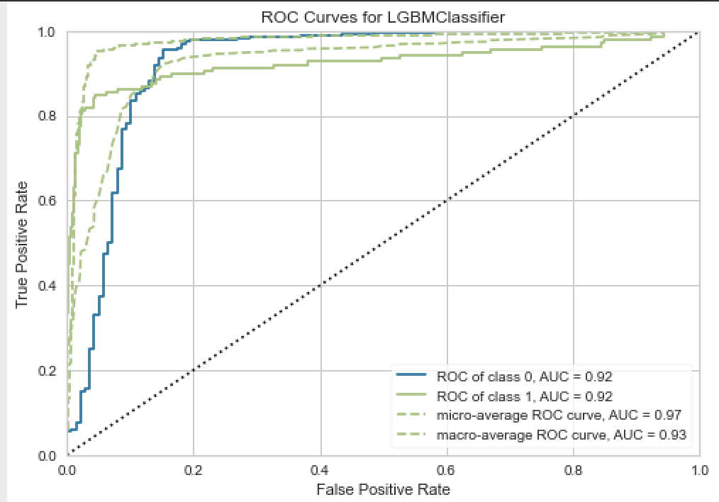
Model Validation

