Slide 1



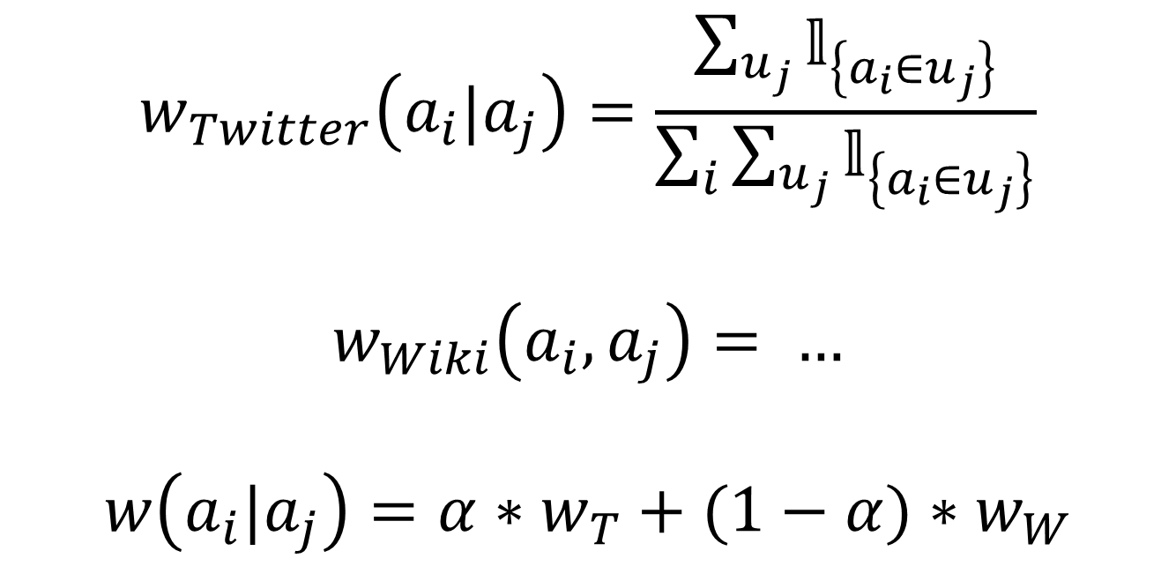


DISCOVR A New Hobby
Miguel Aroca-Ouellette, Akshata Athawale, Mannat Singh
CS/EE 145: Projects in Networking
Abstract
Data Mining & Processing
Results
“What fun activities are there to do nearby?”
Sample 10 million tweets across 50,000 users.
Newest tweeted is a user’s primary activity, secondary activities are those mentioned in older tweets.
Extracted activities using approximate string matching.
Yields directed relationships between activities.
Goal: Create a personalized activity recommendation system.
We used social and classification data we to build a relationship graph for activities.
Using this graph we can recommend activities for users given their current favorite activities.
Built a tree using Wikipedia’s Category data.
1.15 million nodes with a maximum depth of 18.
Processed the tree to remove cycles and only keep shortest path from root node.
Path similarities yield undirected relationships between activities.
Activities |  | Weights
Primary | Secondary | Twitter | Wikipedia
Softball | Baseball | 0.534
Skiing | Running | 0.278
Pottery | Photography | 0.168
Graph Building
Motivation
Fully connected graph with 100 activity nodes.
Yoga
There are lots of apps which recommend establishments, particularly restaurants. i.e. Yelp, Foursquare, etc.
Market gap in recommending activities.
Leverage publicly available social data to create an activity recommendation system.
Take into account user’s location and activity preferences to personalize recommendations.
$$w_{Twitter}\left(a_{i}|a_{j}\right)=\frac{\sum_{u_{j}}{𝕝_{\left\{a_{i}∈u_{j}\right\}}}}{\sum_{i}{\sum_{u_{j}}{𝕝_{\left\{a_{i}∈u_{j}\right\}}}}}$$
$$w_{Wiki}\left(a_{i},a_{j}\right)= …$$
$$w\left(a_{i}|a_{j}\right)=α∗w_{T}+(1−α)∗w_{W}$$
Analysis
$$w(Y|D)$$
$$w(D|Y)$$
Rugby
Dance
Recommendations
User provides 5 input activities.
DISCOVR returns a ranked list of top 5 recommended activities, as well as nearby locations where these activities can be performed.

