Slide 1





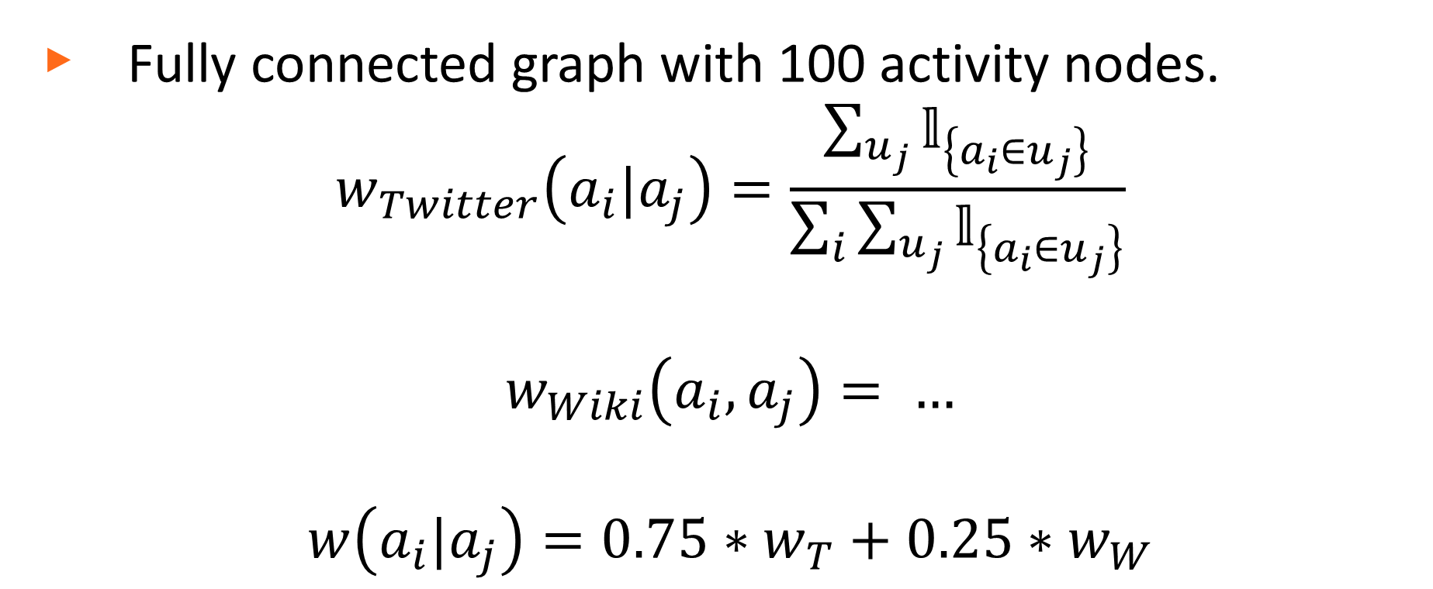
DISCOVR A New Hobby
Miguel Aroca-Ouellette, Akshata Athawale, Mannat Singh
CS/EE 145: Projects in Networking
Abstract
Data Mining & Processing
Results
“What fun activities are there to do nearby?”
Uniformly sampled 10 million Tweets across 50,000 users.
The latest activity tweeted is a user’s primary activity, secondary activities are those mentioned in older tweets.
Extracted activities using fuzzy string matching.
Yields directed relationships between activities.
Our goal with this project was to create a recommendation system which can help users answer this question. Using social and classification data we built a relationship graph for a set of activities. This graph was then used to generate activity recommendations based on a user’s current favorite activities.
Built a tree using Wikipedia’s Category data.
A total of 1.15 million nodes with a maximum depth of 18.
Processed the tree to remove cycles and only keep shortest path from root node.
Path similarities yield undirected relationships between activities.
Activities |  | Weights
Primary | Secondary | Twitter | Wikipedia
Softball | Baseball | 0.534
Skiing | Running | 0.278
Pottery | Photography | 0.168
Graph Building
Motivation
Fully connected graph with 100 activity nodes.
$$w_{Twitter}\left(a_{i}|a_{j}\right)=\frac{\sum_{u_{j}}{𝕝_{\left\{a_{i}∈u_{j}\right\}}}}{\sum_{i}{\sum_{u_{j}}{𝕝_{\left\{a_{i}∈u_{j}\right\}}}}}$$
$$w_{Wiki}\left(a_{i},a_{j}\right)= …$$
$$w\left(a_{i}|a_{j}\right)=0.75∗w_{T}+0.25∗w_{W}$$
Yoga
Analysis
There are lots of apps which recommend establishments, particularly restaurants. i.e. Yelp, Foursquare, etc.
Market gap in recommending activities.
Leverage publicly available social data to create an activity recommendation system.
Take into account user’s location and activity preferences to personalize recommendations.
$$w(D|Y)$$
$$w(Y|D)$$
Rugby
Dance
Recommendations
User provides 5 input activities.
DISCOVR returns a ranked list of top 5 recommended activities, as well as nearby locations where these activities can be performed.

