Slide 1

DESIGN PATTERNS
Miguel Bravo Arvelo
Samuel Fumero Hernández

Slide 2
Index
What is a design pattern?
Objectives of design patterns
Why do we need Design Patterns?
Design pattern Vs. Architecture pattern
Common design patterns
Conclusion
Bibliography

Slide 3
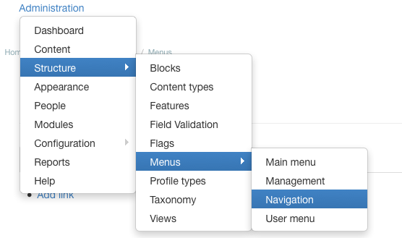
What is a Design Pattern?

Slide 4
What is a Design Pattern?
RECURRING PROBLEM

Slide 5
What is a Design Pattern?
RECURRING PROBLEM

Slide 6
What is a Design Pattern?
RECURRING PROBLEM
PARTICULAR CONTEXT

Slide 7
What is a Design Pattern?
RECURRING PROBLEM
PARTICULAR CONTEXT

Slide 8
What is a Design Pattern?
RECURRING PROBLEM
PARTICULAR CONTEXT
DESIGN PATTERN

Slide 9
What is a Design Pattern?
IS A DESIGN SOLUTION TO A RECURRING PROBLEM IN A PARTICULAR CONTEXT

Slide 10
What is a Design Pattern?
THE IDENTIFICATION
Name (with synonymous)
Pattern category
THE PROBLEM
Intention
Motivation
Applicability
THE SOLUTION
Structure
Participants
Collaborations
Implementations
Example code
Known uses
Related patterns
Consequences

Slide 11
What is a Design Pattern?
Simplified:
NAME
PROBLEM
SOLUTION
CONSEQUENCES

Slide 12

2. Objectives of design patterns
Avoid repetition in the search for solutions
Formalize a common vocabulary among designers
Standardize the way the design is done.
Impose certain design alternatives over other
Eliminate the creativity inherent in the design process
Forcefully implement a pattern in a simple code.

Slide 13

3. Why do we need Design Patterns?
Robust code
Code reusability
High maintainability
Greater understanding among developers

Slide 14
4. Design Pattern Vs. Architecture Pattern
DP
DP
Architecture Pattern
Software application
DP
DP

Slide 15
5. Common Design Patterns
Creational Design
Singleton
Factory
Builder
Prototype
Structural Design
Adapter
Composite
Facade
Bridge
Decorator
FlyWeight
Behavioral Design
Observer
Strategy
Interpreter
Iterator
State Pattern
Chain of Responsibility

Slide 16


5.1 Creational Design Patterns
These design patterns are all about class instantiation.
OBJECT

Slide 17
5.1.1 Singleton
Private constructor to restrict instantiation of the class from other classes.
Private static variable of the same class that is the only instance of the class.
Public static method that returns the instance of the class, this is the global access point for outer world to get the instance of the singleton class.

Slide 18
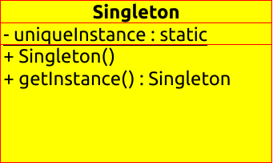
5.1.1 Singleton

Slide 19
5.1.1 Singleton
public class LazyInitializedSingleton {
private static LazyInitializedSingleton instance;
private LazyInitializedSingleton(){}
public static LazyInitializedSingleton getInstance(){
if(instance == null){
instance = new LazyInitializedSingleton();
}
return instance;
}
}

Slide 20


5.1.2 Factory Method
Factory design pattern is used when we have a super class with multiple sub-classes and based on input.
Only returns one of the sub-class.
Takes out the responsibility of instantiation of a class from client program to the factory class.

Slide 21
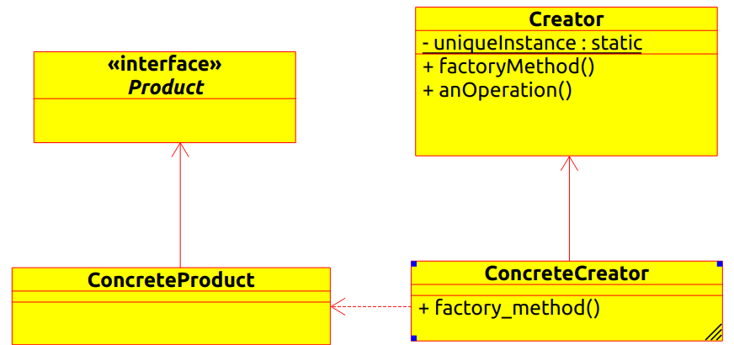
5.1.2 Factory Method

Slide 22
5.1.2 Factory Method
import design.model.Computer;
import design.model.PC;
import design.model.Server;
public class ComputerFactory {
public static Computer getComputer(String type, String ram,
String hdd, String cpu){
if("PC".equalsIgnoreCase(type))
return new PC(ram, hdd, cpu);
else if("Server".equalsIgnoreCase(type))
return new Server(ram, hdd, cpu);
return null;
}
}

Slide 23
5.1.3 Builder
Too Many arguments to pass from client program to the Factory class
Some of the parameters might be optional
new ClassName(arg(1), arg(2), arg(3), … ,arg(n));

Slide 24
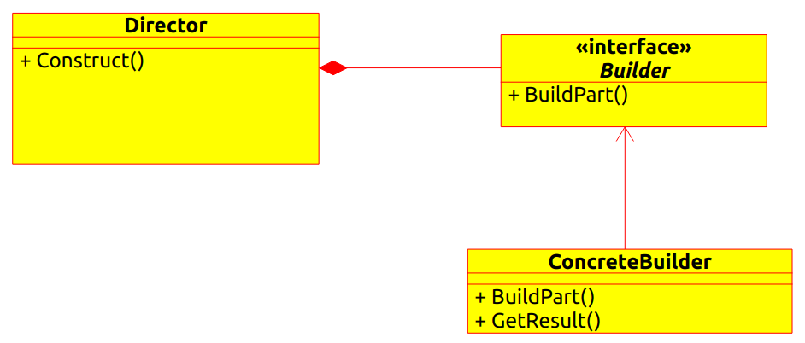
5.1.3 Builder

Slide 25
5.1.3 Builder
public class User {
private int id;
private int age;
.
.
.
private String name;
public User(int id);
public User(int id, int age);
.
.
.
User usu1 = new User(2,22);
User usu2 = new User(“Pepe”,6);
User usu3 = new User(54,22, “Jack”);
.
.
.

Slide 26

5.1.3 Builder
public class User {
private int id;
private int age;
.
.
.
private String name;
public User(int id);
public User(int id, int age);
.
.
.
User usu1 = new User(2,22);
User usu2 = new User(“Pepe”,6);
User usu3 = new User(54,22, “Jack”);
.
.
.

Slide 27
5.1.3 Builder
public class TestBuilderPattern {
public static void main(String[] args) {
User usu1 = new UserBuilder().name(“Pepe”).
age(24).id(5).build();
}
}

Slide 28
5.1.4 Prototype
Create objects by cloning based on a template of existing objects
Objects of the same class are very similar to each other
La creación inicial de cada objeto es una operación costosa

Slide 29
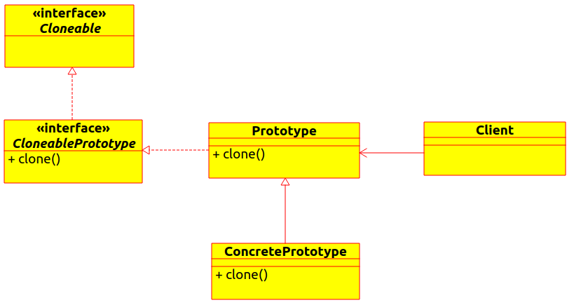
5.1.4 Prototype

Slide 30
5.1.4 Prototype
public class client {
public static void main (String[] args) {
Prototype product = new Prototype();
Prototype product2 = product.clone();
}
}

Slide 31
5.2 Structural Design Patterns
These design patterns are all about Class and Object composition.
Structural class-creation patterns use inheritance to compose interfaces.
Structural object-patterns define ways to compose objects to obtain new functionality.

Slide 32
5.2.1 Adapter
When implementing Adapter pattern, there are two approaches, both these approaches producing the same result.
Class Adapter – This form uses java inheritance and extends the source interface, in our case Socket class.
Object Adapter – This form uses Java Composition and adapter contains the source object.

Slide 33
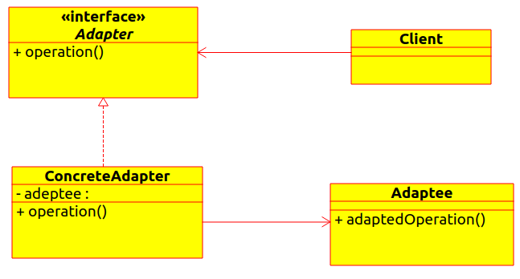
5.2.1 Adapter

Slide 34
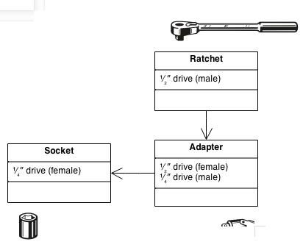
5.2.1 Adapter

Slide 35
5.2.2 Facade
Provide a unified interface to a set of interfaces in a subsystem. Facade Pattern defines a higher-level interface that makes the subsystem easier to use.
So we will have different set of interfaces to work with different types of database. Now a client application can use these interfaces to get the required database connection and generate reports.
But when the complexity increases or the interface behavior names are confusing, client application will find it difficult to manage it.
Provides a wrapper interface on top of the existing interface to help client application.

Slide 36
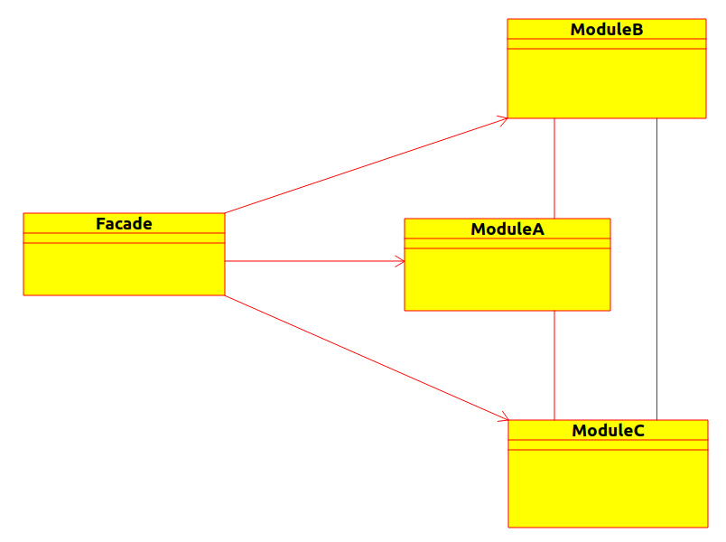
5.2.2 Facade

Slide 37
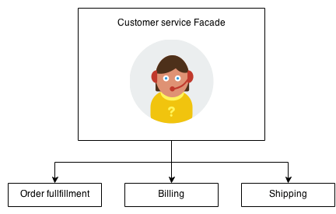
5.2.2 Facade

Slide 38
5.2.3 Bridge
Adapter makes things work after they're designed; Bridge makes them work before they are.
Bridge is designed up-front to let the abstraction and the implementation vary independently. Adapter is retrofitted to make unrelated classes work together.
State, Strategy, Bridge (and to some degree Adapter) have similar solution structures. They all share elements of the "handle/body" idiom. They differ in intent - that is, they solve different problems.

Slide 39
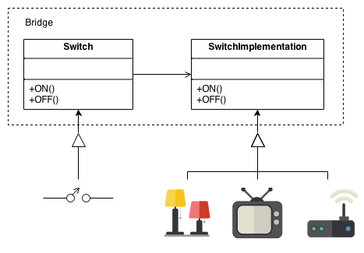
5.2.3 Bridge

Slide 40
5.4 Decorator
We use inheritance or composition to extend the behavior of an object but this is done at compile time and its applicable to all the instances of the class, in order to implement this we will need:
Component Interface – The interface or abstract class defining the methods that will be implemented.
Component Implementation – The basic implementation of the component interface.
Decorator – Decorator class implements the component interface and it has a HAS-A relationship with the component interface.
Concrete Decorators – Extending the base decorator functionality and modifying the component behavior accordingly.

Slide 41
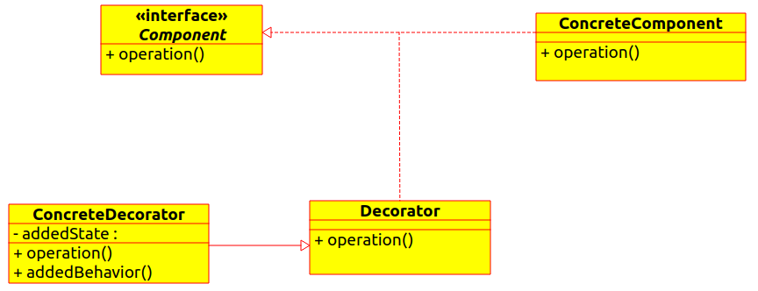
5.4 Decorator

Slide 42
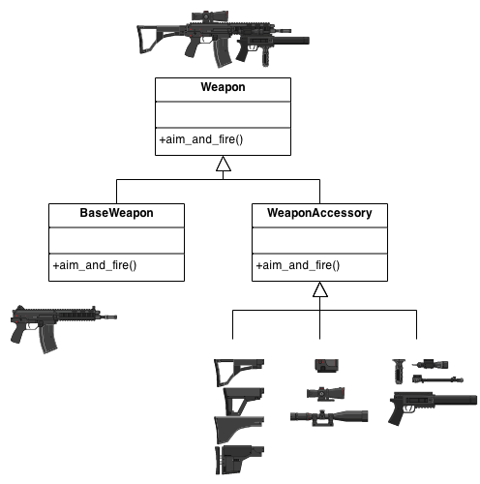
5.4 Decorator

Slide 43
5.4 FlyWeight
The number of Objects to be created by application should be huge.
The object creation is heavy on memory and it can be time consuming too.
The object properties can be divided into intrinsic and extrinsic properties, extrinsic properties of an Object should be defined by the client program.

Slide 44
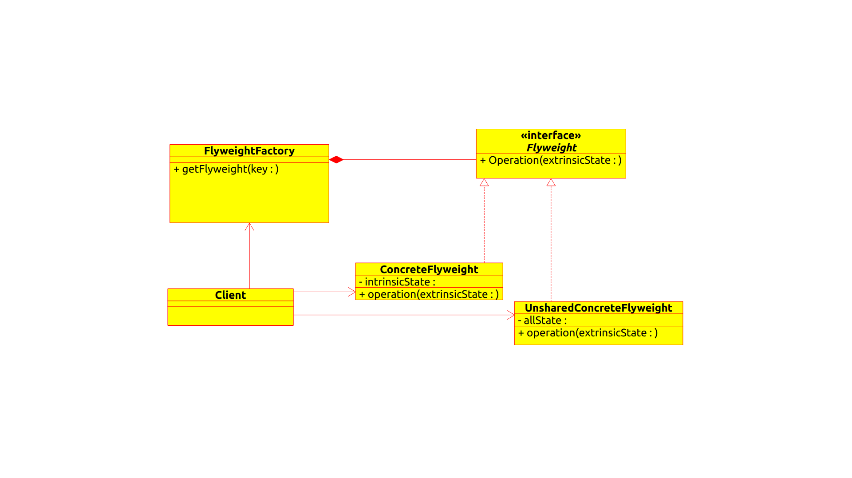
5.4 FlyWeight

Slide 45
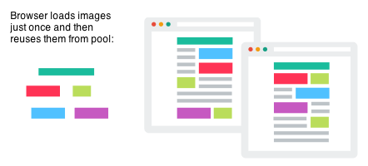
5.4 FlyWeight

Slide 46
5.5 Behavioral Design Patterns
These design patterns are all about Class's objects communication.
Behavioral patterns are those patterns that are most specifically concerned with communication between objects.

Slide 47
5.4 Observer
Define a one-to-many dependency between objects so that when one object changes state, all its dependents are notified and updated automatically.
Encapsulate the core (or common or engine) components in a Subject abstraction, and the variable (or optional or user interface) components in an Observer hierarchy.
The "View" part of Model-View-Controller.

Slide 48
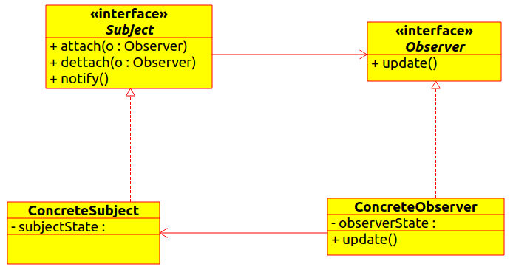
5.4 Observer

Slide 49
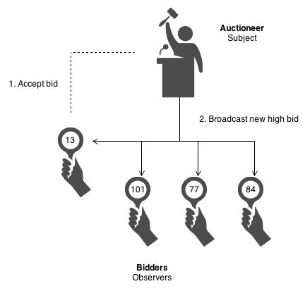
5.4 Observer

Slide 50
5.4 Strategy
Define a family of algorithms, encapsulate each one, and make them interchangeable. Strategy lets the algorithm vary independently from the clients that use it.
Capture the abstraction in an interface, bury implementation details in derived classes.

Slide 51
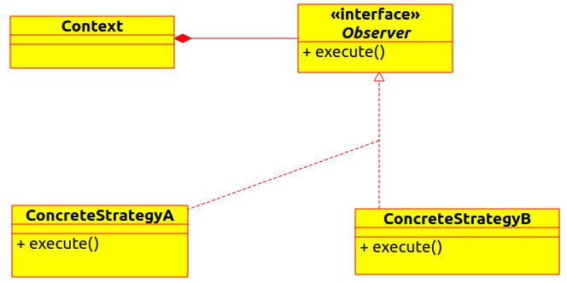
5.4 Strategy

Slide 52
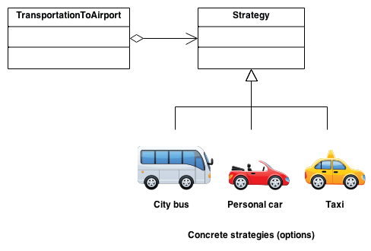
5.4 Strategy

Slide 53
5.4 Interpreter
Given a language, define a representation for its grammar along with an interpreter that uses the representation to interpret sentences in the language.
Map a domain to a language, the language to a grammar, and the grammar to a hierarchical object-oriented design.

Slide 54
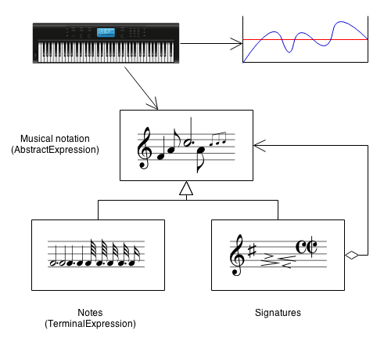
5.4 Interpreter

Slide 55
5.4 Iterator
Provide a way to access the elements of an aggregate object sequentially without exposing its underlying representation.
The C++ and Java standard library abstraction that makes it possible to decouple collection classes and algorithms.
Promote to "full object status" the traversal of a collection.
Polymorphic traversal

Slide 56
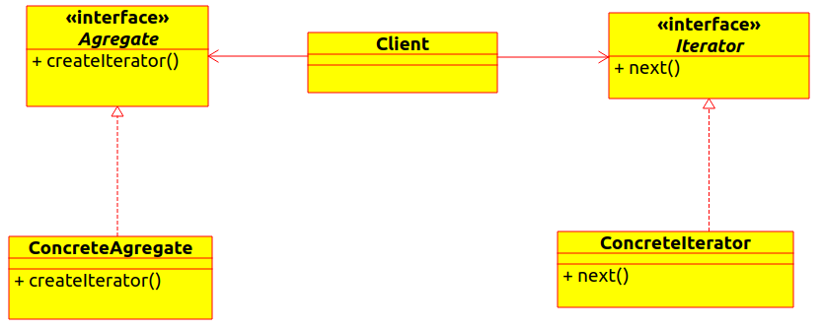
5.4 Iterator

Slide 57
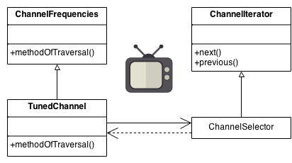
5.4 Iterator

Slide 58

6. Conclusions
I know all the design patterns… I can solve all my problems!!

Slide 59
6. Conclusions
I know all the design patterns… I can solve all my problems!!

Slide 60

6. Conclusions
Design patterns facilitate the process of designing a software
Do not try to apply the design patterns with a shoehorn

Slide 61
Biography
Wikipedia - Design Patterns
https://en.wikipedia.org/wiki/Design_Patterns
Wikipedia - Model View Controller
https://en.wikipedia.org/wiki/Model%E2%80%93view%E2%80%93controller
Black Wasp - Gang of four design patterns
http://www.blackwasp.co.uk/gofpatterns.aspx
Journal Dev - Java Design Patterns
https://www.journaldev.com/1827/java-design-patterns-example-tutorial
Source Making - Design Patterns
https://sourcemaking.com/design_patterns

Slide 62
Thank you!
ANY QUESTIONS?

