Slide 1
DOM and timers

Slide 2
Accessing Dom Elements
// Returns a reference to the element by its ID.
document.getElementById('someid');
// Returns an array-like object of all child elements which have all of the given class names.
document.getElementsByClassName('someclass');
// Returns an HTMLCollection of elements with the given tag name.
document.getElementsByTagName('LI');
// Returns the first element within the document that matches the specified group of selectors.
document.querySelector('.someclass');

Slide 3
Accessing Dom Elements
// Returns a list of the elements within the document (using depth-first pre-order traversal of the document's nodes) that match the specified group of selectors.
document.querySelectorAll('div.note, div.alert');

Slide 4
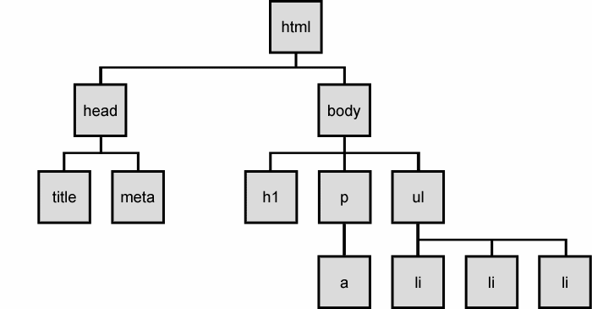
Accessing Dom Elements
DOM Tree Example

Slide 5
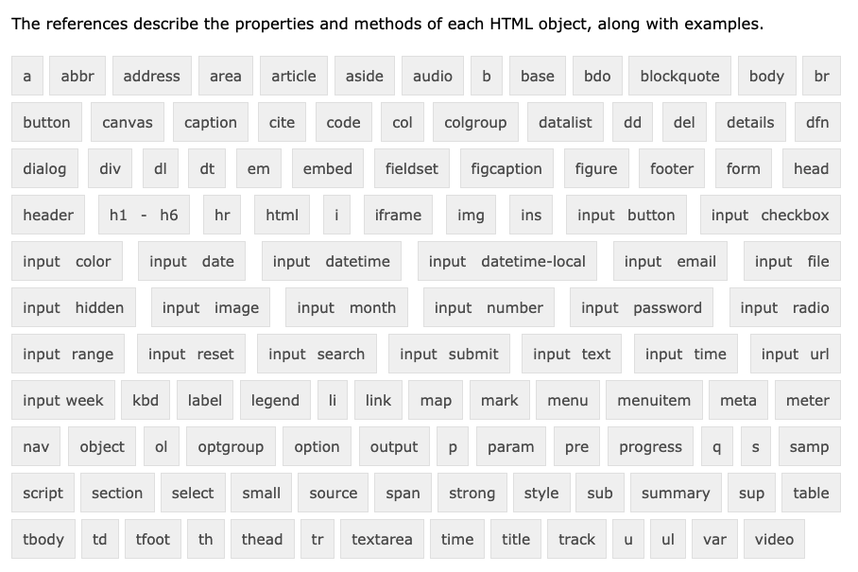
HTML Element Objects reference

Slide 6
Problems with JavaScript
JavaScript is a powerful language, but it has many flaws:
the DOM can be clunky to use
the same code doesn't always work the same way in every browser
code that works great in Firefox, Safari, ... will fail in old Internet Explorer and vice versa
many developers work around these problems with hacks (checking if browser is IE, etc.)

Slide 7
Prototype Framework
<script src=" https://ajax.googleapis.com/ajax/libs/prototype/1.7.0.0/prototype.js "
type="text/javascript"></script> JS
the Prototype JavaScript library adds many useful features to JavaScript:
many useful extensions to the DOM
added methods to String, Array, Date, Number, Object
improves event-driven programming
many cross-browser compatibility fixes
makes Ajax programming easier (seen later)
Notes:
Last updated 2015;
Extends the DOM (document object model)
Usage Statistics and Market Share of JavaScript Libraries for Websites, March 2021 (w3techs.com)

Slide 8
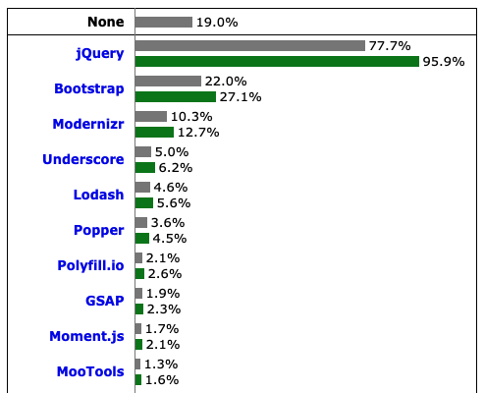
Prototype Framework
Notes:
Last updated 2015;
Extends the DOM (document object model)
Usage Statistics and Market Share of JavaScript Libraries for Websites, March 2021 (w3techs.com)

Slide 9
The $ function
$("id") JS
returns the DOM object representing the element with the given id
short for document.getElementById("id")
often used to write more concise DOM code:
$("footer").innerHTML = $("username").value.toUpperCase(); JS
Notes:
Usage Statistics and Market Share of JavaScript Libraries for Websites, March 2021 (w3techs.com)

Slide 10
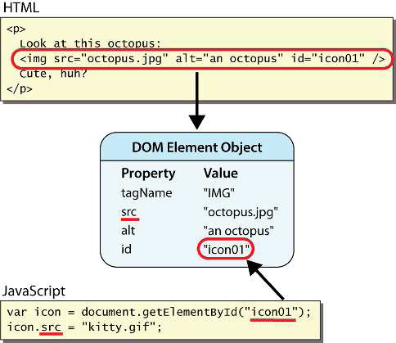
DOM element objects
Notes:
every element on the page has a corresponding DOM object
access/modify the attributes of the DOM object with objectName.attributeName

Slide 11
DOM object properties
<div id="main" class="foo bar">
<p>Hello, I am <em>very</em> happy to see you!</p>
<img id="icon" src="images/potter.jpg" alt=“Potter" />
</div> HTML
Property | Description | Example
tagName | element's HTML tag | $("main").tagName is "DIV"
className | CSS classes of element | $("main").className is "foo bar"
innerHTML | content inside element | $("main").innerHTML is "\n <p>Hello, <em>ve...
src | URL target of an image | $("icon").src is "images/potter.jpg"

Slide 12
DOM properties for form controls
<input id="sid" type="text" size="7" maxlength="7" />
<input id="frosh" type="checkbox" checked="checked" /> Freshman? HTML
Property | Description | Example
value | the text in an input control | $("sid").value could be "1234567"
checked | whether a box is checked | $("frosh").checked is true
disabled | whether a control is disabled (boolean) | $("frosh").disabled is false
readOnly | whether a text box is read-only | $("sid").readOnly is false

Slide 13
Abuse of innerHTML
// bad style!
var paragraph = document.getElementById("welcome");
paragraph.innerHTML = "<p>text and <a href="page.html">link</a>"; JS
innerHTML can inject arbitrary HTML content into the page
however, this is prone to bugs and errors and is considered poor style
Notes:
we forbid using innerHTML to inject HTML tags; inject plain text only
(later, we'll see a better way to inject content with HTML tags in it)

Slide 14
Adjusting styles with the DOM
<button id="clickme">Color Me</button> HTML
window.onload = function() {
document.getElementById("clickme").onclick = changeColor;
};
function changeColor() {
var clickMe = document.getElementById("clickme");
clickMe.style.color = "red";
} JS
contains same properties as in CSS, but with camelCasedNames
examples: backgroundColor, borderLeftWidth, fontFamily

Slide 15
Common DOM styling errors
forgetting to write .style when setting styles:
var clickMe = document.getElementById("clickme");
clickMe.color = "red";
clickMe.style.color = "red"; JS
style properties are capitalized likeThis, not like-this:
clickMe.style.font-size = "14pt";
clickMe.style.fontSize = "14pt"; JS
style properties must be set as strings, often with units at the end:
clickMe.style.width = 200;
clickMe.style.width = "200px";
clickMe.style.padding = "0.5em"; JS

Slide 16
Unobtrusive styling
function okayClick() {
this.style.color = "red";
this.className = "highlighted";
} JS
.highlighted { color: red; } CSS
well-written JavaScript code should contain as little CSS as possible
use JavaScript to set CSS classes/IDs on elements
define the styles of those classes/IDs in your CSS file

Slide 17
Timer events
method | description
setTimeout(function, delayMS); | arranges to call given function after given delay in ms
setInterval(function, delayMS); | arranges to call function repeatedly every delayMS ms
clearTimeout(timerID); clearInterval(timerID); | stops the given timer so it will not call its function
both setTimeout and setInterval return an ID representing the timer
this ID can be passed to clearTimeout/Interval later to stop the timer

Slide 18
setTimeout example
<button onclick="delayMsg();">Click me!</button>
<span id="output"></span> HTML
function delayMsg() {
setTimeout(booyah, 5000);
$("output").innerHTML = "Wait for it...";
}
function booyah() { // called when the timer goes off
$("output").innerHTML = "BOOYAH!";
} JS
Notes:
This code requires prototype framework.

Slide 19
setInterval example
<button onclick="delayMsg2();">Click me!</button>
<span id="output"></span> HTML
var timer = null; // stores ID of interval timer
function delayMsg2() {
if (timer == null) {
timer = setInterval(rudy, 1000);
} else {
clearInterval(timer);
timer = null;
}
}
function rudy() { // called each time the timer goes off
$("output").innerHTML += " Rudy!";
} JS

Slide 20
Passing parameters to timers
function delayedMultiply() {
// 6 and 7 are passed to multiply when timer goes off
setTimeout(multiply, 2000, 6, 7);
}
function multiply(a, b) {
alert(a * b);
} JS
any parameters after the delay are eventually passed to the timer function
why not just write this?
setTimeout(multiply(6 * 7), 2000); JS

Slide 21
Common timer errors
setTimeout(booyah(), 2000);
setTimeout(booyah, 2000);
setTimeout(multiply(num1 * num2), 2000);
setTimeout(multiply, 2000, num1, num2); JS
what does it actually do if you have the () ?
it calls the function immediately, rather than waiting the 2000ms!

