Slide 1
Events

Slide 2
The keyword ‘this’
this.fieldName // access field
this.fieldName = value; // modify field
this.methodName(parameters); // call method JS
All JavaScript code actually runs inside of an object
By default, code runs inside the global window object
all global variables and functions you declare become part of window
the ‘this’ keyword refers to the current object

Slide 3
Event handler binding
function pageLoad() {
$("ok").onclick = okayClick; // bound to okButton here
}
function okayClick() { // okayClick knows what DOM object
this.innerHTML = "booyah"; // it was called on
}
window.onload = pageLoad; JS
Event handlers attached unobtrusively are bound to the element
Inside the handler, that element becomes this (rather than the window)

Slide 4
Fixing redundant code with this
<fieldset>
<label><input type="radio" name="ducks" value="Huey" /> Huey</label>
<label><input type="radio" name="ducks" value="Dewey" /> Dewey</label>
<label><input type="radio" name="ducks" value="Louie" /> Louie</label>
</fieldset> HTML
function processDucks() {
if ($("huey").checked) {
alert("Huey is checked!");
} else if ($("dewey").checked) {
alert("Dewey is checked!");
} else {
alert("Louie is checked!");
}
alert(this.value + " is checked!");
} JS
Notes:
if the same function is assigned to multiple elements, each gets its own bound copy

Slide 5
More about events
abort | blur | change | click | dblclick | error | focus
keydown | keypress | keyup | load | mousedown | mousemove | mouseout
mouseover | mouseup | reset | resize | select | submit | unload
the click event (onclick) is just one of many events that can be handled
Problem: events are tricky and have incompatibilities across browsers
Reasons: fuzzy W3C event specs;
IE disobeying web standards; etc.
Solution: Prototype includes many event-related features and fixes

Slide 6
Attaching event handlers, the Prototype way
element.onevent = function;
element.observe("event", "function"); JS
// call the playNewGame function when the Play button is clicked
$("play").observe("click", playNewGame); JS
to use Prototype's event features, you must attach the handler using the DOM element
object's observe method (added by Prototype)
pass the event of interest and the function to use as the handler
handlers must be attached this way for Prototype's event features to work
Notes:
observe substitutes for addEventListener (not supported by IE)

Slide 7
Attaching multiple event handlers with $$
// listen to clicks on all buttons with class "control" that
// are directly inside the section with ID "game"
window.onload = function() {
var gameButtons = $$("#game > button.control");
for (var i = 0; i < gameButtons.length; i++) {
gameButtons[i].observe("click", gameButtonClick);
}
};
function gameButtonClick() { ... } JS
you can use $$ and other DOM walking methods to unobtrusively attach event handlers to
a group of related elements in your window.onload code

Slide 8
The Event object
function name(event) {
// an event handler function ...
} JS
Event handlers can accept an optional parameter to represent the event that is occurring. Event objects have the following properties / methods:
method / property name | description
type | what kind of event, such as "click" or "mousedown"
element() * | the element on which the event occurred
stop() ** | cancels an event
stopObserving() | removes an event handler
Notes:
replaces non-standard srcElement and which properties
** replaces non-standard return false;, stopPropagation, etc.

Slide 9
Mouse events
click | user presses/releases mouse button on this element
dblclick | user presses/releases mouse button twice on this element
mousedown | user presses down mouse button on this element
mouseup | user releases mouse button on this element

Slide 10
Mouse events
mouseover | mouse cursor enters this element's box
mouseout | mouse cursor exits this element's box
mousemove | mouse cursor moves around within this element's box

Slide 11
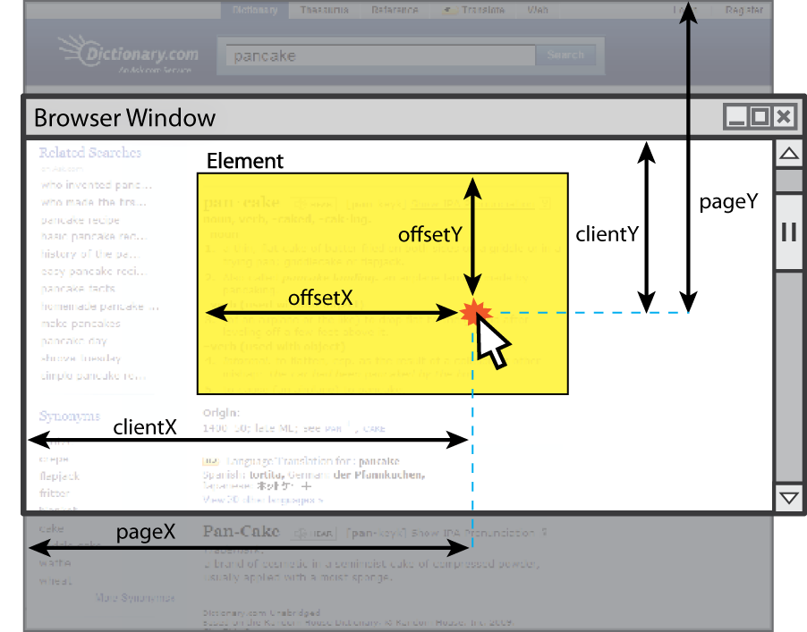
Mouse event objects

Slide 12
Mouse event objects
property/method | description
clientX, clientY | coordinates in browser window
screenX, screenY | coordinates in screen
offsetX, offsetY | coordinates in element
pointerX(), pointerY() * | coordinates in entire web page
isLeftClick() ** | true if left button was pressed
* replaces non-standard properties pageX and pageY
** replaces non-standard properties button and which

Slide 13
The Event object
<pre id="target">Move the mouse over me!</pre> HTML
window.onload = function() {
$("target").observe("mousemove", showCoords);
};
function showCoords(event) {
this.innerHTML =
"pointer: (" + event.pointerX() + ", "
+ event.pointerY() + ")\n"
+ "screen : (" + event.screenX + ", "
+ event.screenY + ")\n"
+ "client : (" + event.clientX + ", "
+ event.clientY + ")"; JS

