Slide 1
HTML5

Slide 2
Brief History

Slide 3
Brief History
The idea of HTML’s evolution started in 2004 with a proposal to W3C from Mozilla and Opera; this was rejected in favor of an XML-based replacement.
Apple, Mozilla, and Opera jointly announced their intent to continue working on the effort under the umbrella of a new venue called the WHATWG.
The scope of the HTML5 specification include what had previously been specified in three separate documents: HTML4, XHTML1, and DOM2 HTML.

Slide 4
Brief History
In 2006, the W3C indicated an interest to participate in the development of HTML5.
In 2007, WHATWG and W3C work together on HTML5 specification. Apple, Mozilla, and Opera allowed the W3C to publish the specification under the W3C copyright.
In 2011, WHATWG and W3C break and work on different goals. W3C wants to publish a "finished" version of "HTML5”.

Slide 5
Brief History
In 2019, the WHATWG and W3C signed an agreement to collaborate on a single version of HTML going forward.
https://html.spec.whatwg.org/multipage/

Slide 6
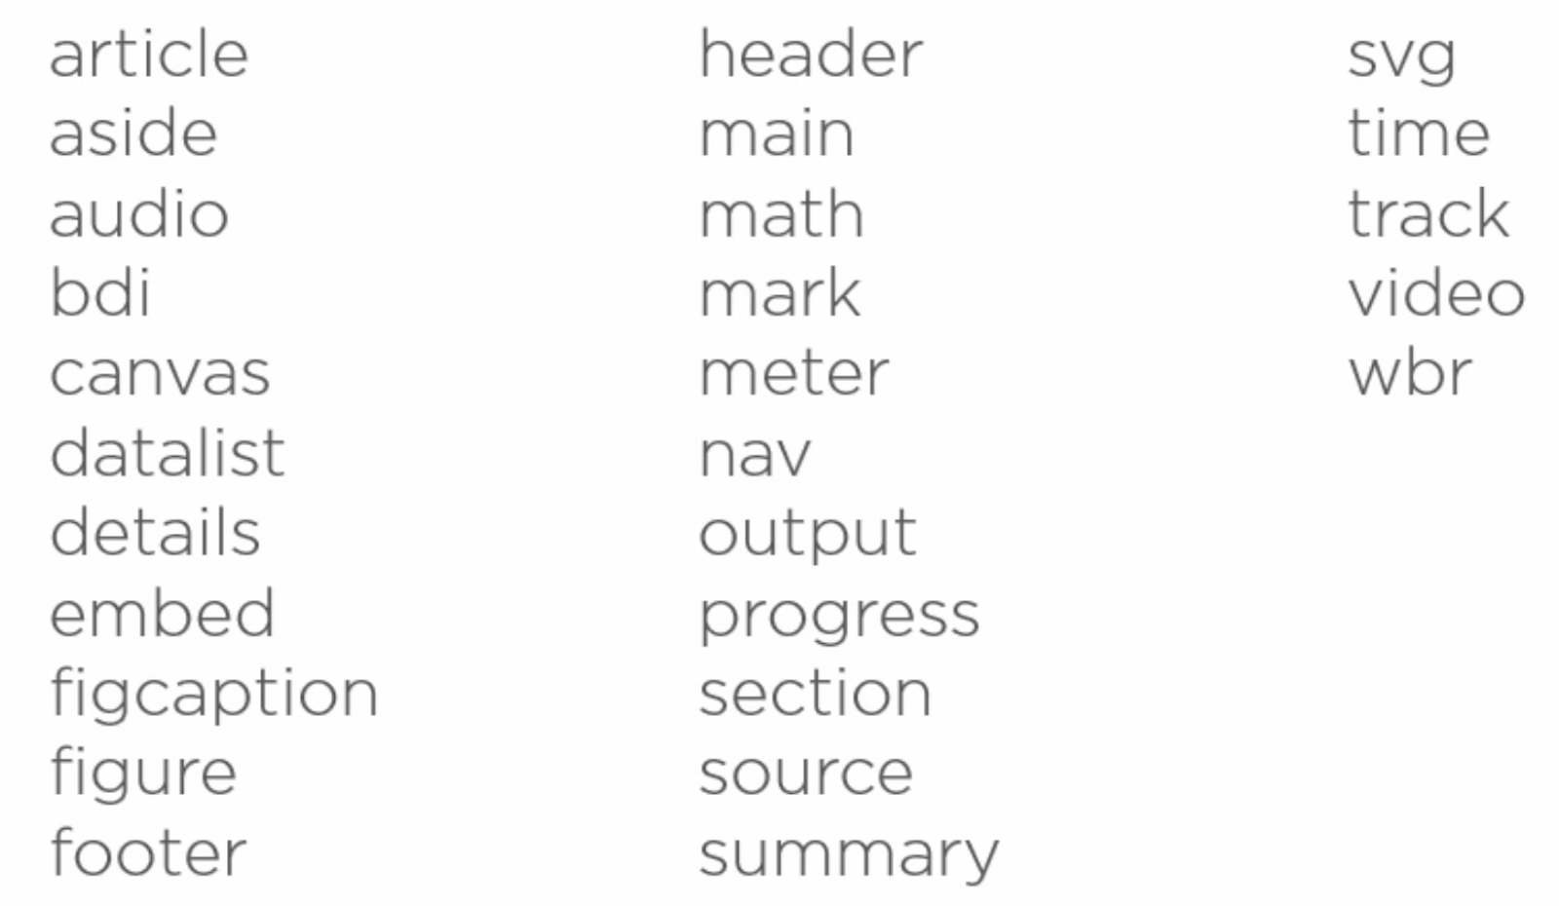
APIs and Elements in HTML5

Slide 7
Main Elements
The <main> element wraps the primary content of the page.
<article> element: a way to group together content that is important.
<aside> element is like a sidebar in a print magazine.
<section> element is for a logical grouping of elements.
<header> and <footer>
<nav> element found in header element.
Notes:
Navigation, header, footer, copyright elements are not in the main body.

Slide 8
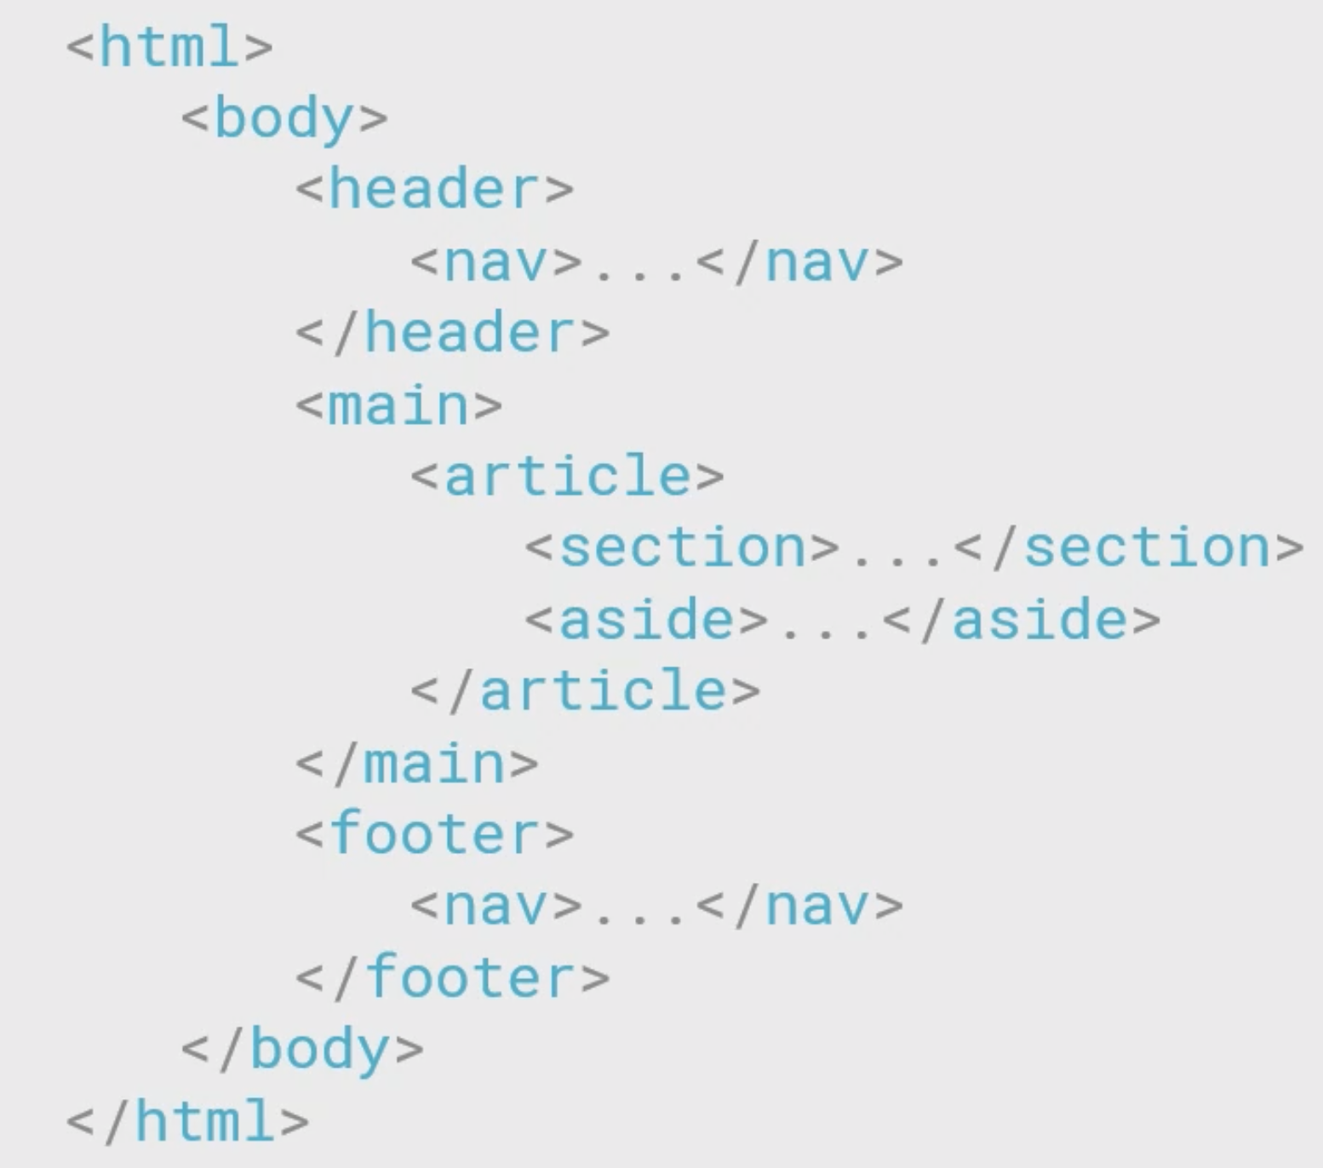
Main Elements
Notes:
Navigation, header, footer, copyright elements are not in the main body.

Slide 9
Time Element
<time date=”2021-01-09” pubdate>
January 9, 2021
</time>
Notes:
The datetime attribute of this element is used translate the time into a machine-readable format so that browsers can offer to add date reminders through the user's calendar, and search engines can produce smarter search results.

Slide 10
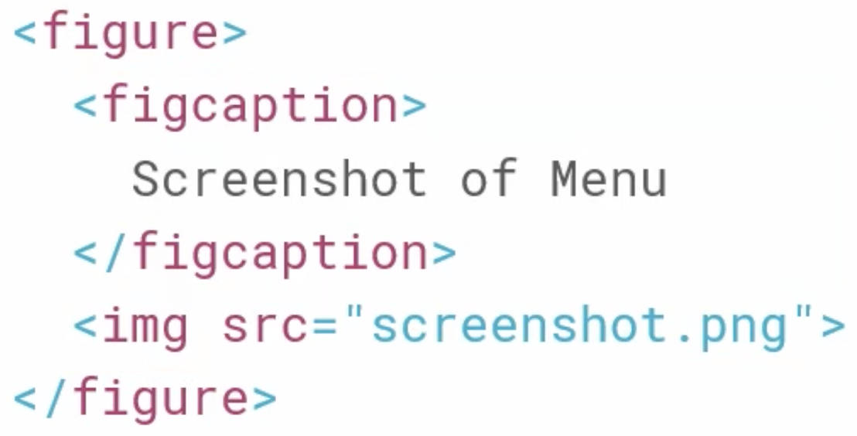
Figure Element
<figure> and <figcaption> elements
Notes:
Use a <figure> element to mark up a photo in a document, and a <figcaption> element to define a caption for the photo:

Slide 11
Details Element
<details>
<summary>Epcot Center</summary>
<p>Epcot is a theme park at Walt Disney World Resort featuring exciting attractions, international pavilions, award-winning fireworks and seasonal special events.</p>
</details>
Notes:
The <details> tag specifies additional details that the user can open and close on demand.

Slide 12
Mark, BDI, WBR, and Output Elements
<mark> highlight text </mark> <p>Do not forget to buy <mark>milk</mark> today.</p>
<bdi> changes the horizontal text direction</bdi>
<bdi>أرمينيا جميلة</bdi> This sentence in Arabic is automatically displayed from right to left.
Notes:
Bidirectional isolation

Slide 13
Mark, BDI, WBR, and Output Elements
<wbr> word break opportunity </wbr> <p>This is a veryveryveryveryveryveryveryveryveryveryveryveryvery<wbr>long word that will break at specific <wbr>places when the browser window is resized.</p>
Notes:
Bidirectional isolation

Slide 14
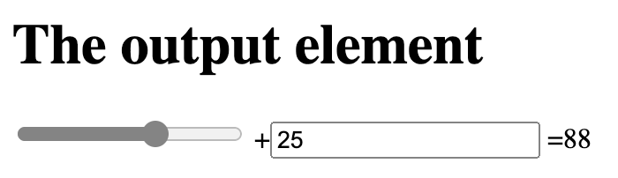
Mark, BDI, WBR, and Output Elements
<output> contains results of calculations</output>
<h1>The output element</h1>
<form oninput ="x.value=parseInt(a.value)+parseInt(b.value)">
<input type="range" id="a" value="50">
+<input type="number" id="b" value="25">
=<output name="x" for="a b"></output>
</form>
Notes:
Bidirectional isolation

Slide 15
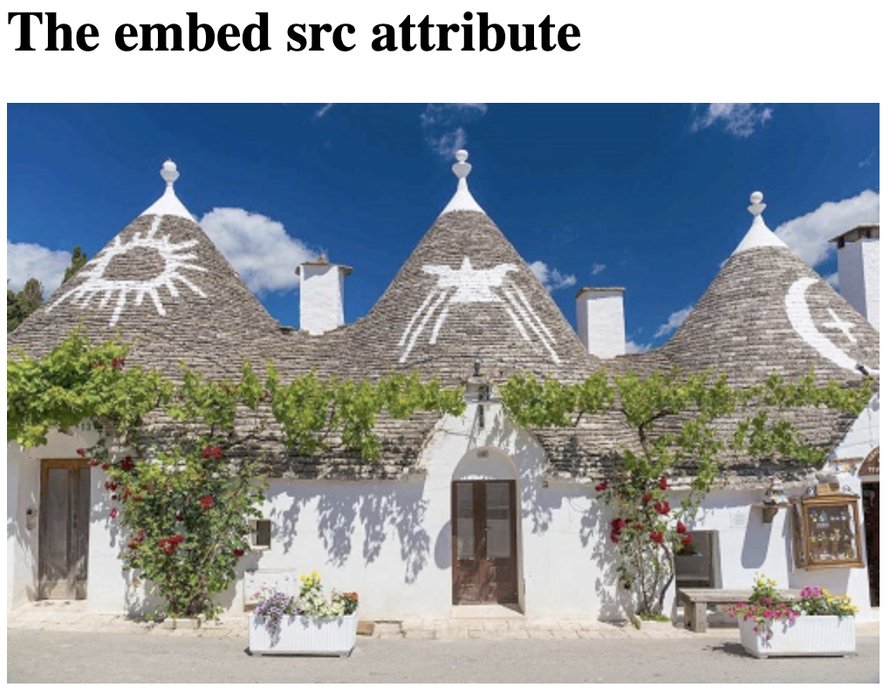
Embed element
<h1>The embed src attribute</h1>
<embed type="image/jpg”
src="pic_trulli.jpg"
width="300" height="200">
Notes:
Bidirectional isolation

Slide 16
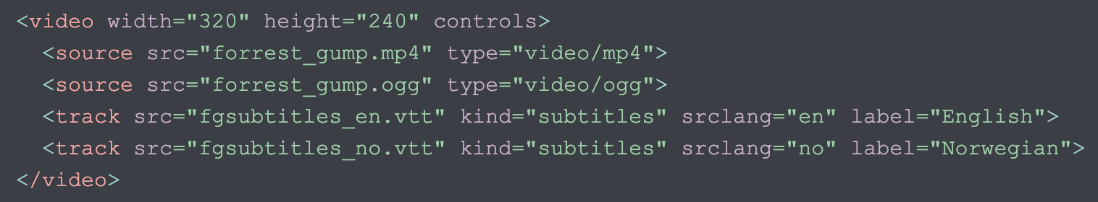
<video> element used with <track>
The <track> tag specifies text tracks for <audio> and <video> elements.
Notes:
Bidirectional isolation

Slide 17
Datalist element
<form action="/action_page.php" method="get">
<label for="browser">Choose your browser from the list:</label>
<input list="browsers" name="browser" id="browser">
<datalist id="browsers">
<option value="Edge">
<option value="Firefox">
<option value="Chrome">
<option value="Safari">
</datalist>
<input type="submit">
</form>
Notes:
Bidirectional isolation

Slide 18
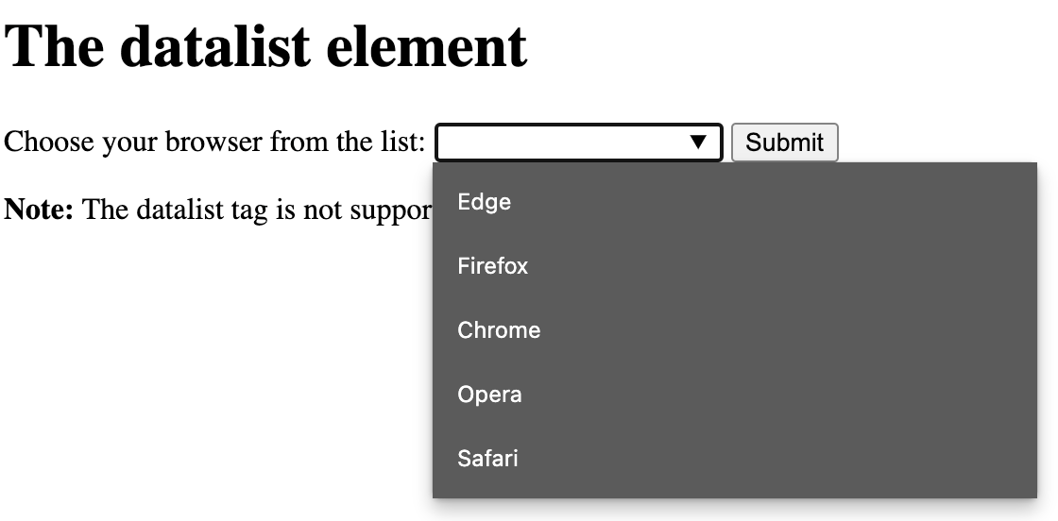
Datalist element
Notes:
Bidirectional isolation

Slide 19
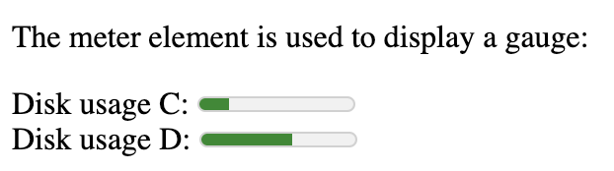
Other Elements
<p>The meter element is used to display a gauge:</p>
<label for="disk_c">Disk usage C:</label>
<meter id="disk_c" value="2" min="0" max="10">2 out of 10</meter><br>
<label for="disk_d">Disk usage D:</label>
<meter id="disk_d" value="0.6">60%</meter>
Notes:
Bidirectional isolation

Slide 20
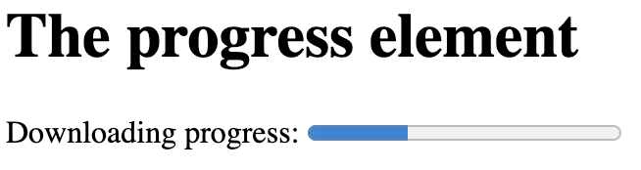
Other Elements
<progress> </progress> element shows how far along a process is:
<label for="file">Downloading progress:</label>
<progress id="file" value="32" max="100"> 32% </progress>
<math> MathML elements </math>
Notes:
Bidirectional isolation

Slide 21
APIs to Coordinate with HTML5
HTML5 = New Elements + New JavaScript APIs
Canvas for Graphics / Animations
Interaction, Events, & Messaging APIs
File Storage and Files APIs
Real-Time Communication APIs
Customizing Names of HTML Elements
Performance Optimizations and Analysis APIs
Security and Privacy APIs
Notes:
Bidirectional isolation

Slide 22
Interaction, Events, and Messages
Battery status
Clipboard API and Events
Cross Document Messaging
Device and Screen Orientation
Fullscreen
Geolocation
Media Capture
Notifications
Touch Events
Vibrations
Notes:
Bidirectional isolation

Slide 23
Taking Care of When to Use
APIs are developed at different rates by browser developers and checking API status is wise
https://caniuse.com
APIs are never complete; constant evolution
Notes:
Bidirectional isolation

Slide 24
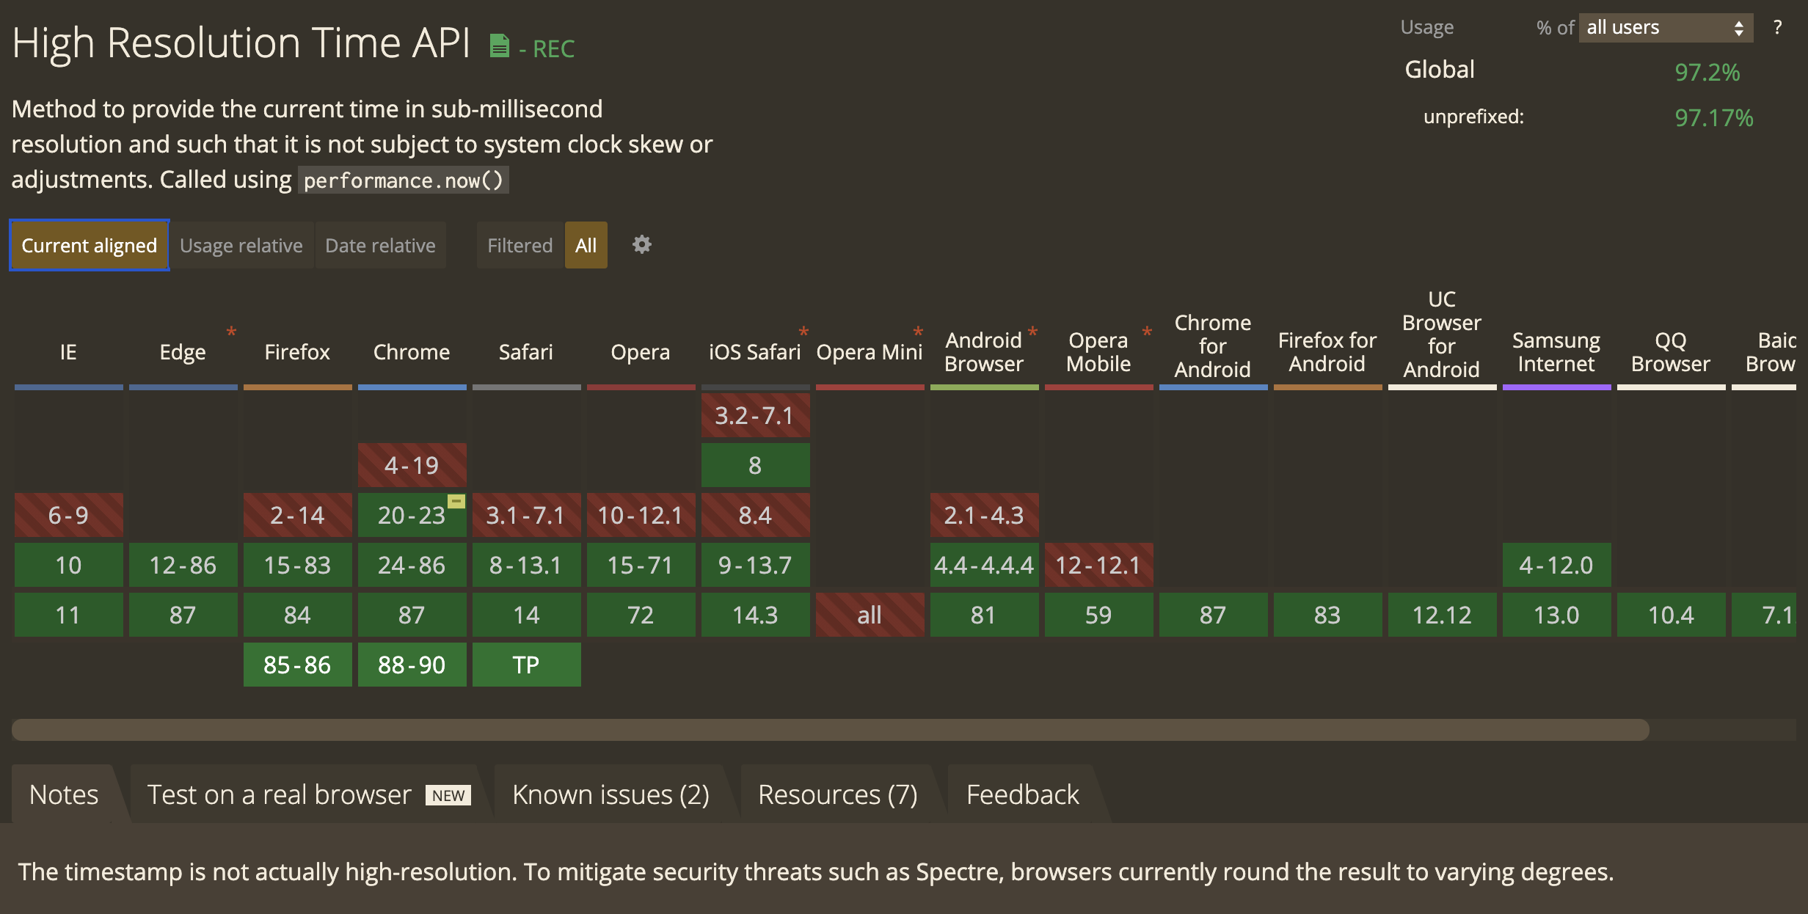
https://caniuse.com Example
Notes:
Bidirectional isolation

Slide 25
HTML 4 vs HTML 5
Boilerplates for HTML are usually good
htmlboilerplate.com
Normalize.css and helpers are included
jQuery and Modernizr minified versions of libraries
Downloadable for use by developers
APIs that work with browsers (check caniuseit.com)
Notes:
Bidirectional isolation

