Slide 1




Master Degree in Computer Science and Engineering
Segurança Informática em Redes e Sistemas 24/25
MOTOR IST
Group T27
Diana Goulão | IST1 102531
Mafalda Fernandes | IST1 102702
Miguel Sol | IST1 102710

Slide 2
POINTS OF DISCUSSION
01
02
03
Introduction
Built infrastructure
Secure document format
04
05
06
Secure channels and
key distribution
Security requirements and challenge
Demonstration

Slide 3
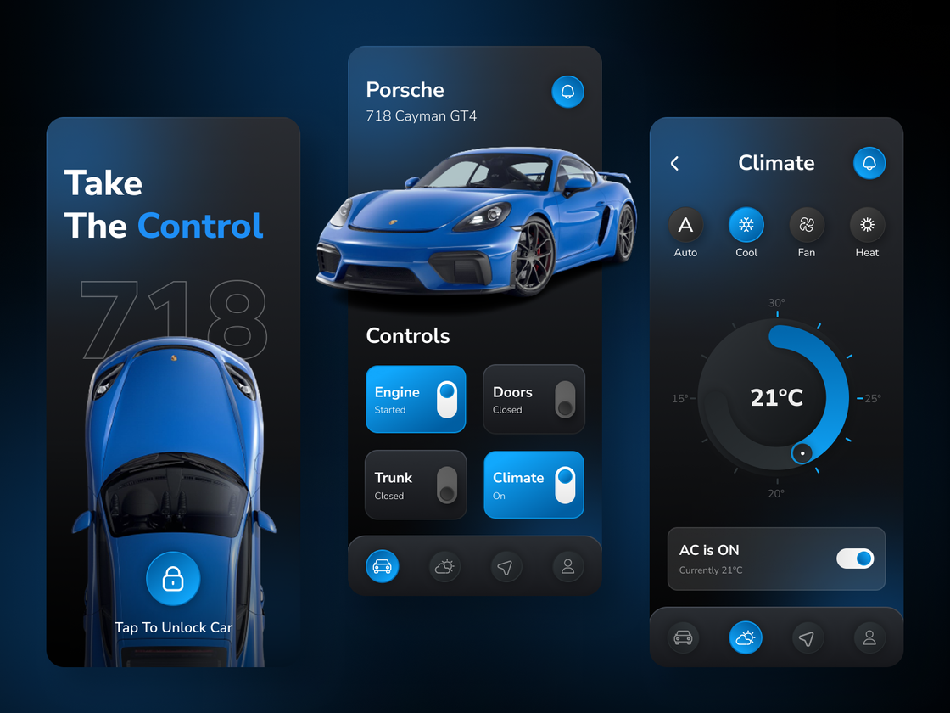
INTRODUCTION
OVERVIEW
Car
Types of client:
Owner
Mechanic
Manufacturer
Client operations
Restrictions
3
Notes:
- Existem carros que podem ser controlados através de uma aplicação
- Os carros têm uma configuração que indica a posição dos bancos e temperatura do ar condicionado
- Tipos de cliente: owner, mechanic, manufacturer
- O owner faz operações como ligar/desligar, ver a bateria, ver e mudar a configuração, meter em maintenence mode
- O mecanico pode ver a configuração, instalar um firmware update e fazer testes ao carro
- O manufacturer pode enviar firmware updates

Slide 4


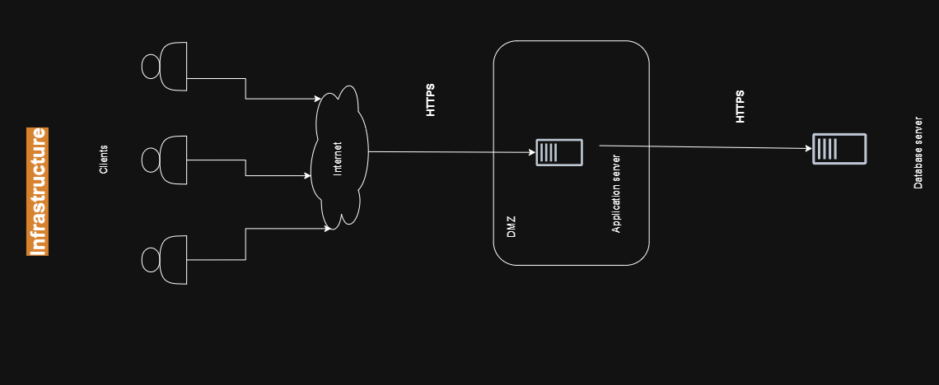


DataBase Server
BUILT
INFRASTRUCTURE
Application Server
Clients Server
4
Notes:
- Database has all cars data backedup and also clients logins
- Firewall - dont allow external communication, only to port 5000, both in server and database. TODO: in database only allow a certain ip to connect to that port.
- Inicial plan: user would connect through the internet and access server's 5000 port
Has it stands it would be possible but didn't have enough time to test it
- So for now we have local internet adapter from where each user connects to it.

Slide 5




SECURE DOCUMENT FORMAT
OVERVIEW
Protect Command
Objective: Ensure data confidentiality, integrity, and authenticity;
Development: Built in Java using Java Crypto;
Main Use: Encryption of car configurations during communications;
Features: CLI support and JSON Object manipulation;
Unprotect Command
Sign Command
Check Command
5
Notes:
DIANA
- The custom library aims to ensure data confidentiality, integrity, and authenticity while meeting the unique security requirements of our application.
- The library is developed in Java and uses some already implemented cryptographic libraries such as Java Cryto.
- The main use in our project is to encrypt car settings between communications.
- The library supports cli commands for direct interaction and is used by the message class to manipulate the transferred JSONobject.

Slide 6



SECURE DOCUMENT FORMAT
PROTECT COMMAND
Encryption: AES for content, RSA for secret key integrity.
CLI & Integration: Results saved to a path or included in the transmitted message.
Protect operations:
protecting only with a symmetric key
protecting a symetric key with an asymmetric key
protecting content encrypted with a symmetric key and the key with an asymmetric key
Protect Command
Protect Command
Unprotect Command
Unprotect Command
Sign Command
Sign Command
Check Command
Check Command
6
Notes:
- The main use in our project of the protect command is for encrypt certain messages;
- We use a secret key for AES encryption of the JSON file (configuration part), and then encrypt the secret key with a private key (RSA) to provide encryption and integrity.
- For the CLI command the results are saved in a specified path, for integration we place the result in the message to be transmitted.
- Others possible operations offered by the protect command are:
- Protect the content only with the symmetric key;
- An isolate function to cipher the symmetric key with the asymmetric key;

Slide 7

SECURE DOCUMENT FORMAT
UNPROTECT COMMAND
Protect Command
Decryption: Secret key to decrypt content, asymmetric key to decrypt secret key.
CLI & Integration: Results saved to a path or returned.
2 modes:
Unprotect with only asymmetric (RSA)
Unprotect with asymmetric (RSA) and symmetric (AES)
Unprotect Command
Sign Command
Check Command
7
Notes:
- This command is used to unprotect documents that were secured with symmetric (AES) and asymmetric (RSA) encryption.
- Unprotects the input encrypted JSON file, using the asymmetric key to decrypt the secret key, and this one to decrypt the settings.
- For the CLI command the results are saved in a specified path, for integration the result is returned to the entity that performed the decryption.
- Can be used in two modes, to match the 2 encryption modes of the protect command:
-- Mode 1: Unprotects a document only protected with asymmetric encryption (RSA) - for requests that do not envolve the car configuration
-- Mode 2: Unprotects a document protected with both symmetric (AES) and asymmetric (RSA) encryption - for requests regarding the configuration that comes encrypted from the database

Slide 8
SECURE DOCUMENT FORMAT
SIGN AND CHECK COMMANDS
Protect Command
Sign: Private Key and JSON object, also uses “SHA256withRSA” algorithm.
Check: Public Key and JSON object.
CLI & Integration: Results saved to a path or returned.
Unprotect Command
Sign Command
Check Command
8
Notes:
Miguel:
So now in the sign and check work like the other two ones. It is divided in a cli command that uses my sign and check functions.
So they receive a json object, and a private key, generate a signature with the private key and puts the same one in the json object.
The check function verifies with a public key to check if it was generated by that person.

Slide 9
SECURE CHANNELS
KEY DISTRIBUTION
KEY DISTRIBUTION
Car Key Analogy:
Symmetric key (car.key) mimics a real car key;
sharing is physical or assumes possession.
Key Distribution:
Private keys for users; server holds public keys for verification.
Symmetric key only shared physically, ensuring security.
SECURE CHANNELS
9
Notes:
- In real life, every car has its own unique key. In our project, this concept is represented by the car.key, a symmetric key.
- Sharing the car.key is imagined as a physical handover (e.g., between the owner and mechanic).
- Access to settings implies possession of the car.key, ensuring proper authorization.
- No alternative key distribution methods were implement in this project.
- Each user has their own private key, with the public key serving for identity verification.
- The symmetric car.key exists only with the car owner or is passed physically to the mechanic, ensuring secure sharing.
- The design avoids security issues typically associated with key distribution.

Slide 10
SECURE CHANNELS
SECURE CHANNELS
TLS:
Confidentiality
Data Integrity
Authentication
Protection against attacks like Man in the Middle and Replay attacks
Ficticious CA
KEY DISTRIBUTION
10
Notes:
- TLS
Ensures:
Confidentiality, by using symmetric and assymetric encryption
Data Integrity, MAC's mesage authentication Code - replay attacks and bit-flipping
Authentication - digital certificates signed by a trusted CA
Man in the middle - by using a secure handshake
secure handshake - Diffie-hellman key exchange

Slide 11
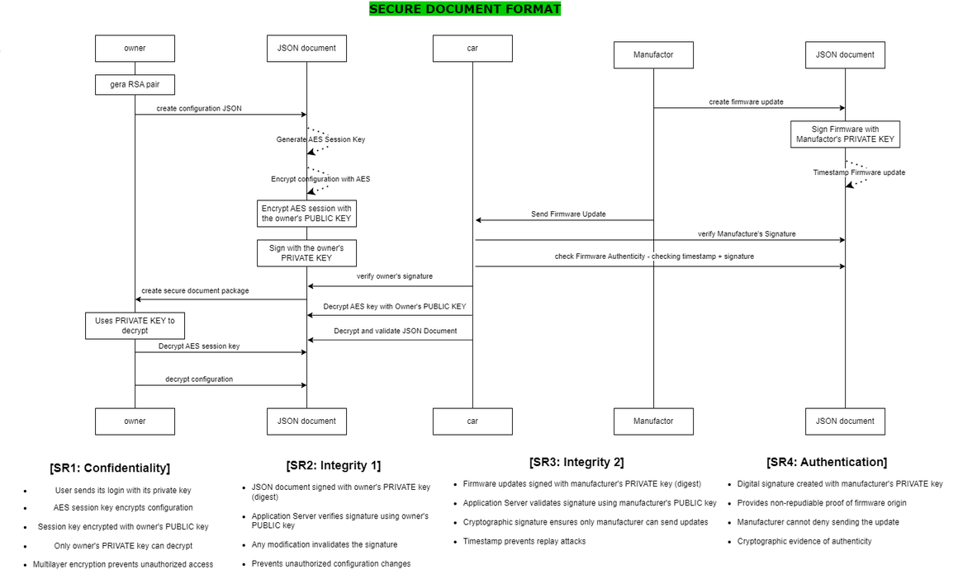
SECURITY REQUIREMENTS
OVERVIEW
[SR1: Confidentiality] The car configurations can only be seen by the car owner.
[SR2: Integrity 1] The car can only accept configurations sent by the car owner.
[SR3: Integrity 2] The car firmware updates can only be sent by the car manufacturer.
[SR4: Authentication] The car manufacture cannot deny having sent firmware updates.
11
Notes:
1 - Only the person who has the key can decrypt the car configuration
2 - We did not meet this requirement because currently our owner is not signing the request to change the configuration
3 - Only a certified and trusted manufacturer has the ability or the option to send an update
4 - The udpates are signed by the manufacturer

Slide 12
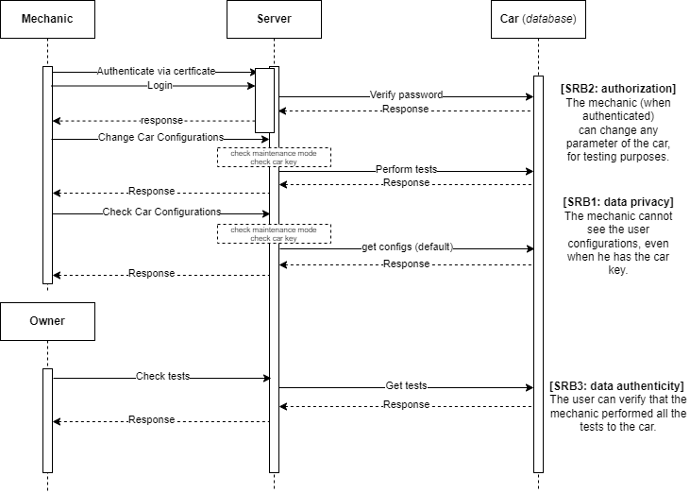
SECURITY CHALLENGE
OVERVIEW
[SRB1: data privacy] The mechanic cannot see the user configurations, even when he has the car key.
[SRB2: authorization] The mechanic (when authenticated) can change any parameter of the car, for testing purposes.
[SRB3: data authenticity] The user can verify that the mechanic performed all the tests to the car.
12
Notes:
- For the requirement 1 if maintenance mode is active, users (owner and mechanic) with the key can only view default settings.
- Ensures limited access during maintenance to prevent unauthorized changes.
- For requirement 2 we use login and certificates to authenticate mechanics as certified and trustworthy.
- Mechanics see an option to perform tests only when maintenance mode is active.
- Tests involve configuration changes saved in the database, linked to the car and the mechanic who performed them.
- This allows the user to list and track test history.
- For requirement 3 car owners can list all tests performed on their vehicle.
- Each test includes the authenticated mechanic’s ID from the login, reducing tampering risks.
- Tests are signed for added integrity, though signatures are not verified due to time constraints.
- which leads us to conclude that perhaps this requirement is not fully implemented

Slide 13
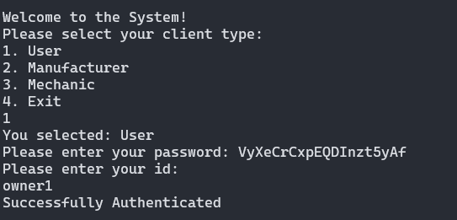
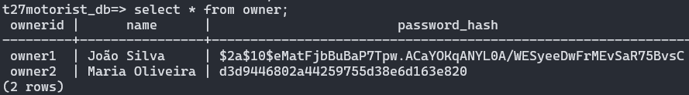
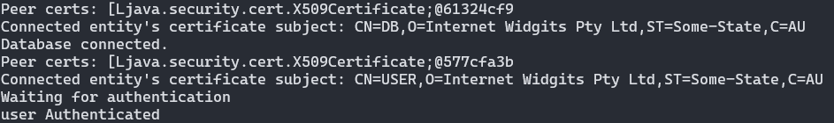
DEMONSTRATION
LOGIN
Client
Database
Server
13
Notes:
- Video com a demonstraçao para por caso não dê em pessoa

Slide 14
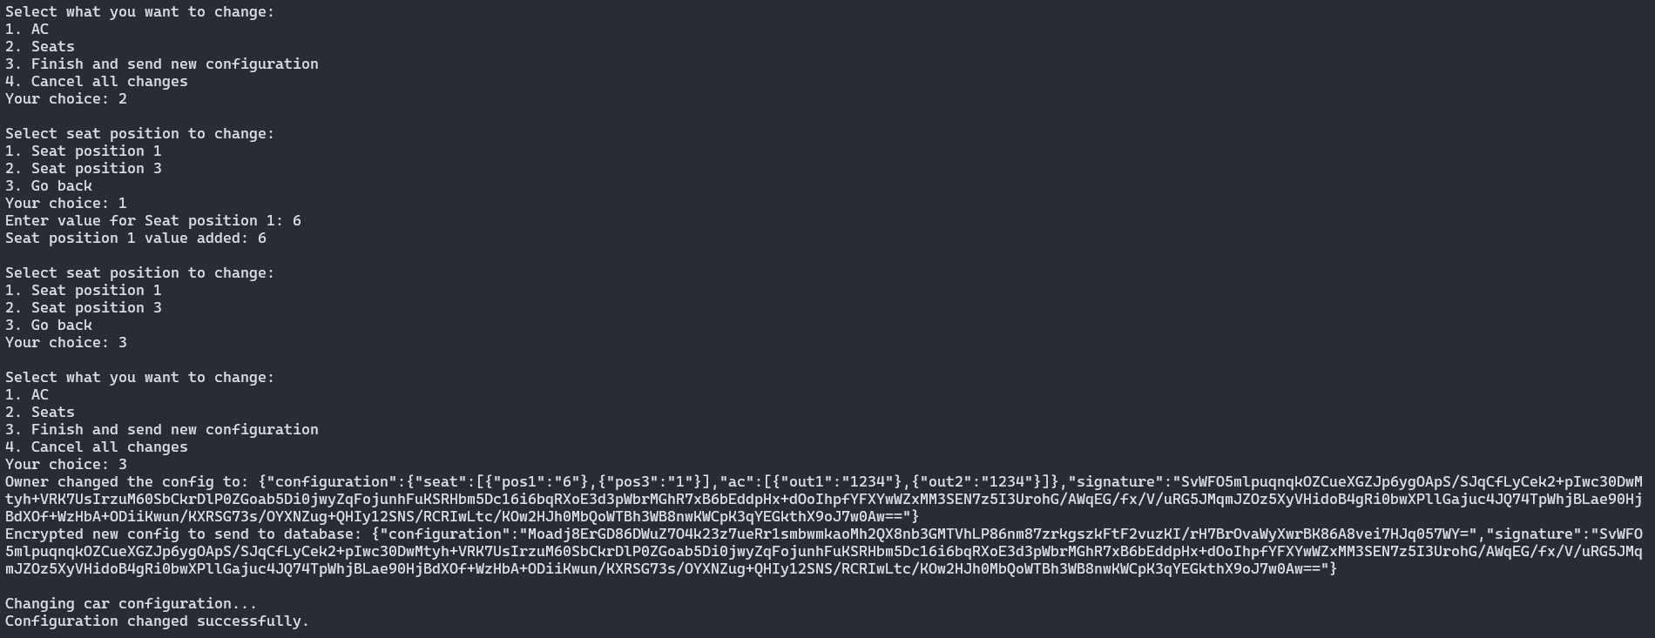
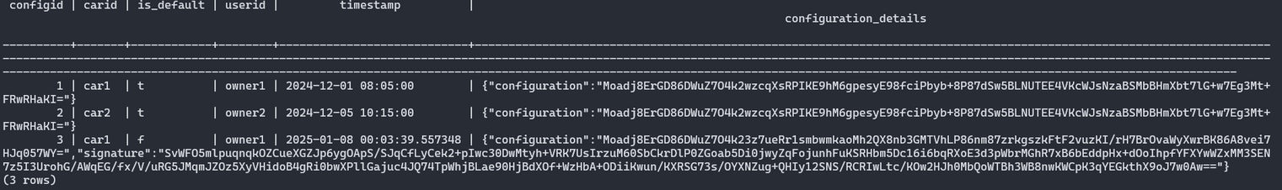
DEMONSTRATION
CHANGE CAR CONFIG
Client
Insert data not encrypted
Send encrypted data
Database
Received encrypted confinguration
Store encrypted configuration
14
Notes:
- Video com a demonstraçao para por caso não dê em pessoa

Slide 15

RESULTS
CONCLUSION
WHAT WE HAVE LEARN
How to implement security in the exchange of sensitive information
Security in communication between servers on the same network and with external clients
WHAT WE DIDN'T IMPLEMENT
Check signatures
Possibility of having more than one owner
15
Notes:
Learn:
- How to implement a secure exchange of information
- Secure communication between diferent servers
What we wanted to implement:
- Check signatures in some parts of the project such as database
- Having more than one user
- Check if owner sending config is the owner of the car
Future Possible work:
- Posibility of creating the app to a new company

