Slide 1
Blockchain
陸裕豪

Slide 2
Blockchain is a distributed and tamper-proof database technology
It can be used to store any type of data, including financial transactions, and has the ability to create trust in an untrustworthy environment.
source: OECD Digital Economy Outlook 2017

Slide 3
Characteristics of Blockchain Technology
Transactions enabled by blockchain technology can be carried out without any trusted party.
It is highly resilient and operates independently of any central authority or intermediary operator.
It is an append-only database, which is also tamper-resistant (防篡改). It relies on cryptographic primitives and game theoretical incentives to ensure that, once data have been recorded on the decentralized database, they cannot be subsequently deleted or modified by any single party.
Data are signed by the originating party and stored in chronological order into a new block of transactions.
source: OECD Digital Economy Outlook 2017

Slide 4
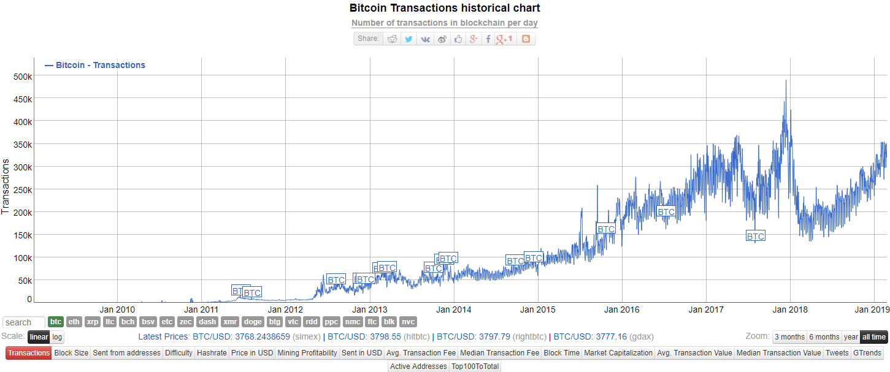
source: https://bitinfocharts.com/comparison/bitcoin-transactions.html

Slide 5
密碼學基礎知識

Slide 6
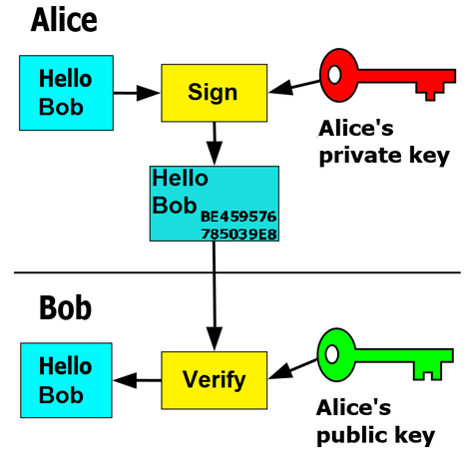
密碼學: 數位簽章
Encrypt
Decrypt

Slide 7
source: “比特幣精粹”, 白隊文化, 魯特著, 2018

Slide 8
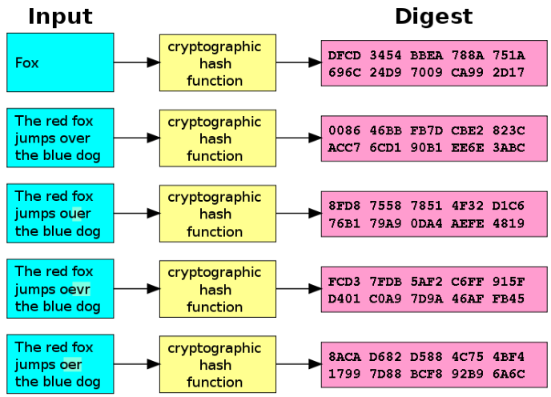
密碼學: 雜凑函數
Encryption

Slide 9
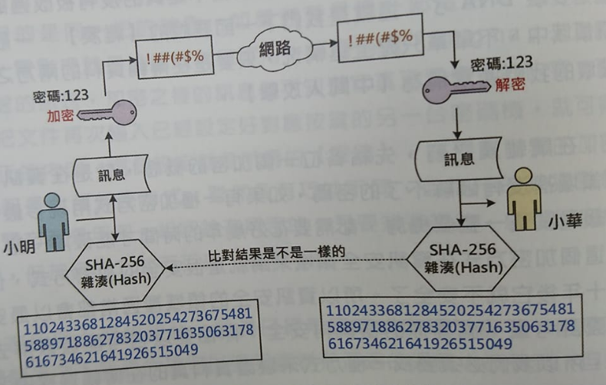
source: “比特幣精粹”, 白隊文化, 魯特著, 2018

Slide 10
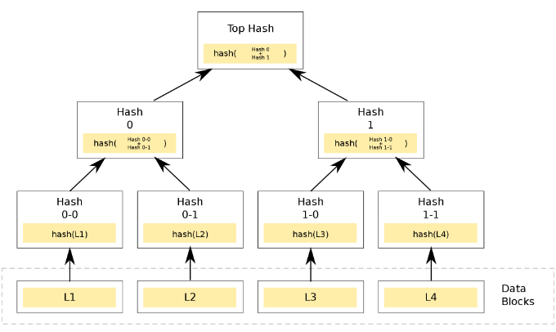
密碼學: Merkle Tree

Slide 11
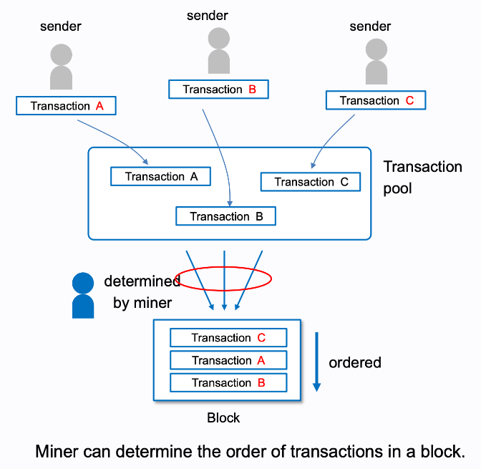

Slide 12
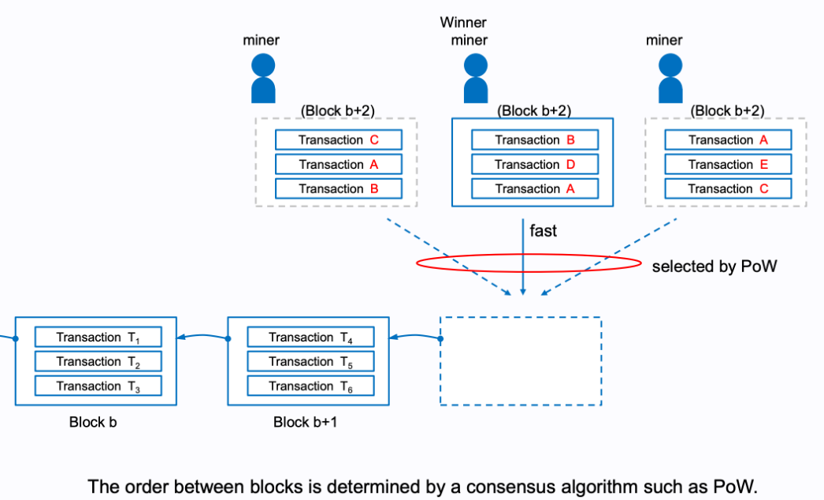

Slide 13
Blockchain Demo
Try it: https://anders.com/blockchain/block.html

Slide 14
Many New Opportunities
Bitcoin was the first application.
Reduced market friction and transaction costs
International remittances (匯款) can take up to 7 days to clear, with fees up to 10%.
Nairobi, BitPesa was the first remittance company using the Bitcoin blockchain for sending money in African countries.
Abra seems to be the leader in the field: the company is the only one addressing the problem how to exchange fiat money (法幣) into Bitcoin and vice versa.
source: OECD Digital Economy Outlook 2017

Slide 15
Many New Opportunities
Trading of securities
In Oct. 2015, Nasdaq partnered with Chain to explore the use of blockchain technology for the exchange of shares in private companies.
A few months later, the publicly traded company Overstock, the first major online retailer to accept payments in Bitcoin, started offering its own stocks on a blockchain-based trading platform (t0) specifically built for that purpose.
source: OECD Digital Economy Outlook 2017

Slide 16
Many New Opportunities
Derivative market
In 2016, by the Depository Trust & Clearing Corporation, together with five Wall Street firms – Bank of America, Merrill lynch, Citi, Credit Suisse and JPMorgan – encoding the terms of credit default swaps into a blockchain-based system in order to manage all post-trade events.
In early 2017, the Depository Trust & Clearing Corporation announced its plan to move USD 11 trillion worth of credit derivatives to a blockchain infrastructure specifically built for that purpose.

Slide 17
Guaranteed Execution through Smart Contracts
A blockchain can also store software programs: smart contracts
Smart contract can run autonomously, i.e. independently from any centralised operator or trusted third party.
By far the most prominent platform for the deployment of smart contract code is Ethereum (以太坊)
Ethereum is currently the second-largest blockchain network after Bitcoin

Slide 18
What Decentralized Applications Exist Today?
OpenBazaar is a decentralised marketplace, much like eBay
The platform relies on blockchain technology to enable buyers and sellers to interact directly with one another without passing through any centralized middleman.
Once a buyer requests a product from a seller, an escrow (第三方託管) account is created on the Bitcoin blockchain to ensure that the funds are only released once the buyer has received the product.
source: OECD Digital Economy Outlook 2017

Slide 19
What Decentralized Applications Exist Today?
A few decentralised carpooling platforms have also been launched, such as lazooz or ArcadeCity.
These platforms are not administered by any trusted third party, such as uber; they are governed by the code deployed on a blockchain-based infrastructure, which manages peer-to-peer interactions between drivers and users.
source: OECD Digital Economy Outlook 2017

Slide 20
What decentralised applications exist today?
Perhaps the most notorious example of a decentralized application was TheDAO, a blockchain-based investment fund deployed on the Ethereum blockchain in Apr. 2016.
TheDAO enabled people to invest money into the fund and vote on the proposals they wanted to fund. As such, it was described as the first decentralized organization using blockchain technology to coordinate the activity of people that do not know, and therefore do not trust, each other.
After just one month of operation, TheDAO had raised over USD 150 million worth of Ether (Ethereum’s native digital currency).
source: OECD Digital Economy Outlook 2017

Slide 21
TheDAO’s Tragedy
Unfortunately, TheDAO was forced to shut down after an attacker exploited a vulnerability in the code, draining more than one-third of its funds (以太幣竊案).
Ethereum community collectively intervened to revert the transaction and recover the funds that had been illegitimately taken by the attacker. This required a “hard fork” of the Ethereum network – a decision that has been severely criticized by some members of the Ethereum community in that it violated the immutability guarantees of the Ethereum blockchain.
This incident contributed to raising awareness about the responsibility issues inherent in these fully decentralized applications.
source: OECD Digital Economy Outlook 2017

Slide 22
Policy challenges
Tax evasion
Money laundering
Terrorist financing
Facilitation of other criminal activities, such as the sale of illegal drugs and weapons, as illustrated by the decentralized market place Silk Road.
Most of these challenges are due, in part, to the transnationality of existing blockchain networks.

Slide 23
Policy challenges
Due to the decentralized nature, blockchain networks are also difficult to shut down, because that would require shutting down every node in the network.
Permissionless blockchains make it difficult (but not impossible) to enforce laws aimed at preventing illegal practices.

Slide 24
區塊鏈的一些統計

Slide 25
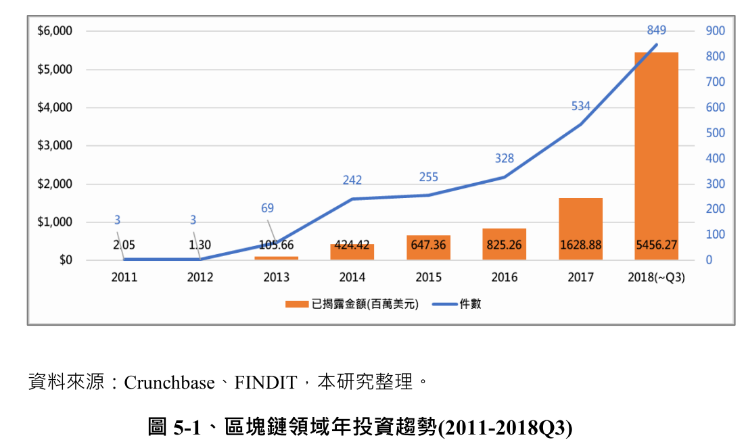

Slide 26
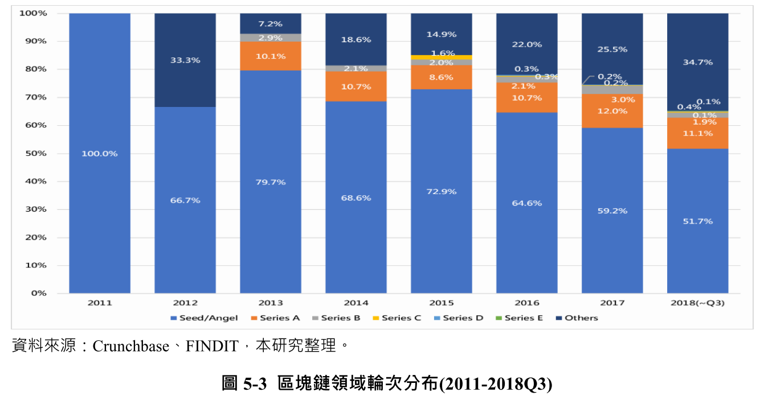

Slide 27
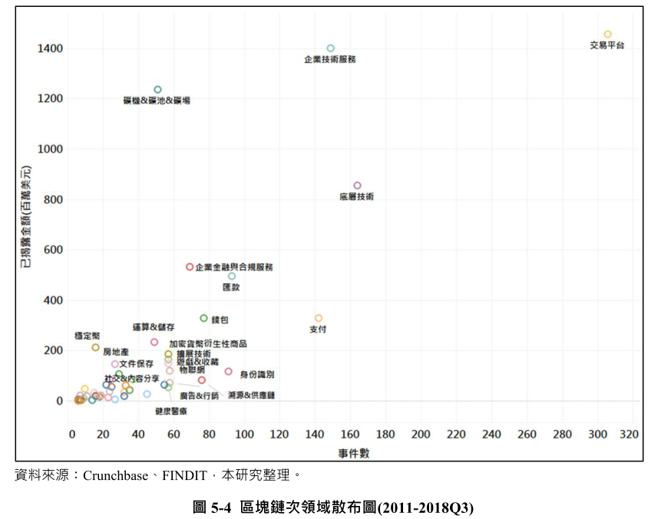

Slide 28
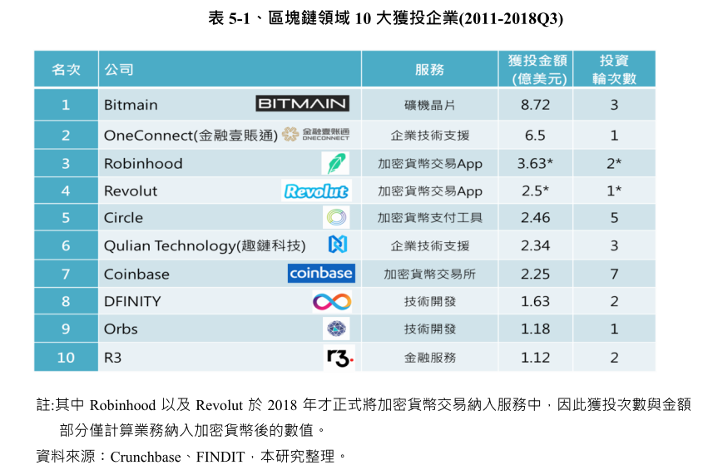

Slide 29
比特大陸 (Bitmain)
Company found in 2013, in China
Miner (礦機), Mining chip (挖礦晶片)
Computing power (算力服務)

Slide 30
Robinhood
Found in 2013, Califonia, USA
Service: no transaction fee for stock trading.
No transaction fee for cyptocurrency trading in Jan 2018.

Slide 31
Trends of FinTech
If you’re contemplating how to adjust your corporate strategy to new moves, focus on the following:
consider altering your business pattern to meet the constant changes of the digital;
take advantage of AI and ML to cut operational costs;
apply robotics to manage customer requests faster;
be client-oriented and provide omnichannel services;
put the spotlight on cyber-security;
make sure that the level of expertise your team have complies with today’s demands.

Slide 32
Trends of FinTech
Current trends in FinTech: a short overview
Disruptive innovations in payments
Platforms as a service
Blockchain movement
Digital assistants
Total automation
FinTech incubators (孵化器)
Digital-only banking
Business alliances
Advanced credit models
Cyber-security

Slide 33
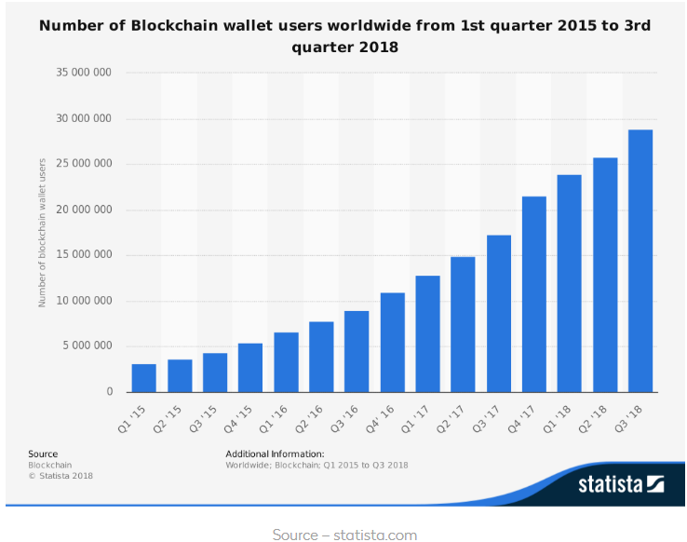

Slide 34
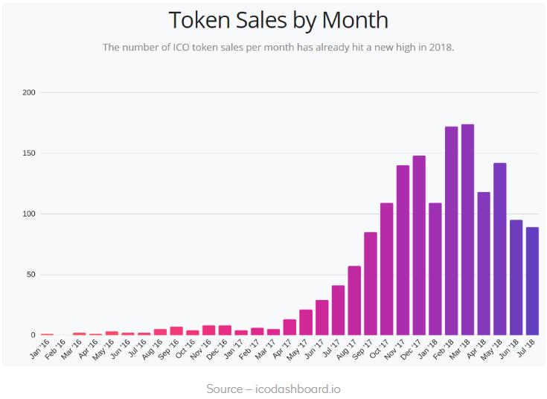

Slide 35
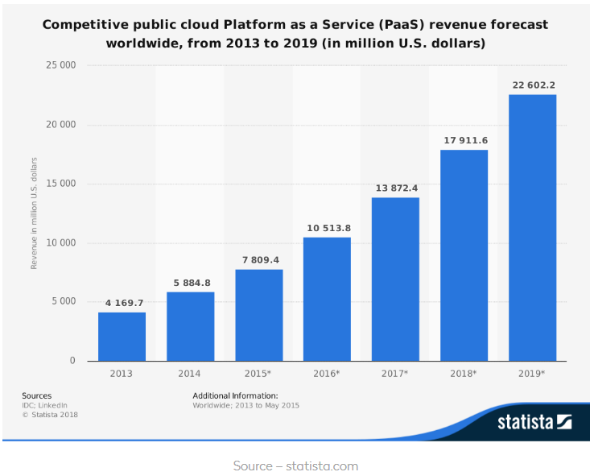

Slide 36
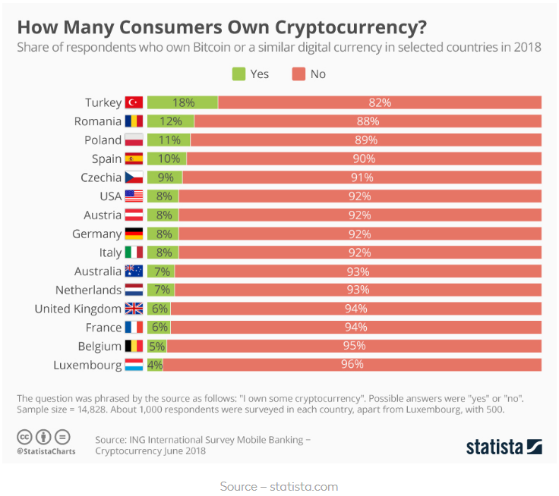

Slide 37
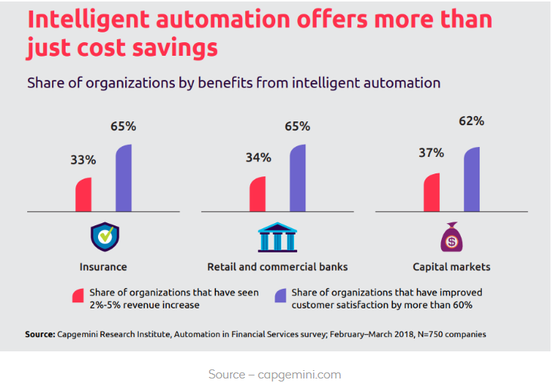

Slide 38
