Slide 1

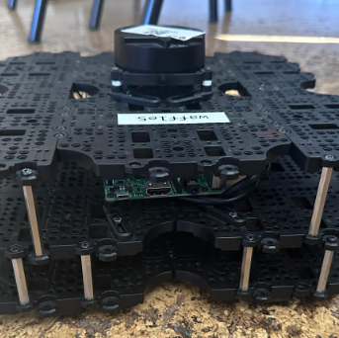
IRob Lab Presentation
Mini-Project 1
Artur Filipe de Menezes Crespo Ferreira nº 102482
Eduardo Afonso Correia Guerra nº 102681
Miguel Correia Coimbra Mano nº 99286

Slide 2
Finished Tasks
map provided with dataset and map estimated from the real robot using gmapping - in RVIZ;
robot paths (estimated by the robot and estimated from the dataset) for MCL-based localization– in RVIZ;
[for the dataset only] ground-truth path– in RVIZ;
[for the dataset only] error (estimated position minus ground truth position) along the path with associated uncertainty (computed from the estimate covariance matrix) for MCL-based localization.
[for the dataset only] error (estimated position minus ground truth position) along the path with associated uncertainty (computed from the estimate covariance matrix) for EKF-based localization.

Slide 3
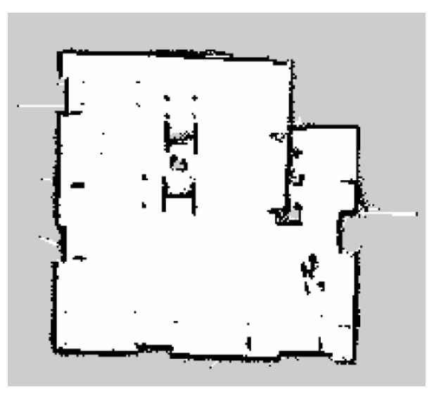
Gmapping
configured the system to use Gmapping for SLAM
Manually controlled the robot using teleop, allowing its LiDAR sensor and odometry data to generate the map in real-time.
Rosbag to capture all relevant sensor and movement data for further analysis and use in the localization process.
2D Occupancy Grid Map of the Room Generated Using Gmapping

Slide 4
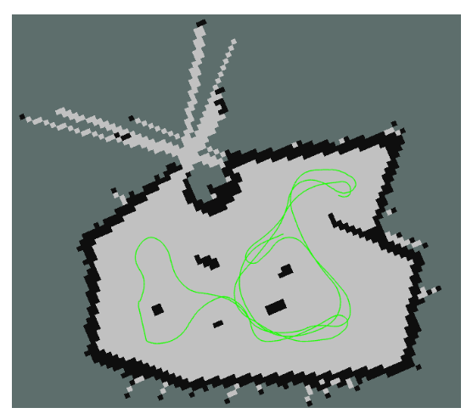
Ground-truth Path
script that subscribes to the ‘/tf‘ topic to track the true position of the robot based on motion capture data.
The accumulated path, which reflects the robot’s true trajectory, is published to the ‘/ground truth path‘ topic.
Allow us to compare the AMCL and EKF estimated paths against the ground-truth to assess the accuracy of our localization
Groud-truth path of the TurtleBot3 Waffle Pi from the dataset

Slide 5
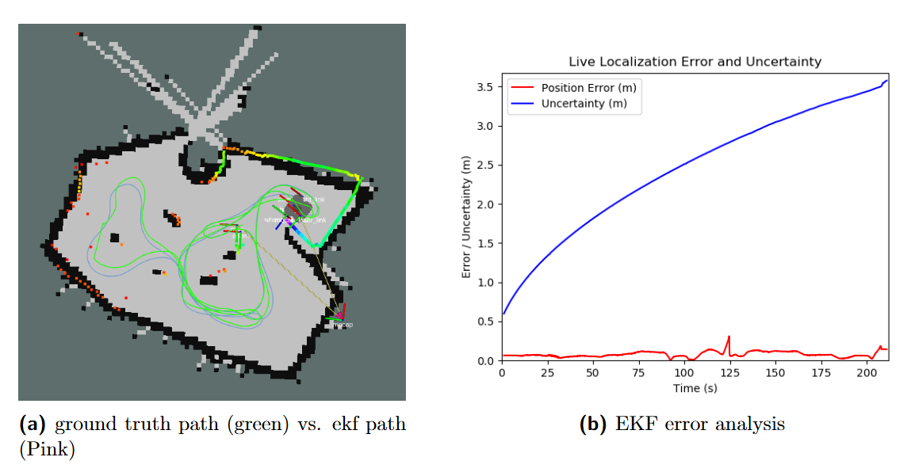
EKF-Based Localization
We estimated the robot’s path using EKF ,where the odometry provides linear and angular velocity information, while the IMU supplies orientation data (yaw), on the generated map and on the dataset.

Slide 6
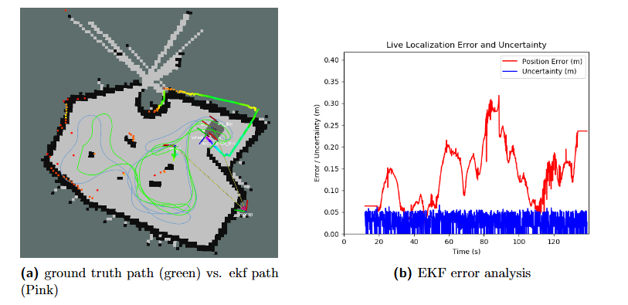
EKF-Based Localization
We then did the same but, in this case, we used pose and velocity information from the odometry, specifically the x, y, and yaw components, while the IMU provides yaw and angular velocity.

Slide 7
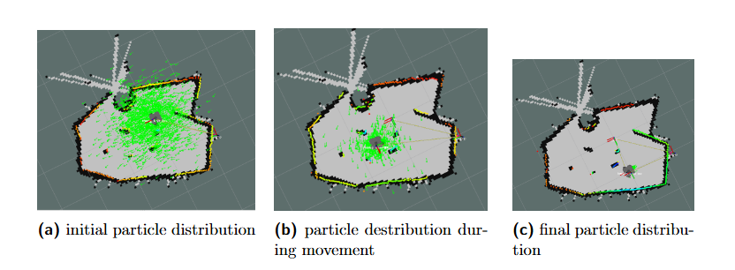
MCL-based localization in RVIZ
AMCL works by constantly updating the robot’s position estimate based on sensor data and refining it using particle filters. By maintaining a history of the robot’s path with a script, we were able to observe how well the robot localized and navigated the environment.
The particle cloud (green dots) represents the possible robot poses, and the estimated pose is marked on the map.

Slide 8
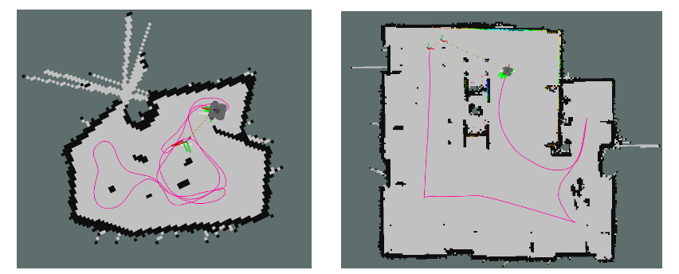
Generated paths
amcl generated path in both data set (left) and real-world map (right)

Slide 9
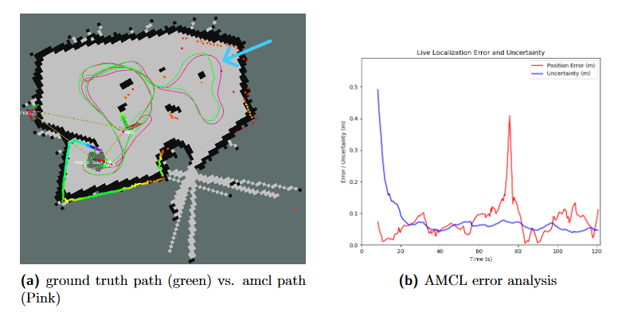
Error Analysis (MCL)
AMCL closely tracks the ground-truth trajectory for most of the experiment. This indicates that the localization system is functioning well across the majority of the robot’s path.
Initially, there is a higher error, which quickly decreases as the robot begins to localize itself more accurately.
The uncertainty remains relatively stable, indicating that AMCL is confident in its estimates throughout the trajectory, even when small errors occur.
Error between estimated and ground truth positions along the path, with associateduncertainty for AMCL-based method

Slide 10
Error Spike
significant spike in error around the 80-second mark
Our problem
Dataset problem

Slide 11
Unfinished Tasks
robot path (estimated by the robot) for EKF-based localization– in RVIZ;

Slide 12
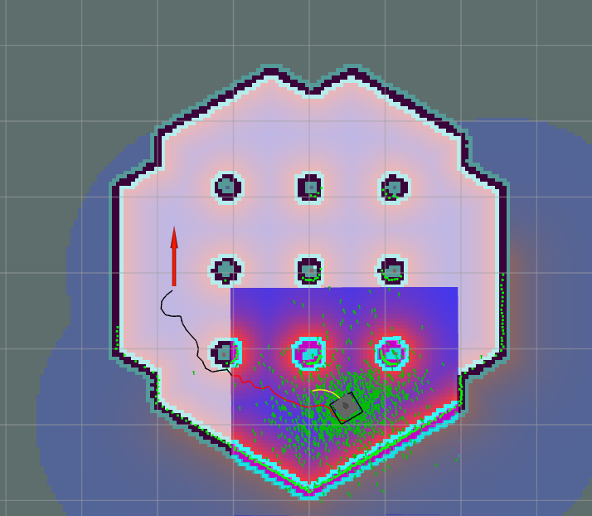
Mini-Project 2
planned paths – in RVIZ
Path is close to obstacles and sometimes nodes can be inside the obstacles
We increased the inflation to prevent the robot from getting too close to the obstacles

