Slide 1

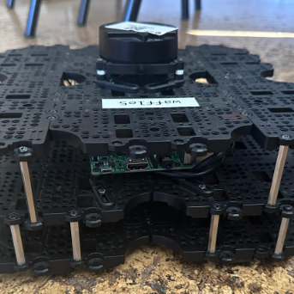
IRob Lab Presentation
Mini-Project 2
Artur Filipe de Menezes Crespo Ferreira nº 102482
Eduardo Afonso Correia Guerra nº 102681
Miguel Correia Coimbra Mano nº 99286

Slide 2
Finished Tasks
planned paths – in RVIZ (not fully optimized)
actual robot path (estimated by the robot) – in RVIZ;
simple program that interacts with move_base to plan and follow a path that visits four waypoints

Slide 3
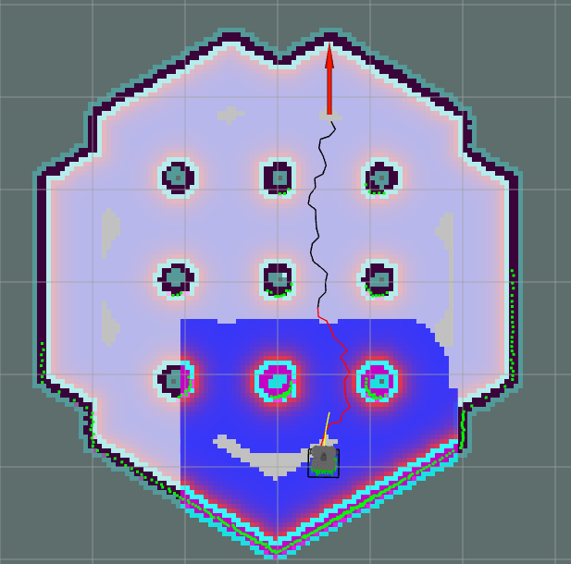
Path planning
Optimizations
Reduced min and max number of nodes
Increased global and local costmap inflation radius
path issues
Robot tends to get to close to the obstacles
New path planning every time the current leads to an obstacle
failure to complete the task

Slide 4
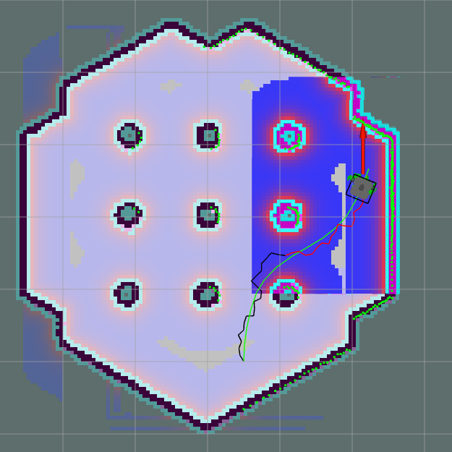
Actual Robot path VS Planned path
Same script from project 1 to create robot path from amcl localization
Actual Robot path(green) VS Planned path (black/red) from simulation

Slide 5
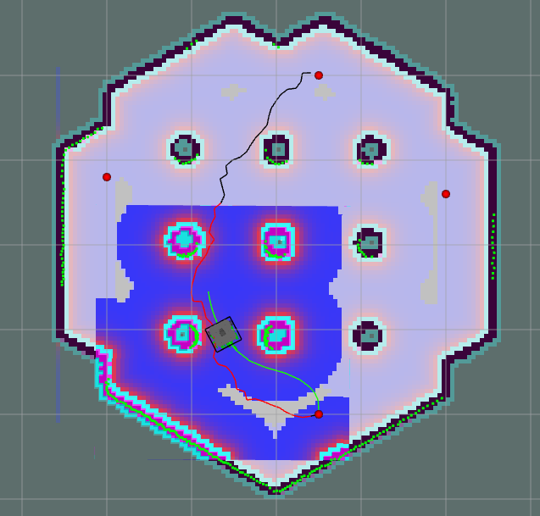
Four waypoints path
1
2
Program contains 4 pre-chosen positions (x, y, way)
publishes each new goal after robot reaches the goal of the previously given position
3
4

Slide 6
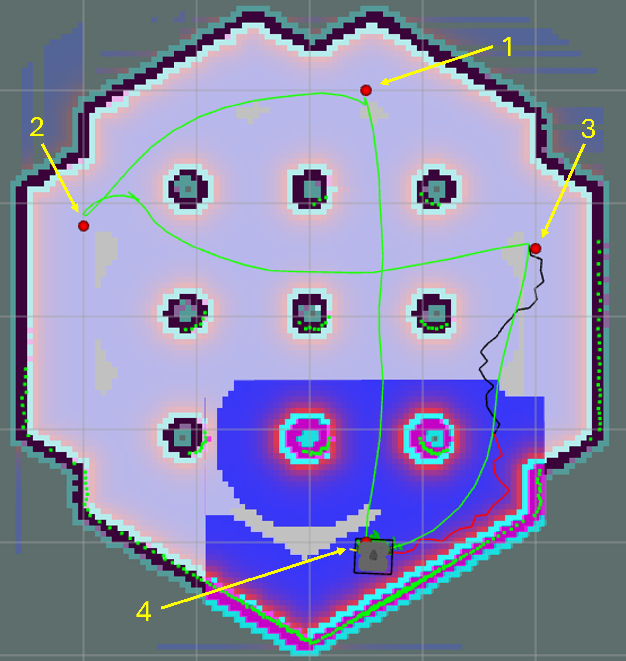
Four waypoints path
Full real path created from the robot (without full path optimization) to complete the four waypoints

Slide 7
Real robot
We also tested the path planning algorithm with the real robot
Works as expected without optimization

Slide 8
Unfinished Tasks
Optimize robot path (?)
comparative analysis between real path and planned path
(unmapped) obstacles avoidance

