Slide 1
Decision tree software C4.5
Comp328 tutorial 2
Kai Zhang

Slide 2
Introduction
C4.5 is a program for inducing classification rules in the form of decision trees from a set of given examples.
C4.5 is a software extension of the basic ID3 algorithm designed by Quinlan.
Source codes downloadable from the author’s homepage Quinlan.

Slide 3
The C4.5 induction system
-------------------------
The C4.5 system consists of four principal programs:
  1) decision tree generator ('c4.5') - construct the decision tree
  2) production rule generator ('c4.5rules') - form production rules from unpruned tree
  3) decision tree interpreter ('consult') - classify items using a decision tree
  4) production rule interpreter ('consultr') - classify items using a rule set

Slide 4
C4.5 Release 8 Installation Instructions
Download the C4.5 source code.
Decompress the archive:
  Type "tar xvzf c4.5r8.tar“,or, alternatively,
  Type "gunzip c4.5r8.tar.gz" to decompress the gzip archive, Type "tar xvf c4.5r8.tar" to decompress the tar archive.
Change to ./R8/Src
Type "make all" to compile the executables.

Slide 5
Notice:
  The system has been targeted to Berkeley BSD4.3.
  It may require the use of additional libraries etc
    e.g. for the random number generator 'random‘
Ways to make things easy:
  You can directly download the .exe files here.

Slide 6
C4.5 Release 8 Instructions
Details can be found at the following
http://www2.cs.uregina.ca/~dbd/cs831/notes/ml/dtrees/c4.5/tutorial.html

Slide 7
Input/Output Files
All files read and written by C4.5 are of the form filestem.ext
  filestem is a file name stem that identifies the induction task
  ext is an extension that defines the type of file
    filestem.data (training data)
    filestem.names (task name)
    filestem.unpruned (unpruned trees)
    filestem.tree (final decision tree)
    filestem.test (unseen data)

Slide 8
Example: Golf
Golf.names
Golf.data
Play, Don't Play.
outlook: sunny, overcast, rain.
temperature: continuous.
humidity: continuous.
windy: true, false.
sunny, 85, 85, false, Don't Play
sunny, 80, 90, true, Don't Play
overcast, 83, 78, false, Play
rain, 70, 96, false, Play
rain, 68, 80, false, Play
rain, 65, 70, true, Don't Play
…

Slide 9
Command Line
c4.5 [ -f filestem ] [ -u ] [ -s ] [ -p ] [ -v verb ] [ -t trials ] [ -w wsize ] [ -i incr ] [ -g ] [ -m minobjs ] [ -c cf ]
Options and their meanings are:
  -ffilestem Specify the filename stem
  -u Evaluate trees on filestem.test.
  -s Force the number of discrete values to be larger than 2, if C4.5 perform a test with a subset of values associated with each branch.
  -p Probabilistic thresholds used for continuous attributes.
  -ttrials Set iterative mode with specified number of trials.
  -vverb Set the verbosity level [0-3] (default 0). This generates more voluminous output that help to explain the program.

Slide 10
c4.5rules [ -f filestem ] [ -u ] [ -v verb ] [ -F siglevel ] [ -c cf ] [ -r redundancy ]
  -ffilestem Specify the filename stem.
  -u Evaluate rulesets on unseen cases in file filestem.test.
  -vverb Set the verbosity level [0-3] (default 0).
  -Fsiglevel Invoke Fisher's significance test when pruning rules.
  -ccf Set the confidence level used in forming the pessimistic estimate of a rule's error rate (default 25%).
  -rredundancy If many irrelevant attributes are included, estimate the ratio of attributes to ``sensible'' attributes (default 1).

Slide 11
consult [ -f filestem ] –t
  -ffilestem Specify the filename stem
  Display the decision tree at the start of the consulting session.
Consult reads a decision tree produced by c4.5 (filestem.tree) and uses this to classify items provided provided by the user.
Consultr prompts for the value of an attribute when needed
When all attributes are tested, consult give one or more classes that the item may belong to.
The likelihood of a class is indicated by a probability. C1 CF = 0.9 [0.85 - 1] means "class C1 with probability in the interval 0.85 - 1, and with best guess probability 0.9".

Slide 12
consultr [ -f FNS ] [ -t ]
  -ffilestem Specify the filename stem (default DF)
  -t Display the rule set at the start of the consulting session.
Consultr reads a rule set produced by c4.5rules (filestem.rules) and uses this to classify items provided by the user.
Consultr prompts for the value of an attribute when needed
The likelihood of the class is indicated by a probability. For example, C1 CF = 0.9 means "class C1 with probability 0.9".

Slide 13
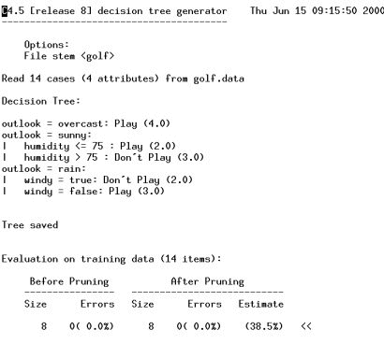
Example run 1
% c4.5 -f golf

Slide 14
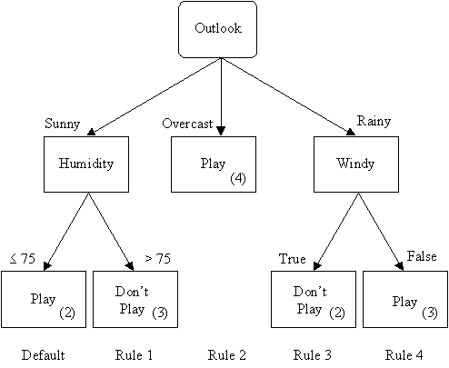
diagram

Slide 15
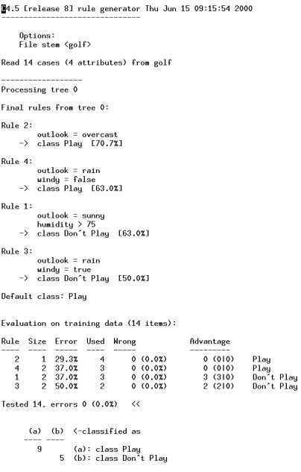
% c4.5rules -f golf

Slide 16
Example run 2
Voting records drawn from the Congressional Quarterly Almanac, Washington, D.C., 1985.|
Data
  Vote.names, vote.data, vote.test
Try following commands
  C4.5 –f vote –u
  C4.5 –f vote –u –t 5
  C4.5rules –f vote
  Consult –f vote
  Consultr –f vote

