Slide 1
C4.5 algorithm
Let the classes be denoted {C₁, C₂,…, C_{k}}. There are three possibilities for the content of the set of training samples T in the given node of decision tree:
  1. T contains one or more samples, all belonging to a single class C_{j}.
  The decision tree for T is a leaf identifying class C_{j}.

Slide 2
C4.5 algorithm
  2. T contains no samples.
  The decision tree is again a leaf, but the class to be associated with the leaf must be determined from information other than T, such as the overall majority class in T. C4.5 algorithm uses as a criterion the most frequent class at the parent of the given node.

Slide 3
C4.5 algorithm
  3. T contains samples that belong to a mixture of classes.
  In this situation, the idea is to refine T into subsets of
  samples that are heading towards single-class collections of samples.
  An appropriate test is chosen, based on single attribute,
  that has one or more mutually exclusive outcomes
  {O₁,O₂, …,O_{n}}:
    T is partitioned into subsets T₁, T₂, …, T_{n} where T_{i} contains all the samples in T that have outcome O_{i} of the chosen test. The decision tree for T consists of a decision node identifying the test and one branch for each possible outcome.

Slide 4
C4.5 algorithm
Test – entropy:
  If S is any set of samples, let freq (C_{i}, S) stand for the number of samples in S that belong to class C_{i} (out of k possible classes), and ⏐S⏐ denotes the number of samples in the set S. Then the entropy of the set S:
Info(S) = - ∑ ( (freq(C_{i}, S)/ ⏐S⏐) ⋅ log₂ (freq(C_{i}, S)/ ⏐S⏐))
k
i=1

Slide 5
C4.5 algorithm
After set T has been partitioned in accordance with n outcomes of one attribute test X:
Info_{x}(T) = ∑ ((⏐Ti⏐/ ⏐T⏐) ⋅ Info(Ti))
Gain(X) = Info(T) - Info_{x}(T)
Criterion: select an attribute with the highest Gain value.
n
i=1

Slide 6
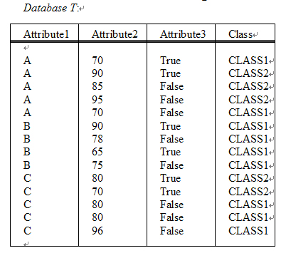
Example of C4.5 algorithm
TABLE 7.1 (p.145)
A simple flat database
of examples for training

Slide 7



Example of C4.5 algorithm
Info(T)=-9/14*log₂(9/14)-5/14*log₂(5/14)
=0.940 bits
Info_{x1}(T)=5/14(-2/5*log₂(2/5)-3/5*log₂(3/5))
+4/14(-4/4*log₂(4/4)-0/4*log₂(0/4))
+5/14(-3/5*log₂(3/5)-2/5*log2(2/5))
=0.694 bits
Gain(x1)=0.940-0.694=0.246 bits

Slide 8
Example of C4.5 algorithm
Test X1:
Attribite1
A B C
T1:
T2:
T3:
Att.2 Att.3 Class
-------------------------------
70 True CLASS1
90 True CLASS2
85 False CLASS2
95 False CLASS2
70 False CLASS1
Att.2 Att.3 Class
-------------------------------
90 True CLASS1
78 False CLASS1
65 True CLASS1
75 False CLASS1
Att.2 Att.3 Class
-------------------------------
80 True CLASS2
70 True CLASS2
80 False CLASS1
80 False CLASS1
96 False CLASS1

Slide 9
Example of C4.5 algorithm
Info(T)=-9/14*log₂(9/14)-5/14*log₂(5/14)
=0.940 bits
Info_{A3}(T)=6/14(-3/6*log₂(3/6)-3/6*log₂(3/6))
+8/14(-6/8*log₂(6/8)-2/8*log₂(2/8))
=0.892 bits
Gain(A₃)=0.940-0.892=0.048 bits

Slide 10
Example of C4.5 algorithm
Test
Attribite3
T3:
T1:
True False
Att.1 Att.2 Class
-------------------------------
A 85 CLASS2
A 95 CLASS2
A 70 CLASS1
B 78 CLASS1
B 75 CLASS1
C 80 CLASS1
C 80 CLASS1
C 96 CLASS1
Att.1 Att.2 Class
-------------------------------
A 70 CLASS1
A 90 CLASS2
B 90 CLASS1
B 65 CLASS1
C 80 CLASS2
C 70 CLASS2

Slide 11
C4.5 algorithm
C4.5 contains mechanisms for proposing three types of tests:
  The “standard” test on a discrete attribute, with one outcome and branch for each possible value of that attribute.
  If attribute Y has continuous numeric values, a binary test with outcomes Y≤Z and Y>Z could be defined, based on comparing the value of attribute against a threshold value Z.

Slide 12
C4.5 algorithm
  A more complex test based also on a discrete attribute, in which the possible values are allocated to a variable number of groups with one outcome and branch for each group.

Slide 13
Handle numeric values
Threshold value Z:
  The training samples are first sorted on the values of the attribute Y being considered. There are only a finite number of these values, so let us denote them in sorted order as {v₁, v₂, …, v_{m}}.
  Any threshold value lying between v_{i} and v_{i+1} will have the same effect of dividing the cases into those whose value of the attribute Y lies in {v₁, v₂, …, v_{i}} and those whose value is in {v_{i+1}, v_{i+2}, …, v_{m}}. There are thus only m-1 possible splits on Y, all of which should be examined systematically to obtain an optimal split.

Slide 14
Handle numeric values
  It is usual to choose the midpoint of each interval: (v_{i} +v_{i+1})/2 as the representative threshold.
  C4.5 chooses as the threshold a smaller value v_{i} for every interval {v_{i}, v_{i+1}}, rather than the midpoint itself.

Slide 15
Example(1/2)
Attribute2:
After a sorting process, the set of values is:
{65, 70, 75, 78, 80, 85, 90, 95, 96},
the set of potential threshold values Z is (C4.5):
{65, 70, 75, 78, 80, 85, 90, 95}.
The optimal Z value is Z=80 and the corresponding process of information gain computation for the test x3 (Attribute2 ≤ 80 or Attribute2 > 80).

Slide 16
Example(2/2)
Info_{x3}(T)=9/14(-7/9log2(7/9)–2/9log2(2/9))
+5/14(-2/5log2(2/5)–3/5log2 (3/5))
=0.837 bits
Gain(x3)= 0.940- 0.837=0.103 bits
Attribute1 gives the highest gain of 0.246 bits, and therefore this attribute will be selected for the first splitting.

Slide 17
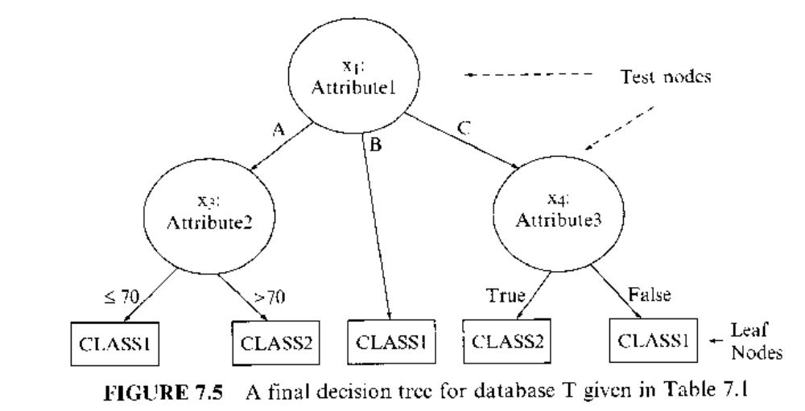

Slide 18
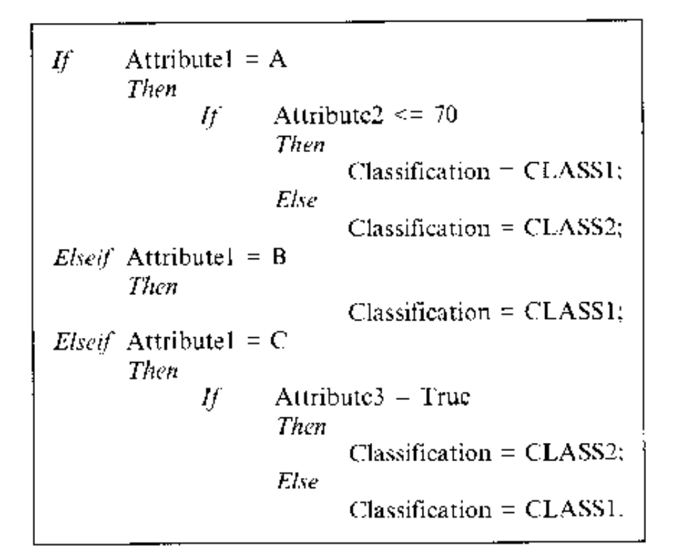

Slide 19
Unknown attribute values
In C4.5 it is accepted a principle that samples with the unknown values are distributed probabilistically according to the relative frequency of known values.
The new gain criterion will have the form:
Gain(x) = F ( Info(T) – Info_{x}(T))
F = number of samples in database with known value for a given attribute / total number of samples in a data set

Slide 20
Example
Attribute1 Attribute2 Attribute3 Class
-------------------------------------------------------------------------------------
A 70 True CLASS1
A 90 True CLASS2
A 85 False CLASS2
A 95 False CLASS2
A 70 False CLASS1
? 90 True CLASS1
B 78 False CLASS1
B 65 True CLASS1
B 75 False CLASS1
C 80 True CLASS2
C 70 True CLASS2
C 80 False CLASS1
C 80 False CLASS1
C 96 False CLASS1
--------------------------------------------------------------------------------------

Slide 21
Example
Info(T) = -8/13log2(8/13)-5/13log2(5/13)= 0.961 bits
Info_{x1}(T) = 5/13(-2/5log₂(2/5)–3/5log₂(3/5))
+ 3/13(-3/3log₂(3/3)–0/3log₂(0/3))
+ 5/13(-3/5log₂(3/5)–2/5log₂(2/5))
= 0.747 bits
Gain(x1) = 13/14 (0.961 – 0.747) = 0.199 bits

Slide 22
Unknown attribute values
When a case from T with known value is assigned to subset T_{i} , its probability belonging to T_{i} is 1, and in all other subsets is 0.
C4.5 therefore associate with each sample (having missing value) in each subset T_{i} a weight w representing the probability that the case belongs to each subset.

Slide 23
Unknown attribute values
Splitting set T using test x1 on Attribute1. New weights w_{i} will be equal to probabilities in this case: 5/13, 3/13, and 5/13, because initial (old) value for w is equal to one.
⏐T₁⏐ = 5+5/13, ⏐T₂⏐ = 3 +3/13, and ⏐T₃⏐ = 5+5/13.

Slide 24
Example: Fig 7.7
T1: (attribute1 = A)
T1: (attribute1 = B)
T1: (attribute1 = C)
Att.2 | Att.3 | Class | w
70 90 85 95 70 90 | True True False False False True | C1 C2 C2 C2 C1 C1 | 1 1 1 1 1 5/13
Att.2 | Att.3 | Class | w
90 78 65 75 | True False True False | C1 C1 C1 C1 | 3/13 1 1 1
Att.2 | Att.3 | Class | w
80 70 80 80 96 90 | True True False False False True | C2 C2 C1 C1 C1 C1 | 1 1 1 1 1 5/13

Slide 25
Unknown attribute values
The decision tree leafs are defined with two new parameters: (⏐T_{i}⏐/E).
⏐T_{i}⏐ is the sum of the fractional samples that reach the leaf, and E is the number of samples that belong to classes other than nominated class.

Slide 26
Unknown attribute values
If Attribute1 = A Then
If Attribute2 <= 70 Then
Classification = CLASS1 (2.0 / 0);
else
Classification = CLASS2 (3.4 / 0.4);
elseif Attribute1 = B Then
Classification = CLASS1 (3.2 / 0);
elseif Attribute1 = C Then
If Attribute3 = true Then
Classification = CLASS2 (2.4 / 0);
else
Classification = CLASS1 (3.0 / 0).

Slide 27
Pruning decision trees
Discarding one or more subtrees and replacing them with leaves simplify decision tree and that is the main task in decision tree pruning:
  Prepruning
  Postpruning
C4.5 follows a postpruning approach (pessimistic pruning).

Slide 28
Pruning decision trees
Prepruning
  Deciding not to divide a set of samples any further under some conditions. The stopping criterion is usually based on some statistical test, such as the χ²-test.
Postpruning
  Removing retrospectively some of the tree structure using selected accuracy criteria.

Slide 29
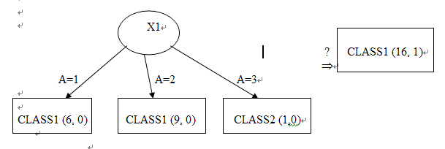
Pruning decision trees in C4.5

Slide 30
Generating decision rules
Large decision trees are difficult to understand because each node has a specific context established by the outcomes of tests at antecedent nodes.
To make a decision-tree model more readable, a path to each leaf can be transformed into an IF-THEN production rule.

Slide 31
Generating decision rules
The IF part consists of all tests on a path.
  The IF parts of the rules would be mutually exclusive(互斥).
The THEN part is a final classification.

Slide 32
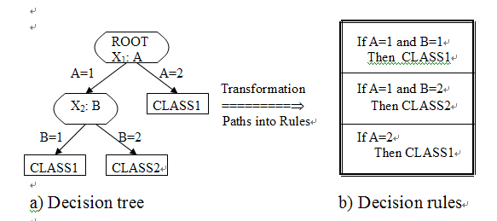
Generating decision rules

Slide 33
Generating decision rules
Decision rules for decision tree in Fig 7.5:
If Attribute1 = A and Attribute2 <= 70
Then Classification = CLASS1 (2.0 / 0);
If Attribute1 = A and Attribute2 > 70
Then Classification = CLASS2 (3.4 / 0.4);
If Attribute1 = B
Then Classification = CLASS1 (3.2 / 0);
If Attribute1 = C and Attribute3 = True
Then Classification = CLASS2 (2.4 / 0);
If Attribute1 = C and Attribute3 = False
Then Classification = CLASS1 (3.0 / 0).

